Slide 1


Count One More
and One Less
© Classroom Secrets Limited 2018

Slide 2


Introduction
Write the value of each set of Base 10 in the boxes below.
1 less
1 more
© Classroom Secrets Limited 2018

Slide 3
Introduction
Write the value of each set of Base 10 in the boxes below.
1 less
1 more
14
15
16
© Classroom Secrets Limited 2018

Slide 4
Varied Fluency 1
Look at this number line.
Find one more and one less than 14.
11 | 12 | 13 | 14 | 15
© Classroom Secrets Limited 2018

Slide 5
Varied Fluency 1
Look at this number line.
Find one more and one less than 14.
One more is 15.
One less is 13.
11 | 12 | 13 | 14 | 15
© Classroom Secrets Limited 2018

Slide 6
Varied Fluency 2
Put these numbers in order on the number line.
18
20
21
19
© Classroom Secrets Limited 2018

Slide 7
Varied Fluency 2
Put these numbers in order on the number line.
18
20
21
19
18 | 19 | 20 | 21
© Classroom Secrets Limited 2018

Slide 8
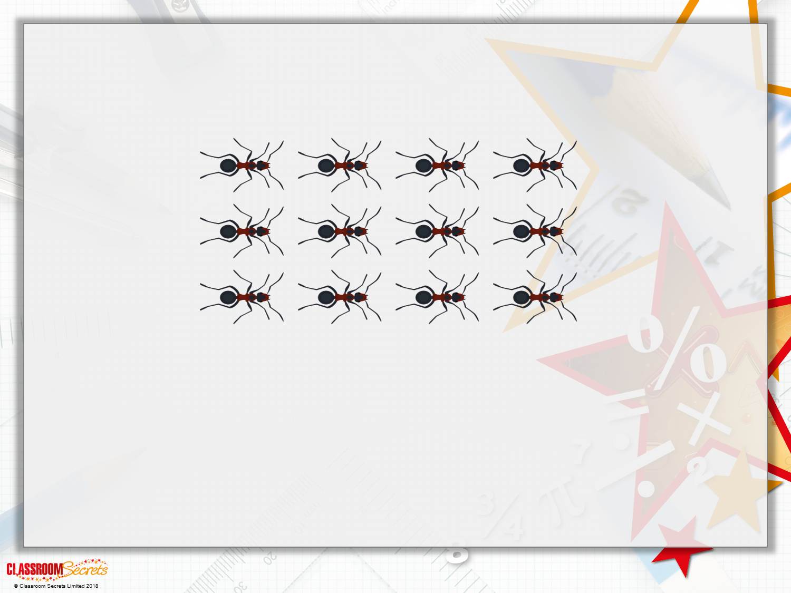
Varied Fluency 3
How many ants are there?

Slide 9
Varied Fluency 3
How many ants are there?
12

Slide 10

Varied Fluency 3
How many ants are there?
12
One more ant appears.
How many are there now?

Slide 11
Varied Fluency 3
How many ants are there?
12
One more ant appears.
How many are there now?
13

Slide 12


Varied Fluency 3
What is this number?
How many is one less?
© Classroom Secrets Limited 2018

Slide 13
Varied Fluency 3
What is this number?
12
How many is one less?
11
© Classroom Secrets Limited 2018

Slide 14
Varied Fluency 4
Look at the bead string.
How many is one more? 18
How many is one less? 16
© Classroom Secrets Limited 2018

Slide 15
Varied Fluency 4
Look at the bead string.
How many is one more? 18
How many is one less? 16
© Classroom Secrets Limited 2018

Slide 16
Varied Fluency 5
Write one more and one less than this number.
Tens | Ones
10
10
10
10
1
1
1
1
1
1
1
1
1
© Classroom Secrets Limited 2018

Slide 17
Varied Fluency 5
Write one more and one less than this number.
One more is 50.
One less is 48.
Tens | Ones
10
10
10
10
1
1
1
1
1
1
1
1
1
© Classroom Secrets Limited 2018

Slide 18
Varied Fluency 6
Complete the number line.
 |  |  | 77
© Classroom Secrets Limited 2018

Slide 19
Varied Fluency 6
Complete the number line.
74 | 75 | 76 | 77
© Classroom Secrets Limited 2018

Slide 20
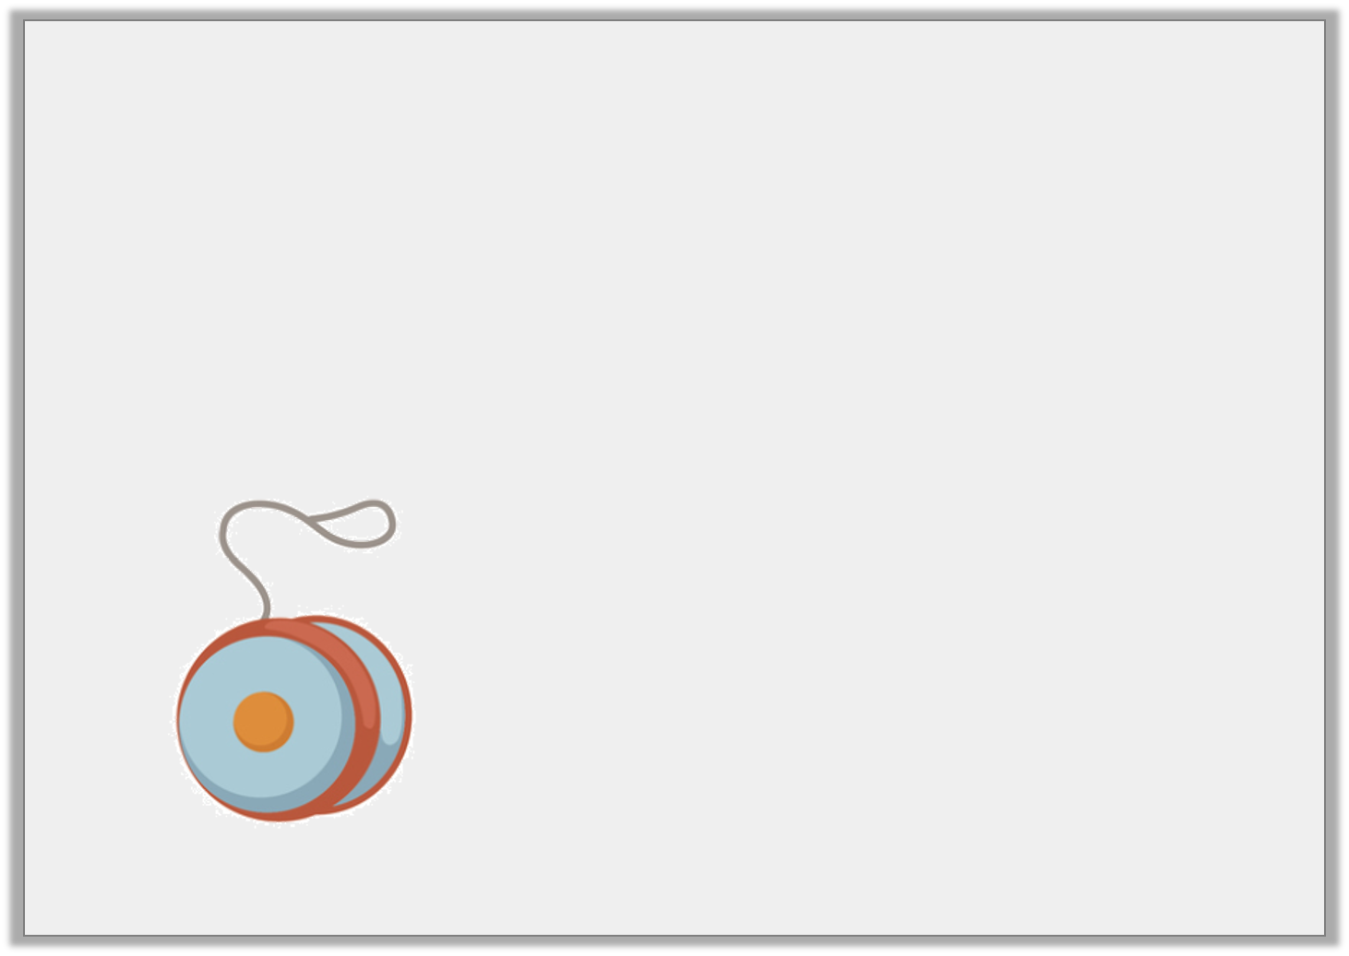
Varied Fluency 7
Amy has 31 toys in her room.
She buys one more at the shop.
How many does she have now?
© Classroom Secrets Limited 2018

Slide 21
Varied Fluency 7
Amy has 31 toys in her room.
She buys one more at the shop.
How many does she have now?
32
© Classroom Secrets Limited 2018

Slide 22

Problem Solving 1
Mickey is filling in the gaps on
this number line.
How many answers can you find for the missing numbers?
?
?
?
One of the numbers
is 13.

Slide 23
Problem Solving 1
Mickey is filling in the gaps on
this number line.
How many answers can you find for the missing numbers?
13, 14, 15 or 12, 13, 14 or 11, 12, 13
?
?
?
One of the numbers
is 13.

Slide 24
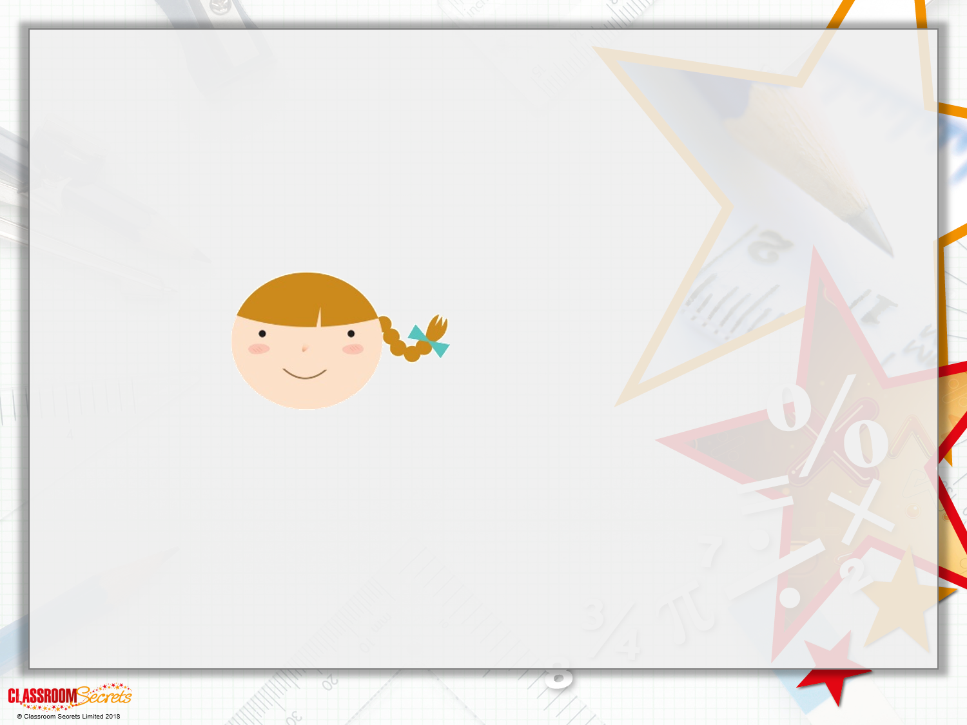
Reasoning 1
Annie is thinking of a number.
What is Annie’s number?
Explain your answer.
One less than my number is 18.

Slide 25
Reasoning 1
Amani is thinking of a number.
What is Amani’s number?
Explain your answer.
Amani’s number is 19 because…
One less than my number is 18.

Slide 26
Reasoning 1
Amani is thinking of a number.
What is Amani’s number?
Explain your answer.
Amani’s number is 19 because 18 is one less than 19. 19 is one more than 18.
One less than my number is 18.

