Slide 1


Year 1 – Spring Block 1 – Addition and Subtraction – Find and Make Number Bonds
About This Resource:
This PowerPoint has been designed to support your teaching of this small step. It includes a starter activity and an example of each question from the Varied Fluency and Reasoning and Problem Solving resources also provided in this pack. You can choose to work through all examples provided or a selection of them depending on the needs of your class.
National Curriculum Objectives:
Mathematics Year 1: (1C1) Represent and use number bonds and related subtraction facts within 20
More Year 1 Addition and Subtraction resources.
Did you like this resource? Don’t forget to review it on our website.
© Classroom Secrets Limited 2018

Slide 2
Year 1 – Spring Block 1 – Addition and Subtraction
IALT find and make number bonds to 10 and 20
© Classroom Secrets Limited 2018

Slide 3
Introduction
Circle the number bonds to 10
6 | + | 3
2 | + | 7
5 | + | 6
7 | + | 3
8 | + | 2
9 | + | 1
© Classroom Secrets Limited 2018

Slide 4
Introduction
Circle the number bonds to 10
6 | + | 3
2 | + | 7
5 | + | 6
7 | + | 3
8 | + | 2
9 | + | 1
© Classroom Secrets Limited 2018

Slide 5
Varied Fluency 1
Write a number sentence to match the image below.
+
 | + |  | =
© Classroom Secrets Limited 2018

Slide 6
Varied Fluency 1
Write a number sentence to match the image below.
+
13 | + | 7 | = | 20
© Classroom Secrets Limited 2018

Slide 7
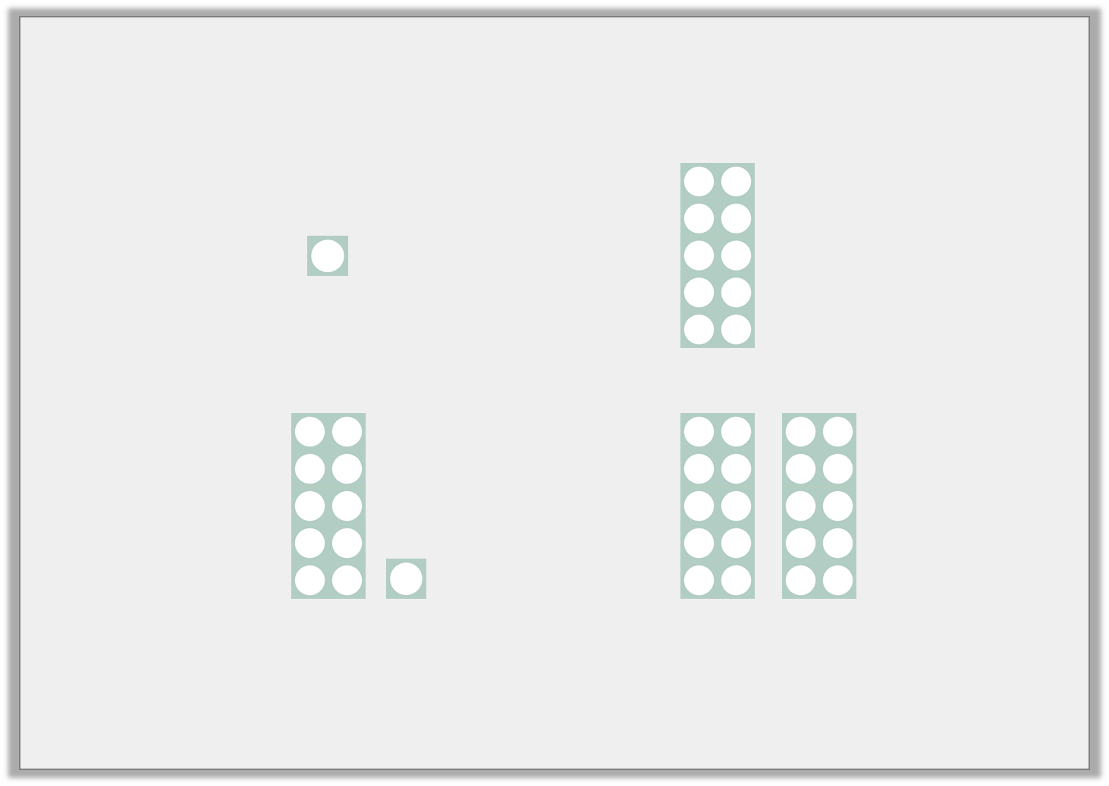
Varied Fluency 2
Fill in the missing numbers to complete the number sentences.
+ |  | =
+ |  | =
© Classroom Secrets Limited 2018

Slide 8
Varied Fluency 2
Fill in the missing numbers to complete the number sentences.
+ | 9 | =
+ | 9 | =
© Classroom Secrets Limited 2018

Slide 9
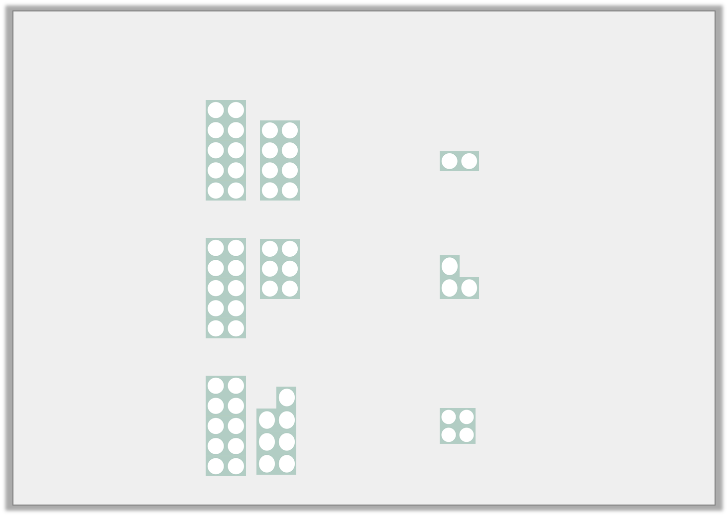
Varied Fluency
Match the Numicon pieces to make number bonds to 20.
© Classroom Secrets Limited 2018

Slide 10
Varied Fluency
Match the Numicon pieces to make number bonds to 20.
© Classroom Secrets Limited 2018

Slide 11
Varied Fluency
True or false? 5 + 16 = 20
© Classroom Secrets Limited 2018

Slide 12
Varied Fluency
True or false? 5 + 16 = 20
False, 5 + 15 = 20
© Classroom Secrets Limited 2018

Slide 13
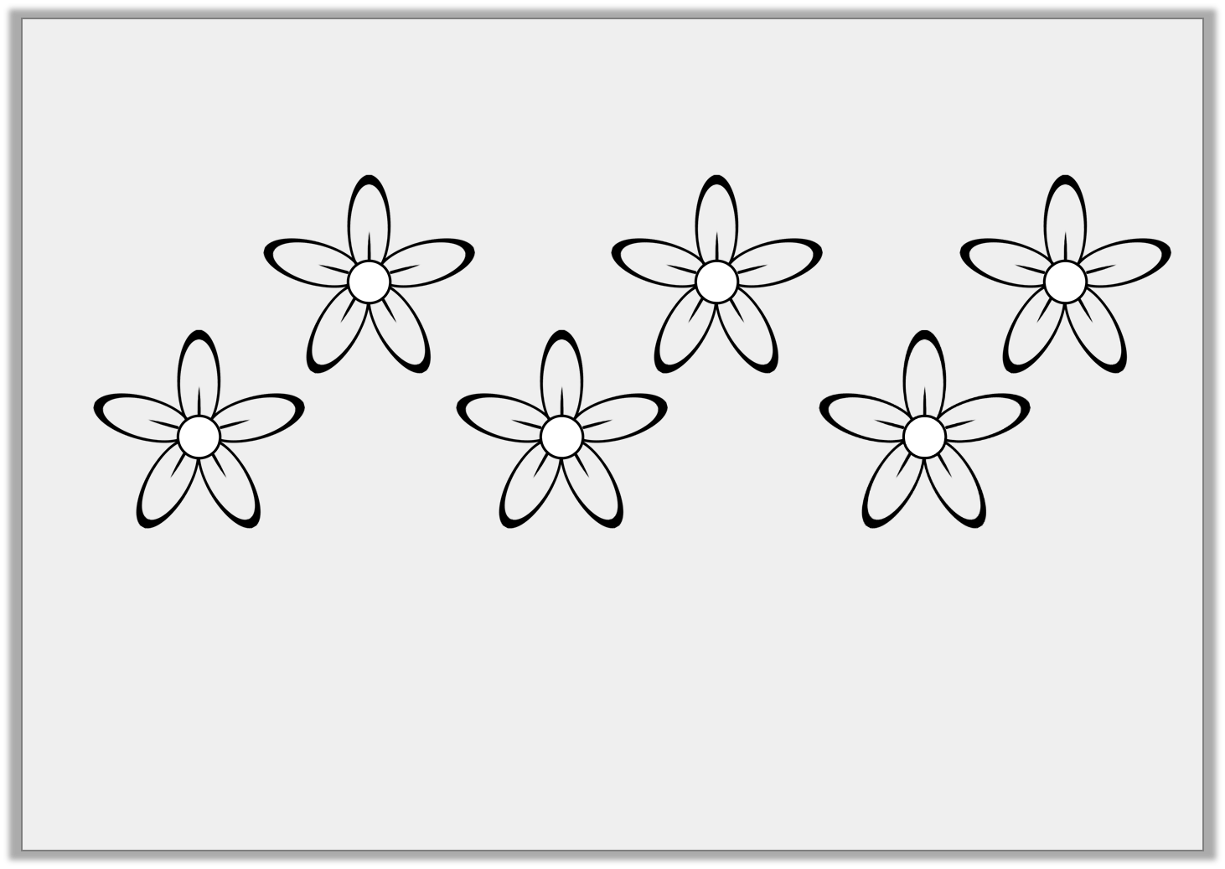
Problem Solving 1
A garden has 20 flowers. Some are blue, the rest are pink.
Write a number sentence about the flowers in the garden.
© Classroom Secrets Limited 2018

Slide 14
Problem Solving 1
A garden has 20 flowers. Some are blue, the rest are pink.
Write a number sentence about the flowers in the garden.
Various answers, for example:
20 – 5 = 15
15 + 5 = 20
5 + 15 = 20
© Classroom Secrets Limited 2018

Slide 15
Problem Solving 2
Use the digit cards to complete the number sentences.
1
13
10
15
5 | + |  | = | 20
 | + | 9 | = | 10
10 | + |  | = | 20
© Classroom Secrets Limited 2018

Slide 16
Problem Solving 2
Use the digit cards to complete the number sentences.
1
13
10
15
5 | + | 15 | = | 20
1 | + | 9 | = | 10
10 | + | 10 | = | 20
© Classroom Secrets Limited 2018

Slide 17

Reasoning 1
Isiah says,
Is he correct? Explain how you know.
You must add two odd numbers to make 20.
© Classroom Secrets Limited 2018

Slide 18
Reasoning 1
Isiah says,
Is he correct? Explain how you know.
Isiah is incorrect because…
You must add two odd numbers to make 20.
© Classroom Secrets Limited 2018

Slide 19
Reasoning 1
Isiah says,
Is he correct? Explain how you know.
Isiah is incorrect because you can add two even numbers to make 20 (for example, 4 + 16 or 12 + 8).
You must add two odd numbers to make 20.
© Classroom Secrets Limited 2018

