Slide 1


Year 1 – Summer Block 4 – Place Value – Partitioning Numbers
About This Resource:
This PowerPoint has been designed to support your teaching of this small step. It includes a starter activity and an example of each question from the Varied Fluency and Reasoning and Problem Solving resources also provided in this pack. You can choose to work through all examples provided or a selection of them depending on the needs of your class.
National Curriculum Objectives:
Mathematics Year 1: (1N4) Identify and represent numbers using objects and pictorial representations including the number line, and use the language of: equal to, more than, less than (fewer), most and least
More Year 1 Place Value resources.
Did you like this resource? Don’t forget to review it on our website.
© Classroom Secrets Limited 2018

Slide 2
Year 1 – Summer Block 4 – Place Value
Step 2: Partitioning Numbers
© Classroom Secrets Limited 2018

Slide 3
Introduction
How many tens does each number have?
How many ones does each number have?
24
31
48
70
86
© Classroom Secrets Limited 2018

Slide 4
Introduction
How many tens does each number have?
How many ones does each number have?
24
31
48
2 tens and 4 ones
3 tens and 1 one
4 tens and 8 ones
70
86
7 tens and 0 ones
8 tens and 6 ones
© Classroom Secrets Limited 2018

Slide 5
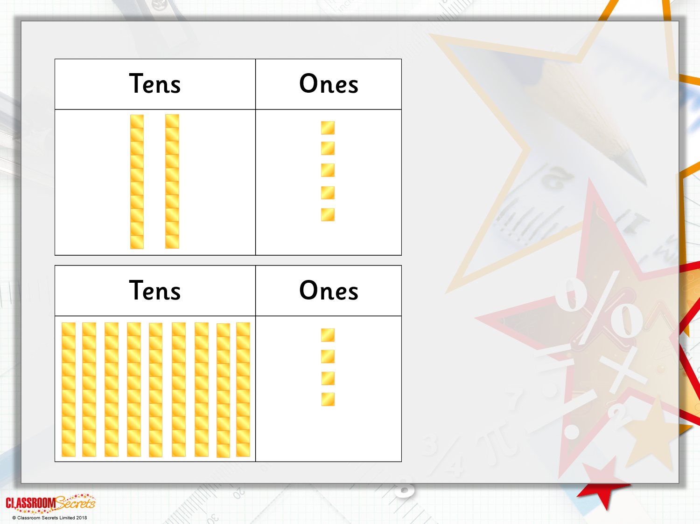
Varied Fluency 1
 | True or false?
= 25
 | True or false?
= 84

Slide 6
Varied Fluency 1
 | True or false?
= 25 | True
2 tens and 5 ones = 25
 | True or false?
= 84 | False
9 tens and 4 ones = 94

Slide 7
Varied Fluency 2
Complete these part-whole models
 | 3
3
10
1
10
10
1
1
10
10
1
© Classroom Secrets Limited 2018

Slide 8
Varied Fluency 2
Complete these part-whole models
5 | 3
3 | 4
10
10
1
10
1
1
10
10
10
1
1
10
1
10
1
© Classroom Secrets Limited 2018

Slide 9
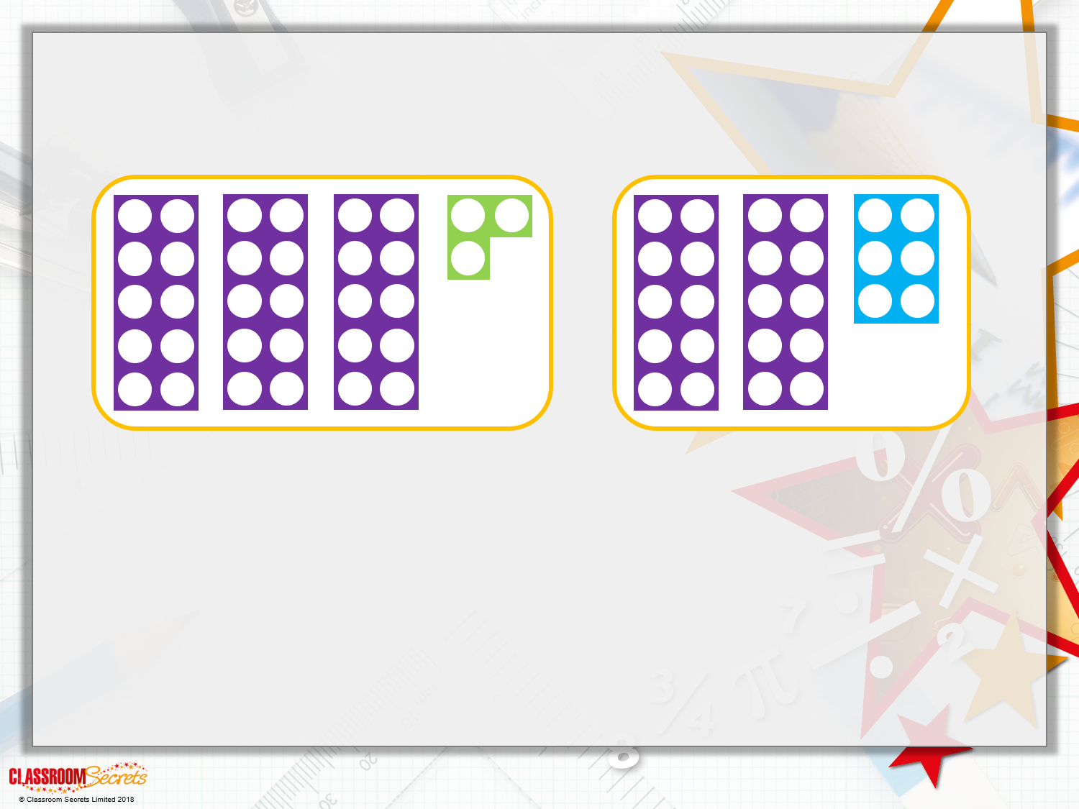
Varied Fluency 3
Match each diagram to a number.
26 | 47 | 33 | 23

Slide 10
Varied Fluency 3
Match each diagram to a number.
26 | 47 | 33 | 23

Slide 11
Varied Fluency 4
Complete the sentences
36 | has |  | tens | and |  | ones.
 | has | 4 | tens | and | 8 | ones.
59 | has |  | tens | and |  | ones.
 | has | 8 | tens | and | 7 | ones.
© Classroom Secrets Limited 2018

Slide 12
Varied Fluency 4
Complete the sentences
36 | has | 3 | tens | and | 6 | ones.
48 | has | 4 | tens | and | 8 | ones.
59 | has | 5 | tens | and | 9 | ones.
87 | has | 8 | tens | and | 7 | ones.
© Classroom Secrets Limited 2018

Slide 13
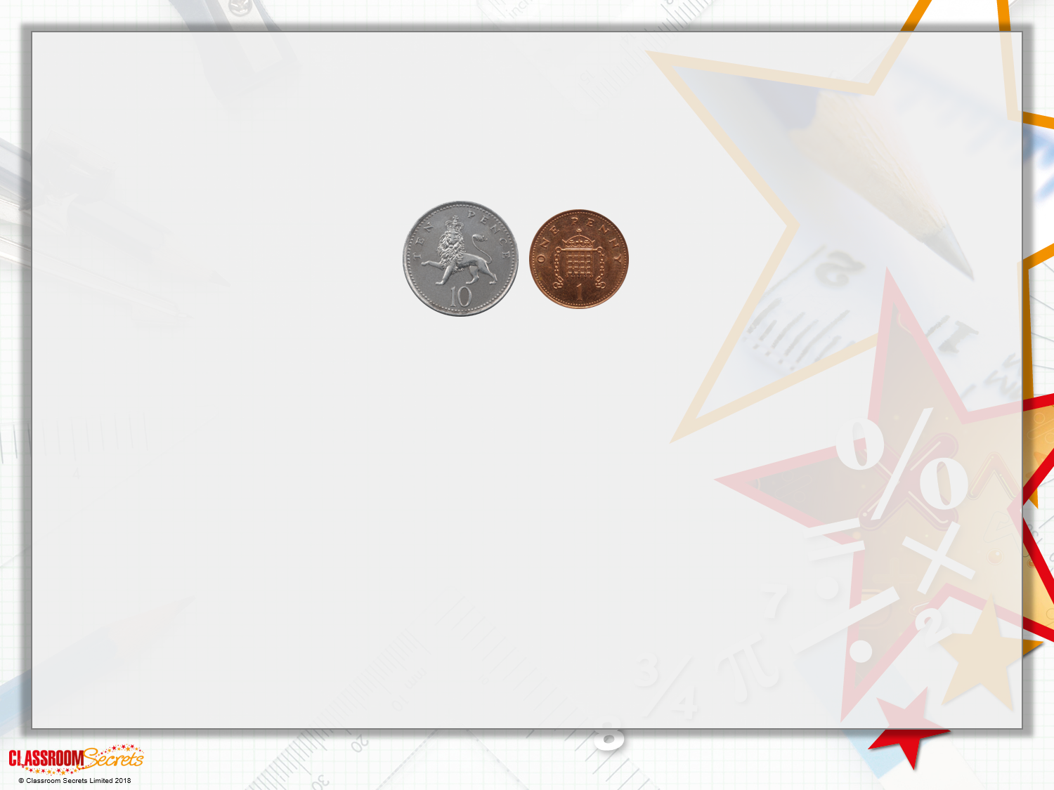
Problem Solving 1
Lottie has 7 coins.
Some are 10p coins and some are 1p coins.
What total amounts could she have?
Find all the possibilities

Slide 14
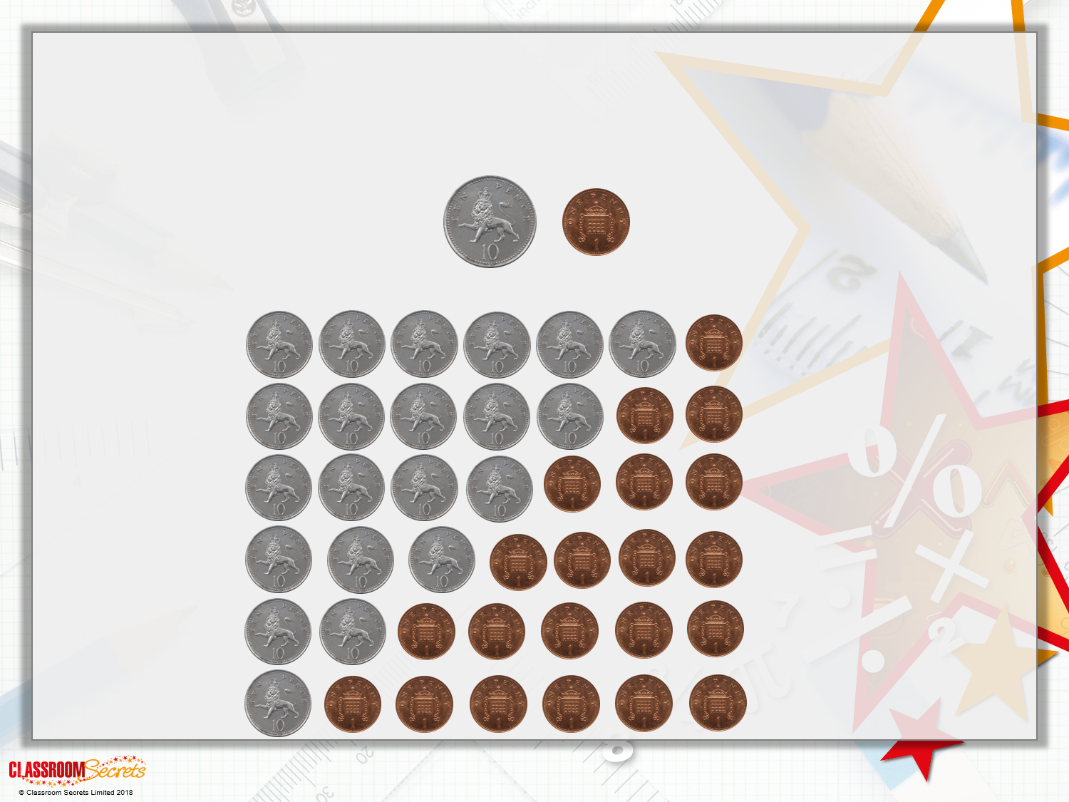
Problem Solving 1
Lottie has 7 coins.
Some are 10p coins and some are 1p coins.
What total amounts could she have?
61p
52p
43p
34p
25p
16p

Slide 15
Reasoning 1
Callum has completed the diagram.
Do you think he has done it correctly? Explain how you know.
Greater than 80
Less than 63
65
62
93
64
81
46
© Classroom Secrets Limited 2018

Slide 16
Reasoning 1
Callum has completed the diagram.
Do you think he has done it correctly? Explain how you know.
Callum has not completed the diagram correctly.
_____ is not greater than 80. _____ is not less than 63.
Greater than 80
Less than 63
65
62
93
64
81
46
© Classroom Secrets Limited 2018

Slide 17
Reasoning 1
Callum has completed the diagram.
Do you think he has done it correctly? Explain how you know.
Callum has not completed the diagram correctly.
_____ is not greater than 80. _____ is not less than 63.
Greater than 80
Less than 63
65
62
93
64
81
46
65
64
© Classroom Secrets Limited 2018

Slide 18
Problem Solving 2
Use place value counters to make a number which
has more than 6 tens and less than 5 ones.
Can you find 5 different answers?
Tens | Ones
© Classroom Secrets Limited 2018

Slide 19
Problem Solving 2
Use place value counters to make a number which
has more than 6 tens and less than 5 ones.
Can you find 5 different answers?
Other answers are:
73, 72, 71, 70.
84, 83, 82, 81, 80.
94, 93, 92, 91, 90.
Tens | Ones
10
10
10
1
1
1
10
10
10
1
10
© Classroom Secrets Limited 2018

