Slide 1
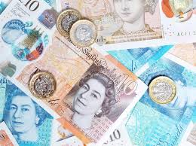
Adding amounts of money!

Slide 2
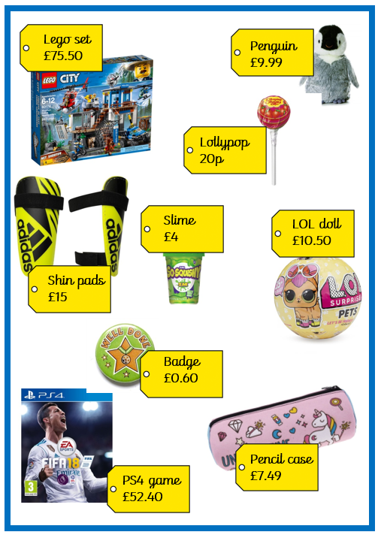
Key statements:
When adding money, I need to remember that it can come in pounds (£) and pence (p).
These are often separated by a decimal point (.).
There are 100 pennies (100p) in a pound (£1).

Slide 3
Using column method:
When adding money, I can use the column method. It is really important to line them up carefully – think place value… £ or p?

Slide 4

Using column method:
If for example, I was adding the LOL doll and a badge this is how I would set it out:
10.50
00.60
.
11
10
1

Slide 5
Using column method:
If I am adding slime and a lollypop, I need to be careful!!:
4.00
0.20
.
4
20

