Slide 1


Year 1 – Spring Block 2 – Place Value to 50 – Represent Numbers to 50
About This Resource:
This PowerPoint has been designed to support your teaching of this small step. It includes a starter activity and an example of each question from the Varied Fluency and Reasoning and Problem Solving resources also provided in this pack. You can choose to work through all examples provided or a selection of them depending on the needs of your class.
National Curriculum Objectives:
Mathematics Year 1: (1N2a) Count, read and write numbers to 100 in numerals
Mathematics Year 1: (1N4) Identify and represent numbers using objects and pictorial representations including the number line, and use the language of: equal to, more than, less than (fewer), most, least
Mathematics Year 1: (1N2c) Read and write numbers from 1 to 20 in numerals and words
More Year 1 Place Value resources.
Did you like this resource? Don’t forget to review it on our website.
© Classroom Secrets Limited 2018

Slide 2
Year 1 – Spring Block 2 – Place Value to 50
Step 3: Represent Numbers to 50
© Classroom Secrets Limited 2018

Slide 3
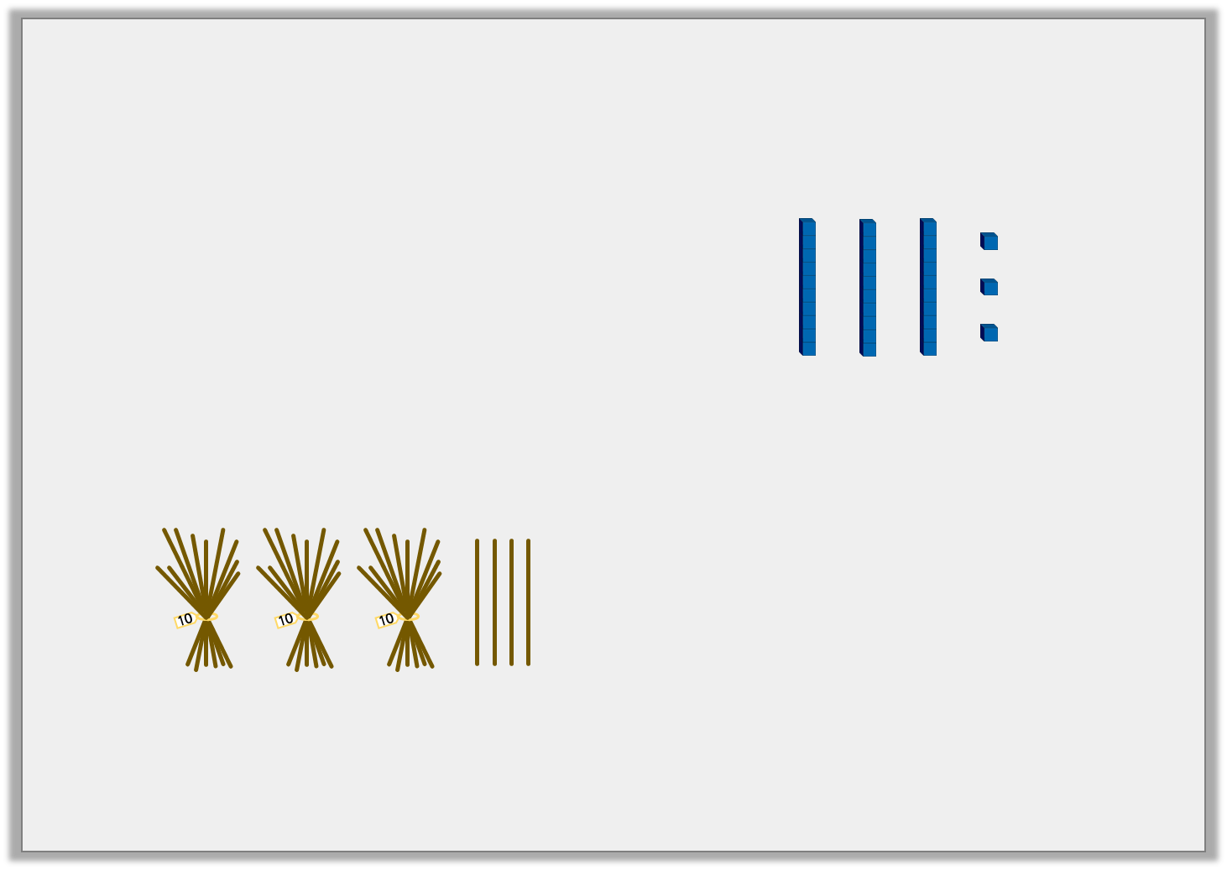
Introduction
Circle the materials which represent the number 34.
Tens | Ones
© Classroom Secrets Limited 2018

Slide 4
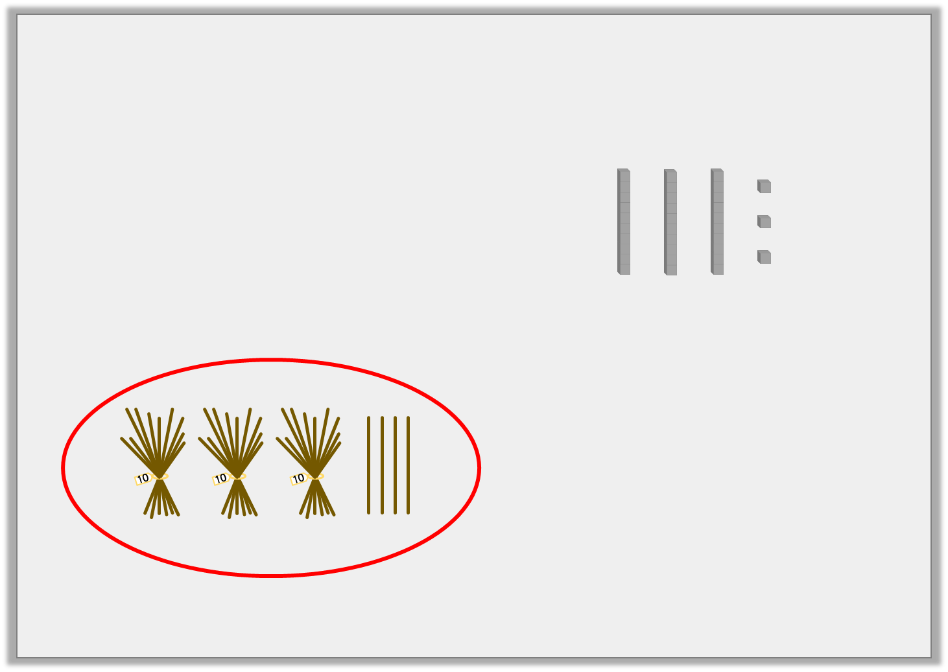
Introduction
Circle the materials which represent the number 34.
Tens | Ones
© Classroom Secrets Limited 2018

Slide 5
Varied Fluency 1
Circle the number of tens in the number 31.
Underline the number of ones.
2 | 1 | 6 | 0
4 | 5 | 7 | 3
© Classroom Secrets Limited 2018

Slide 6
Varied Fluency 1
Circle the number of tens in the number 31.
Underline the number of ones.
2 | 1 | 6 | 0
4 | 5 | 7 | 3
© Classroom Secrets Limited 2018

Slide 7
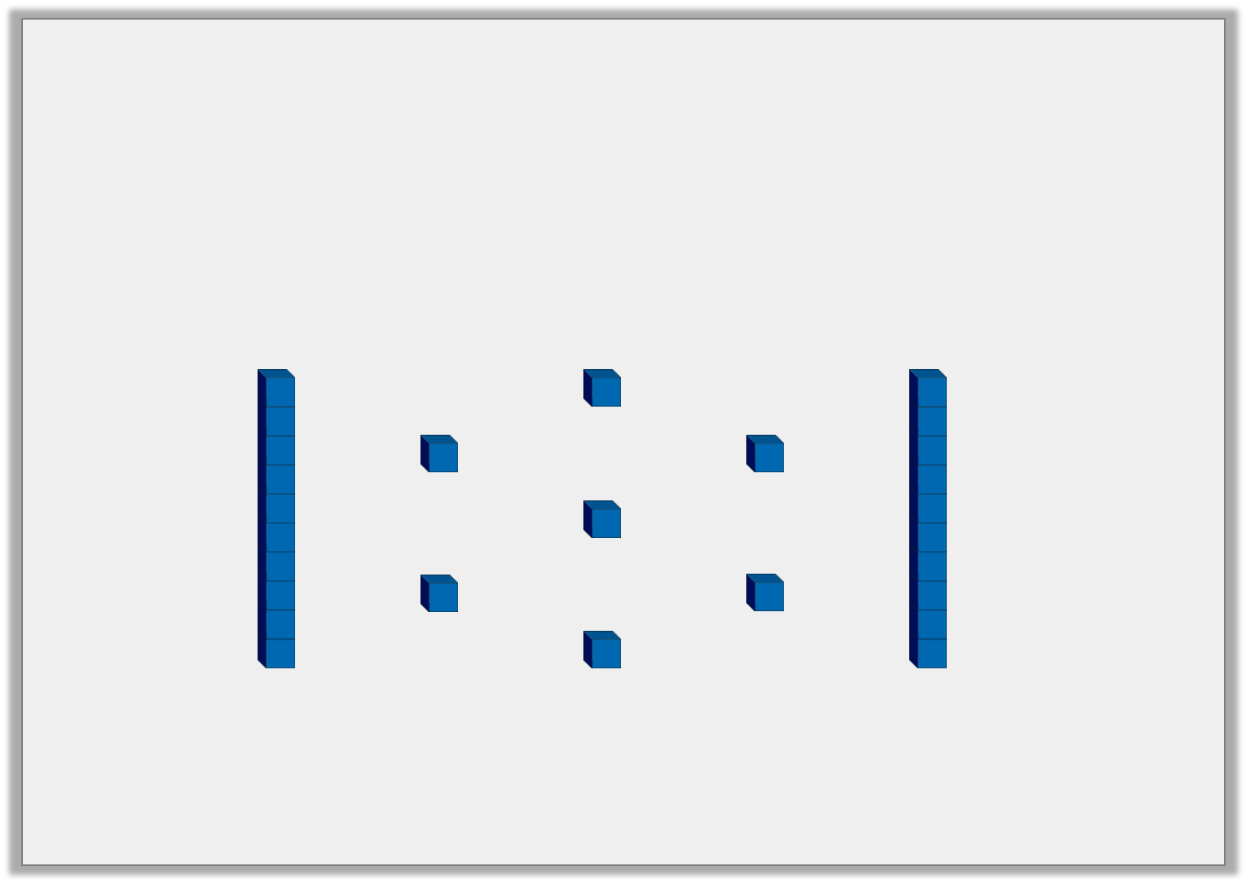
Varied Fluency 2
True or false?
The Base 10 represents the number 17.
© Classroom Secrets Limited 2018

Slide 8
Varied Fluency 2
True or false?
The Base 10 represents the number 17.
False, the Base 10 represents the number 27.
© Classroom Secrets Limited 2018

Slide 9
Varied Fluency 3
What number is represented below?
Tens | Ones
© Classroom Secrets Limited 2018

Slide 10
Varied Fluency 3
What number is represented below?
36
Tens | Ones
© Classroom Secrets Limited 2018

Slide 11
Varied Fluency 4
Use the ten frames to represent the number 28.
© Classroom Secrets Limited 2018

Slide 12
Varied Fluency 4
Use the ten frames to represent the number 28.
© Classroom Secrets Limited 2018

Slide 13
Reasoning 1
Circle the odd one out.
Explain your reasoning.
41 |  | 46
 | 34
49 |  | 42
© Classroom Secrets Limited 2018

Slide 14
Reasoning 1
Circle the odd one out.
Explain your reasoning.
34 is the odd one out because…
41 |  | 46
 | 34
49 |  | 42
© Classroom Secrets Limited 2018

Slide 15
Reasoning 1
Circle the odd one out.
Explain your reasoning.
34 is the odd one out because it is the only number which does not have four tens.
41 |  | 46
 | 34
49 |  | 42
© Classroom Secrets Limited 2018

Slide 16
Problem Solving 1
Use the place value grid to represent 3 different numbers using all 7 counters. Your number must be no bigger than 50.
Complete the sentence for each number:
There are ___ tens and ___ ones in the number ___.
Tens | Ones
© Classroom Secrets Limited 2018

Slide 17
Problem Solving 1
Use the place value grid to represent 3 different numbers using all 7 counters. Your number must be no bigger than 50.
Various answers; for example:
Complete the sentence for each number:
There are 3 tens and 4 ones in the number 34.
Tens | Ones
© Classroom Secrets Limited 2018

Slide 18
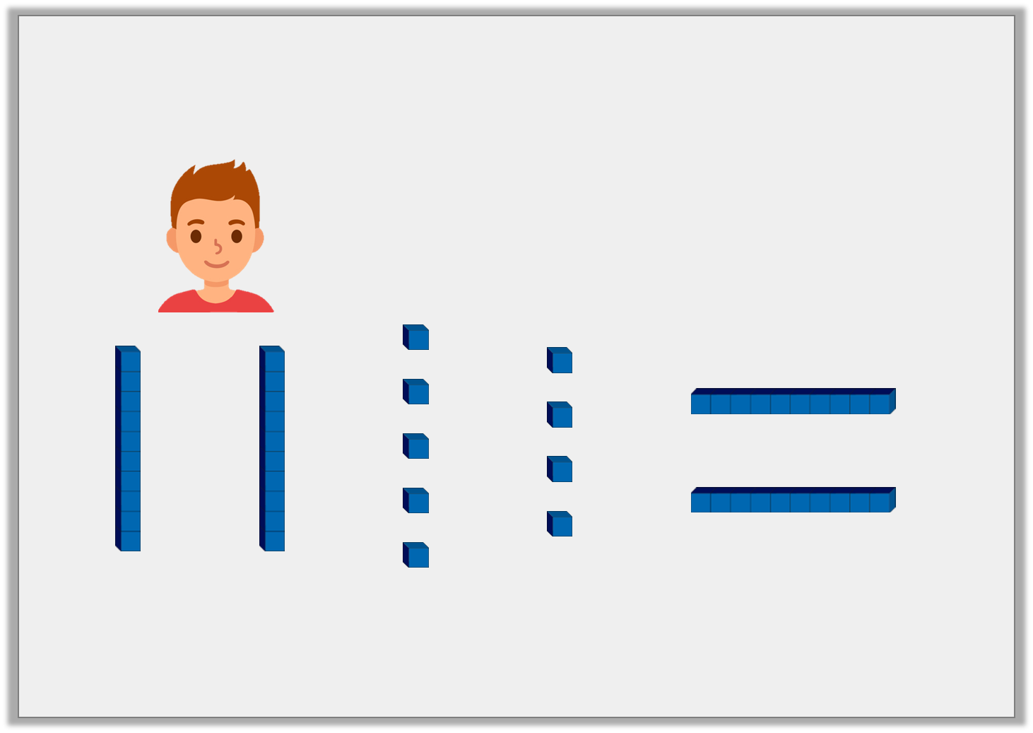
Reasoning 2
Alex says,
Is he correct? Prove it.
I can represent all of the numbers from 1 to 50 using the Base 10.
© Classroom Secrets Limited 2018

Slide 19
Reasoning 2
Alex says,
Is he correct? Prove it.
Alex is not correct because…
I can represent all of the numbers from 1 to 50 using the Base 10.
© Classroom Secrets Limited 2018

Slide 20
Reasoning 2
Alex says,
Is he correct? Prove it.
Alex is not correct because there are only 4 tens so he could not represent the number 50.
I can represent all of the numbers from 1 to 50 using the Base 10.
© Classroom Secrets Limited 2018

