Slide 1


Year 1 – Autumn Block 2 – Addition and Subtraction – Counting Back
About This Resource:
This PowerPoint has been designed to support your teaching of this small step. It includes a starter activity and an example of each question from the Varied Fluency and Reasoning and Problem Solving resources also provided in this pack. You can choose to work through all examples provided or a selection of them depending on the needs of your class.
National Curriculum Objectives:
Mathematics Year 1: (1N4) Identify and represent numbers using objects and pictorial representations including the number line, and use the language of: equal to, more than, less than (fewer), most, least​
Mathematics Year 1: (1N2c) Read and write numbers from 1 to 20 in numerals and words​
Mathematics Year 1: (1C4) Solve one-step problems that involve addition and subtraction, using concrete objects and pictorial representations, and missing number problems such as 7 = – 9
More Year 1 Addition and Subtraction Resources.
Did you like this resource? Don’t forget to review it on our website.
© Classroom Secrets Limited 2018

Slide 2
Year 1 – Autumn Block 2 – Addition and Subtraction
Step 15: Counting Back
© Classroom Secrets Limited 2018

Slide 3
Introduction
Complete each sequence of numbers.
8 |  | 7 |  | 6
20 |  | 19 |  | 18
15 |  | 14 |  | 13
© Classroom Secrets Limited 2018

Slide 4
Introduction
Complete each sequence of numbers.
8 |  | 7 |  | 6 |  | 5 |  | 4 |  | 3
20 |  | 19 |  | 18 |  | 17 |  | 16 |  | 15
15 |  | 14 |  | 13 |  | 12 |  | 11 |  | 10
© Classroom Secrets Limited 2018

Slide 5
Varied Fluency 1
Which number sentence matches the number line?
1 | 2 | 3 | 4 | 5 | 6 | 7 | 8 | 9 | 10
A. | 6 | – | 2 | = | 4
B. | 6 | – | 3 | = | 3
C. | 6 | – | 1 | = | 5
© Classroom Secrets Limited 2018

Slide 6
Varied Fluency 1
Which number sentence matches the number line?
1 | 2 | 3 | 4 | 5 | 6 | 7 | 8 | 9 | 10
A. | 6 | – | 2 | = | 4
B. | 6 | – | 3 | = | 3
C. | 6 | – | 1 | = | 5
© Classroom Secrets Limited 2018

Slide 7
Varied Fluency 2
True or false?
If I count backwards from 9, it will take 4 jumps to land on 5.
1 | 2 | 3 | 4 | 5 | 6 | 7 | 8 | 9 | 10
© Classroom Secrets Limited 2018

Slide 8
Varied Fluency 2
True or false?
If I count backwards from 9, it will take 4 jumps to land on 5.
True
1 | 2 | 3 | 4 | 5 | 6 | 7 | 8 | 9 | 10
© Classroom Secrets Limited 2018

Slide 9
Varied Fluency 3
Use the number track to complete the number sentence.
1 | 2 | 3 | 4 | 5 | 6 | 7 | 8 | 9 | 10
8 | – |  | = | 5
© Classroom Secrets Limited 2018

Slide 10
Varied Fluency 3
Use the number track to complete the number sentence.
1 | 2 | 3 | 4 | 5 | 6 | 7 | 8 | 9 | 10
8 | – | 3 | = | 5
© Classroom Secrets Limited 2018

Slide 11
Varied Fluency 4
Start on the number 10. Make four jumps backwards.
Which number do you land on?
Write a number sentence to match.
1 | 2 | 3 | 4 | 5 | 6 | 7 | 8 | 9 | 10
© Classroom Secrets Limited 2018

Slide 12
Varied Fluency 4
Start on the number 10. Make four jumps backwards.
Which number do you land on?
Write a number sentence to match.
10 – 4 = 6
1 | 2 | 3 | 4 | 5 | 6 | 7 | 8 | 9 | 10
© Classroom Secrets Limited 2018

Slide 13

Problem Solving 1
The frog starts on 7. It makes 3 jumps back.
Which number does it land on?
Write a number sentence to match.
1 | 2 | 3 | 4 | 5 | 6 | 7 | 8 | 9 | 10
© Classroom Secrets Limited 2018

Slide 14
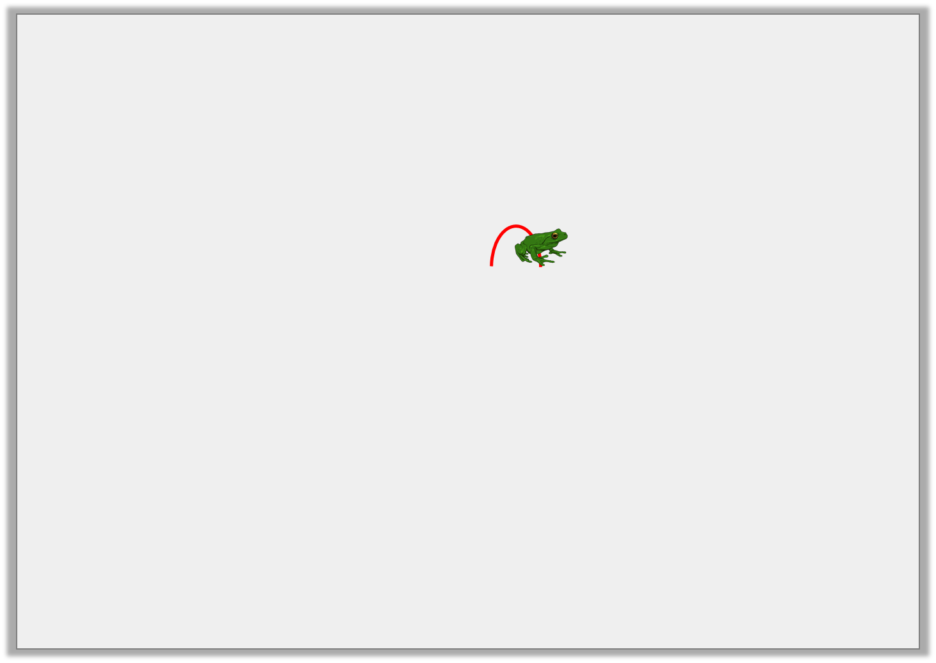
Problem Solving 1
The frog starts on 7. It makes 3 jumps back.
Which number does it land on?
Write a number sentence to match.
The frog will land on the number 4.
7 – 3 = 4
1 | 2 | 3 | 4 | 5 | 6 | 7 | 8 | 9 | 10
© Classroom Secrets Limited 2018

Slide 15

Reasoning 1
Aliza is thinking of a number.
Explain your answer.
If I make 6 jumps backwards, I will land on 2.
Which number am I thinking of?
1 | 2 | 3 | 4 | 5 | 6 | 7 | 8 | 9 | 10
© Classroom Secrets Limited 2018

Slide 16
Reasoning 1
Aliza is thinking of a number.
Explain your answer.
Aliza is thinking of the number 8 because…
If I make 6 jumps backwards, I will land on 2.
Which number am I thinking of?
1 | 2 | 3 | 4 | 5 | 6 | 7 | 8 | 9 | 10
© Classroom Secrets Limited 2018

Slide 17
Reasoning 1
Aliza is thinking of a number.
Explain your answer.
Aliza is thinking of the number 8 because…
Reasoning 1
Aliza is thinking of a number.
Explain your answer.
Aliza is thinking of the number 8 because 8 – 6 = 2.
If I make 6 jumps backwards, I will land on 2.
Which number am I thinking of?
1 | 2 | 3 | 4 | 5 | 6 | 7 | 8 | 9 | 10
© Classroom Secrets Limited 2018

Slide 18

Problem Solving 2
Sarah is sharing a jar of sweets.
She gives two sweets to Millie.
She gives one sweet to Natasha.
She has 4 sweets left.
How many sweets did Sarah have to start with?
Write a calculation to match.
Use the number track to help.
1 | 2 | 3 | 4 | 5 | 6 | 7 | 8 | 9 | 10
© Classroom Secrets Limited 2018

Slide 19
Problem Solving 2
Sarah is sharing a jar of sweets.
She gives two sweets to Millie.
She gives one sweet to Natasha.
She has 4 sweets left.
How many sweets did Sarah have to start with?
Write a calculation to match.
Use the number track to help.
Sarah had 7 sweets to start with.
7 – 2 – 1 = 4
1 | 2 | 3 | 4 | 5 | 6 | 7 | 8 | 9 | 10
© Classroom Secrets Limited 2018

