Slide 1
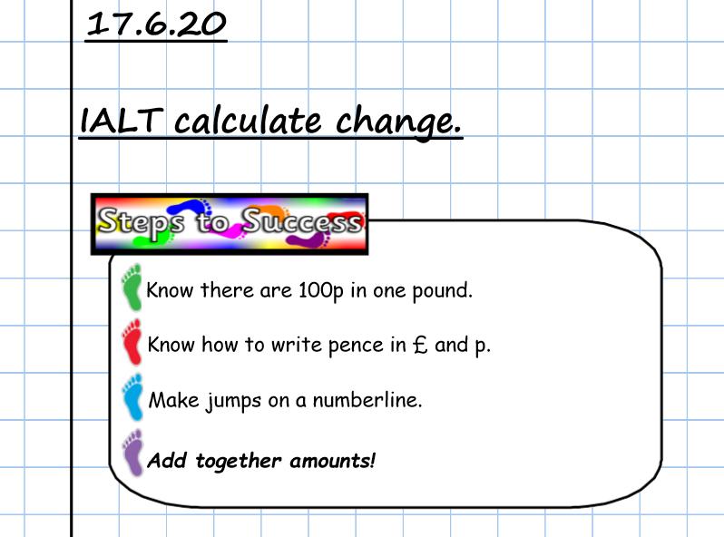

Slide 2

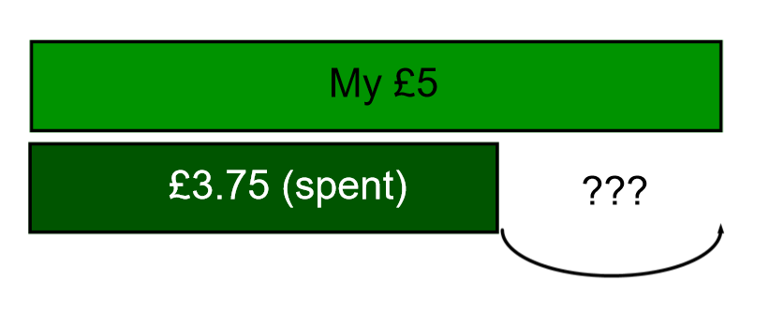

Slide 3
I buy something for £3.75.
How much change would I get from £5?
+5p
+20p
+£1
=£1.25
£3.75
£3.80
£4.00
£5
1) Draw a numberline.
2) Start with how much you spent.
3) End with how much you have.
4) Jump to nearest 10p.
5) Jump to nearest pound.
6) Jump in pounds to end.
7) Add all the jumps.

Slide 4
I buy something for £2.49.
How much change would I get from £5?
+1p
+50p
+£2
=£2.51
£2.49
£2.50
£3.00
£5
1) Draw a numberline.
2) Start with how much you spent.
3) End with how much you have.
4) Jump to nearest 10p.
5) Jump to nearest pound.
6) Jump in pounds to end.
7) Add all the jumps.

Slide 5
I buy something for £5.36.
How much change would I get from £10?
+4p
+60p
+£4
=£4.64
£5.36
£5.40
£6.00
£10
1) Draw a numberline.
2) Start with how much you spent.
3) End with how much you have.
4) Jump to nearest 10p.
5) Jump to nearest pound.
6) Jump in pounds to end.
7) Add all the jumps.

