Slide 1


Year 1 – Autumn Block 2 – Addition and Subtraction – Finding the Difference
About This Resource:
This PowerPoint has been designed to support your teaching of this small step. It includes a starter activity and an example of each question from the Varied Fluency and Reasoning and Problem Solving resources also provided in this pack. You can choose to work through all examples provided or a selection of them depending on the needs of your class.
National Curriculum Objectives:
Mathematics Year 1: (1C4) Solve one-step problems that involve addition and subtraction, using concrete objects and pictorial representations, and missing number problems such as 7 = – 9
Mathematics Year 1: (1C2a) Add and subtract one-digit and two-digit numbers to 20, including zero
More Year 1 Addition and Subtraction resources.
Did you like this resource? Don’t forget to review it on our website.
© Classroom Secrets Limited 2018

Slide 2
Year 1 – Autumn Block 2 – Addition and Subtraction
Step 16: Finding the Difference
© Classroom Secrets Limited 2018

Slide 3
Introduction
Match the answers to the correct calculations.
7 – 5 =
8 – 4 =
9 – 1 =
4
8
2
© Classroom Secrets Limited 2018

Slide 4
Introduction
Match the answers to the correct calculations.
7 – 5 =
8 – 4 =
9 – 1 =
4
8
2
© Classroom Secrets Limited 2018

Slide 5
Varied Fluency 1
How many more is 8 than 3? Tick the correct answer.
1 | 2 | 3 | 4 | 5 | 6 | 7 | 8 | 9 | 10
5 |  | 2 |  | 6
© Classroom Secrets Limited 2018

Slide 6
Varied Fluency 1
How many more is 8 than 3? Tick the correct answer.
1 | 2 | 3 | 4 | 5 | 6 | 7 | 8 | 9 | 10
5 |  | 2 |  | 6
✓
© Classroom Secrets Limited 2018

Slide 7
Varied Fluency 2
How many more circles are there than squares?
Circles
Squares
4 |  | 2 |  | 3
© Classroom Secrets Limited 2018

Slide 8
Varied Fluency 2
How many more circles are there than squares?
Circles
Squares
4 |  | 2 |  | 3
✓
© Classroom Secrets Limited 2018

Slide 9

Varied Fluency 3
What is the difference between 9 and 5? Tick the correct answer.
4 |  | 3 |  | 2
© Classroom Secrets Limited 2018

Slide 10
Varied Fluency 3
What is the difference between 9 and 5? Tick the correct answer.
4 |  | 3 |  | 2
✓
© Classroom Secrets Limited 2018

Slide 11
Varied Fluency 4
Circle the pair of numbers that have a difference of 3.
a) | 10 | 6
b) | 8 | 4
c) | 9 | 6
d) | 6 | 2
© Classroom Secrets Limited 2018

Slide 12
Varied Fluency 4
Circle the pair of numbers that have a difference of 3.
a) | 10 | 6
b) | 8 | 4
c) | 9 | 6
d) | 6 | 2
© Classroom Secrets Limited 2018

Slide 13
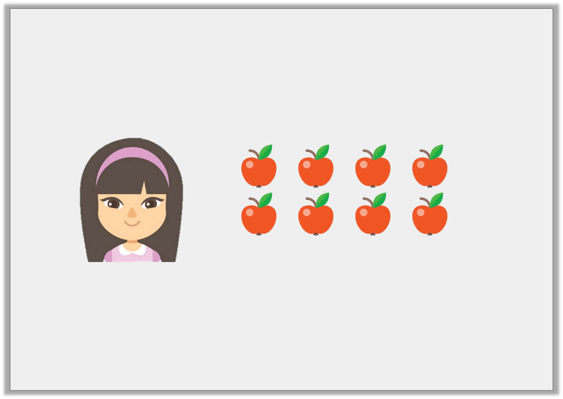
Problem Solving 1
The difference between Emmie and Lee’s apples is 2.
If Emmie has 8 apples, how many apples could Lee have?
Emmie
© Classroom Secrets Limited 2018

Slide 14
Problem Solving 1
The difference between Emmie and Lee’s apples is 2.
If Emmie has 8 apples, how many apples could Lee have?
Emmie
6 or 10
© Classroom Secrets Limited 2018

Slide 15
Problem Solving 2
Use the digit cards to make 3 different subtraction calculations.
8
6
5
2
7
 | – |  | =
 | – |  | =
 | – |  | =
© Classroom Secrets Limited 2018

Slide 16
Problem Solving 2
Use the digit cards to make 3 different subtraction calculations.
8
6
5
2
7
8 | – | 2 | = | 6
8 | – | 6 | = | 2
7 | – | 2 | = | 5
Other possible calculations:
7 – 5 = 2; 6 – 2 = 4; 6 – 4 = 2
© Classroom Secrets Limited 2018

Slide 17
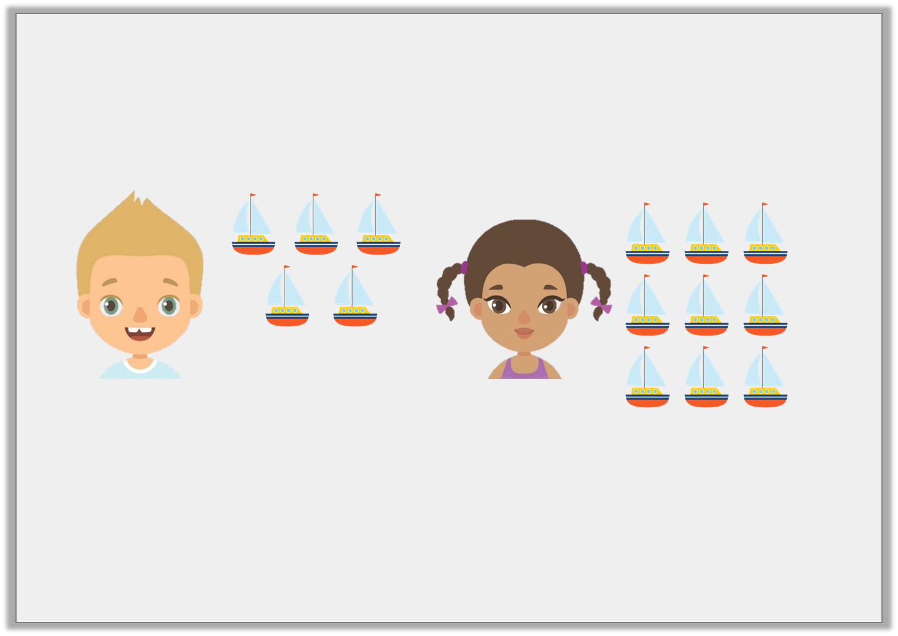
Reasoning 1
Harry has 5 boats and Beth has 9 boats.
Beth thinks the difference is 5.
Is she correct? Explain why.
Harry
Beth
© Classroom Secrets Limited 2018

Slide 18
Reasoning 1
Harry has 5 boats and Beth has 9 boats.
Beth thinks the difference is 5.
Is she correct? Explain why.
Beth is incorrect because…
Harry
Beth
© Classroom Secrets Limited 2018

Slide 19
Reasoning 1
Harry has 5 boats and Beth has 9 boats.
Beth thinks the difference is 5.
Is she correct? Explain why.
Beth is incorrect because 9 – 5 = 4.
Harry
Beth
© Classroom Secrets Limited 2018

