Slide 1


Year 1 – Summer Block 1 – Multiplication and Division – Making Doubles
About This Resource:
This PowerPoint has been designed to support your teaching of this small step. It includes a starter activity and an example of each question from the Varied Fluency and Reasoning and Problem Solving resources also provided in this pack. You can choose to work through all examples provided or a selection of them depending on the needs of your class.
National Curriculum Objectives:
Mathematics Year 1: (1C4) Solve one-step problems that involve addition and subtraction, using concrete objects and pictorial representations, and missing number problems
Mathematics Year 1: (1N1b) Count in multiples of twos, fives and tens
More Year 1 Multiplication and Division resources.
Did you like this resource? Don’t forget to review it on our website.
© Classroom Secrets Limited 2018

Slide 2
Year 1 – Summer Block 1 – Multiplication and Division
Step 5: Making Doubles
© Classroom Secrets Limited 2018

Slide 3

Introduction
Share the footballs into 3 equal groups.
© Classroom Secrets Limited 2018

Slide 4
Introduction
Share the footballs into 3 equal groups.
© Classroom Secrets Limited 2018

Slide 5

Varied Fluency 1
What is the double of these objects?
© Classroom Secrets Limited 2018

Slide 6

Varied Fluency 1
What is the double of these objects?
Double 5 is 10
© Classroom Secrets Limited 2018

Slide 7
Varied Fluency 2
Complete the missing doubles from this table.
Double 5 | 10
Double 6
Double 8
Double 7 | 14
© Classroom Secrets Limited 2018

Slide 8
Varied Fluency 2
Complete the missing doubles from this table.
Double 5 | 10
Double 6 | 12
Double 8 | 16
Double 7 | 14
© Classroom Secrets Limited 2018

Slide 9
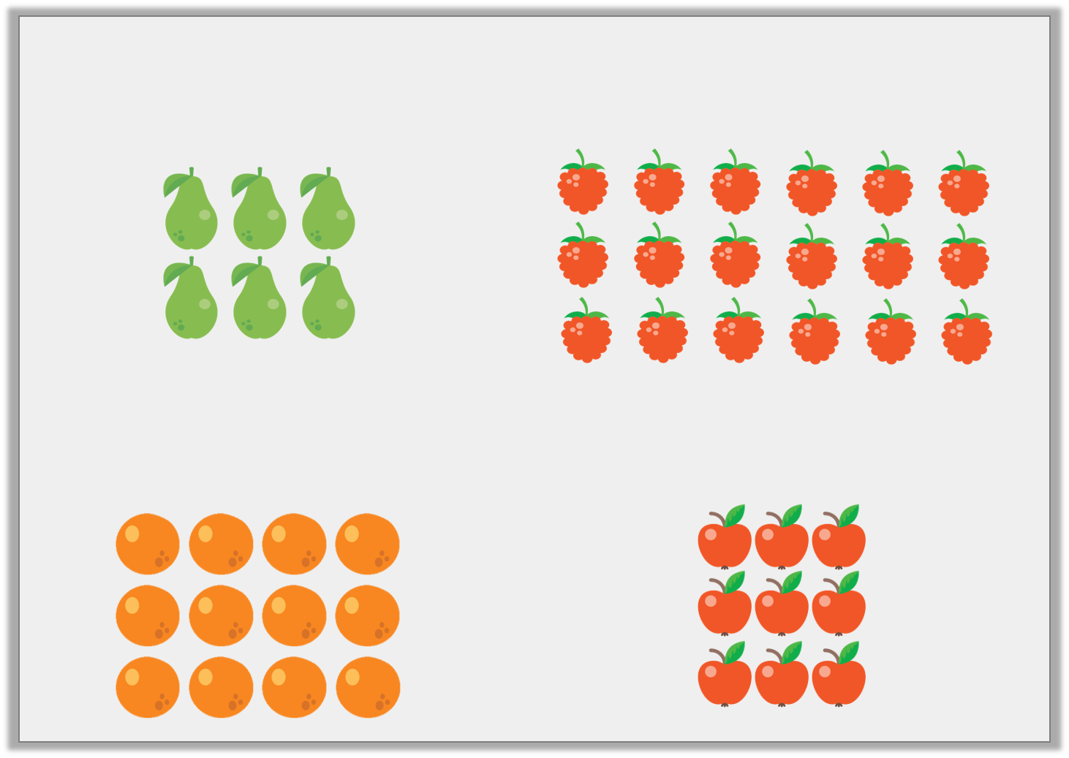
Varied Fluency 3
Match the doubles using these pictures.
© Classroom Secrets Limited 2018

Slide 10
Varied Fluency 3
Match the doubles using these pictures.
6
18
12
9
© Classroom Secrets Limited 2018

Slide 11


Varied Fluency 4
Complete these number sentences.
Double 7 is ___.
Double ___ is 18.
© Classroom Secrets Limited 2018

Slide 12
Varied Fluency 4
Complete these number sentences.
Double 7 is 14.
Double 9 is 18.
© Classroom Secrets Limited 2018

Slide 13
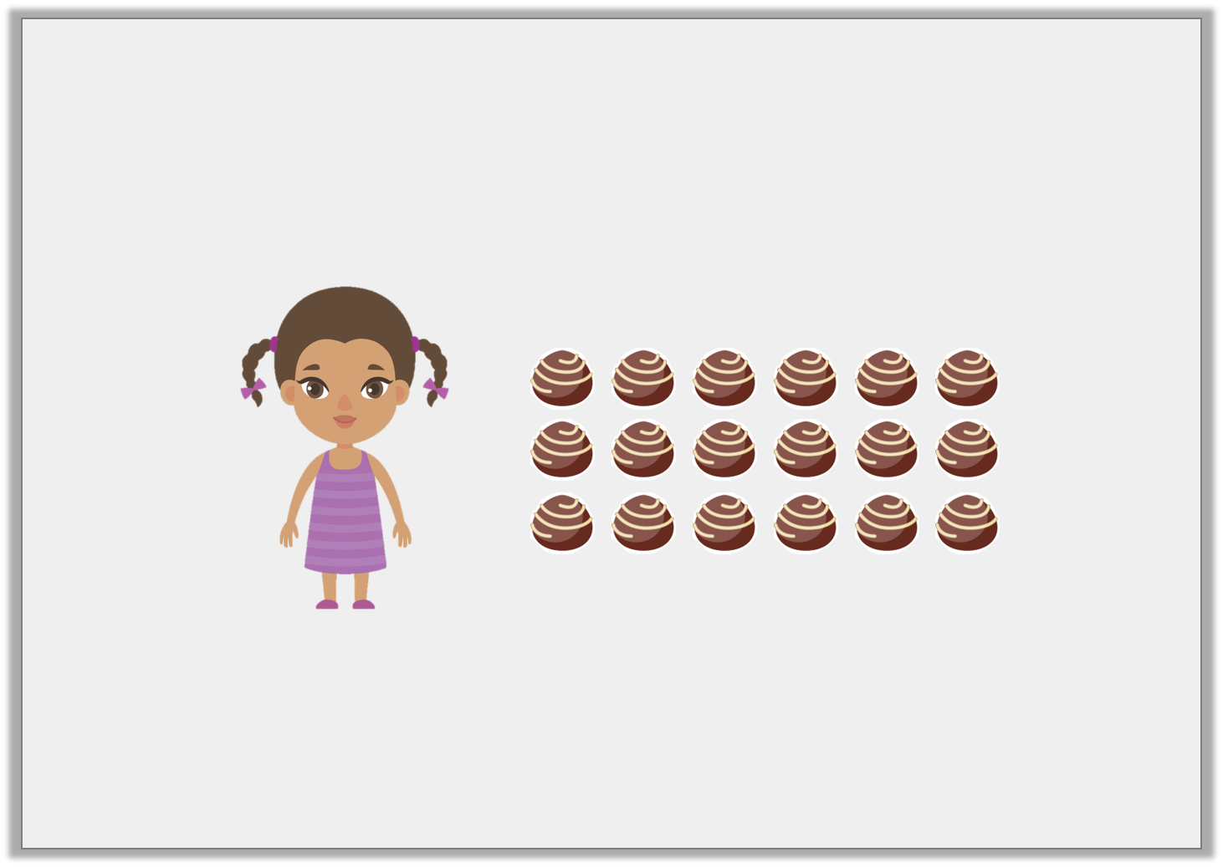
Reasoning 1
Sunita doubles her sweets. She now has 18 sweets. How many did she start with?
Explain your answer.
© Classroom Secrets Limited 2018

Slide 14
Reasoning 1
Sunita doubles her sweets. She now has 18 sweets. How many did she start with?
Explain your answer.
Sunita started with _____ sweets as half of 18 is ___.
© Classroom Secrets Limited 2018

Slide 15
Reasoning 1
Sunita doubles her sweets. She now has 18 sweets. How many did she start with?
Explain your answer.
Sunita started with 9 sweets as half of 18 is 9.
© Classroom Secrets Limited 2018

Slide 16

Problem Solving 1
Find the errors in these calculations.
Double 7 = 16
Double 8 = 16
Double 6 = 11
Double 9 = 18
© Classroom Secrets Limited 2018

Slide 17
Problem Solving 1
Find the errors in these calculations.
Double 7 = 16 14
Double 8 = 16
Double 6 = 11 12
Double 9 = 18
© Classroom Secrets Limited 2018

Slide 18
Reasoning 2
Complete these doubling number sentences.
Double 7 is 14.
Double 8 is _____.
Double 9 is 18.
Double 10 is _____.
Double 6 is 12.
Explain how you know.
© Classroom Secrets Limited 2018

Slide 19
Reasoning 2
Complete these doubling number sentences.
Double 7 is 14.
Double 8 is 16.
I know this because…
Double 9 is 18.
Double 10 is 20.
I know this because…
Double 6 is 12.
Explain how you know.
© Classroom Secrets Limited 2018

Slide 20
Reasoning 2
Complete these doubling number sentences.
Double 7 is 14.
Double 8 is 16.
I know this because 8 + 8 = 16.
Double 9 is 18.
Double 10 is 20.
I know this because 10 + 10 = 20.
Double 6 is 12.
Explain how you know.
© Classroom Secrets Limited 2018

