Slide 1


Year 1 – Summer Block 1 – Multiplication and Division – Make Arrays
About This Resource:
This PowerPoint has been designed to support your teaching of this small step. It includes a starter activity and an example of each question from the Varied Fluency and Reasoning and Problem Solving resources also provided in this pack. You can choose to work through all examples provided or a selection of them depending on the needs of your class.
National Curriculum Objectives:
Mathematics Year 1: (1N1b) Count in multiples of twos, fives and tens
Mathematics Year 1: (1C8) Solve one-step problems involving multiplication and division, by calculating the answer using concrete objects, pictorial representations and arrays with the support of the teacher
More Year 1 Multiplication and Division resources.
Did you like this resource? Don’t forget to review it on our website.
© Classroom Secrets Limited 2019

Slide 2
Year 1 – Summer Block 1 – Multiplication and Division
Step 4: Make Arrays
© Classroom Secrets Limited 2019

Slide 3
Introduction
Complete the number lines to show counting in 10s.
0 |  | 20 |  | 40 |  |  | 70 |  | 90
20 |  | 40 |  | 60 |  | 80 |  | 100
40 |  |  |  |  | 90 | 100
© Classroom Secrets Limited 2019

Slide 4
Introduction
Complete the number lines to show counting in 10s.
0 | 10 | 20 | 30 | 40 | 50 | 60 | 70 | 80 | 90
20 | 30 | 40 | 50 | 60 | 70 | 80 | 90 | 100
40 | 50 | 60 | 70 | 80 | 90 | 100
© Classroom Secrets Limited 2019

Slide 5
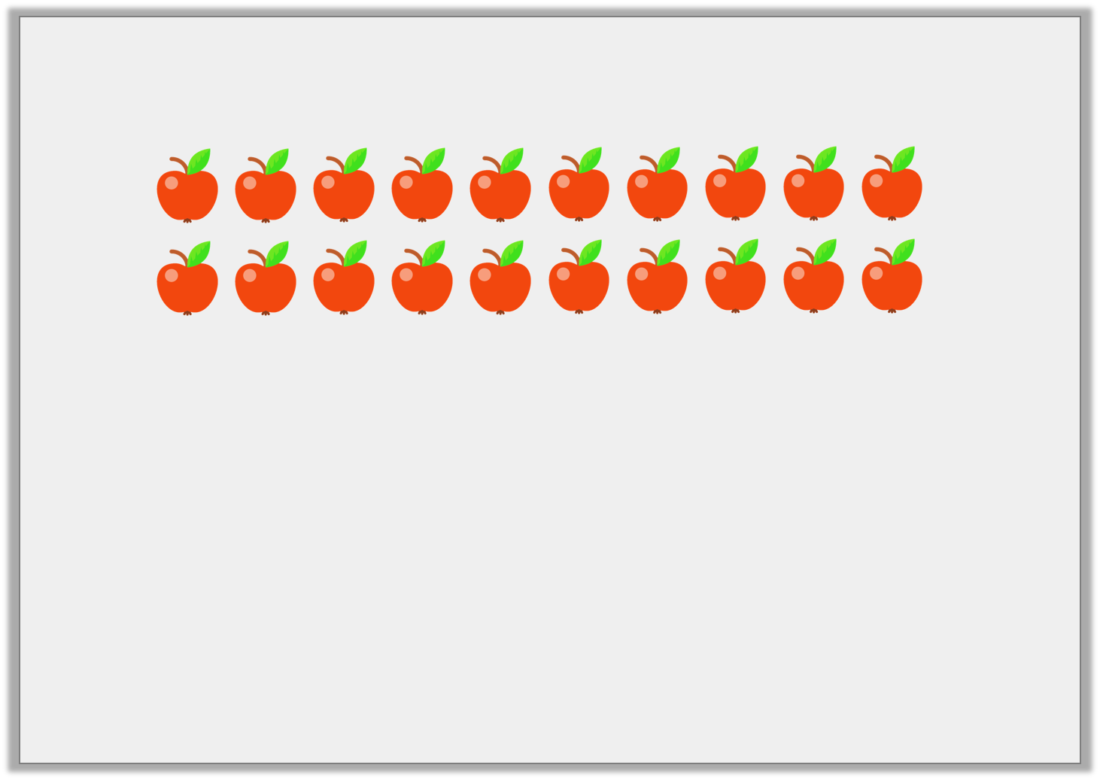
Varied Fluency 1
There are apples in each row.
There are rows.
© Classroom Secrets Limited 2019

Slide 6
Varied Fluency 1
There are apples in each row.
There are rows.
10
2
© Classroom Secrets Limited 2019

Slide 7

Varied Fluency 2
There are 2 counters in each column.
There are 6 columns.
Draw the array.
© Classroom Secrets Limited 2019

Slide 8
Varied Fluency 2
There are 2 counters in each column.
There are 6 columns.
Draw the array.
© Classroom Secrets Limited 2019

Slide 9
Varied Fluency 3
Complete the calculations.
There are 10 counters in each row. There are 4 rows.
There are 2 counters in each column. There are 5 columns.
 | + |  | + |  | + |  | =
 | + |  | + |  | + |  | + |  | =
© Classroom Secrets Limited 2019

Slide 10
Varied Fluency 3
Complete the calculations.
There are 10 counters in each row. There are 4 rows.
There are 2 counters in each column. There are 5 columns.
10 | + | 10 | + | 10 | + | 10 | = | 40
2 | + | 2 | + | 2 | + | 2 | + | 2 | = | 10
© Classroom Secrets Limited 2019

Slide 11
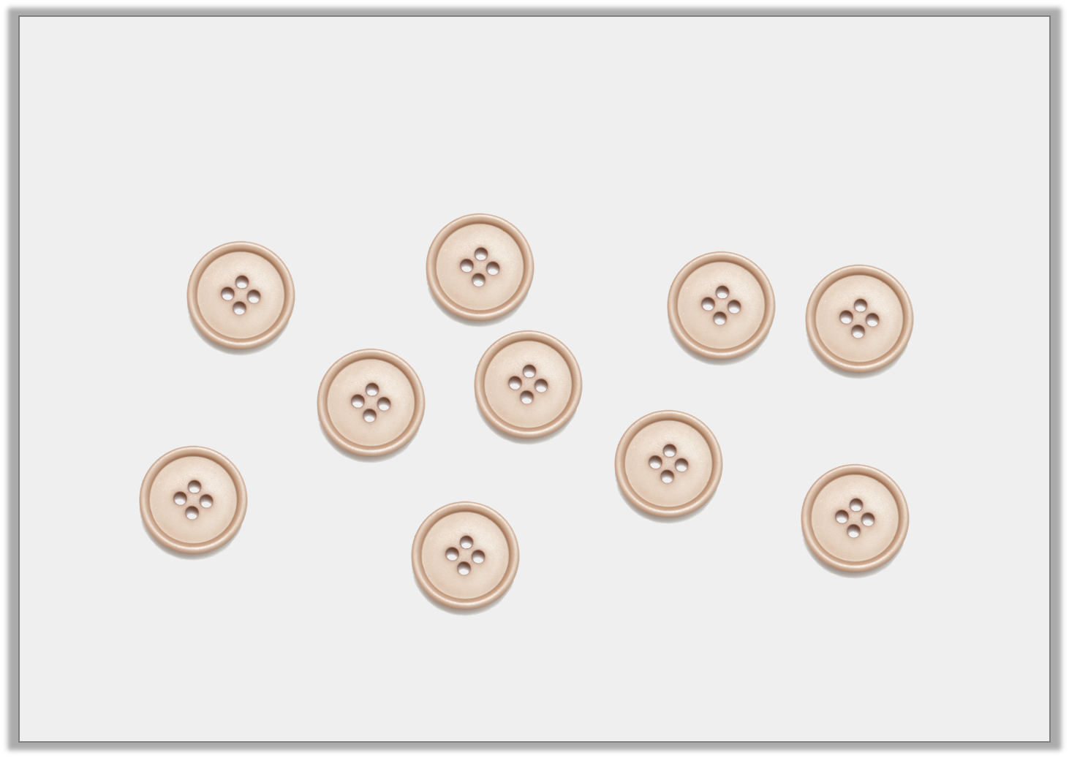
Varied Fluency 4
Use the buttons to make an array representing
2 + 2 + 2 + 2 + 2 = 10.
© Classroom Secrets Limited 2019

Slide 12
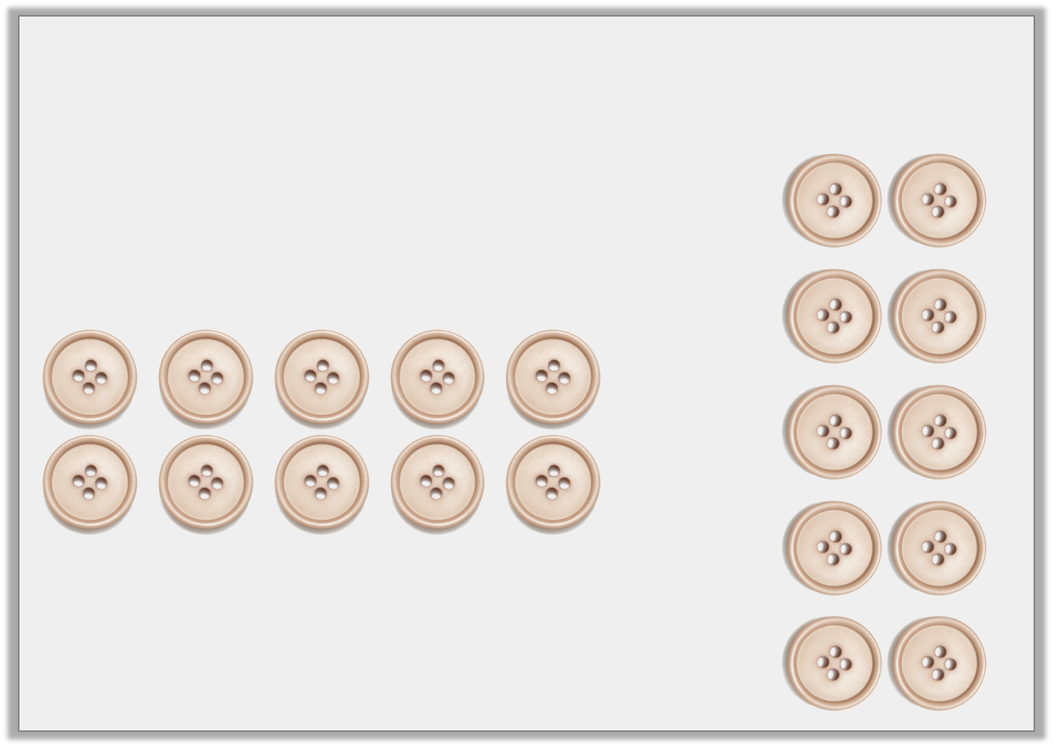
Varied Fluency 4
Use the buttons to make an array representing
2 + 2 + 2 + 2 + 2 = 10.
or
© Classroom Secrets Limited 2019

Slide 13

Reasoning 1
Is Eileen correct? Explain your answer.
My array has 4 columns with 10 in each column. I will need 14 counters to make it.
© Classroom Secrets Limited 2019

Slide 14
Reasoning 1
Is Eileen correct? Explain your answer.
Eileen is incorrect because…
My array has 4 columns with 10 in each column. I will need 14 counters to make it.
© Classroom Secrets Limited 2019

Slide 15
Reasoning 1
Is Eileen correct? Explain your answer.
Eileen is incorrect because she would need 40 counters rather than 14.
My array has 4 columns with 10 in each column. I will need 14 counters to make it.
© Classroom Secrets Limited 2019

Slide 16

Problem Solving 1
Complete the array.
© Classroom Secrets Limited 2019

Slide 17
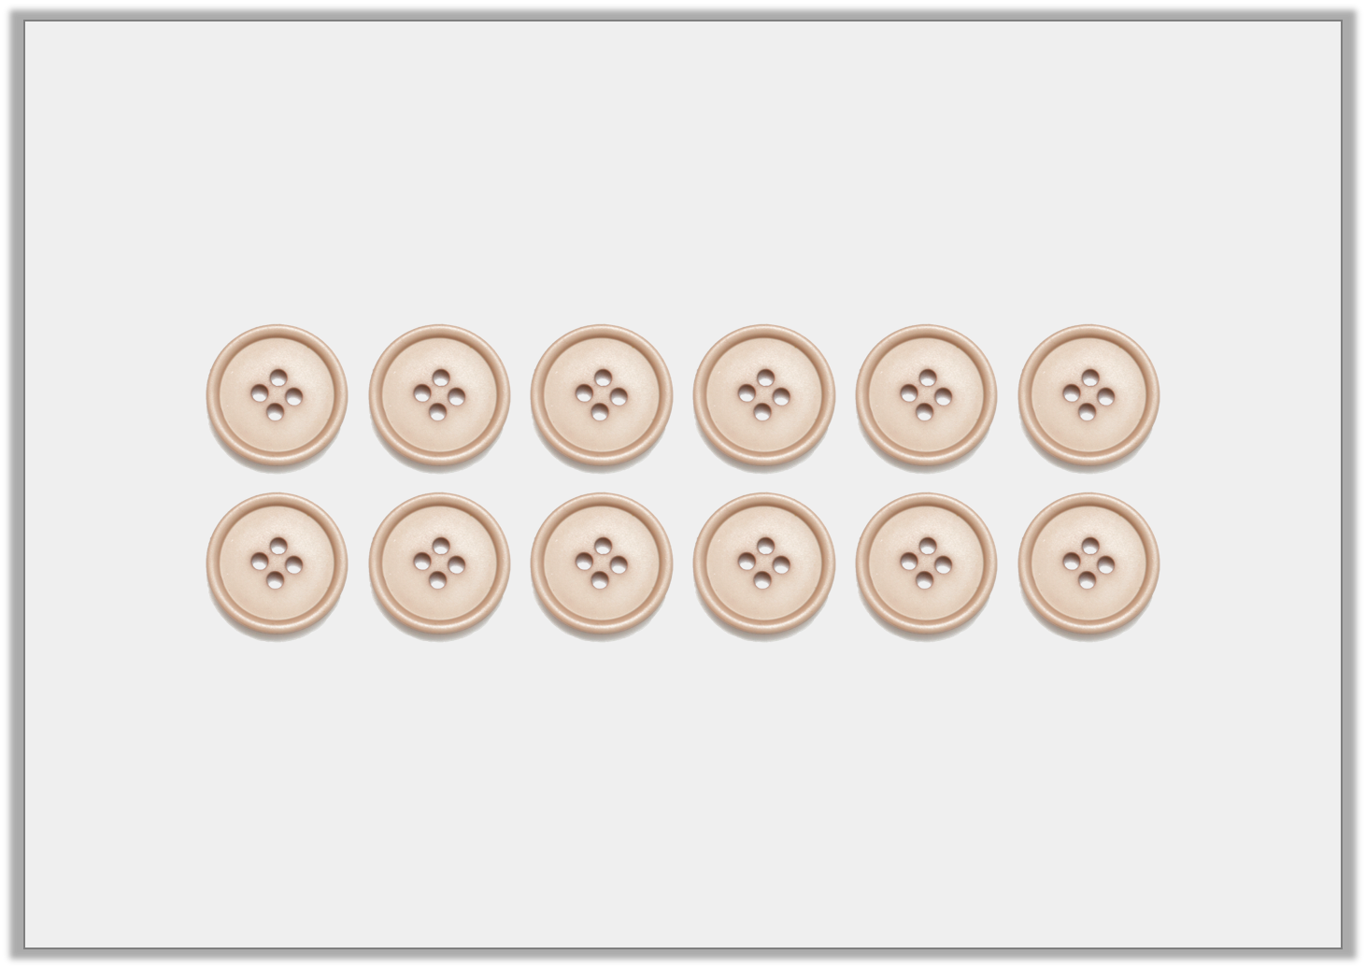
Problem Solving 1
Complete the array.
© Classroom Secrets Limited 2019

Slide 18
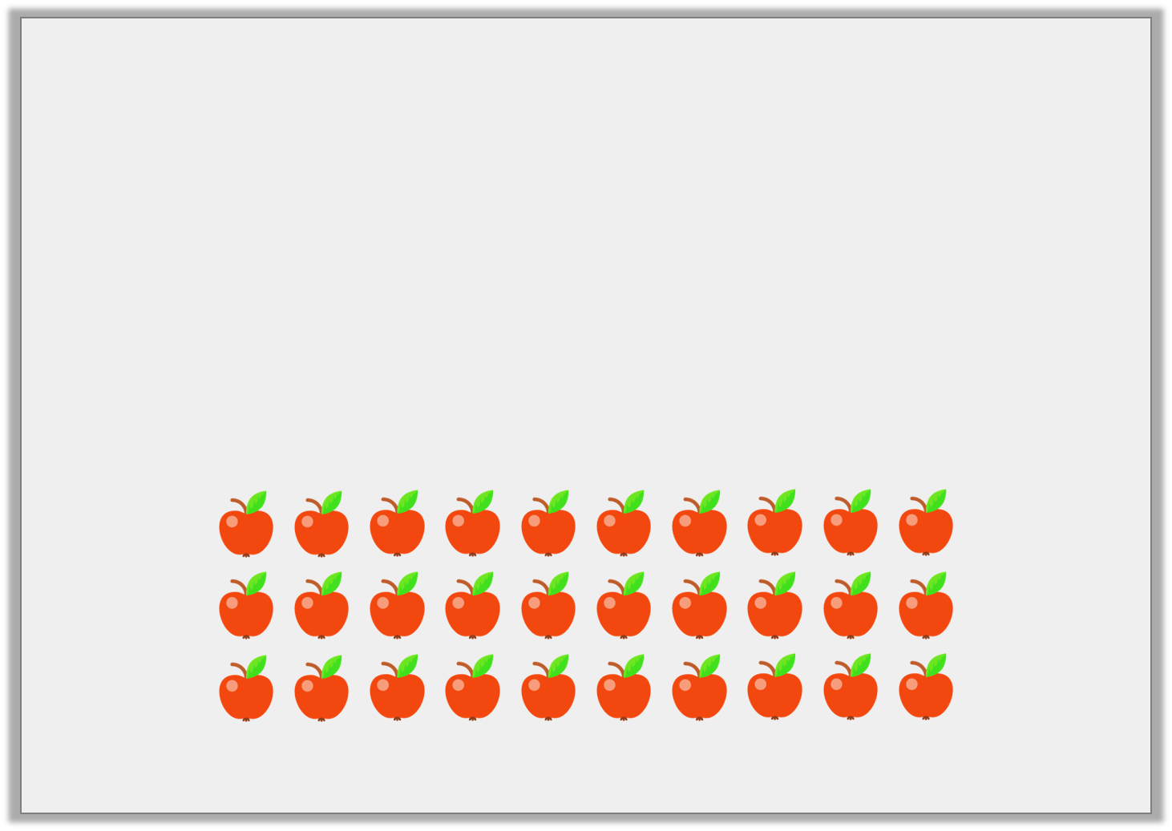
Reasoning 2
Which is the odd one out? Why?
10 + 10 = 20 | There are 10 apples in each row. There are 2 rows.
© Classroom Secrets Limited 2019

Slide 19
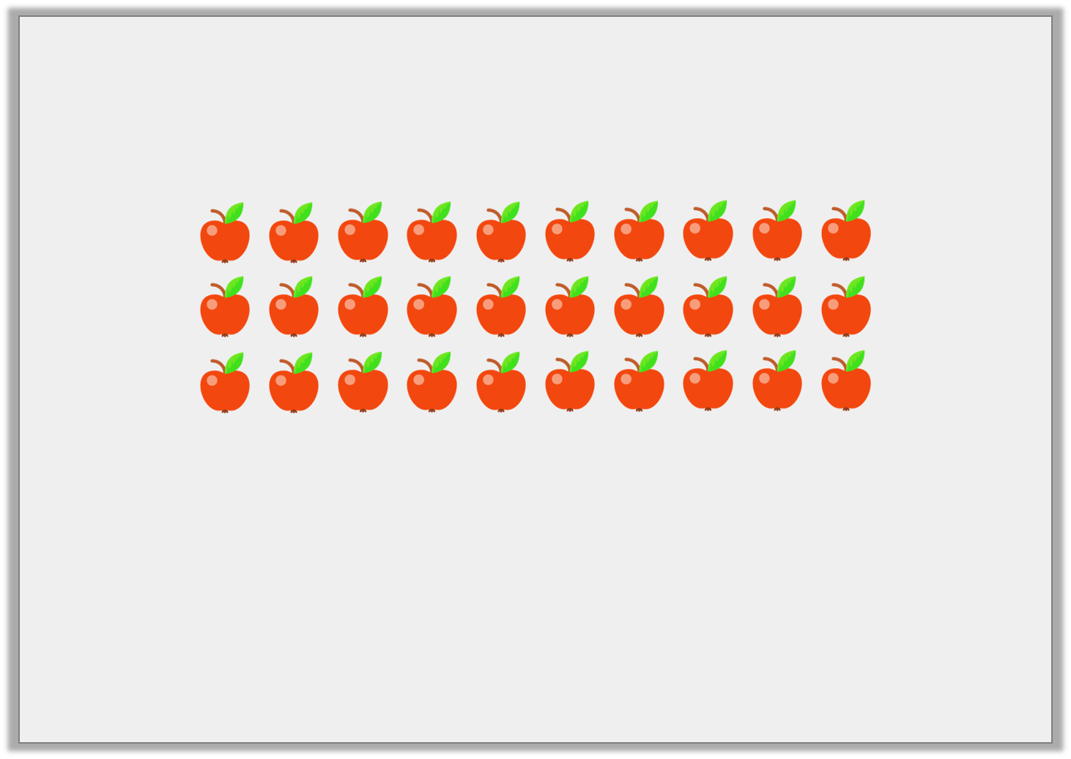
Reasoning 2
Which is the odd one out? Why?
The array is the odd one out as it shows
3 rows of 10 apples.
© Classroom Secrets Limited 2019

