Slide 1

Right angles and compasses
By Mr Beraet

Slide 2

Starting simple… The 4 compass points
orth
est
ast
outh

Slide 3
Starting simple… The 4 compass points
aughty
How can you remember their order?
There are many more, such as: Never Eat Shredded Wheat
ater
lephants
Can you come up with your own?
quirt

Slide 4
Where do right angles fit in?
Can you see any?
N
Here!
Here!
W
E
Here!
Here!
S

Slide 5
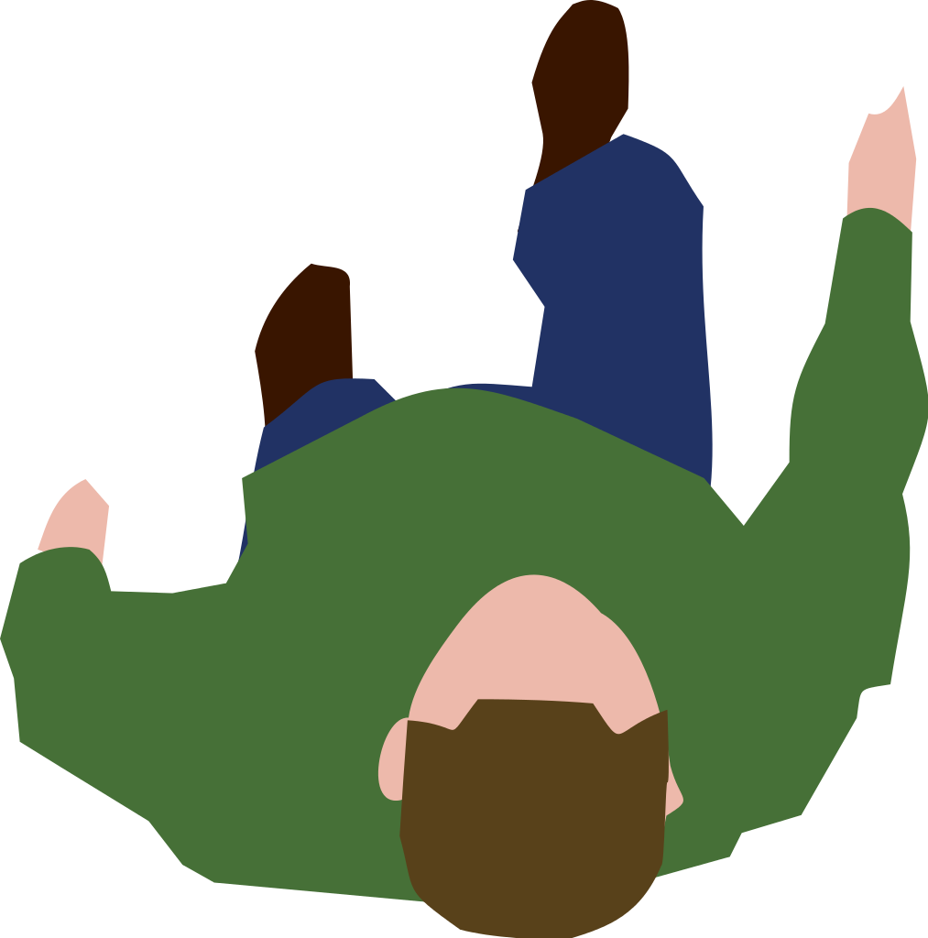
How does it work?
Imagine you start facing north.
N
Clockwise
1 right angle
You turn through one right angle clockwise (the way the hands go on a clock).
W
E
You are now facing… East!
S

Slide 6


Top tips
N
W
If you need to answer questions, sketch a quick compass grid. It could be on a scrap bit of paper.
E
N
S
W
Use a pencil as a pointer. Start facing the instructed direction and physically turn it through the right angles!
E
S

Slide 7
Questions:
Q1: What direction will I end up facing if I start facing…
North and turn one right angle clockwise?
North and turn three right angles clockwise?
East and turn one right angle anti-clockwise?
South and turn two right angles clockwise?
West and turn three right angles anti-clockwise?
East and turn one right angle clockwise?
South and turn five right angles anti-clockwise?

Slide 8
Questions:
Q2: How many right angles have I gone through if I started facing…
North, turned clockwise and am now facing East?
South, turned clockwise and am now facing East?
West, turned anti-clockwise and am now facing South?
East, turned anti-clockwise and am now facing West?
South, turned anti-clockwise and am now facing East?
South, turned anti-clockwise and am now facing West?

