Slide 1




Slide 2
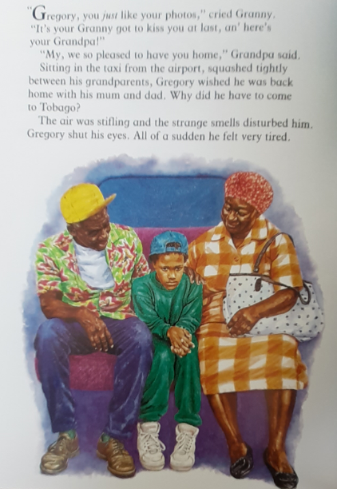
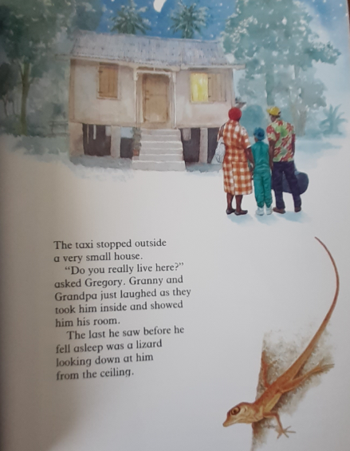

Slide 3
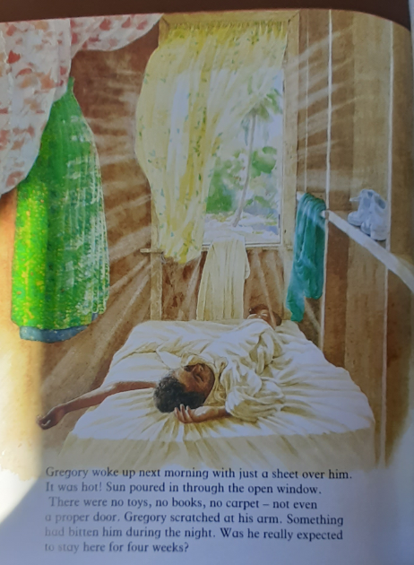
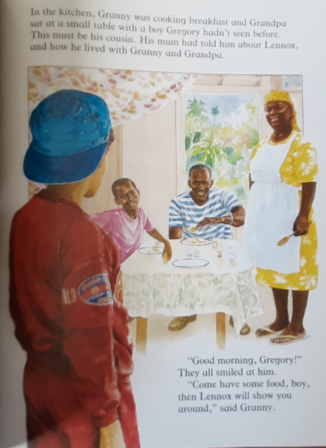

Slide 4
Q1: Where has Gregory gone?
Q2: How did he get there?
Q3: What disturbed Gregory during the taxi ride?
Q4: Which word or phrase tells us that Gregory is not impressed with Granny and Grandpa’s house?
Q5: What was the last thing he saw before he fell asleep?
Q6: List 4 ways that this room is different to his bedroom back home.
Q7: What happened during the night?
Q8: How long is Gregory staying with his granny and Grandpa?
Q9: Is Gregory looking forward to staying here? How do you know?
Q10: Who is the boy at the breakfast table?

