Slide 2

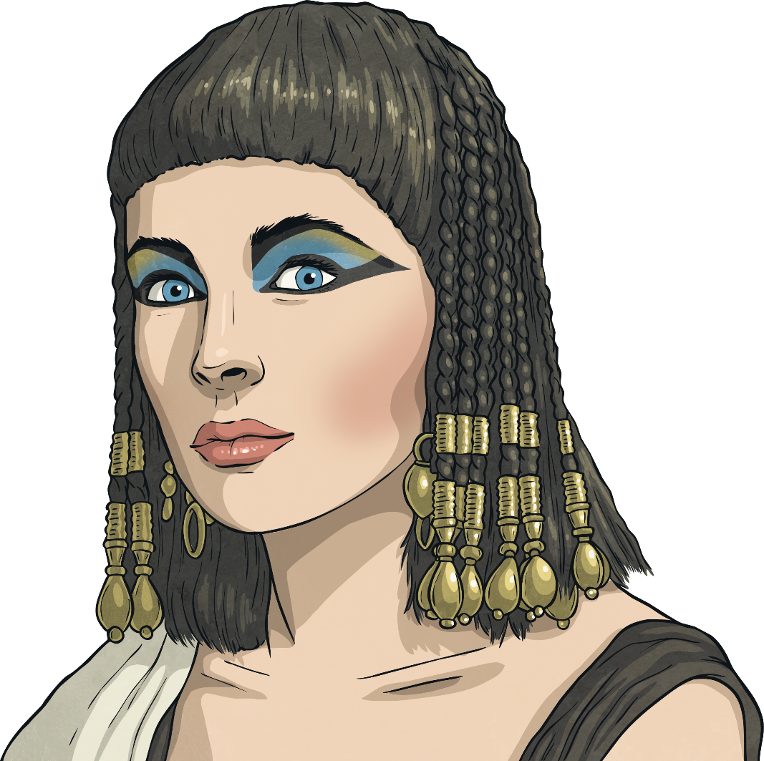
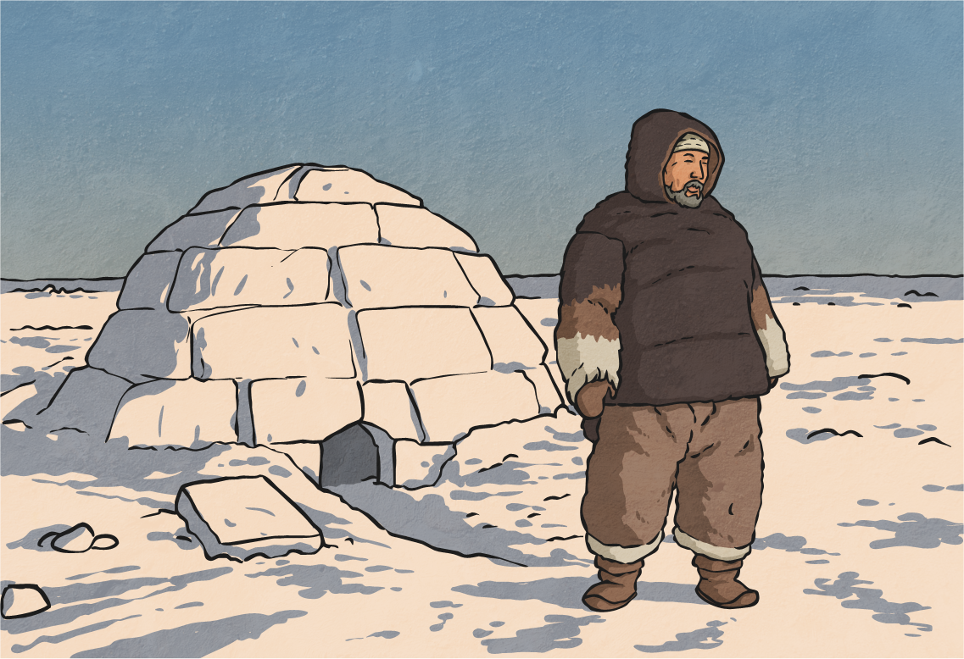

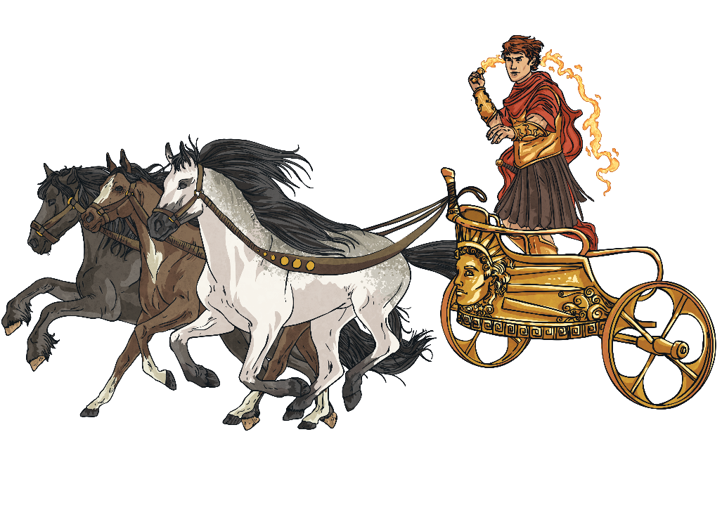
Day and Night
Before we had the knowledge we now possess, different cultures explained how day and night occurred in lots of different ways.
Helios was an ancient Greek god. The ancient Greeks believed that Helios pulled the sun across the sky each day in a chariot.
The ancient Egyptians believed that the sun god, Ra, travelled across the land each day. At the end of each day, Ra died and this caused darkness. At the start of each new day, Ra was reborn.
The Inuit people told stories about the sun goddess, Malina, and her brother, Anningan, the moon god. Night and day were a result of arguments between the siblings.

Slide 3
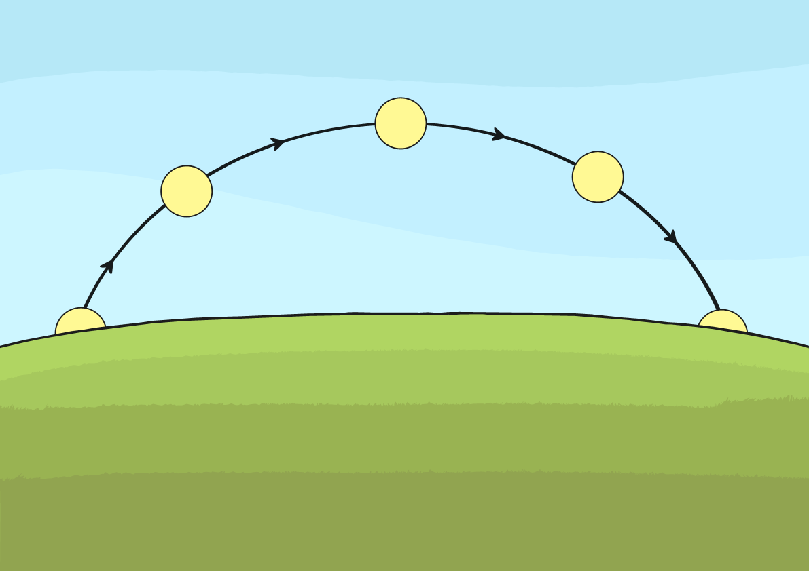
Does the Sun Move?
Have you noticed how shadows change throughout the day?
Why do you think this is? Talk about it with a partner.
The Sun stays in the same place in relation to the Earth. It appears to move because of the movements of Earth as it orbits the Sun.
In the morning and late afternoon, shadows are longer. They are shortest at midday as this is when the sun appears to be highest in the sky. This idea of the sun appearing to move during the day is where the traditional stories explaining day and night came from.

Slide 4
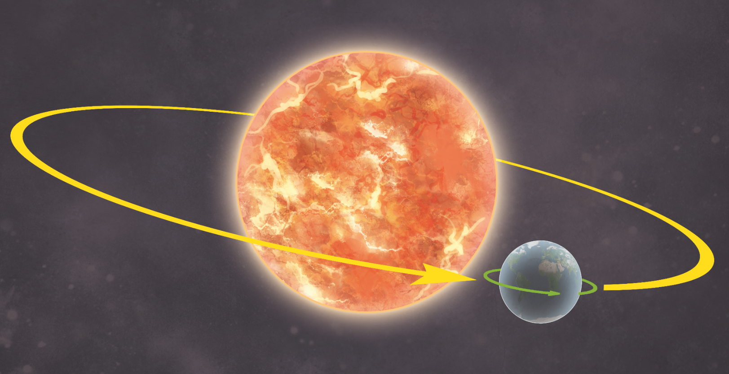
How Does Earth Move?
Earth moves in two ways.
It revolves (orbits) the Sun. One revolution takes just over 365 days.
It rotates (spins) round once every 24 hours.

Slide 5

How Does Earth Move?
The revolution of Earth (once every 365 days) causes the seasons.
The rotation of Earth (once every 24 hours) causes night and day.

Slide 6


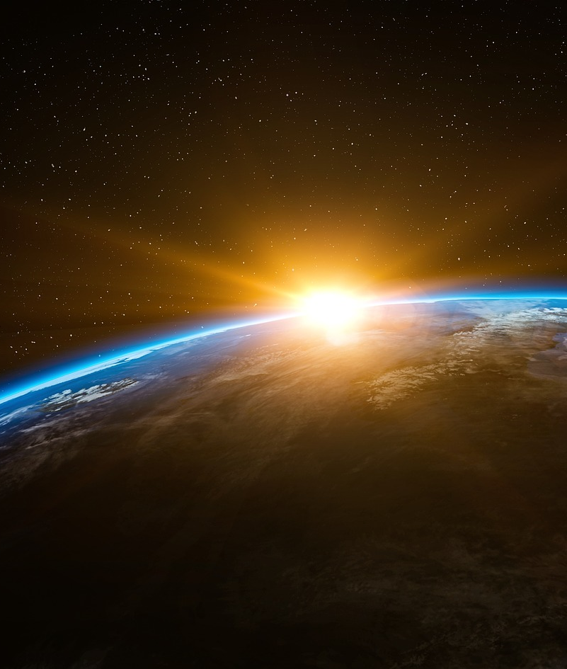
Day and Night
Earth rotates on its axis. This is an imaginary line that runs from the North Pole to the South Pole.
Imagine you are spinning a basketball on your finger. Your finger is where the axis is and the basketball is Earth spinning.
1 spin = 1 rotation = 24 hours = 1 day

Slide 7

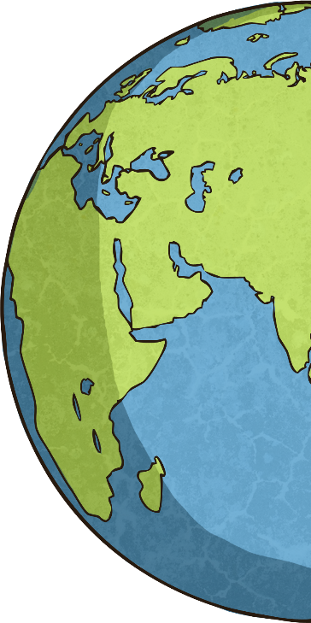
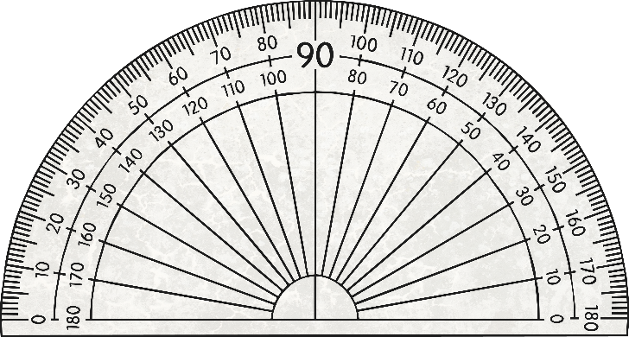
Day and Night
Have you ever noticed that a globe is slightly tilted?
This is because Earth itself is slightly tilted on its axis. Currently, this tilt is 23.5°. However, this can change over thousands of years.

Slide 8

Day and Night
Earth is a sphere*. Because of this, half of Earth will always be facing towards the Sun and half of it will always be facing away.
The half of Earth that is facing towards the Sun has light (daytime). The half of Earth facing away from the Sun has darkness (night time).
Actually, Earth is an a oblate spheroid which is a spherical shape with a bulge around the middle and a slightly flatter bit at the top
and bottom.

Slide 9


Time Zones
The rotation of Earth creates different time zones across the world.
When it is 9 a.m. in the UK, it is 6 p.m. in Sydney, Australia
and 1 a.m. in Los Angeles, United States.

