Slide 1
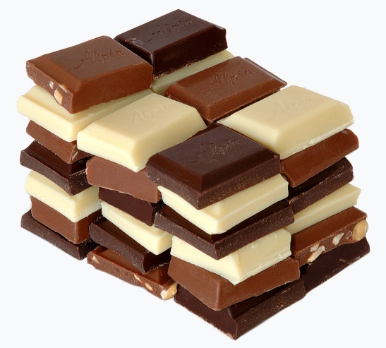
So far, we have learned about the geography and history linked with chocolate. Today, we think of chocolate as tasty, delicious and good.
There is, however, a sinister past that needs to be explored.

Slide 2
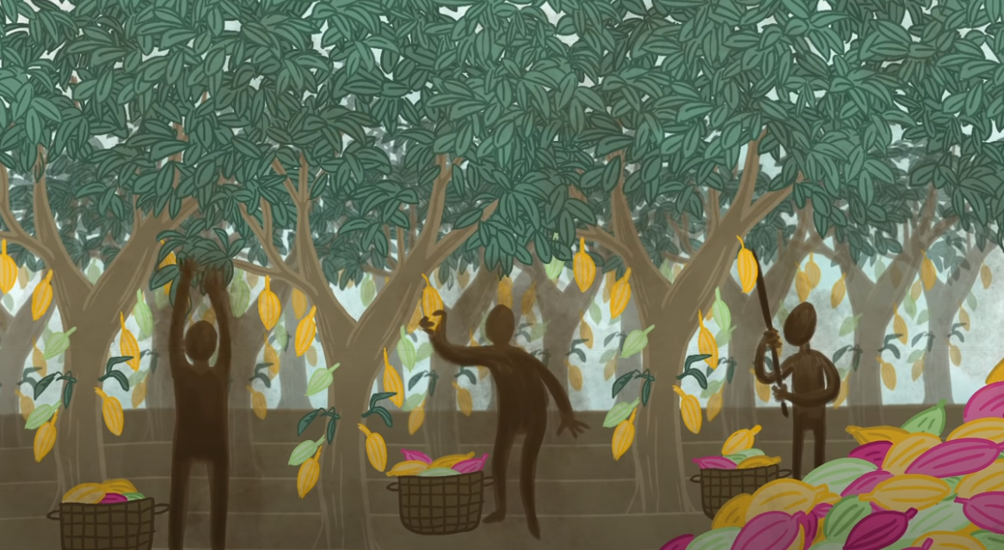
A brief back story…
Last week, you looked at how chocolate is taken from the cacao bean. This was quite hard work (especially hundreds of years ago when there were no machines to do it). The plantation owners needed lots of people to do the work for them, but to make even more money, they didn’t want to pay them.

Slide 3
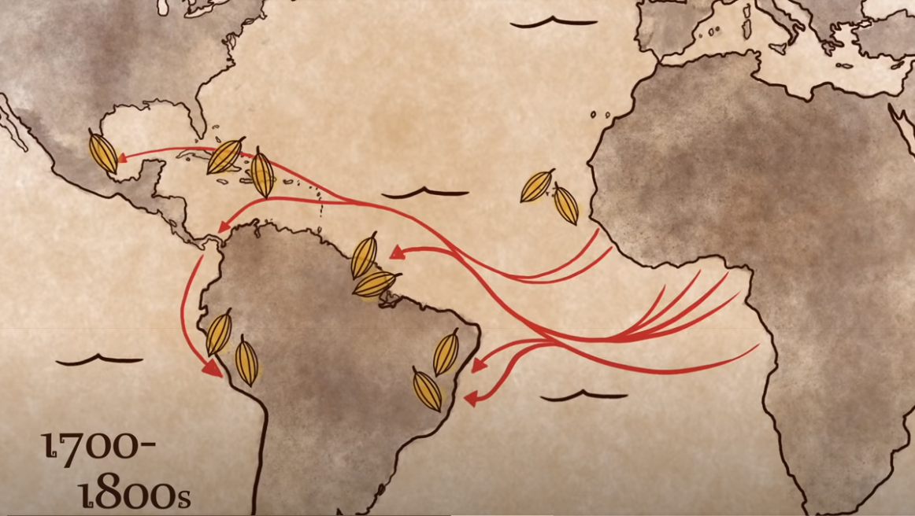
Slavery
The image of the cacao bean shows where they were being grown between 1700 and 1800. The red arrows show the forced movement of people (slaves) to work on these cacao plantations.

Slide 4
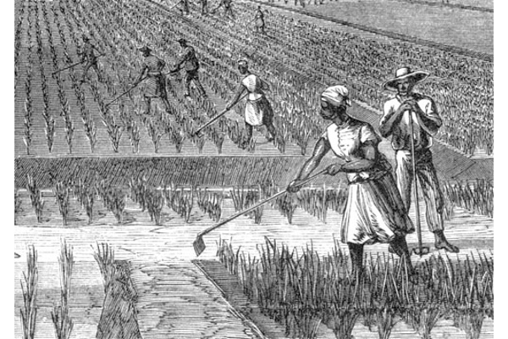
Plantations
Plantations were large estates where one particular crop was grown in large amounts. As well as cacao, there were plantations for other crops such as sugar, tobacco and coffee.
Life on a plantation was extremely tough.
Check out one of these websites to find out more!
http://www.understandingslavery.com/index.php-option=com_content&view=article&id=309_plantation-life&catid=125_themes&Itemid=221.html
https://www.youtube.com/watch?v=UYqllZ3kdrc

Slide 5
Europe’s role in slavery
Unfortunately, Britain and other European countries such as Spain, Portugal and the Netherlands are mostly responsible for the slave trade. Ships would sail to Africa, where they would collect people and take them thousands of miles away to work in horrid conditions for others. Families could be split up.
Try and imagine if someone came to your house, took you and put you in chains, then sent you far away never to see your family or home again. How would you feel?
Lots of people in our country were able to become rich from selling slaves. They made money from the misery of others.
A statue of one of these men made the news recently:
https://www.bbc.co.uk/news/uk-england-bristol-52962356

Slide 6
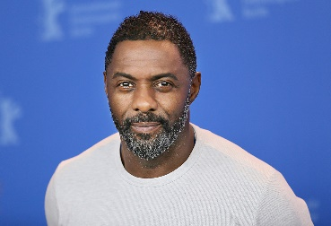

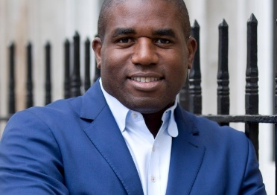
What is being done today?
Today, there is a real awareness of the ‘Black Lives Matter’ movement and a sense that some of the great injustices of the past, that still exist in today’s world, need to be put right.
Many people have spoken out about the need to ensure that all people, regardless of skin colour, are given the same rights and opportunities. Famous figures such as Martin Luther King, Rosa Parks, Malcolm X and Nelson Mandela have brought this issue to global attention.
There are many role models out there in politics, the arts and sport who are showing how black and other minority groups contribute and shape our society. It is important to remember however that, through no fault of their own, the pathway can be far harder for them to achieve than it might be for others.
Idris Elba (actor and musician)
David Lammy MP
Alex Scott (footballer)

Slide 7
Optional tasks
Choose one or more of the following to complete:
Write a diary entry of a young slave being sent to work on a cacao plantation from Africa.
Write an information text about plantations.
Boris Johnson said it was a “criminal act” to remove and pull down the statue in Bristol. Do you agree? Have a discussion with someone in your house.

