Slide 1
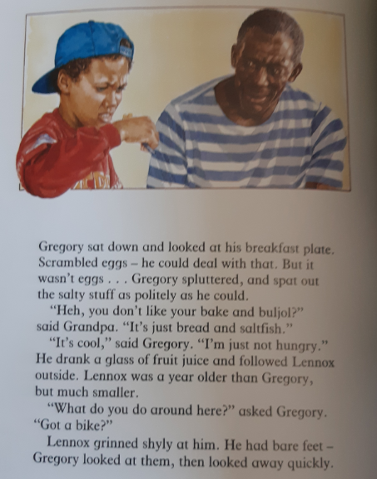
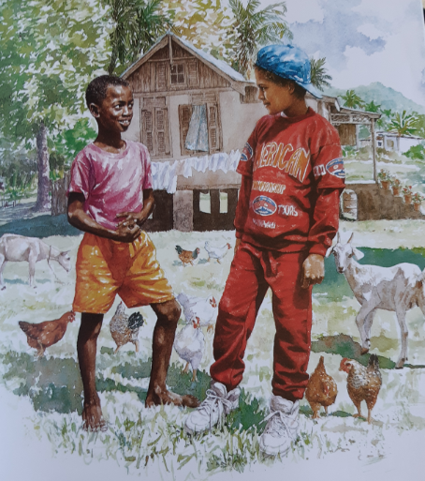

Gregory arrived at Tobago to see his grandparents. He has just woken up and sat down for breakfast.

Slide 2
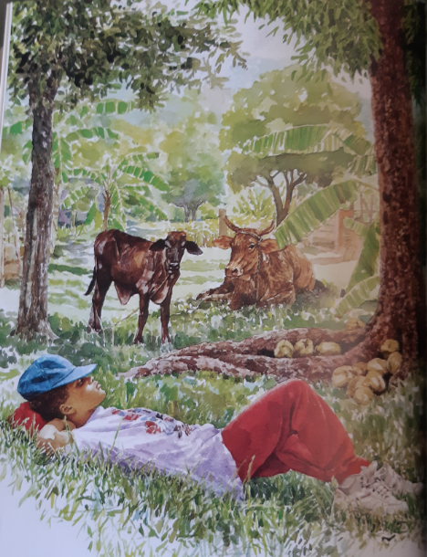
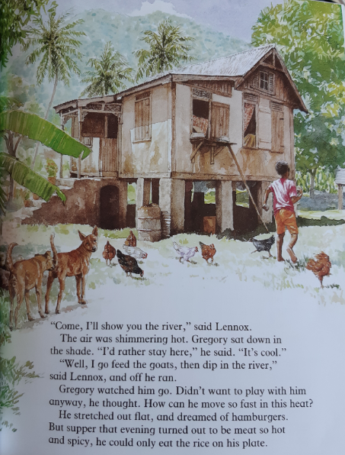

Slide 3
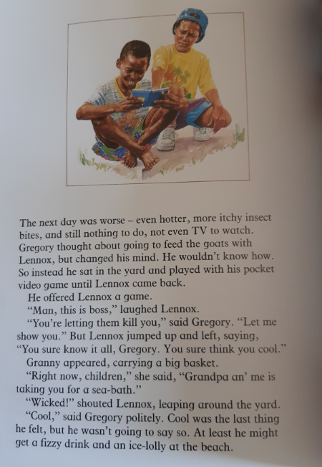
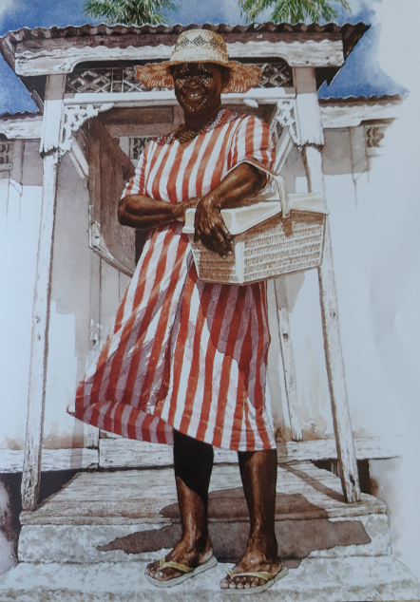

Slide 4
Q1: What did Gregory think he was having for breakfast?
Q2: What did he actually have?
Q3: Why do you think Gregory says that, ‘I’m just not hungry’?
Q4: After Gregory noticed Lennox had bare feet, he ‘looked away quickly’. Why do you think he did this?
Q5: Where did Lennox go when he left Gregory?
Q6: Why do you think Gregory is dreaming of ‘hamburgers’?
Q7: List THREE reasons why the ‘next day was worse’.
Q8: Why doesn’t Gregory go with Lennox to feed the goats?
Q9: What has upset Lennox?
Q10: Where is Granny taking them?

