Slide 1
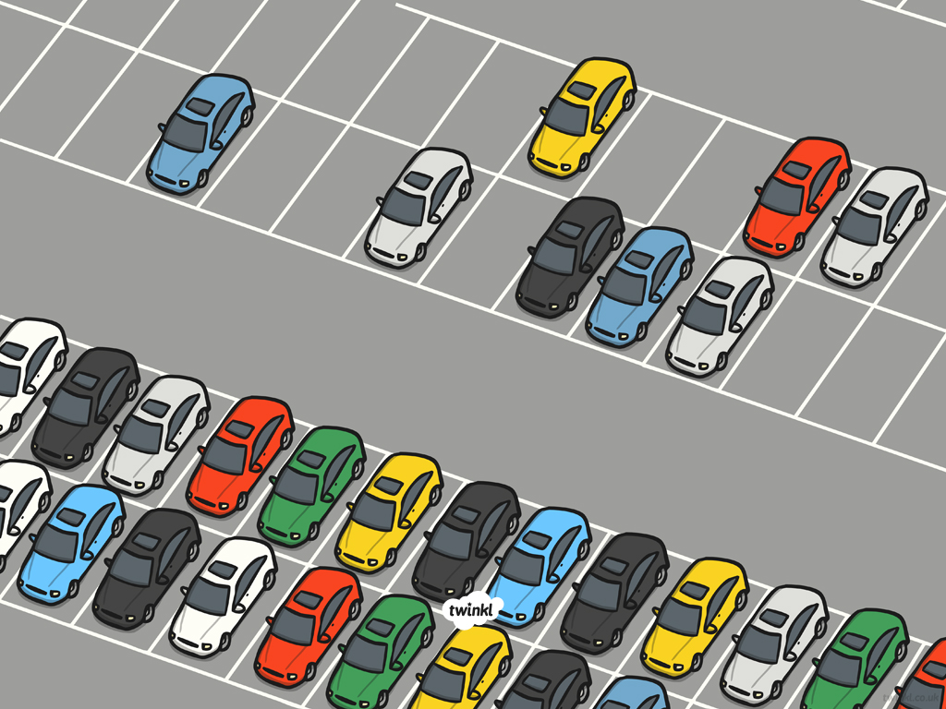
Arrays

Slide 2
Aim
To make arrays.
Success Criteria
I can group objects in twos, fives and tens.
I can make an array from a context.
I can make a context from an array.

Slide 3



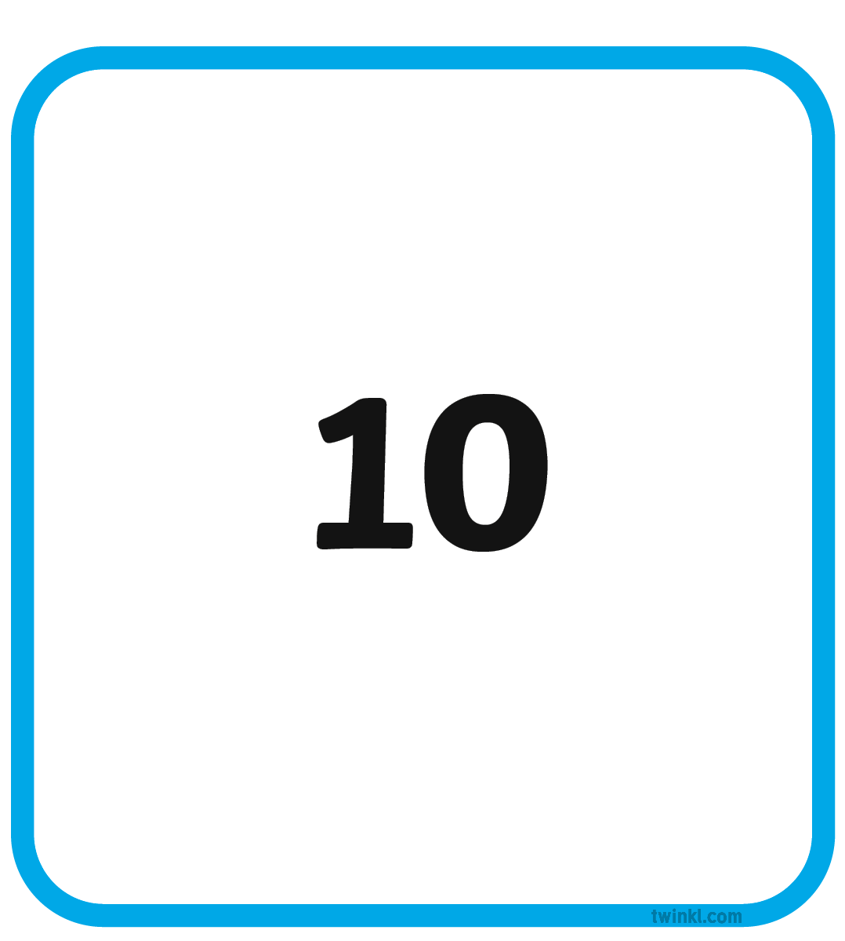
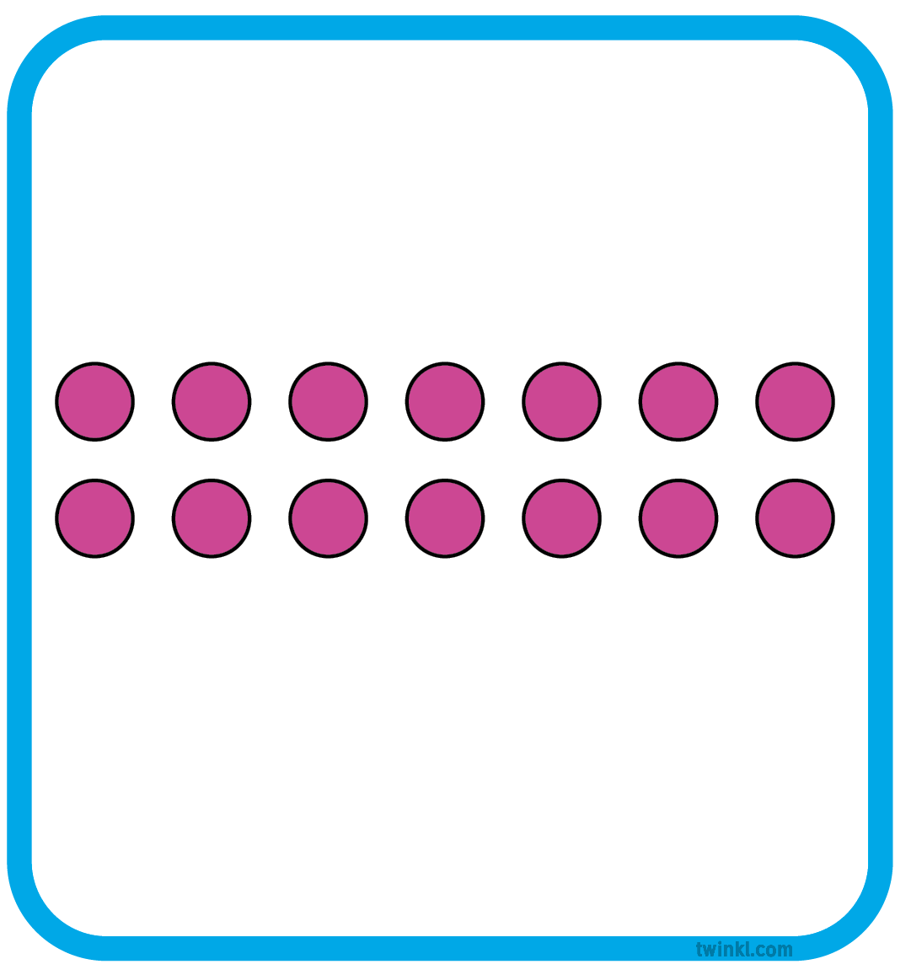
Match It
Can you find someone whose card shows the same number representation as your card?

Slide 4











Count the Marbles!
Can you count the marbles?
Are the marbles easier to count now?
Has the number of marbles changed?
Were they difficult to count? Why?
What could we do with the marbles so we could count them faster?
Why are they easier to count?

Slide 5











Count the Marbles!
What is the same about what you can see now? What is different?

Slide 6

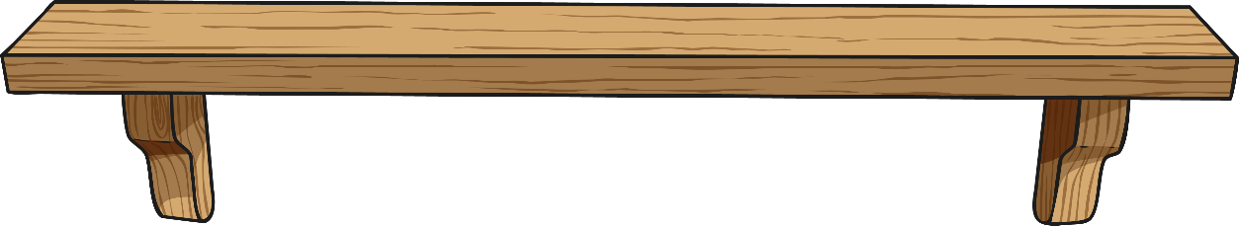
Toy Shop
How could we count the teddies?
How many shelves will we need for the teddies?
How many teddies will be on each shelf?

Slide 7


Toy Shop
How many teddies are there now?
How many shelves will we need?
How many teddies will be on each shelf?

Slide 8

Arrays
An array is an arrangement of objects in lines and columns.
It makes things very easy to count.
We can make arrays with objects or with dots.
array of objects
array of dots

Slide 9
Arrays
Let’s count the dots. We can count the dots in 2 ways.
What do you notice about the 2 ways that we can count the dots?
2 + 2 + 2 + 2 + 2 + 2 = 12 or 6 + 6 = 12

Slide 10
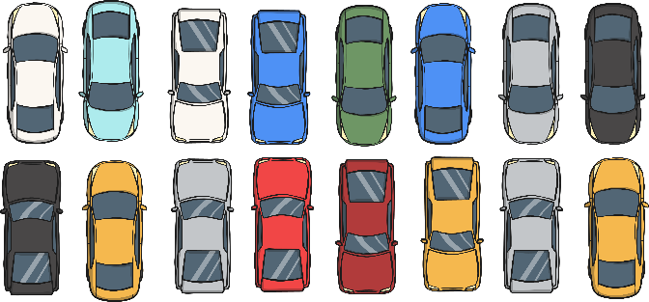
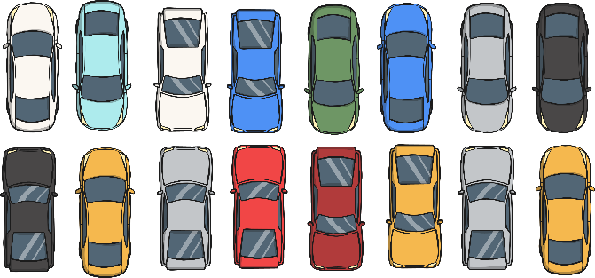
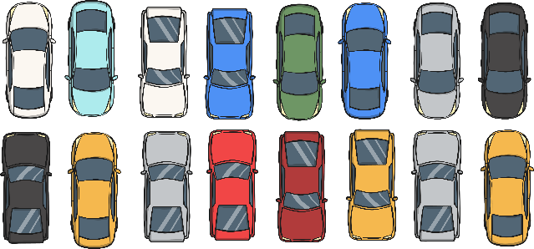

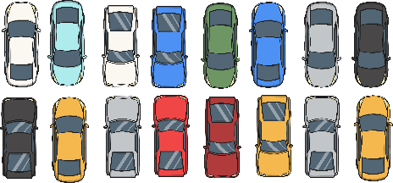
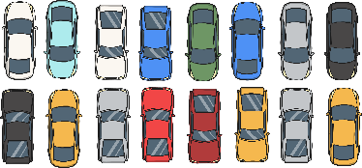
30 Cars
Mrs Hey has made an array with 30 cars.
How might she have arranged them?

Slide 11
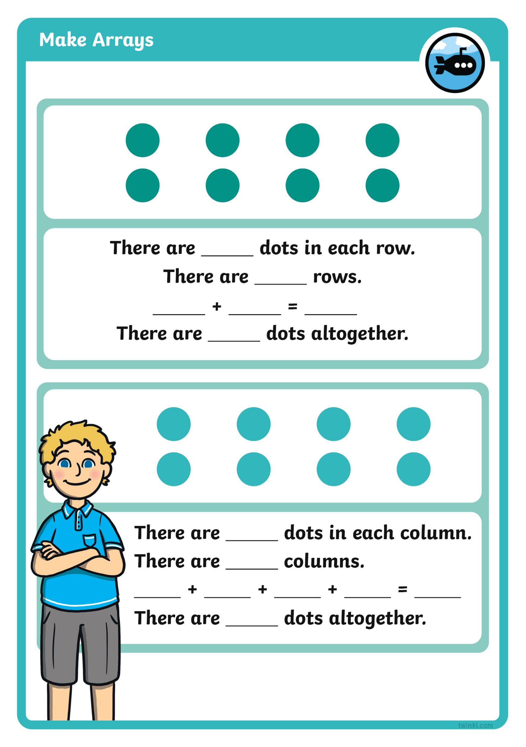
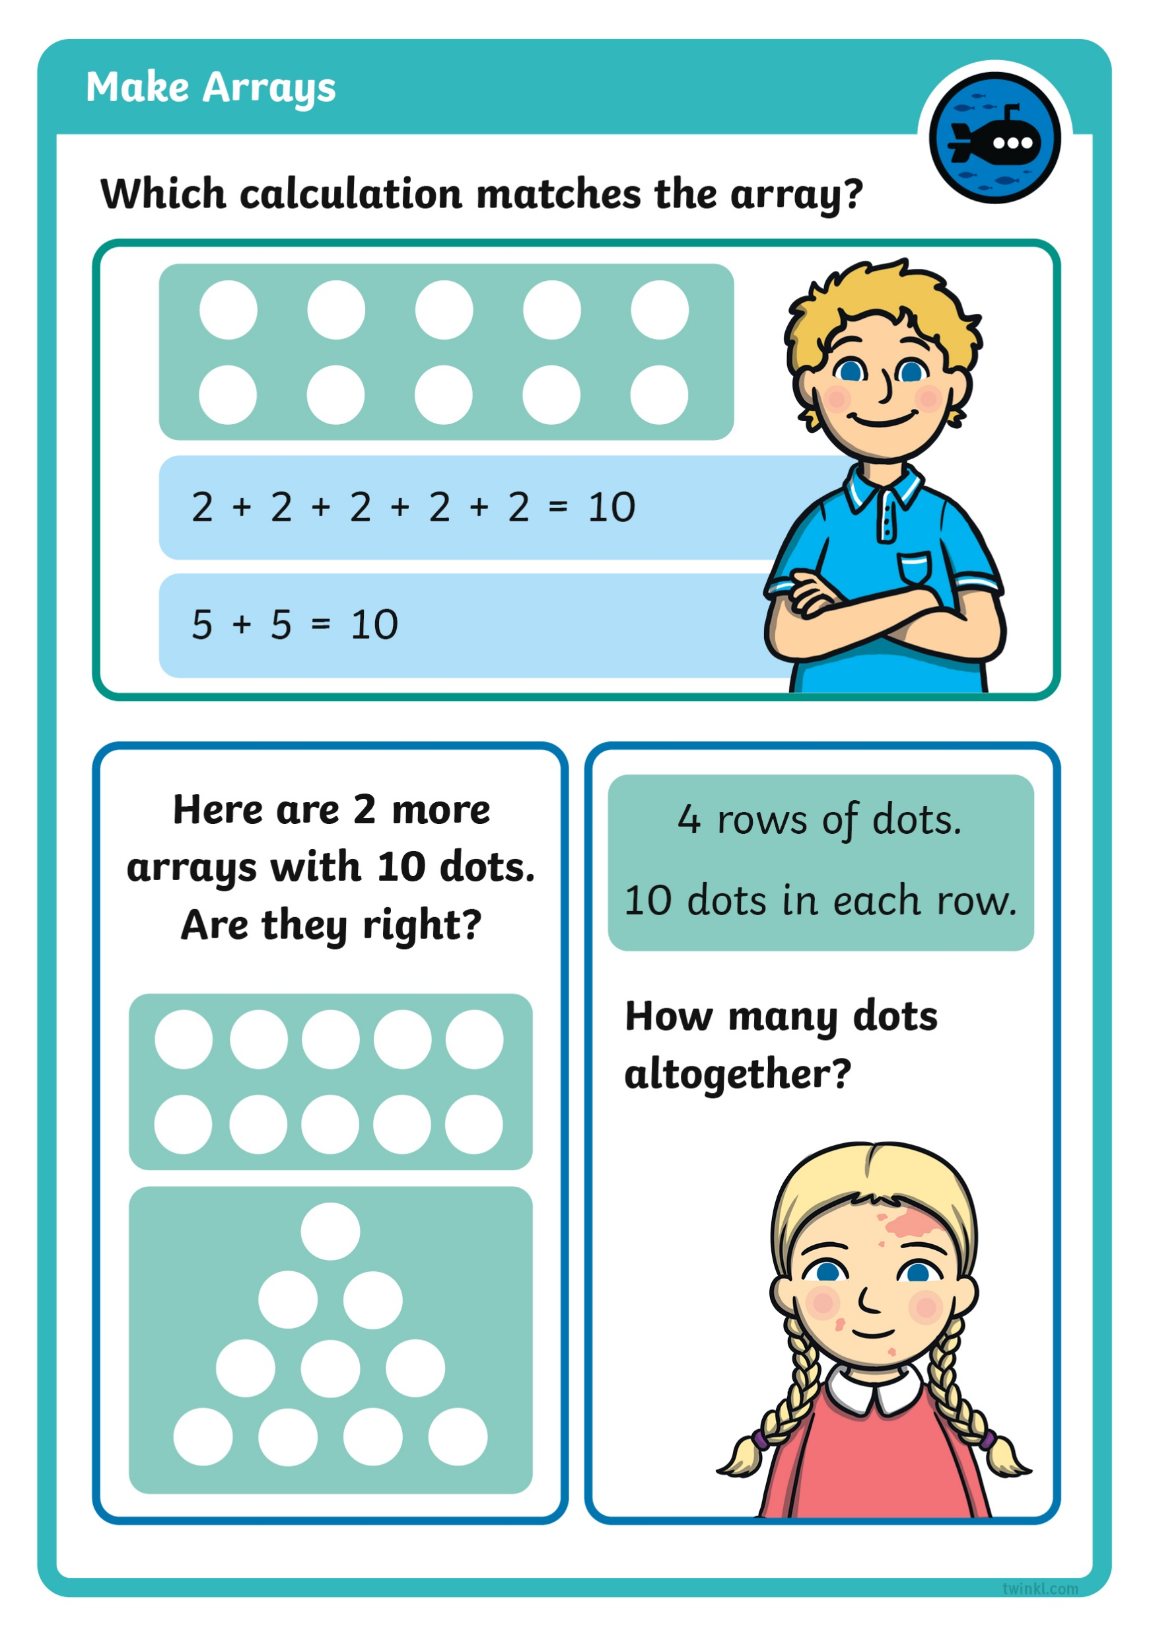

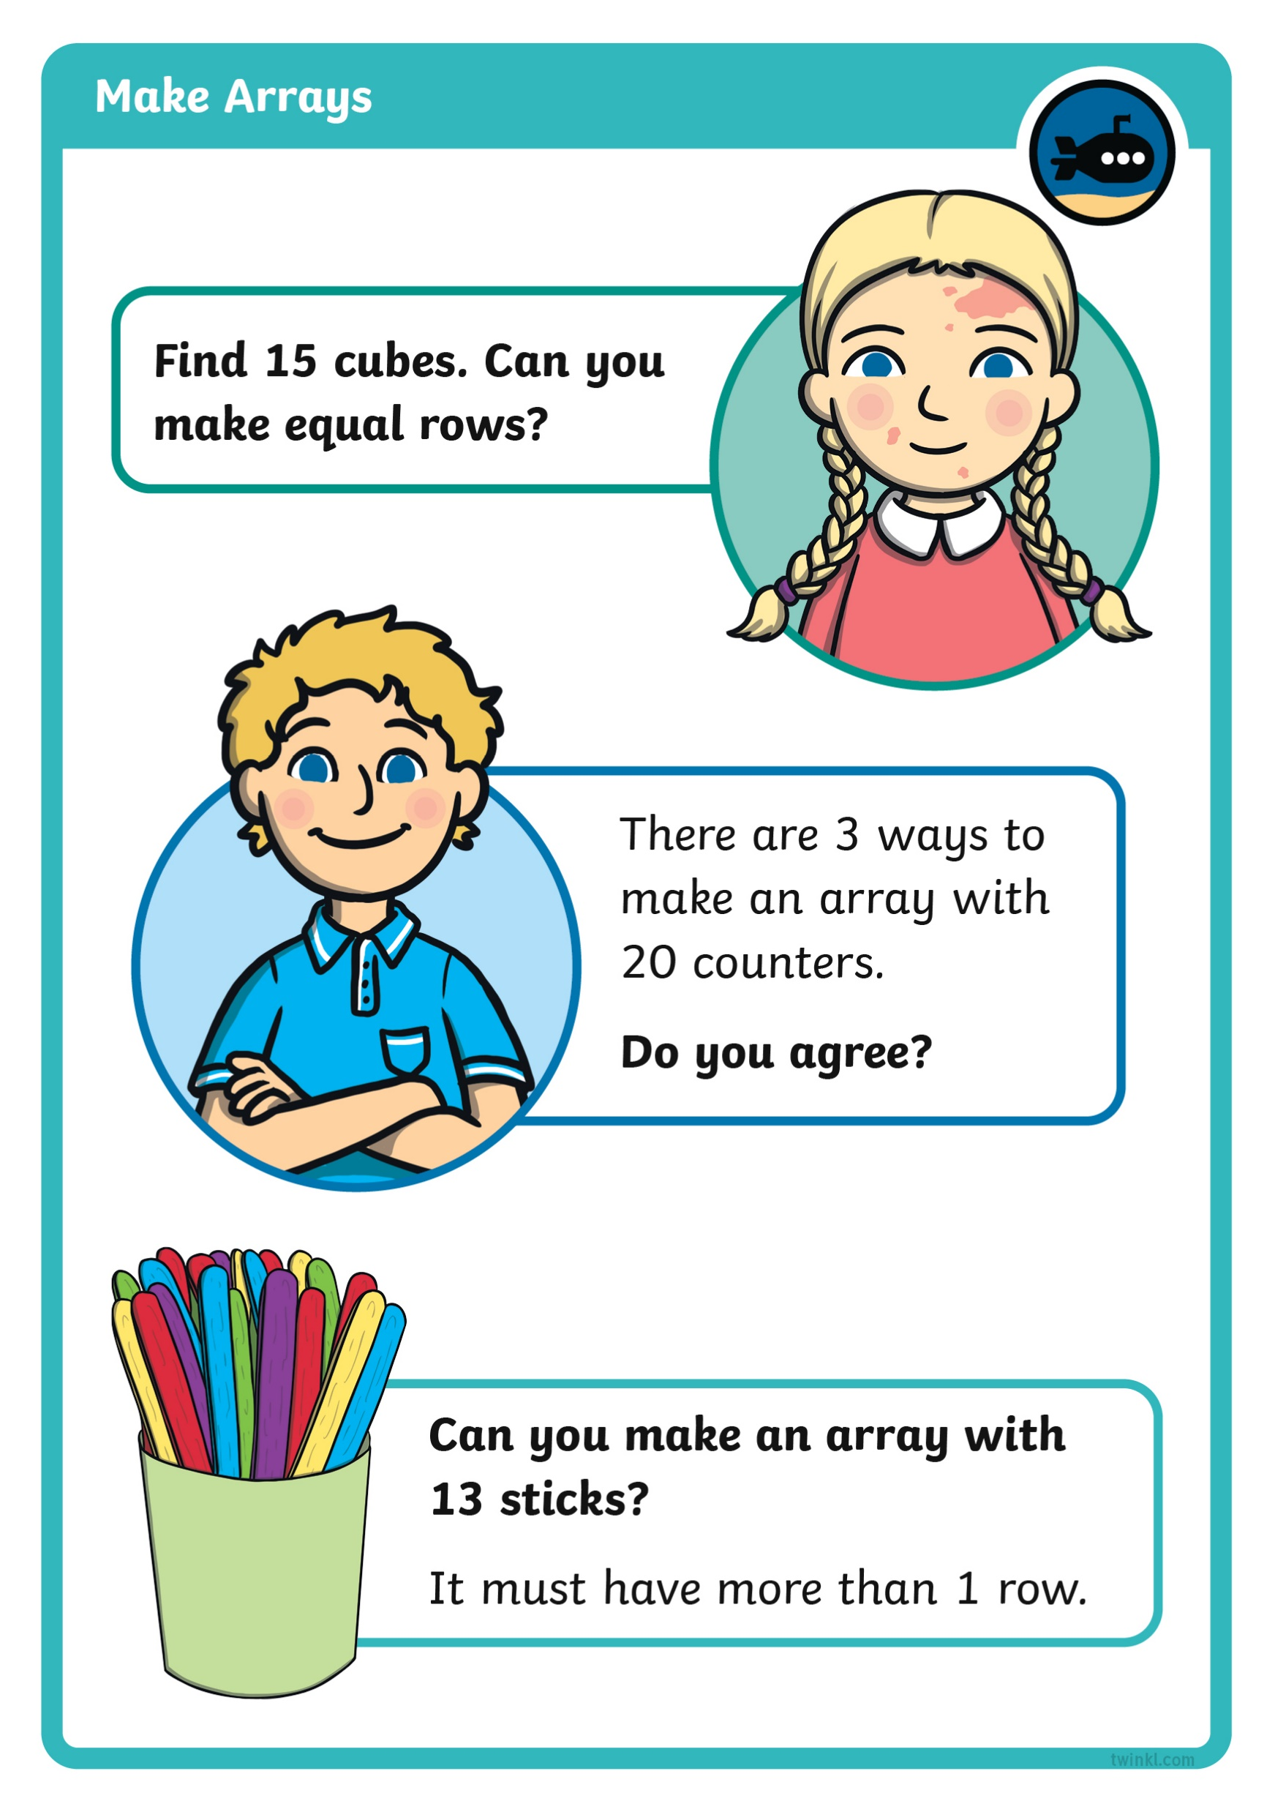
Diving into Mastery
Dive in by completing your own activity!

