Slide 1
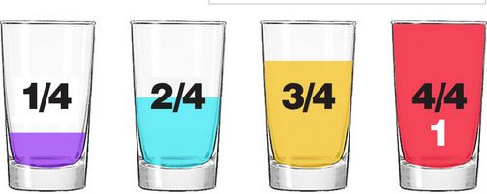
Fractions: A Quick Review
Before we cover new ground, a quick review of what we know!

Slide 2
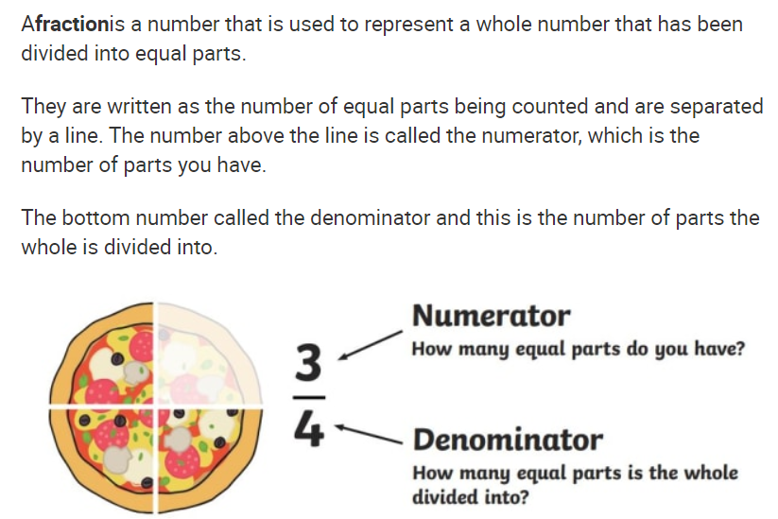
What is a fraction?

Slide 3
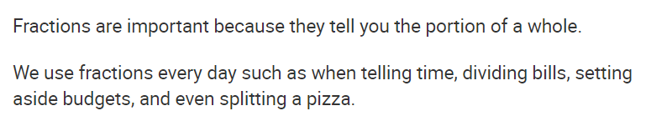
Why are fractions used?
For example…
Quarter to 7 in the morning.
She ate one third of the pizza.
Five people go out for a meal. When the bill arrives, they all agree to pay one fifth.

Slide 4
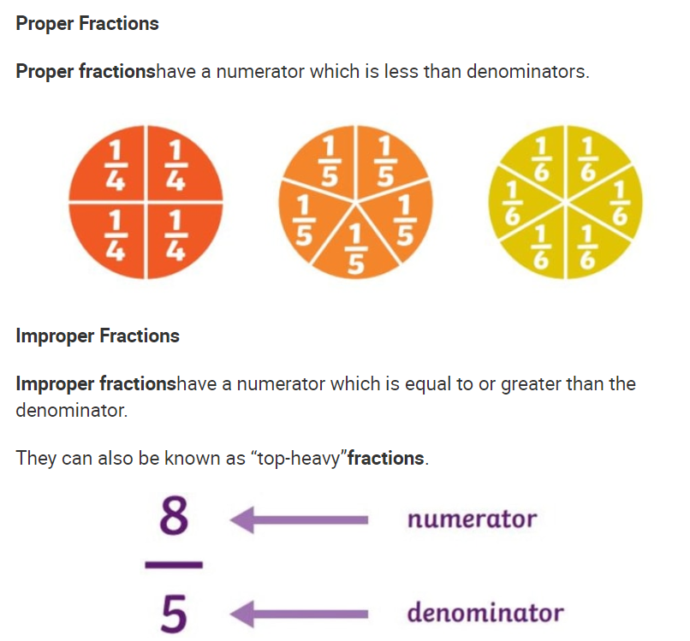
Types of fractions:

Slide 5
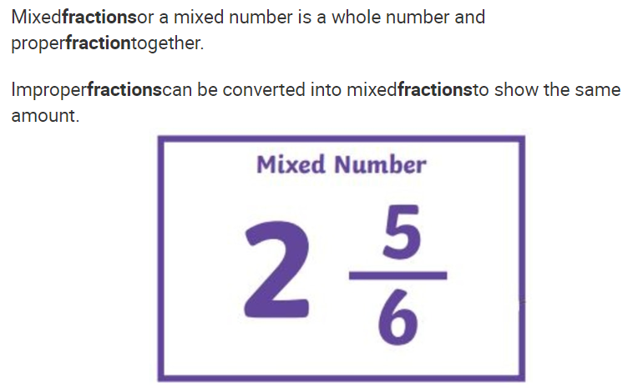
Mixed numbers:

Slide 6
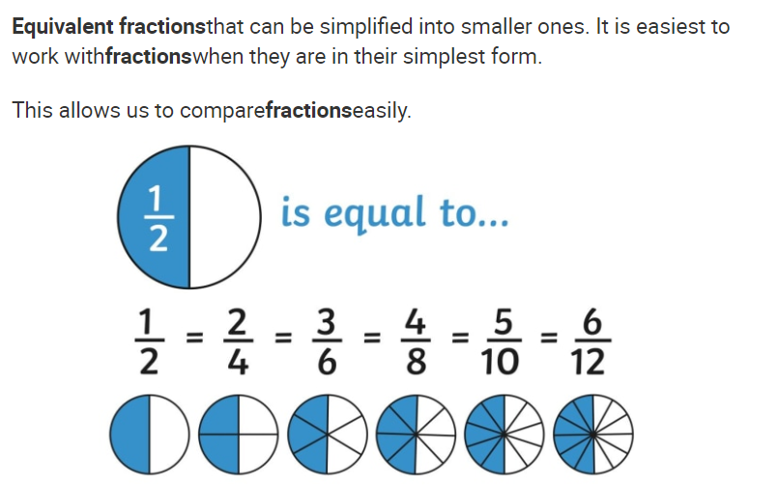
Equivalent fractions:
Remember… Look different, worth the same!

Slide 7
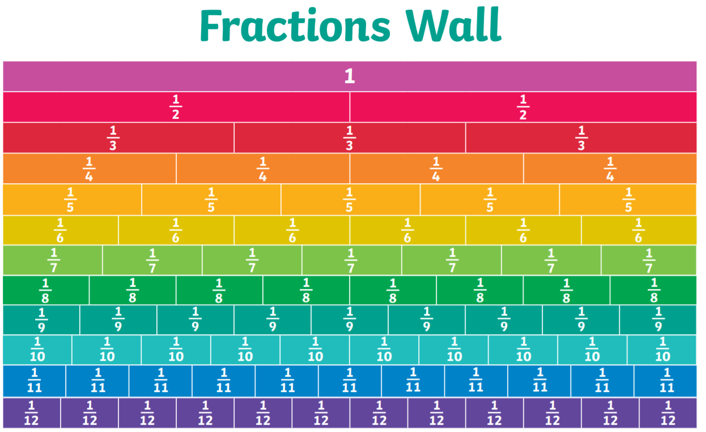
Fraction walls:
Remember… A fraction wall can be used to help us compare and order fractions, or to find equivalent fractions.

