Slide 1
Writing a character description
Monday 29th June 2020

Slide 2


IALT describe a character.
Steps to success:
Use a range of interesting sentence openers.
Use adventurous, exciting adjectives in expanded noun phrases.
Group ideas into paragraphs.
Re-read writing to check punctuation and spelling.

Slide 3
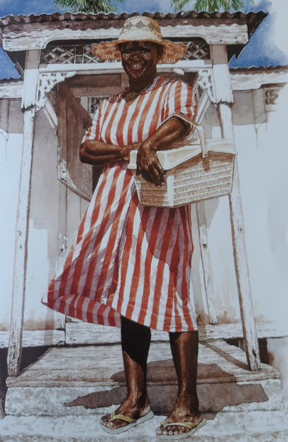
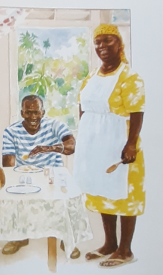
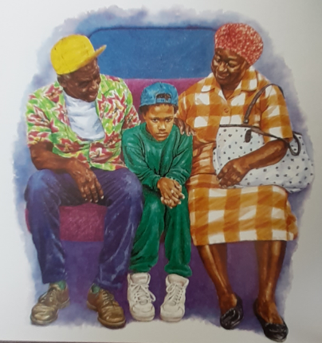
Remember this lady?
Granny!

Slide 4
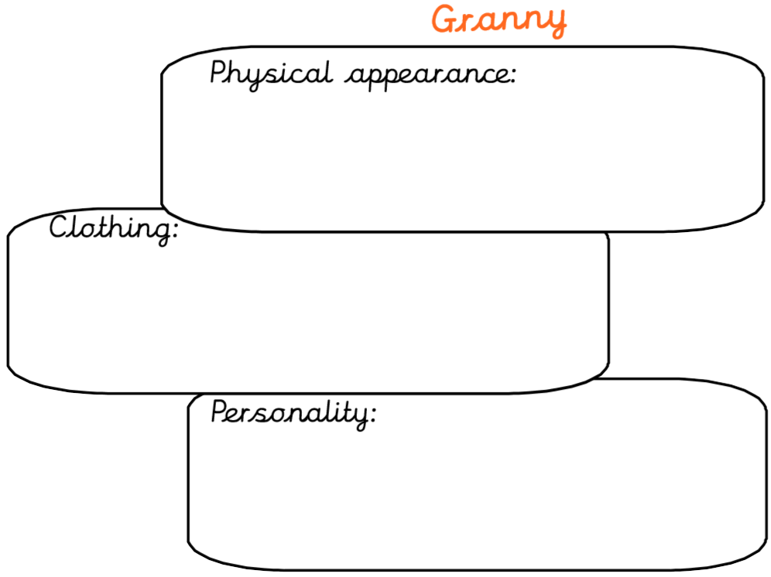
Planning…
How could we describe Granny? What might we include?

Slide 5
Helpful vocabulary:
Possible openers
Possible adjectives
On her head
Upon
Around her
In her
Covering her
Across her
On top of her
straw
broad
wide-brimmed
wicker
sparkling
mischievous
striped
bare
wrinkled
vibrant

Slide 6
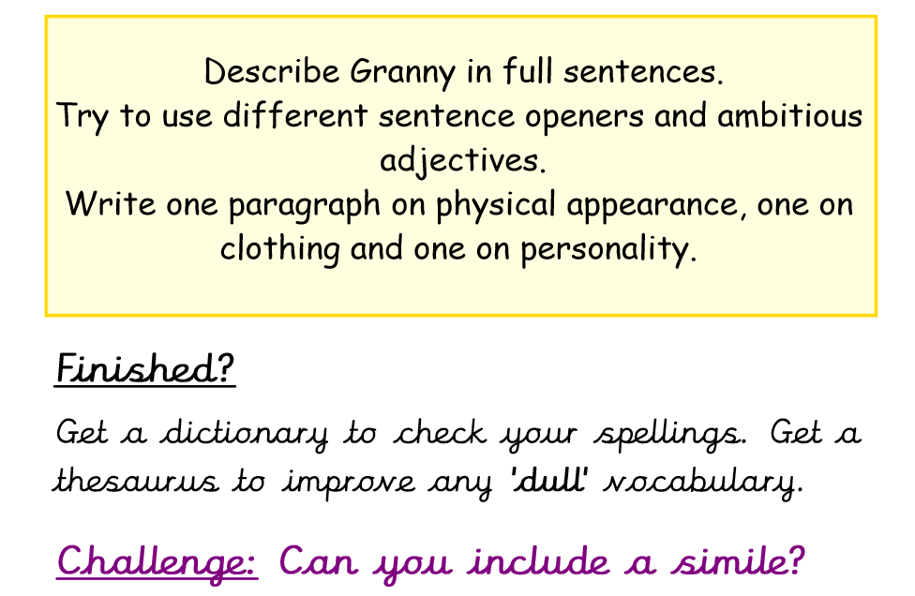
The task:

