Slide 1
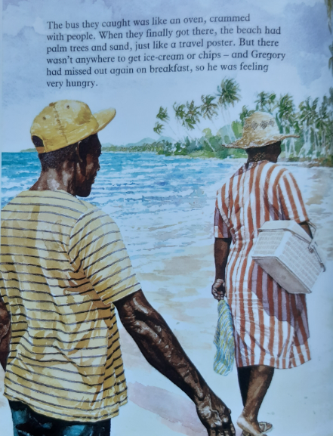
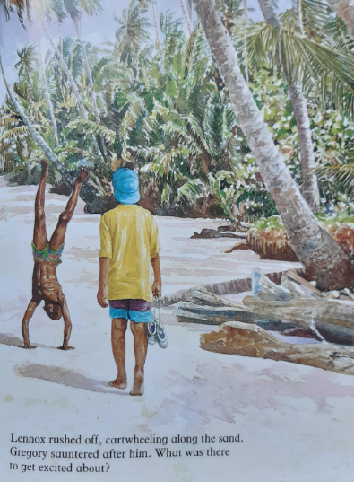

Granny has just announced that they are going to head to the beach.

Slide 2
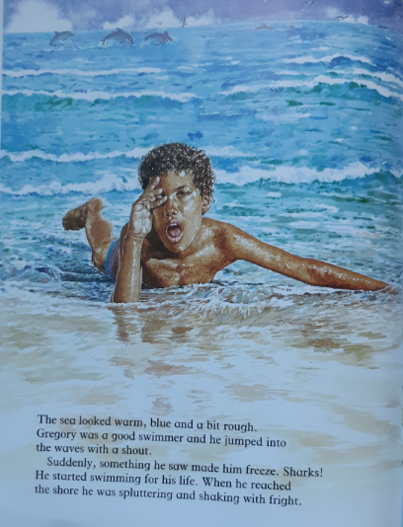
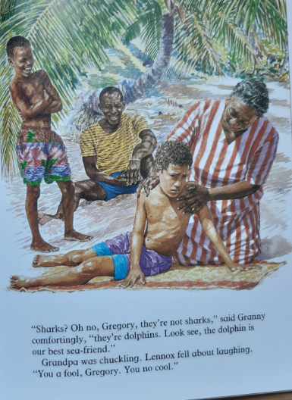

Slide 3
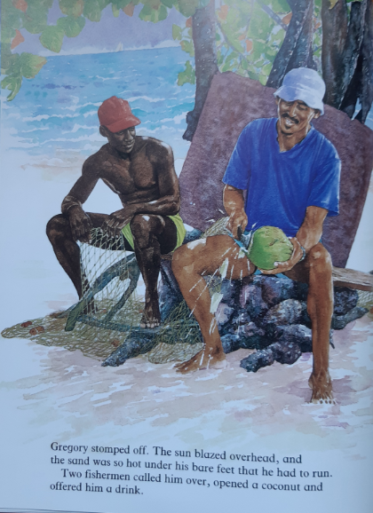
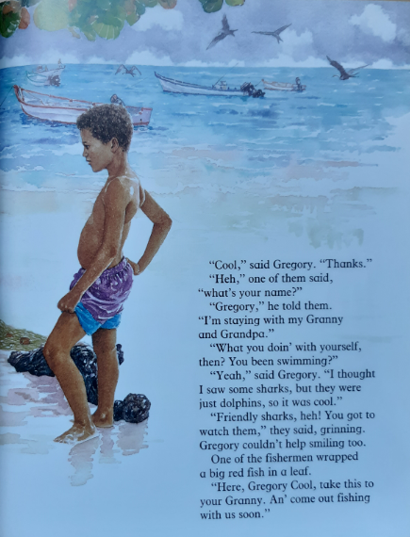

Slide 4
Q1: How did they get to the beach?
Q2: The author has used 2 similes on the first slide. List them.
Q3: What does ‘sauntered’ mean? Have a guess from the sentence it is in, then look it up in a dictionary or online.
Q4: What has made Gregory miserable?
Q5: Find 3 adjectives the author has used to describe the sea.
Q6: What did Gregory think he saw in the sea? What were they really?
Q7: Why did Gregory ‘stomp’ off?
Q8: Why did Gregory have to run?
Q9: How did Gregory get the name ‘Gregory Cool’?
Q10: List 3 kind things the fishermen did for Gregory.

