Slide 1
Standard and non-standard English
Lots of people around the world speak English as their first language, but that does not means it is always spoken the same.
Even in England, there are so many regional differences to how we speak not just in our accents, but also in the words and phrases that we use.
Gregory is visiting Tobago, where they speak English, but there are different vocabulary uses to reflect their culture.

Slide 2
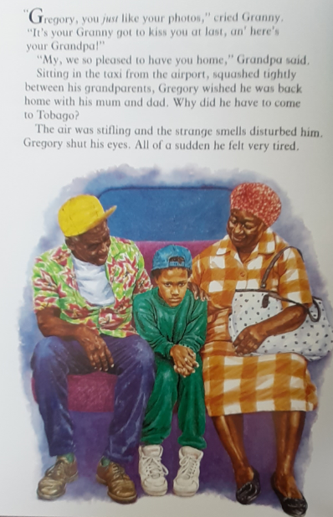
non-standard English in Gregory Cool
In standard English, these phases may be said as:
“Gregory, you look just like you do in your photos.”
“My goodness, we are so pleased to have you back home.”

Slide 3

non-standard English
Non-standard English is often used to books to help give characters personality, as well as to reflect where they may be from.
How do you think this should be said in standard English?

Slide 4
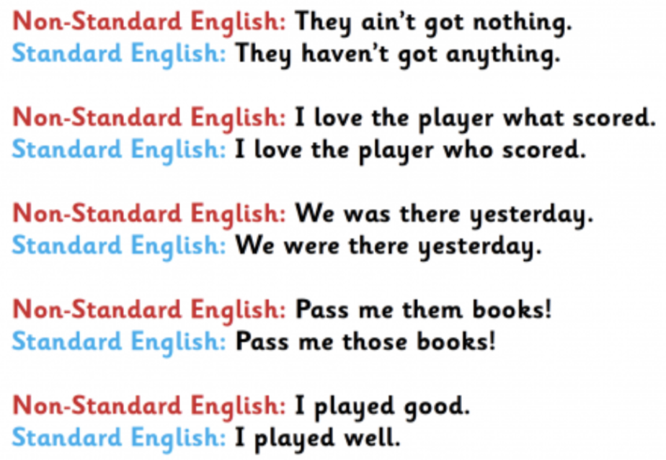
Common examples:
These are examples of non-standard English that you will hear a lot around Kent and the South-East of England.

Slide 5
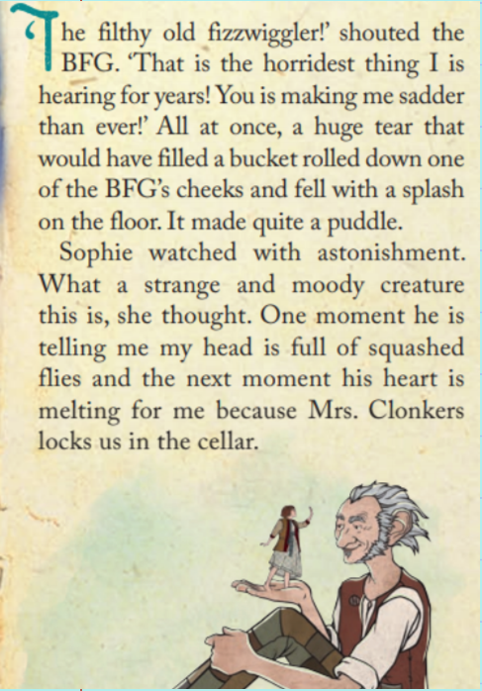
Modelling how to complete the upcoming task (using BFG)
Find examples of non-standard English in the text and copy it down. Then try and turn it into standard English.
Non-standard English
Standard English
That is the horridest thing I is hearing for years!
You is making me sadder than ever!
That is the most horrid thing I have heard in years!
You are making me sadder than ever!

Slide 6
TASK TIME:
Go through the pages of Gregory Cool we have read so far and find phrases of Non-Standard English. Try and turn them into standard English!
Non-standard English
Standard English

