Slide 1

Arrays For Division
12 ÷ 3 =
4

Slide 2

28 ÷ 7 =
4

Slide 3
6
24 ÷ ? = 4

Slide 4
2
16 ÷ ? = 8

Slide 5
40
? ÷ 5 = 8

Slide 6
30
? ÷ 6 = 5

Slide 7
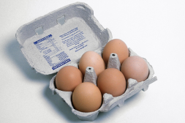
Solving division problems
How many boxes of 6 eggs do I have if I have 24 eggs altogether?
Number Sentence: 24 ÷ 6 =
Array:
4
6
12
18
24

