Slide 1
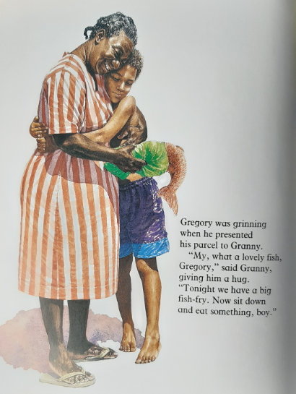
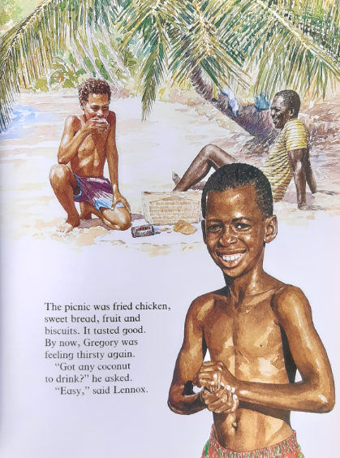

RECAP: After a tough time on the beach, Gregory met the kind fishermen who cheered him up.

Slide 2
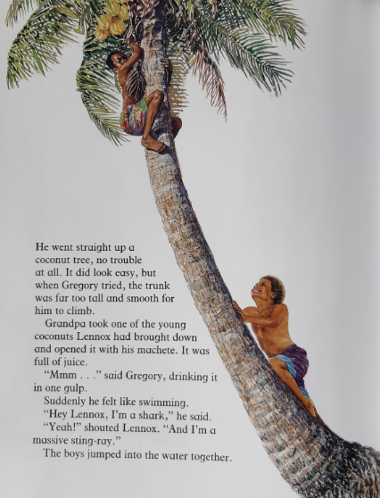
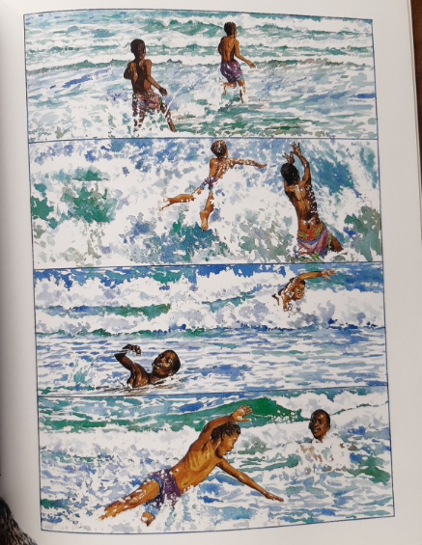

Slide 3
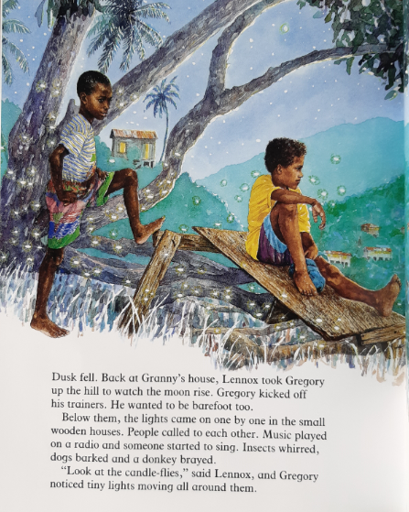
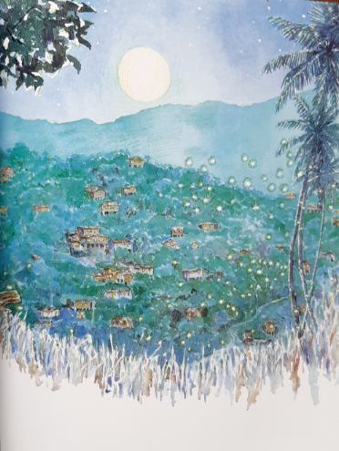

Slide 4
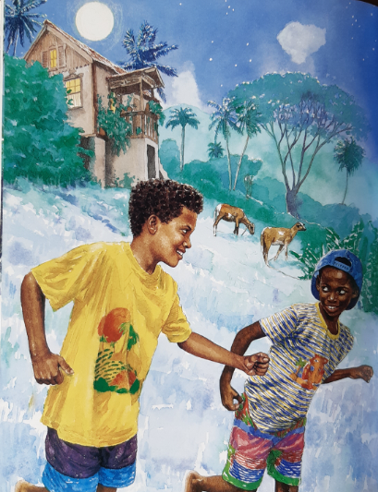
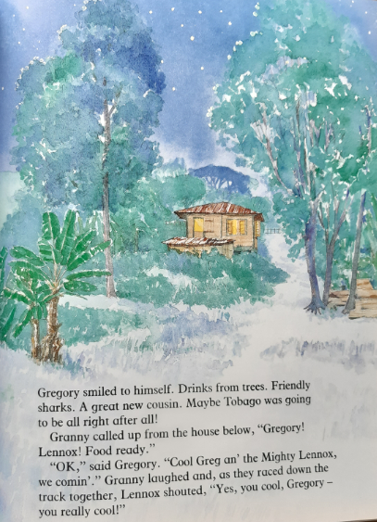

Slide 5
Q1: How can you tell Granny was pleased with the fish Gregory gave her?
Q2: The author tells us four foods in their picnic basket. List them.
Q3: What is a ‘machete’? Have a guess from the sentence it is in, then look it up in a dictionary or online.
Q4: What does Lennox pretend to be when they jump back into the water together?
Q5: When the boys are watching the moon rise, WHY do you think Gregory took off his shoes?
Q6: Whilst the boys are watching the moon rise, the author describes what is happening in the village below. How is it different to what Gregory might be used to back in the UK?
Q7: Why does Gregory now think ‘Tobago was going to be all right after all’?
Q8: How has Lennox’s opinion of Gregory changed? Why might this be?

