Slide 1

Making your own chocolate bar!
Lesson 1: Design

Slide 2
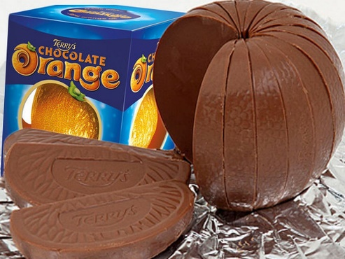
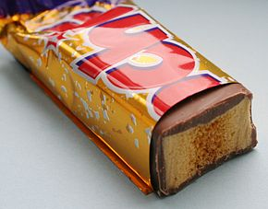
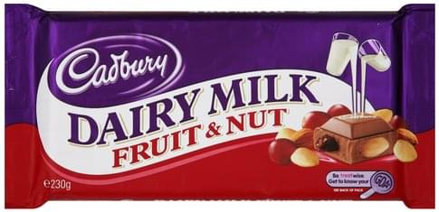
Over the course of this week, we are going to come up with our own design for a new chocolate bar, considering flavours and packaging, try to make it and design an advert for it.
For our first lesson, we need to design the bar itself!
You need to decide what flavour combinations work well…
Choc & orange
Choc, fruit & nuts
Choc & honeycomb

Slide 3
To give you some ideas…
Visit this website to help inspire your own bar. You do not have to enter the competition, just use the first couple of slides to help with ideas!
You need to decide:
What flavours / ingredients you will include.
A name for your bar.
https://www.cadburyinventor.com/competition?gclsrc=aw.ds&&gclid=EAIaIQobChMI_Pn9poe26gIVTe7tCh0K2QeNEAAYASAAEgJITfD_BwE

Slide 4
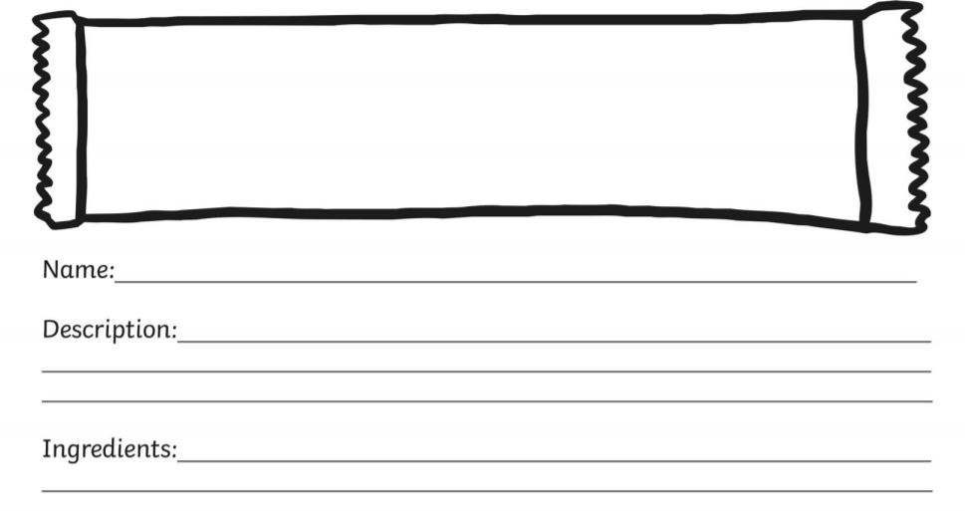
You now need to design the wrapper for your own chocolate bar. On the next slide are pictures of real chocolate bars to give your inspiration. You want a bold, clear name and think which colours work well. Not too many, and maybe link them to the colours of your ingredients?

Slide 5


