Slide 1
Compare and contrast
Using Gregory Cool

Slide 2
What Does it mean?
To compare and contrast means to look at two or more objects, people or places and think about how they are similar and how they are different.

Slide 3
Two countries…
The UK is, in many ways, very different from Tobago, but there are some similarities as well! Have a look at the pictures on the next couple of slides and start to think about how they are alike and how they differ.

Slide 4
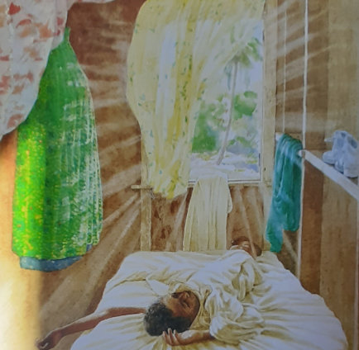
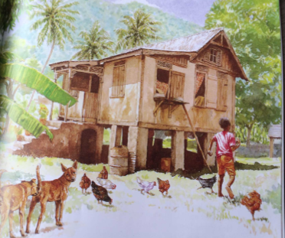

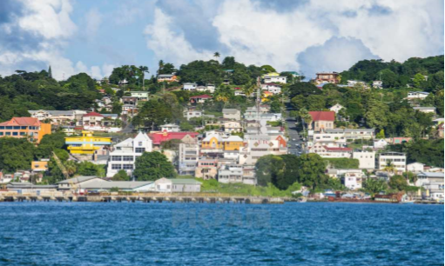
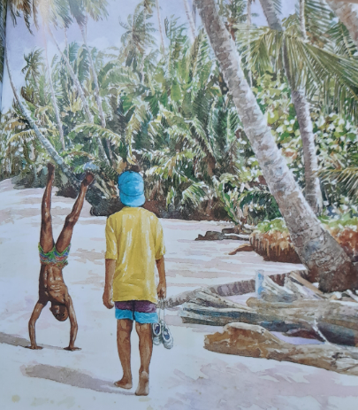
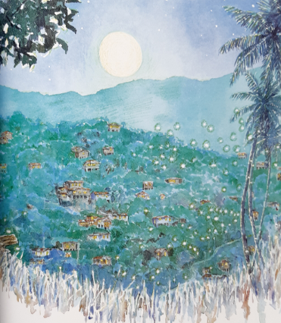
Tobago…

Slide 5
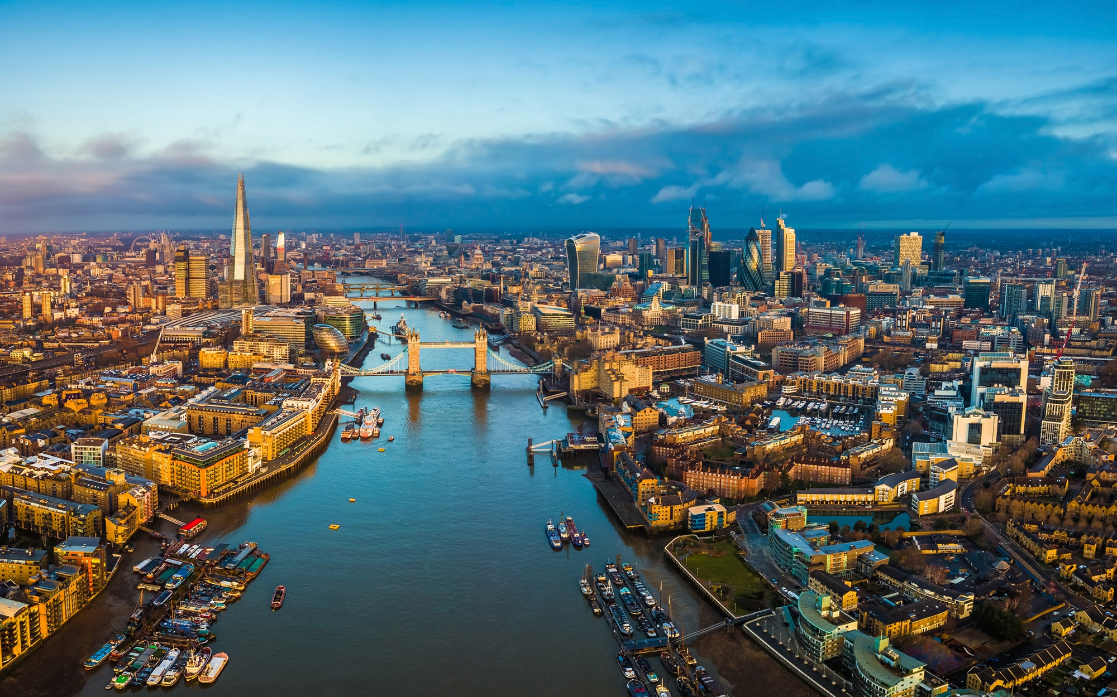
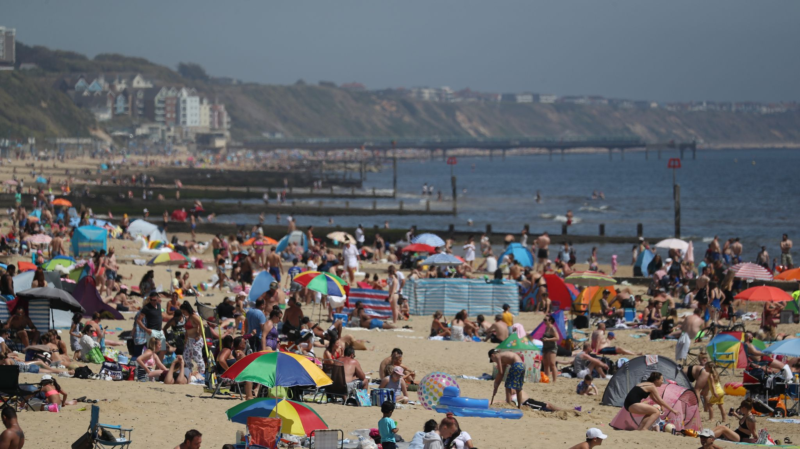
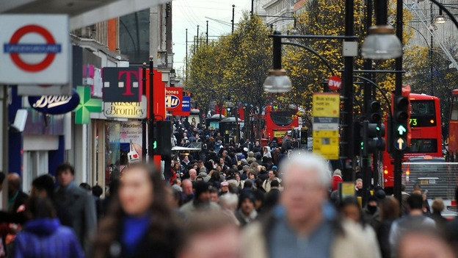

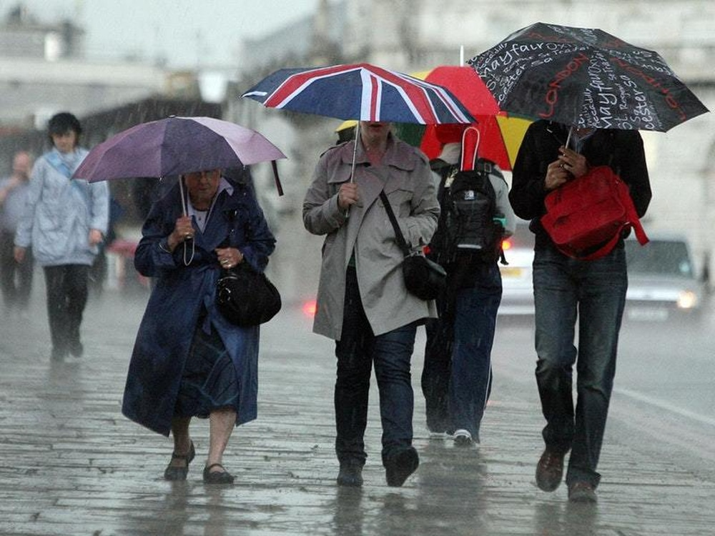
The UK…

Slide 6
Using conjunctions
We can use conjunctions (joining words and phrases) to help us build our sentences. Here are some that may be useful:
and, but, whilst, because, whereas, yet, however, meanwhile, although, on the other hand
For example:
Both Tobago and Britain are island countries.
Although Tobago is hot all year round, Britain can get very cold in the Winter.
Some people walk barefoot in Tobago, whereas people in the UK normally wear shoes.

Slide 7
Your Task:
Write a series of sentences to compare Tobago with the UK.
Include a conjunction in EACH sentence and underline.
Use the pictures to inspire you.
EXTRA CHALLENGE:
Use expanded noun phrases for extra detail.
Use interesting openers to upscale sentences.
Get a dictionary to check your spellings.
Get a thesaurus to improve any 'dull' vocabulary.

