Slide 1

Making your own chocolate bar!
Lesson 3: Advertising

Slide 2
By now, you have designed a chocolate bar (hopefully with some great flavours), written out instructions on how to make it and maybe even tried to make it yourself too!
Once you have your chocolate bars though, what next?
Well, if you want to be a big player in the chocolate market, you need to get people to want to buy your bar! There are a LOT of chocolate bars for sale, so to get yours to stand out you need to advertise!

Slide 3
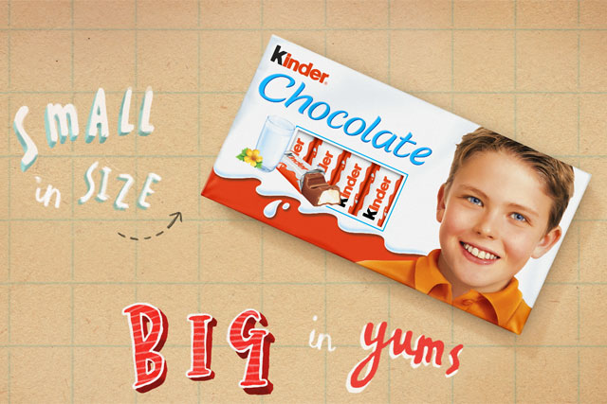
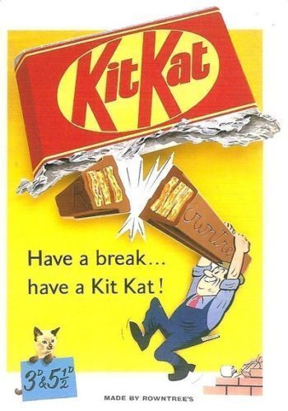
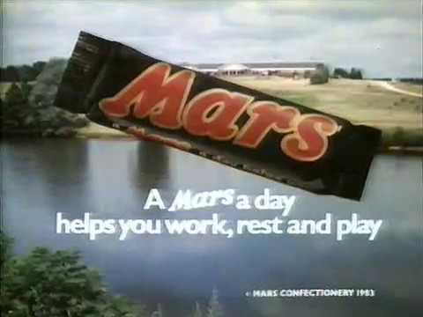
Here are some poster adverts. You will notice that the chocolate bars are BIG in the design to make them stand out!

Slide 4
Ferrero Rocher: This advert is designed to convince you that eating these makes you fancy, sophisticated and having great taste.
https://www.youtube.com/watch?time_continue=8&v=hMlP_Moo0bE&feature=emb_logo
Mars: This suggests that Mars is quite simply better than any others.
https://www.youtube.com/watch?v=WnF28ZosL9o
Dairy Milk: Cadbury’s showing that they can be fun and that by eating their chocolate life is always half-full or better!
https://www.youtube.com/watch?v=IIJD93Z2C_8
Bounty: This bar is exotic and different from the rest. It takes you to another place!
https://www.youtube.com/watch?time_continue=23&v=wP_u2sv1op4&feature=emb_logo

Slide 5
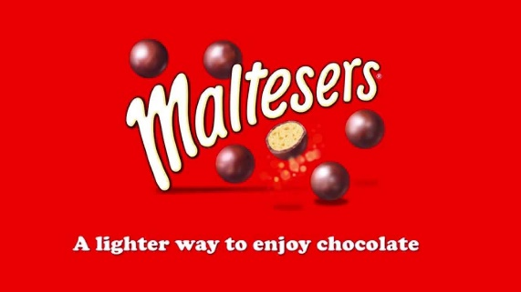
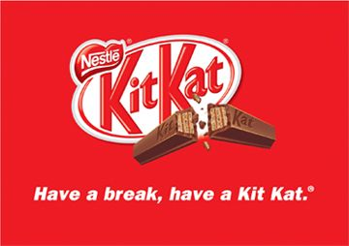
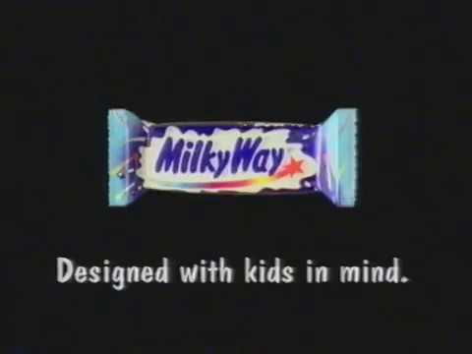
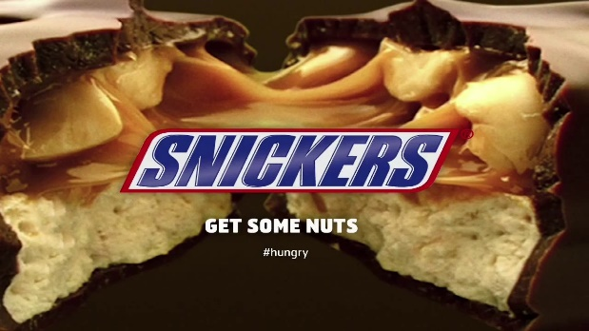
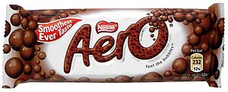
What about a slogan?
Can you come up with a ‘catchy phrase’ to make people remember your chocolate bar?

Slide 6
Your task:
Design an advert for your chocolate bar. It could be a picture to go on an advertising board or in a magazine, or instead, it could be filming a video advert!

