Slide 1
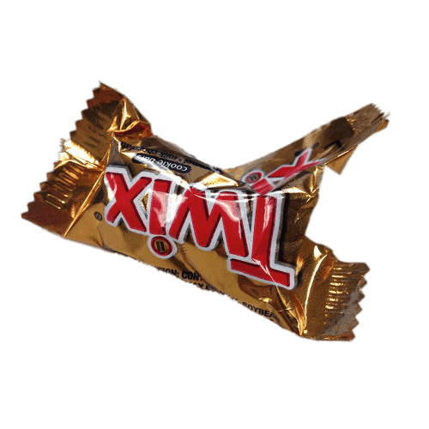
Chocolate bar wrappers

Slide 2
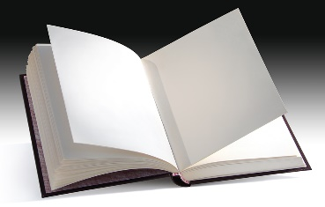
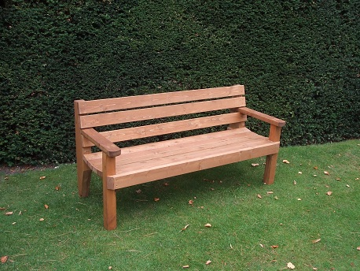
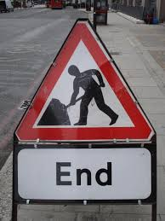
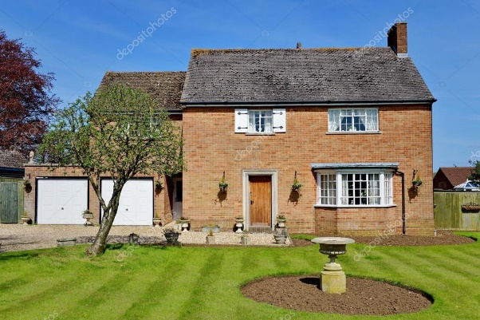
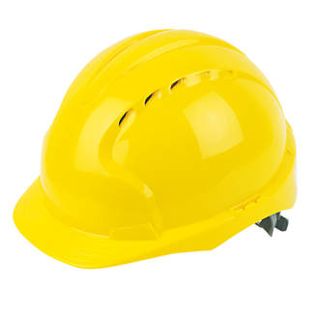
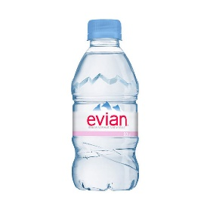
Materials
As humans and consumers, we use lots of different materials in our everyday lives for different purposes and various uses. For example…
Metal
Wood
Paper
Plastics
Bricks
And these are just a FEW examples!

Slide 3
A chocolate wrapper
Have a look at a chocolate bar wrapper if you have one, or look at the picture and think about when you have handled one in the past.
Optional task – Describe it!
Imagine you had to describe the wrapper to someone who had never seen it before. Think about its texture, size, shape etc.

Slide 4
Properties of materials
These are all words that can be used to describe a range of materials. What do they mean? Try to complete the table on the next slide. Some you may know, some you may need you look up online.
Magnetic
Rigid
Flexible
Light
Heavy
Soft
Hard
Transparent
Opaque
Waterproof
Soluble
Smooth
Rough
Insoluble

Slide 5
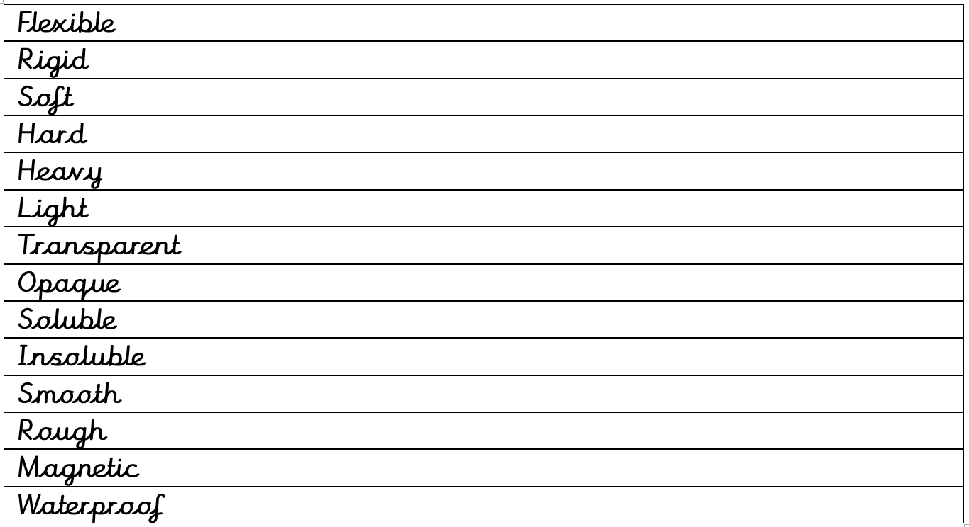
Properties of materials
Task:
Complete the meanings of these words:

Slide 6
Properties of materials
Of these words, which are important for chocolate bars? WHY?
Task:
Write a short paragraph to explain why chocolate bar wrappers are made from foil. Try to use some of the vocabulary from the previous slides and explain why these properties are important.
Optional extension:
Write a sentence (using the proper vocabulary) to say why you would NOT use:
Paper
Metal
Wood

