Slide 1


Year 1 – Summer Block 2 – Fractions – Find a Quarter of a Shape or Object
About This Resource:
This PowerPoint has been designed to support your teaching of this small step. It includes a starter activity and an example of each question from the Varied Fluency and Reasoning and Problem Solving resources also provided in this pack. You can choose to work through all examples provided or a selection of them depending on the needs of your class.
National Curriculum Objectives:
Mathematics Year 1: (1F1b) Recognise, find and name a quarter as one of four equal parts of an object, shape or quantity
Mathematics Year 1: (1M1) Compare, describe and solve practical problems for mass/weight [for example, heavy/light, heavier than, lighter than, half, quarter]
More Year 1 Fractions resources.
Did you like this resource? Don’t forget to review it on our website.
© Classroom Secrets Limited 2018

Slide 2
Year 1 – Summer Block 2 – Fractions
Step 3: Find a Quarter of a Shape or Object
© Classroom Secrets Limited 2018

Slide 3
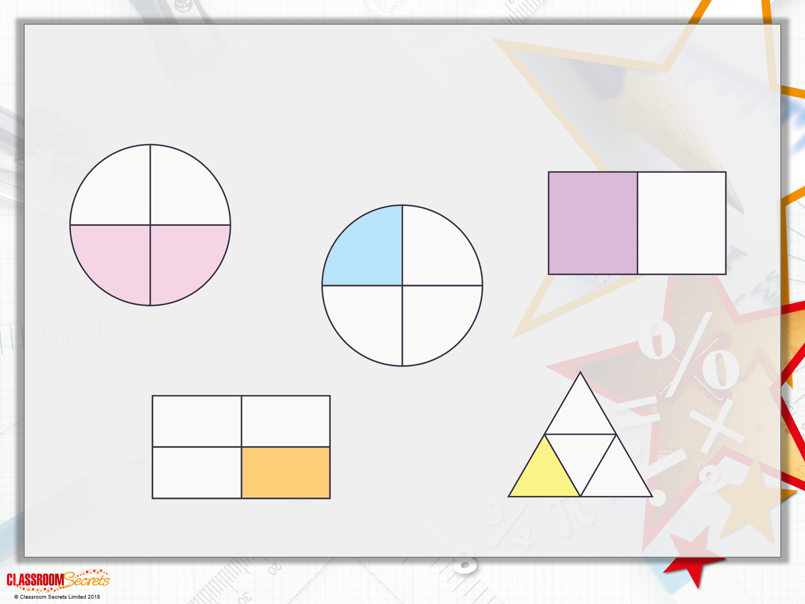
Introduction
Which shapes show one quarter?

Slide 4
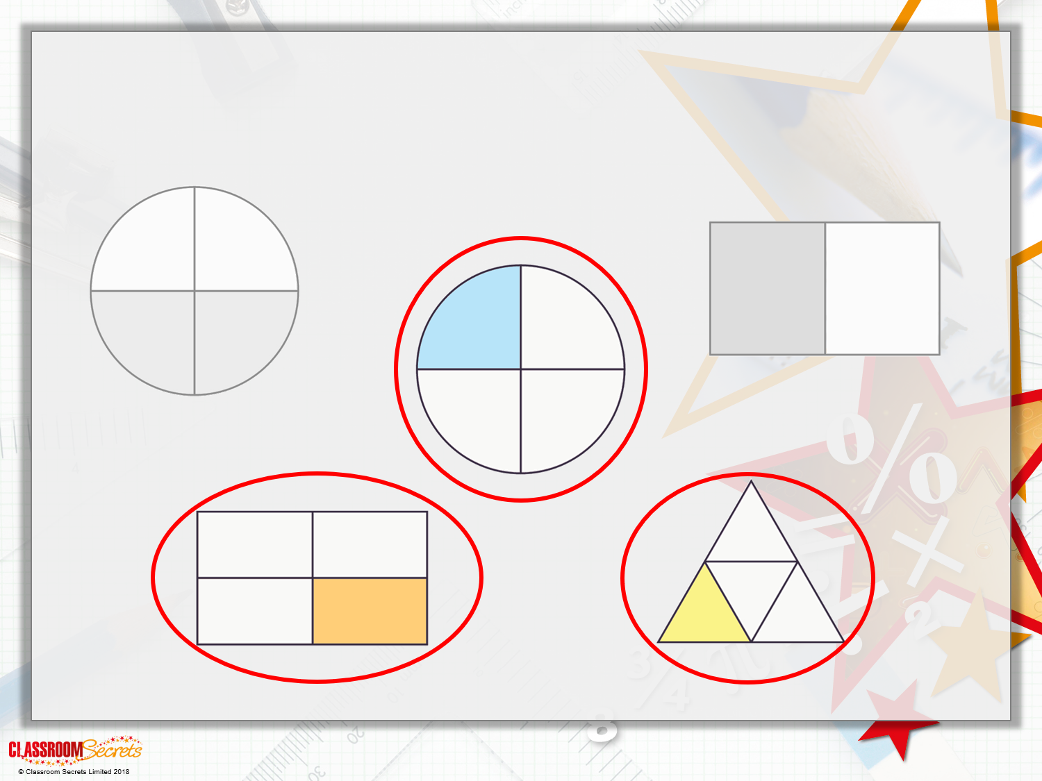
Introduction
Which shapes show one quarter?

Slide 5
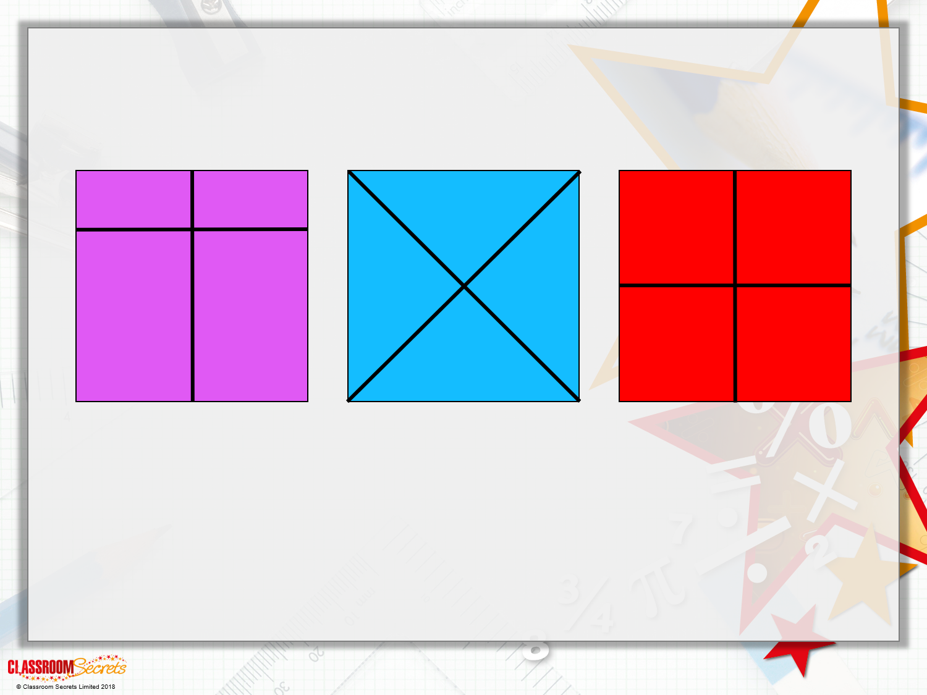
Varied Fluency 1
Tick the shapes that are split into equal quarters.

Slide 6
Varied Fluency 1
Tick the shapes that are split into equal quarters.
✓
✓

Slide 7
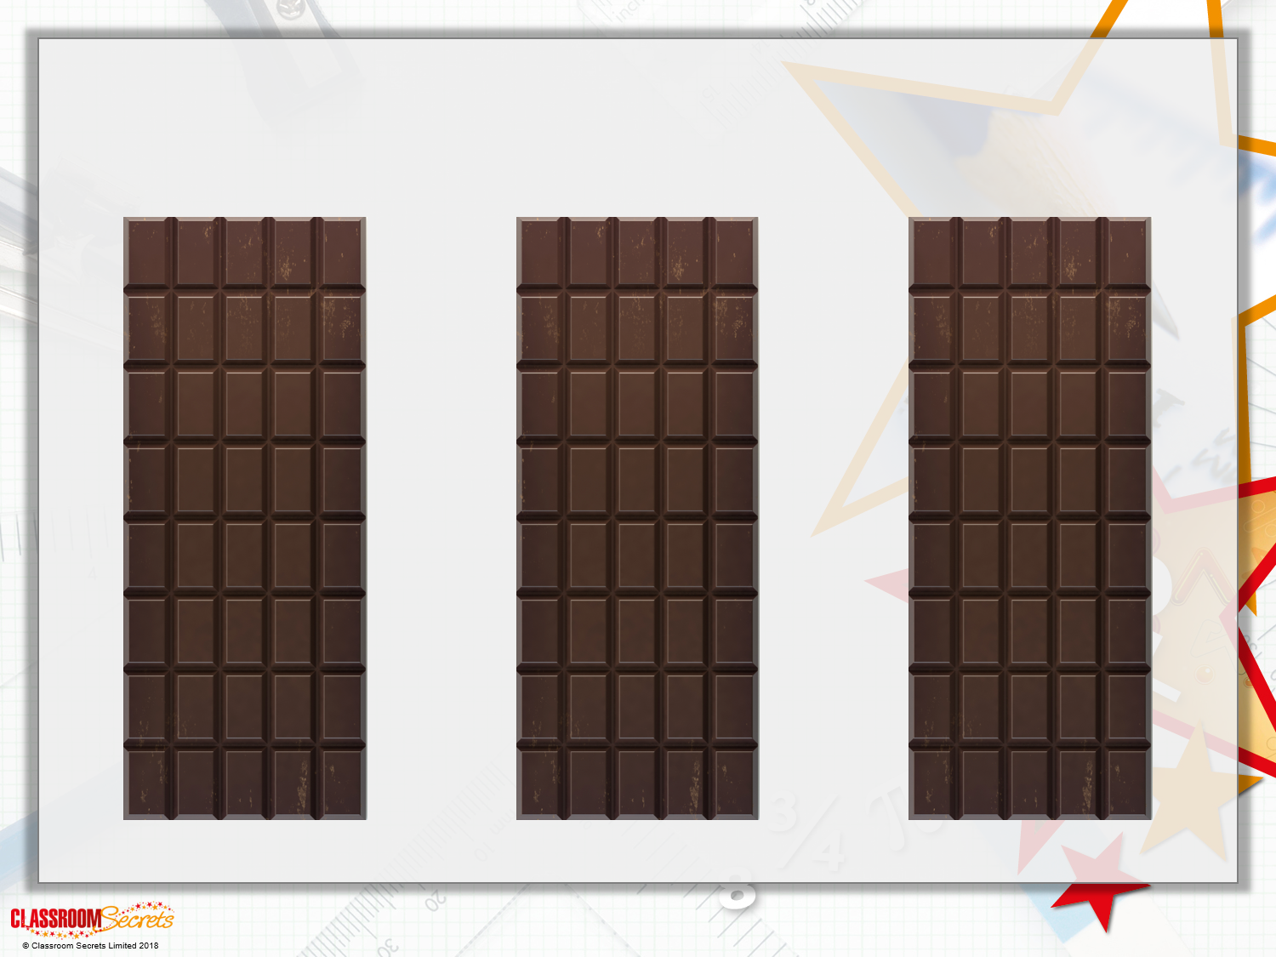
Varied Fluency 2
Find 3 different ways to split this object into 4 equal quarters.

Slide 8

Varied Fluency 2
Find 3 different ways to split this object into 4 equal quarters.

Slide 9
Varied Fluency 3
How could you colour a quarter of this shape?
Think of three different ways of doing it.
© Classroom Secrets Limited 2018

Slide 10
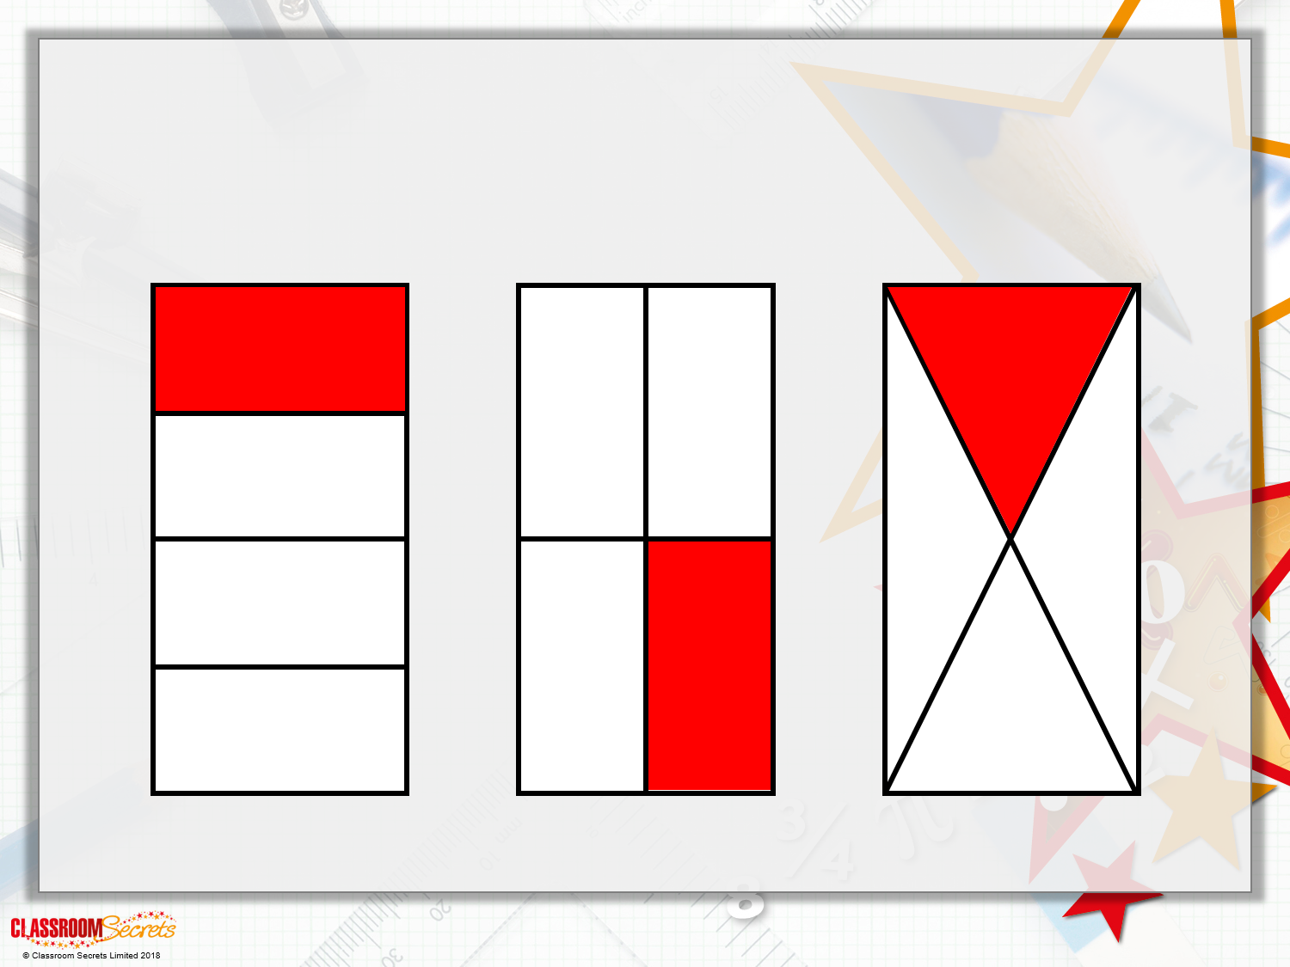
Varied Fluency 3
How could you colour a quarter of this shape?
Think of three different ways of doing it.
Possible answers:

Slide 11
Varied Fluency 4
How could you colour a quarter of each shape?
© Classroom Secrets Limited 2018

Slide 12
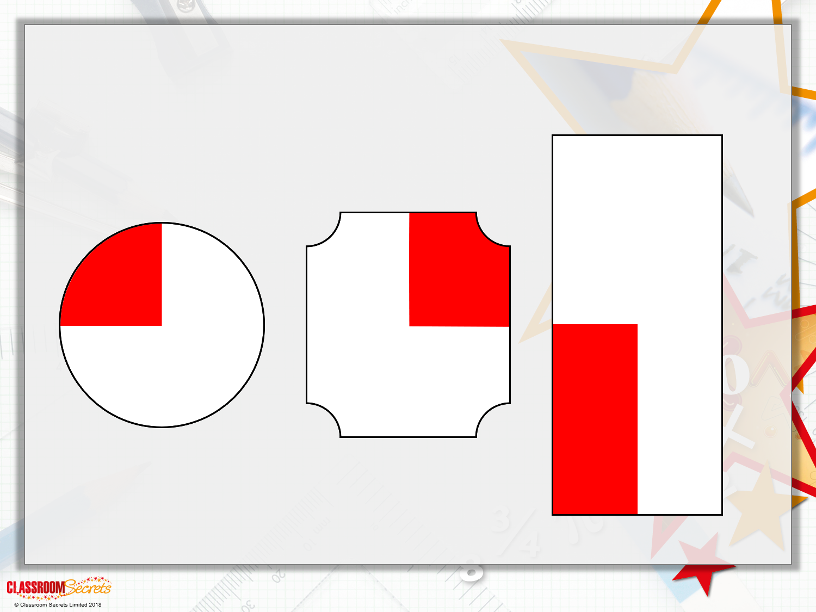
Varied Fluency 4
How could you colour a quarter of each shape?
Possible answers:

Slide 13
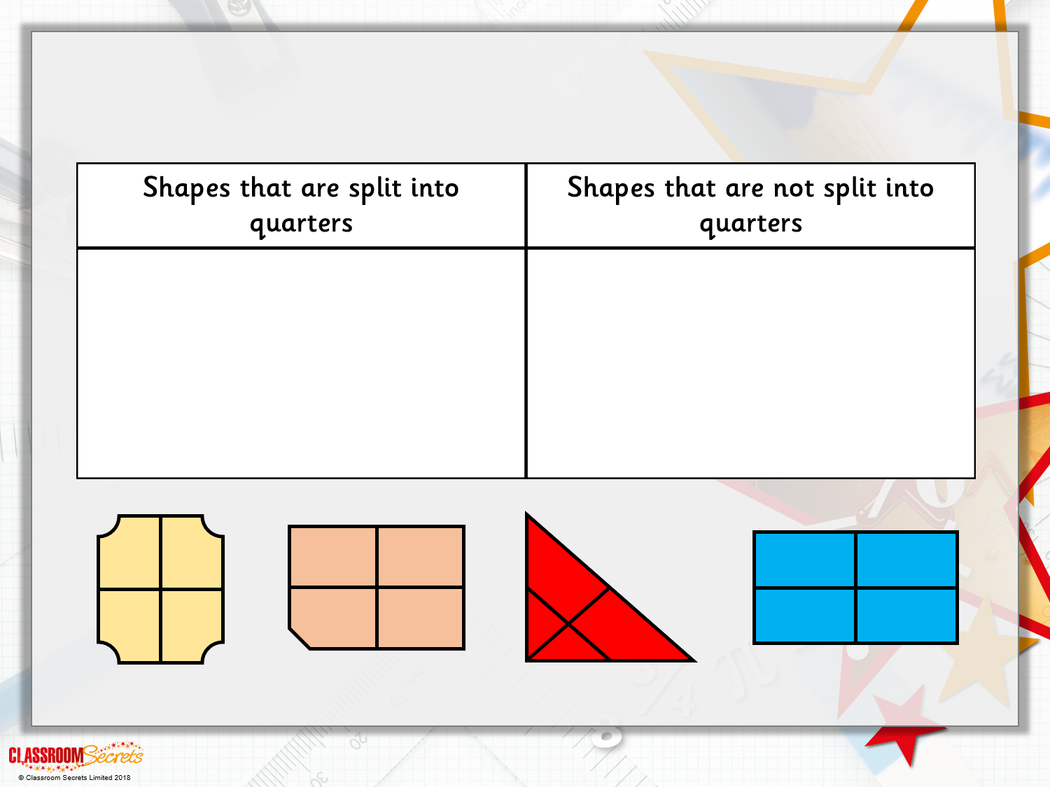
Problem Solving 1
Sort the shapes into the table

Slide 14
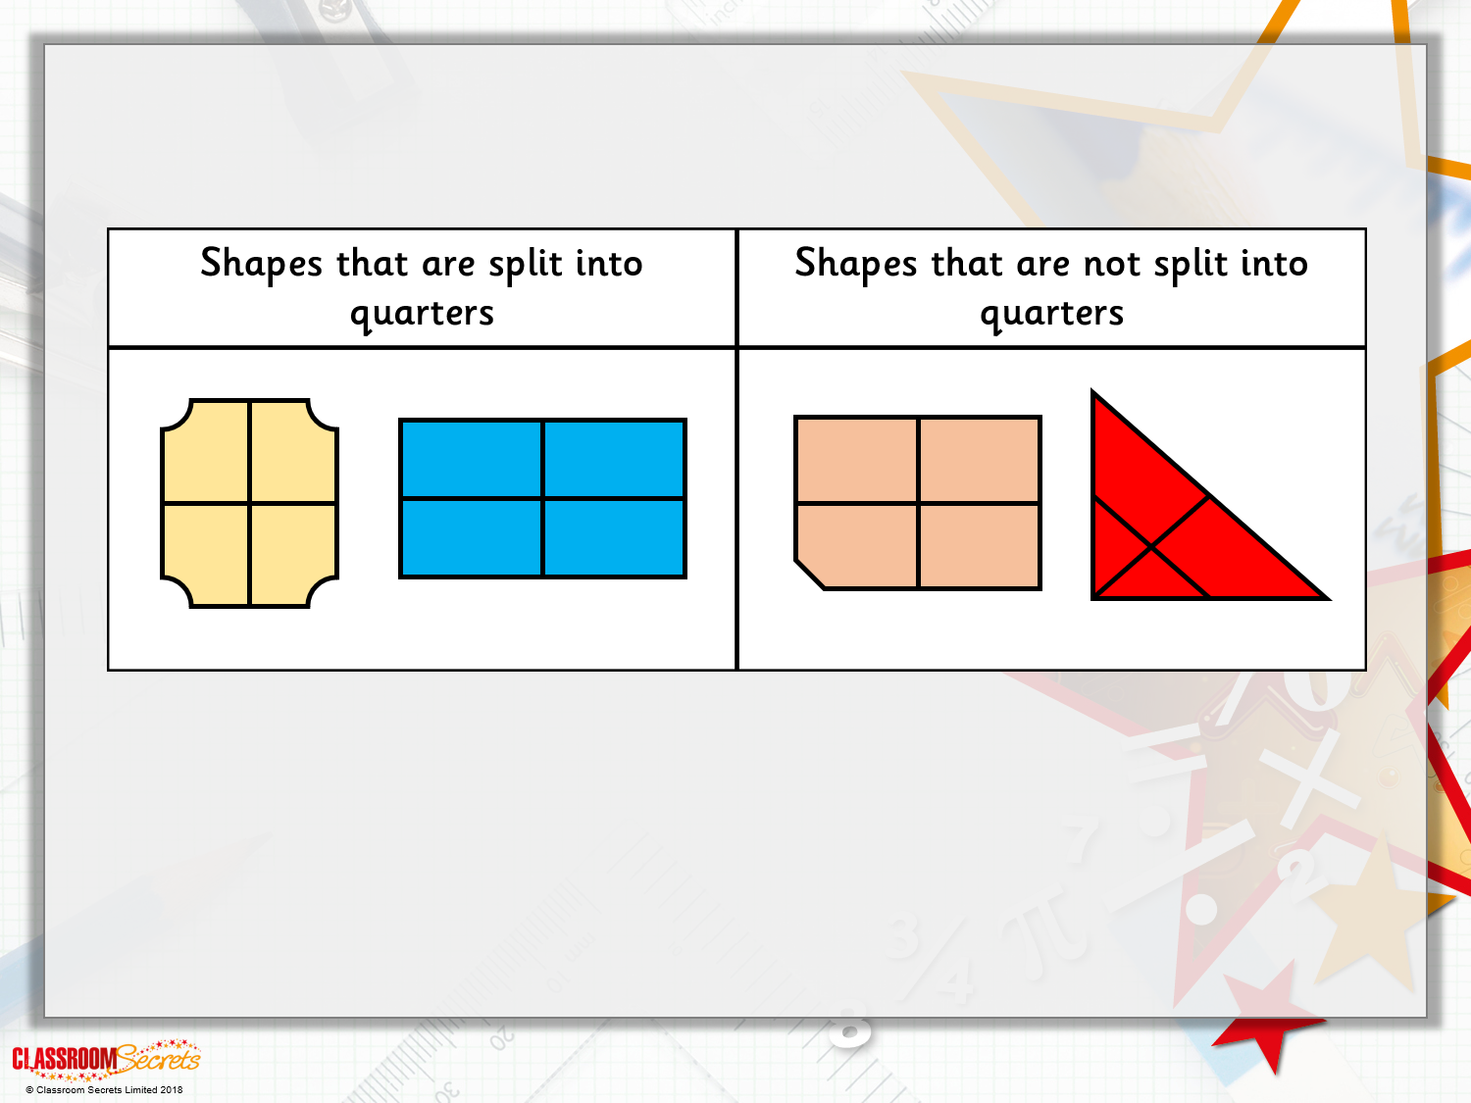
Problem Solving 1
Sort the shapes into the table

Slide 15
Problem Solving 2
How could you colour the shapes to match their labels?
less than a quarter
exactly a quarter
more than a quarter
© Classroom Secrets Limited 2018

Slide 16
Problem Solving 2
How could you colour the shapes to match their labels?
less than a quarter
exactly a quarter
more than a quarter
© Classroom Secrets Limited 2018

Slide 17
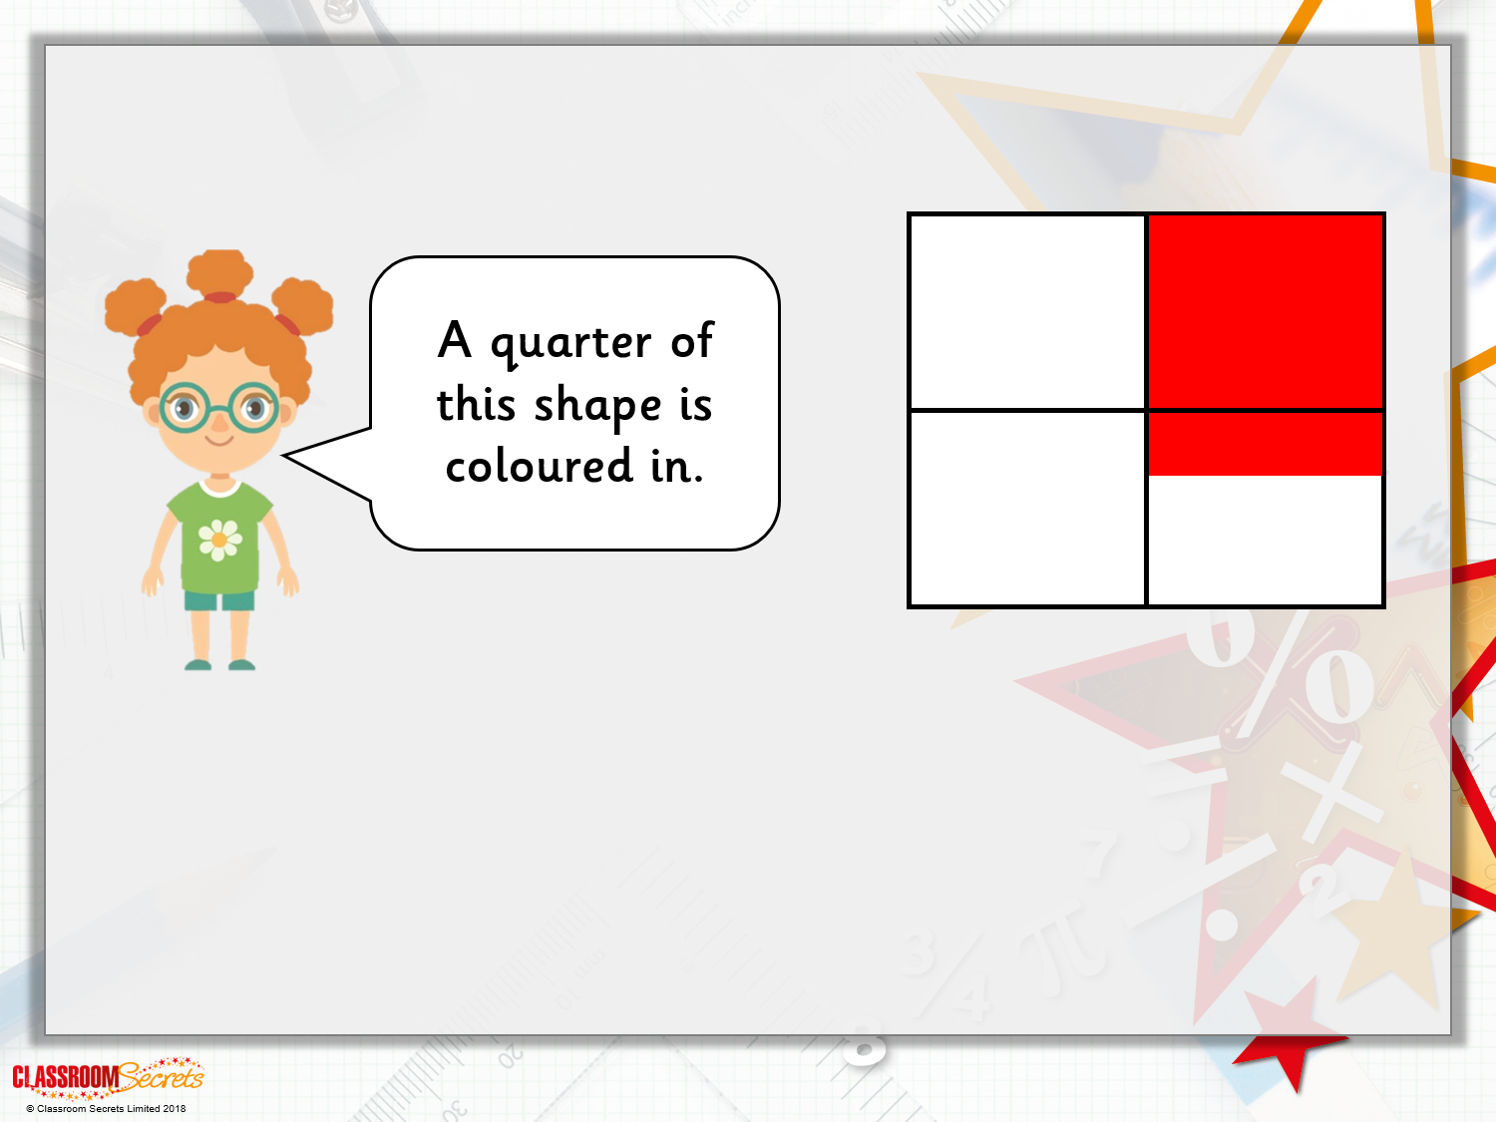
Reasoning 1
Beth says:
Is she right? Explain your answer.

Slide 18
Reasoning 1
Beth says:
Is she right? Explain your answer.
Beth is wrong because...

Slide 19
Reasoning 1
Beth says:
Is she right? Explain your answer.
Beth is wrong because the shape is divided into quarters but the colour clearly goes through more than just a quarter.

