Slide 1
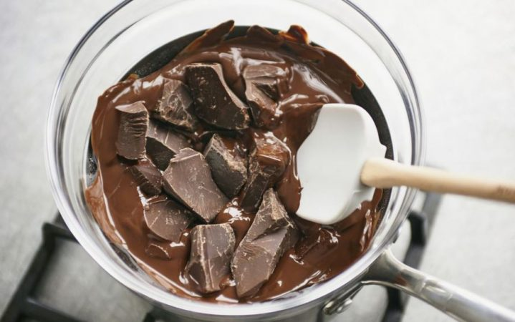
Melting chocolate: Part 1

Slide 2
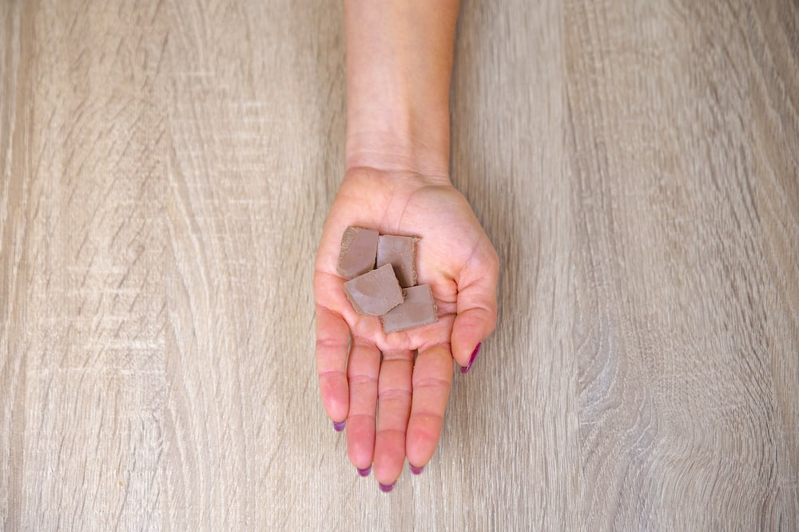
Chocolate
What would happen if you leave a small square of chocolate in the palm of your hand?
Optional task – prediction
Explain to a partner or parent what you think would happen and WHY.

Slide 3
Chocolate
If you leave a piece of chocolate in your hand, it will melt because the temperature of the body is higher than that of the chocolate!
BUT will all chocolate melt at the same rate?
Today we are going to PLAN an experiment to test this!

Slide 4
Planning an experiment
AIM: To find out if different types of chocolate will melt at the same rate.
What different chocolate could we melt?
Milk choc?
Dark choc?
Organic choc?
White choc?

Slide 5
Planning an experiment
You need to think about HOW you are going to carry out the experiment. HOW will you get the chocolate to melt? How much chocolate will you use? Are you going to time when it starts to melt or when it has all melted?
Task:
Write a list of what you will need. E.g. chocolate, timer, bowl, saucepan, boiling water?
Write a method for how you will conduct the experiment.
Draw a diagram to show your experiment.

Slide 6
If you are stuck…
Here is an example in case you are not sure. You can use some of the ideas here, but try and put it in your words!
Equipment:
4 types of chocolate
Stopwatch
Saucepan of boiling water
Glass bowl
Method:
Boil a kettle and pour the water into a saucepan.
Place one square of each type of chocolate at the bottom of the bowl.
Sit the bowl into the boiling water.
Start the timer.

Slide 7
Planning an experiment
The last part of the planning is to think about how we have ensured it is a fair test and what we think will happen (make a prediction).
Task:
Copy and complete this sentence:
My test will be fair because I have only changed one variable and kept all the others…
Make a prediction:
I think that the _____ chocolate will melt the fastest, because ____.

