Slide 1
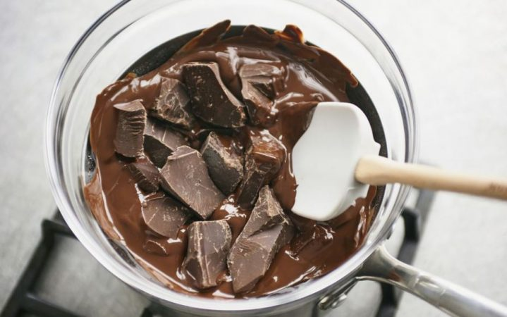
Melting chocolate: Part 2

Slide 2
Planning an experiment
Yesterday, you began to plan an experiment to answer the question…
Today, we will hopefully carry it out!
Does all chocolate melt at the same rate?

Slide 3
Before you start…
DO NOT attempt this without a grown-up’s assistance.
DO NOT use boiling water or handle melting chocolate on your own.
Here is my example plan from yesterday. Firstly, I need to get my equipment. Before I begin though, I need to draw a results table to record my findings. Again, there is an example of one on the next slide!
Equipment:
4 types of chocolate
Stopwatch
Saucepan of boiling water
Glass bowl
Method:
Boil a kettle and pour the water into a saucepan.
Place one square of each type of chocolate at the bottom of the bowl.
Sit the bowl into the boiling water.
Start the timer.

Slide 4
Results
You may want to draw your own table (and you need to decide if you are noting the time the chocolate starts to melt, or when it has completely melted.
Type of chocolate | Time taken to melt (seconds)
Milk chocolate
Dark chocolate
White chocolate
Organic chocolate

Slide 5
Fair test
To make it fair, remember that we are only changing ONE variable – the type of chocolate. That means you must put in the same amount of each type of chocolate. You may need to weigh / measure this before you begin.

Slide 6
Afterwards
Once you have completed your experiment, it is important to look at your results. Have you managed to answer the question:
Task: Copy and complete (you may use words such as; quicker, slower, equally):
I found out that ______ chocolate melts…
Does all chocolate melt at the same rate?

