Slide 1
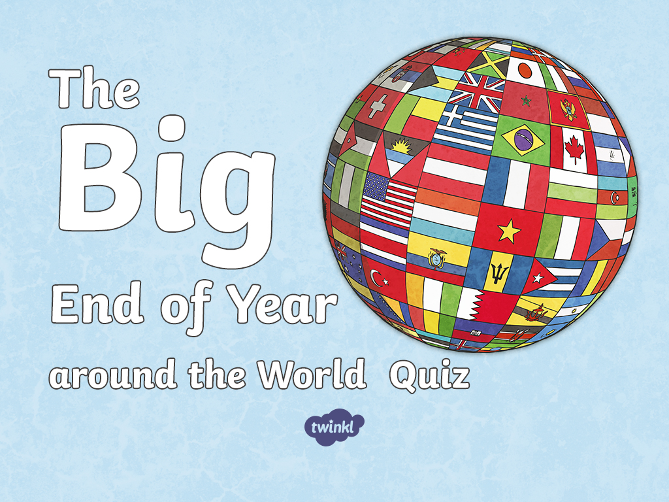

Slide 2

Canada
Iceland
Norway
Russia
Switzerland
Italy
Japan
Jamaica
Mexico
Cuba
Peru
Brazil
Madagascar
Chile
South Africa

Slide 3
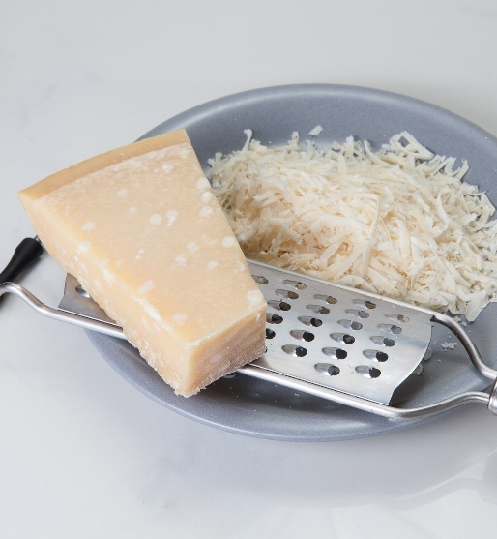
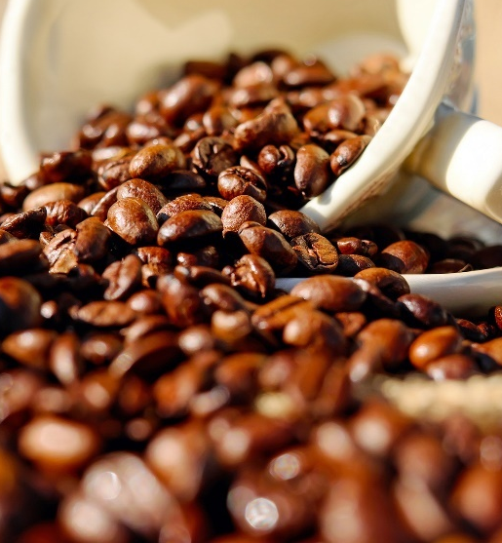


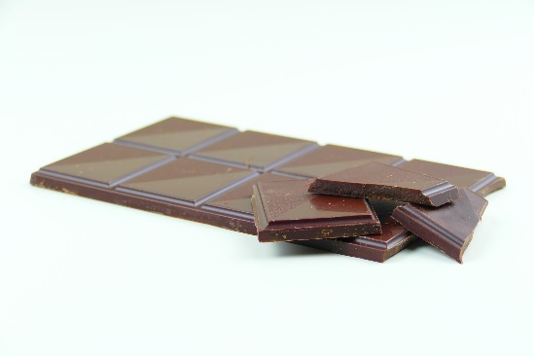
Brazil
Brazil produces the largest amount of one of these popular products. Which is it?
chocolate
cheese
coffee
Back to Map
Next

Slide 4
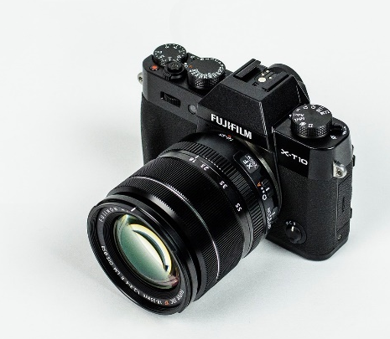
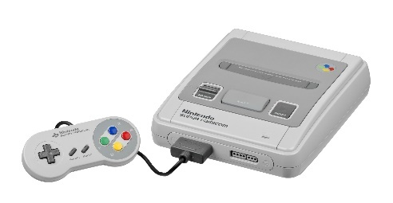
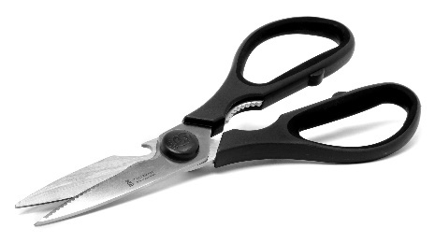
Japan
One of these objects was invented in Japan. Which one is it?
Nintendo
scissors
camera
Back to Map
Next

Slide 5
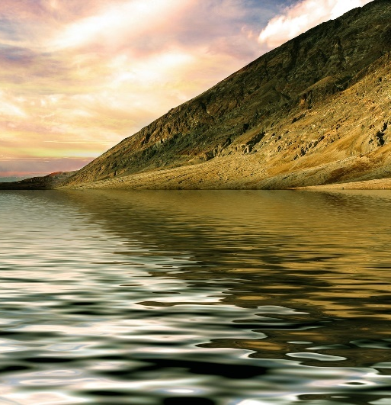
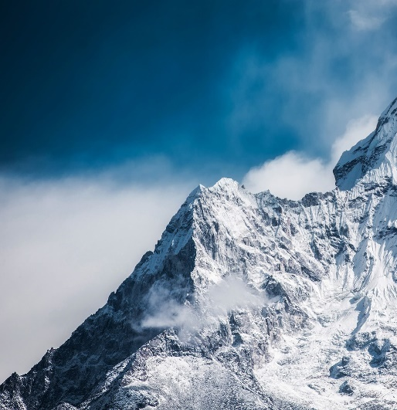
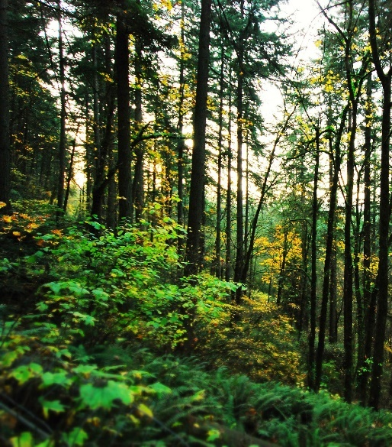
Russia
Russia has the largest area of a geographical feature in the world. Which is it?
lakes
mountains
forests
Back to Map
Next

Slide 6
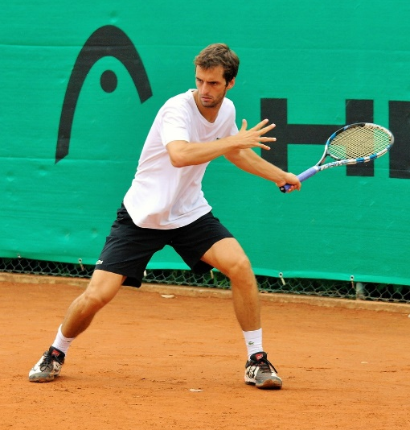


Italy
Which is the most popular sport in Italy?
tennis
football
swimming
Back to Map
Next

Slide 7
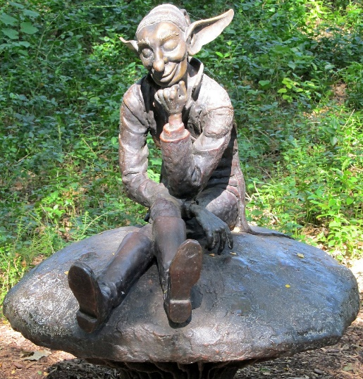
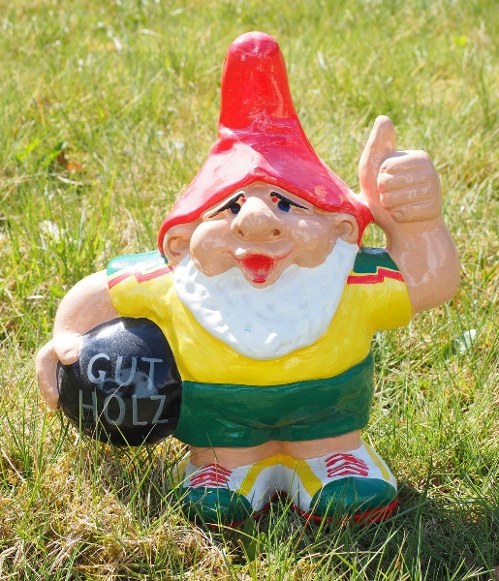
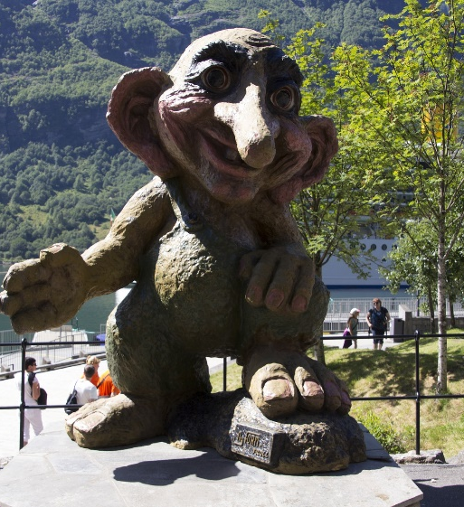
Norway
Which character comes from Norwegian folklore?
pixies
gnomes
trolls
Back to Map
Next

Slide 8
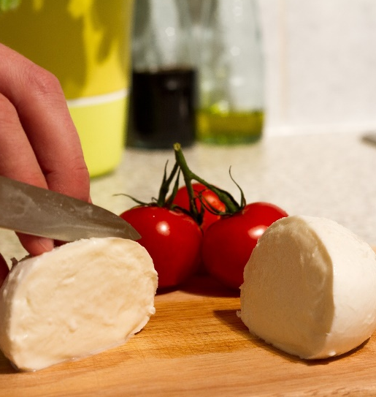
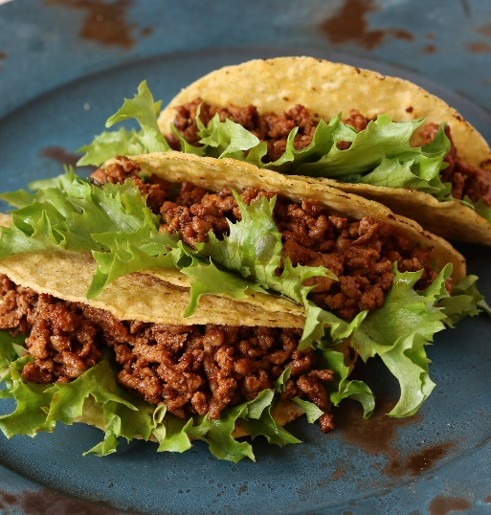
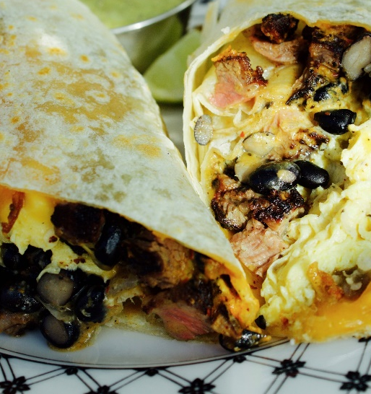
Mexico
Mexico is famous for many different foods. Which one of these foods did not originate in Mexico?
mozzarella
tacos
burritos
Back to Map
Next

Slide 9
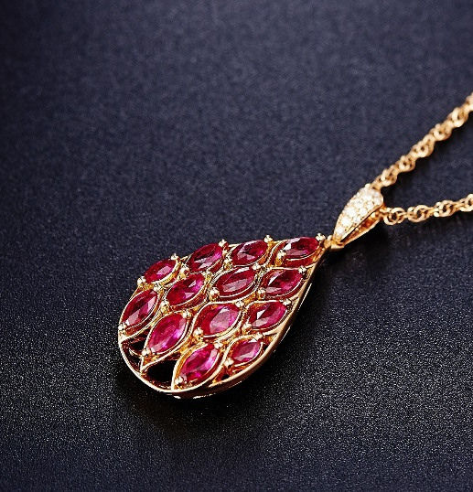
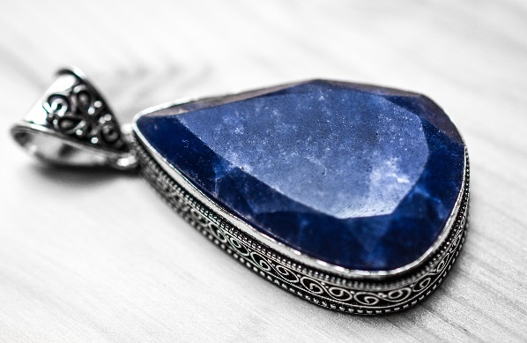
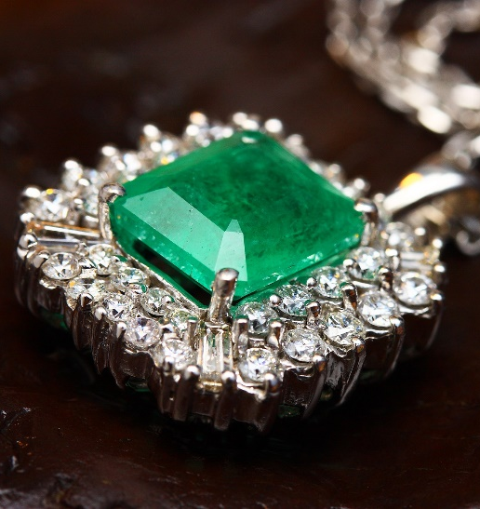
Madagascar
Madagascar provides half the world’s supply of which precious gemstone?
ruby
sapphire
emerald
Back to Map
Next

Slide 10
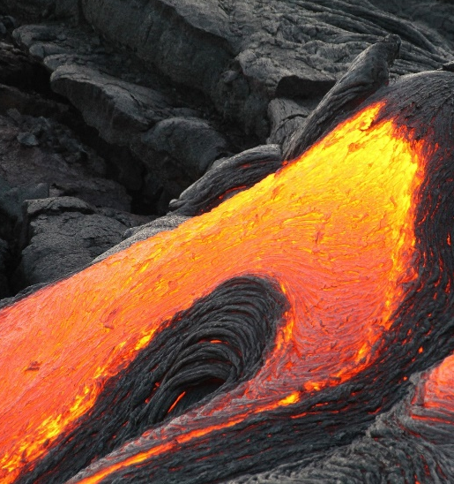
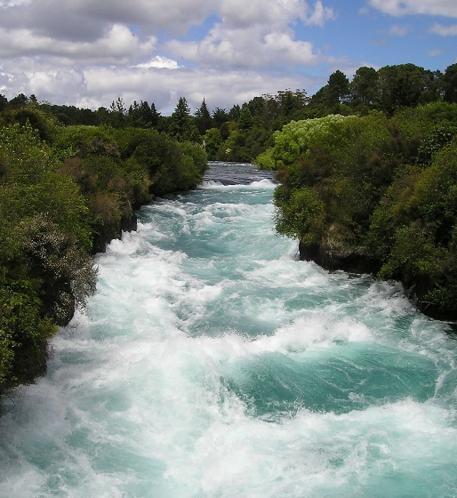
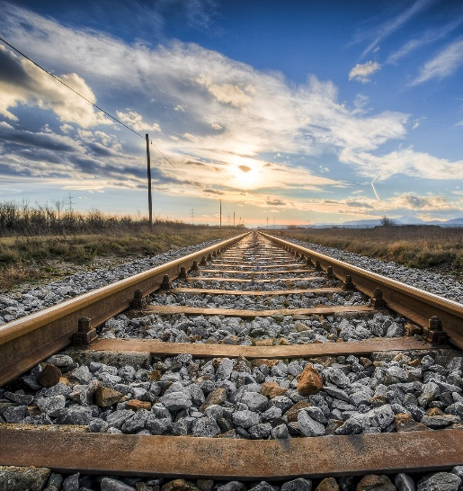
Iceland
Iceland is home to two hundred of which?
volcanoes
rivers
railway lines
Back to Map
Next

Slide 11
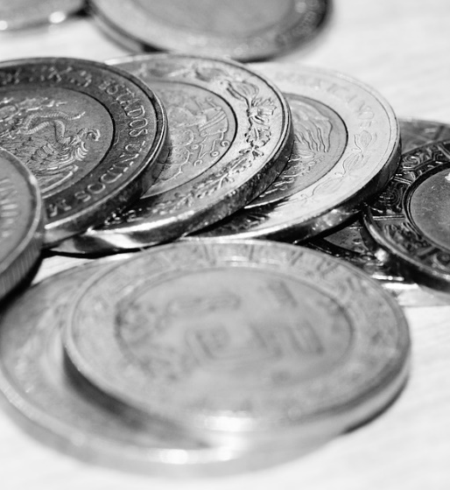
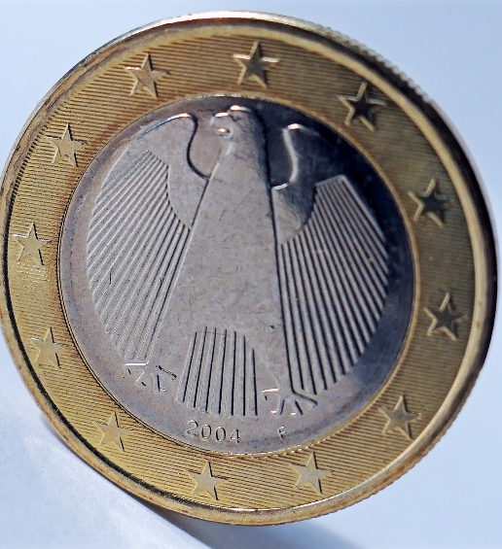
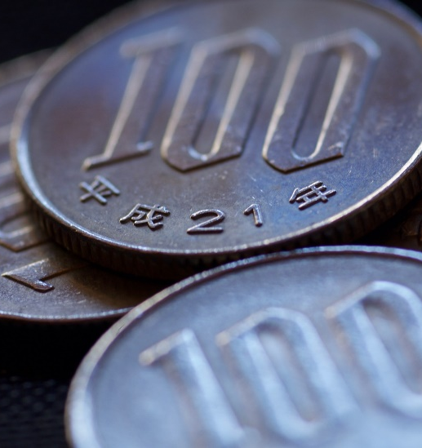
Chile
The currency used in Chile is called the Chilean .
peso
euro
yen
Back to Map
Next

Slide 12
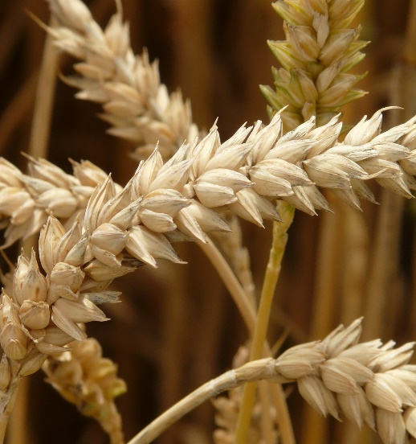
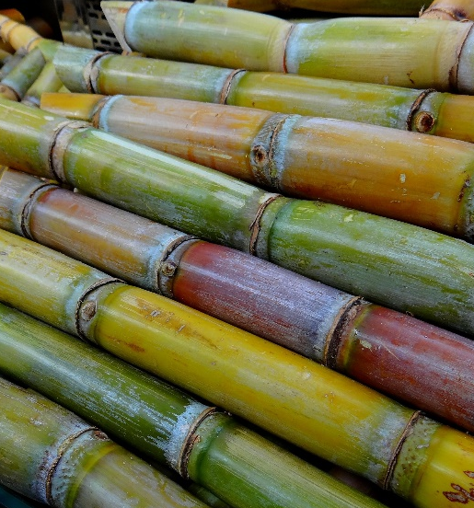
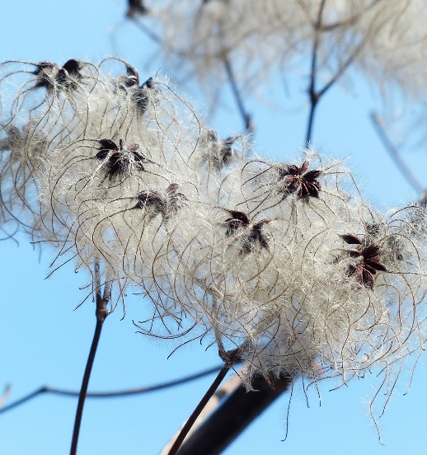
Cuba
Which is Cuba’s main crop?
wheat
sugar cane
cotton
Back to Map
Next

Slide 13

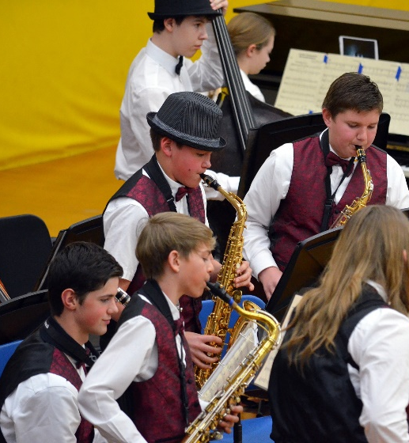
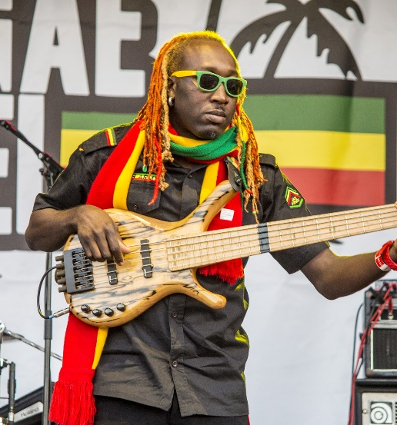
Jamaica
Which type of music came from Jamaica?
Folk
Jazz
Reggae
Back to Map
Next

Slide 14
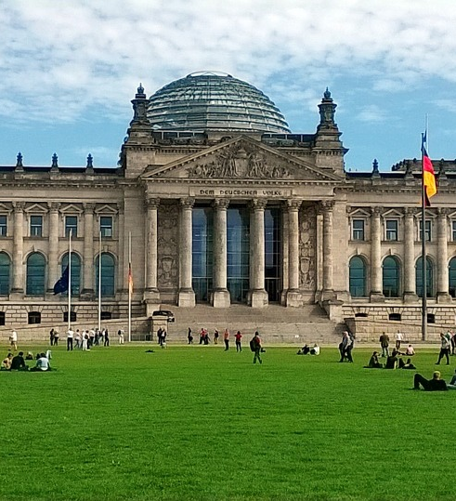
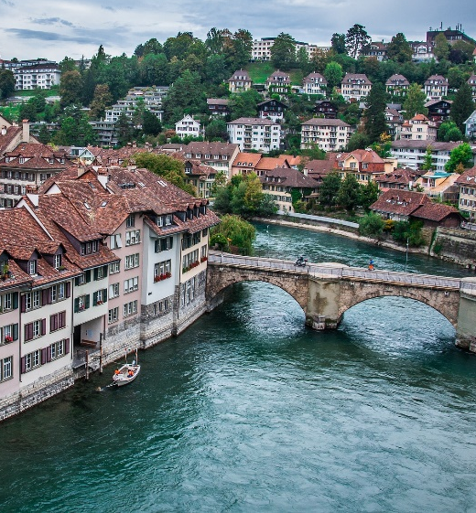
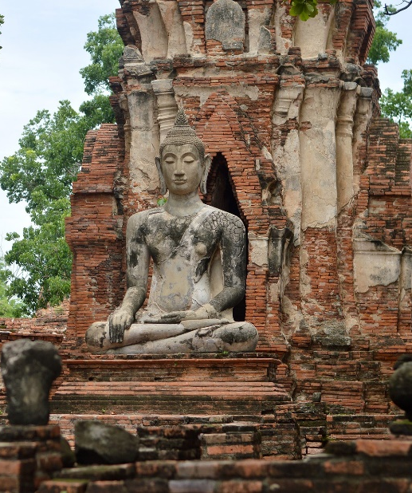
Switzerland
What is the capital of Switzerland?
Berlin
Bern
Bangkok
Back to Map
Next

Slide 15
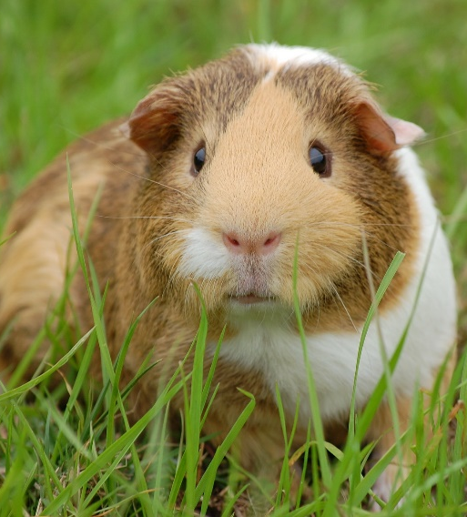
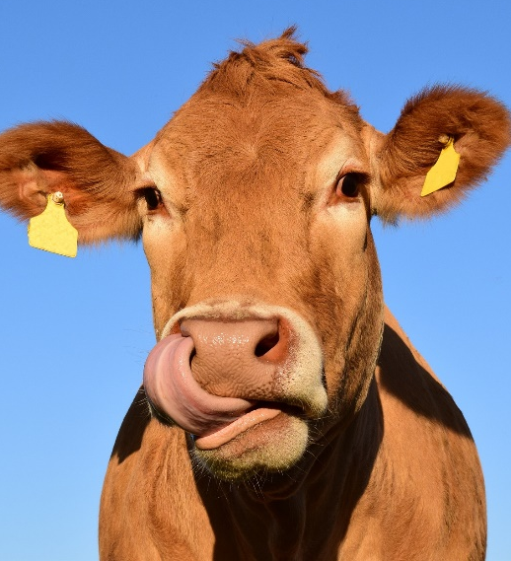
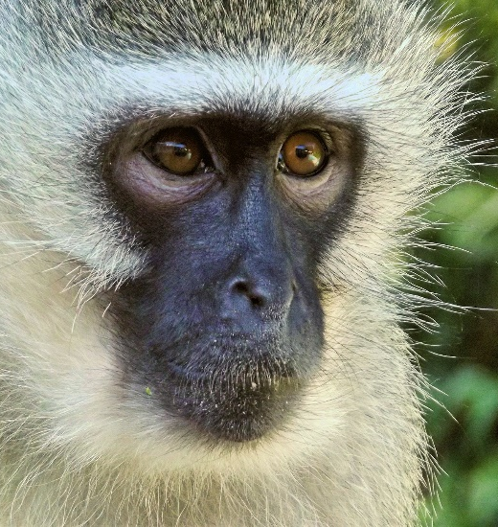
Peru
Which animal provides the traditional meat in Peru?
Guinea pig
cow
monkey
Back to Map
Next

Slide 16
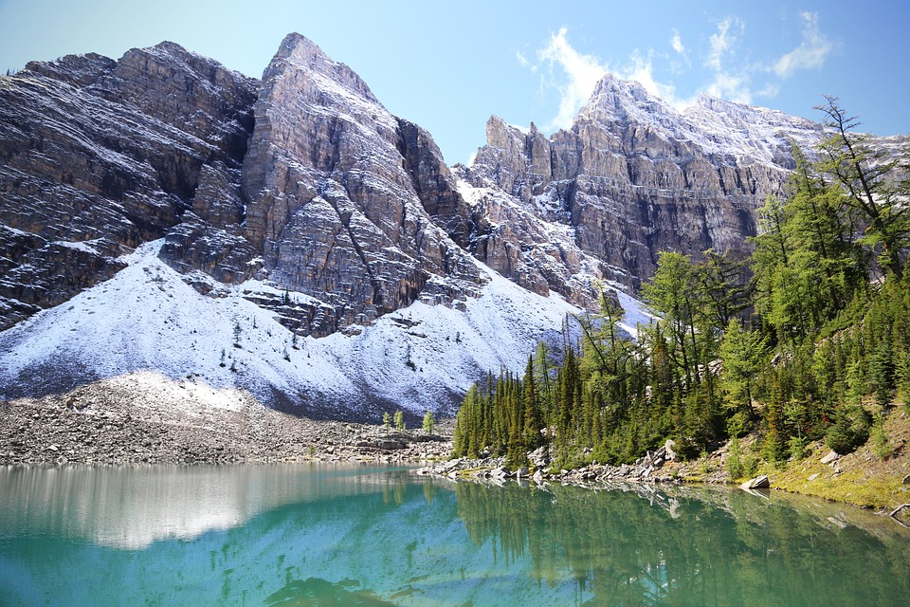
Canada
How many lakes are in Canada?
over 4000
over 30,000
over 13,000
Back to Map
Next

Slide 17
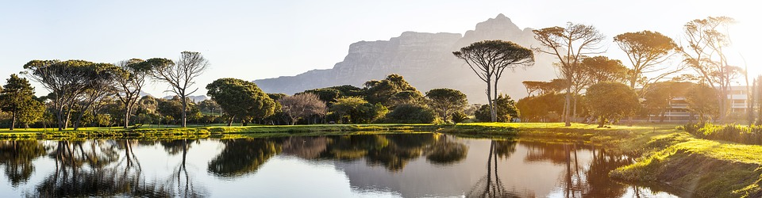
South Africa
How many official languages are spoken in South Africa?
6
22
11
Back to Map
Next

