Slide 1



Welcome to Year 1
One Childhood, One Chance
Together we make a difference

Slide 2
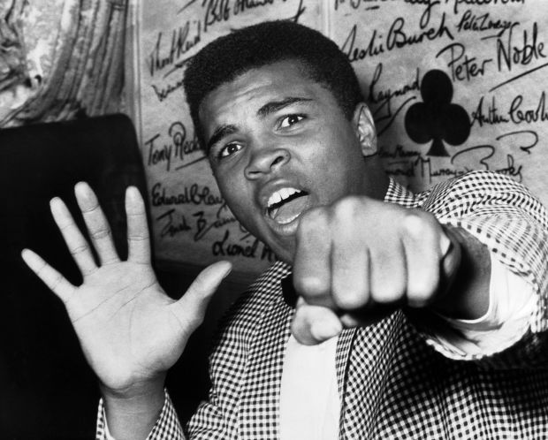
What we’ll cover:
The school day
Learning
Core Values
Behaviour for learning
Home Learning
Home Reading
Other information

Slide 3
The School Day:
APPROXIMATE TIMES!
8:15 – doors open, early morning work
8:30–8:40 - doors close, registration
8:40-9:25– Maths
9:25-10:25 – Child-initiated time
10:25-11:10 – RWI
11:15-11:30 – Story
11:30-12:30 – Lunch
12:30-12.45 – peer massage / handwriting
12.45 – 13:30 – RPC (Topic)
13:30-14:30 – Child-initiated time
15:00– Home time

Slide 4
Days to be aware of:
PE is on a Tuesday
Music is on a Tuesday
Please ensure your child’s reading books and records are in school EVERYDAY ☺
Friday we will write a comment in your child’s reading record

Slide 5
Learning
Maths – Term 1 – recognising numbers (numerals and written word), ordering numbers, counting in 1s, 2s and 10s, knowing what is 1 more and 1 less than a given number, using the language equal to, more than, less than (=, >, <)
RAPS Topic – Term 1 – Me and My Place
RWI – phonics and handwriting.
Website will show termly update

Slide 6
Our Core Values…
These are at the heart of everything we do at Ramsgate Arts Primary School.
Engagement
Enquiry
Diversity
Aspiration
Challenge
Collaboration
Autonomy

Slide 7
Behaviour For Learning
At RAPS, we want our children to be ready to learn.
Happy Safe Successful

Slide 8

3
Call Backs
2
4
5
1
“1,2,3 eyes on me”
1,2, eyes on you.”
“Hands on top”
“That means stop”
Hand signal
“Macaroni cheese”
“Everybody freeze”

Slide 9

Daily rewards
Verbal praise for all effort is at
the core of our teaching!
House points
Superstar Learner cards (If a child has a Superstar learner card on their table at the end of the lesson they can swap it for a house point as they leave).

Slide 10

Smiley cards
We will continue smiley cards for the time being to support behaviour and transition in to year 1
We will gradually adopt the whole school behaviour policy based on a point system

Slide 11




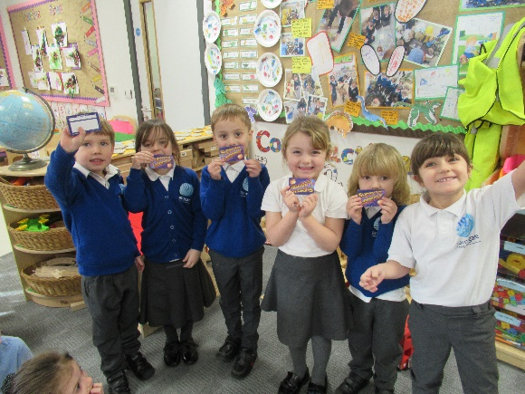
Behaviour
Smiley Cards – for good/expected behaviour each day (keeps you in the loop).
25 smiley cards brought back in will be exchanged for a certificate and reward.
Yellow and Red face may lead to missing some of their choosing time or time out.
Superstar
House points

Slide 12

Sanctions
If a child is:
talking
messing around
refusing to work
rude
disrupting the lesson etc
a non-verbal warning, a verbal warning then their name will be moved to the yellow face. This will act as a reminder to the child that they have got to improve their behaviour. If the behaviour continues their name will go on the red face. There are opportunities all day to work their way off the sad faces and earn back their smiley card.

Slide 13

Home Learning
Love 2 learn will be assigned every 3 weeks and it will always be linked to out topic learning

Slide 14
Home Reading
Reading is very important to us at RAPS. It is crucial to your child’s learning and development; therefore, we recommend that your child reads at least 4 times a week.
If your child’s book needs changing, please put the book and reading record in your teacher’s designated box in the morning.
Whether the book is completed or not, all children’s books and records need to be on a Friday.
The class teacher will then make an acknowledgement (a stamp or if necessary a specific comment) in your child’s record and return it.
In KS1 all books read by your child count towards the ‘Race to 100’. Please write down other books, read at home not set by RAPS in your child’s reading record.

Slide 15
Home Reading
Book bands…it is very important in Year 1 to build fluency and confidence so we only move the children on when they are reading fluently and showing solid comprehension of what they have read.
Too easy or too difficult? Please let your child’s teacher know via the record book. The teachers will then assess their understanding of the book band that Friday and make their decision based upon that assessment.
Bug Club logins will also be sent out. This is a good tool to aid your child’s comprehension using the ‘question bugs’. Please write any books read on Bug Club in the Reading Record Book.
In addition to a ‘banded book’, your child is also more than welcome to take home a book from the book corner/corridor. This is your child’s choice of book.

Slide 16
Home Reading
September 2020
EYFS + KS1 Agreements:
- Teachers will continue to check the children’s yellow reading records every Friday and make a comment or acknowledgment.
We will log how many books the children have read using the Race to 100 display.
- TAs/Teachers will change the books for the children when they bring them in Monday-Thursday. We will use a stamp or comment to acknowledge the children have read each day.
- Children are expected to read at least 4x a week. If that is not being seen via the reading records parents will receive a letter.
- Reading regularly with your child and communicating with the CT or TA will ensure we are all supporting your child in the best way that we can.
- Teacher or TA will listen to each child read at least 3 times a term and make a comment in their reading records.
-Teachers and Ta’s will read a story to their class at least once a day.

Slide 17
Other information
School Uniform expectations – smart and shirts tucked in
PE kits
Reading books can be changed whenever your child has finished their book.
Class blogs up to 3 per week letting you know what is going on in classroom plus homework blog
Open door policy: come and chat with us!

Slide 18

Any Questions?

