Slide 1


Welcome to
Team Dannell
One Childhood, One Chance
Together we make a difference

Slide 2

What we’ll cover:
The Team
Covid 19 and adaptions
The School day
Learning
Core Values
Behaviour for learning
Home Learning
Home Reading
Mathletics
Other information

Slide 3
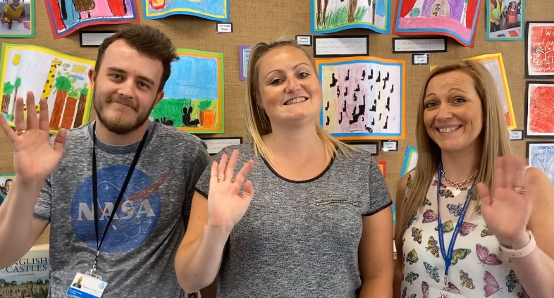
The Team
Miss Dannell
Mrs Aldred
Mr Brierly

Slide 4

Covid 19 and adaptions
Start of day (8.15am-8.30am)
Children are dropped off at the gate
Children walk round the back of the school and through door at the far end
Pick up
Parents to collect children from playground
Look for Y5 parents sign
Exit school through Reception gate
Children are in ‘bubbles’ (Y5 and Y6 are bubble)
Handwashing will take place regularly
Outside areas zoned
Children will have their own labelled stationery

Slide 5
Covid 19 and adaptions
Mon + Thurs come to school in PE kit
Bring labelled water bottle
If a child is showing symptoms they must not come into school
If a child becomes symptomatic at school, they will be isolated and parents will be phoned to pick them up
They will need a negative test result before returning to school

Slide 6
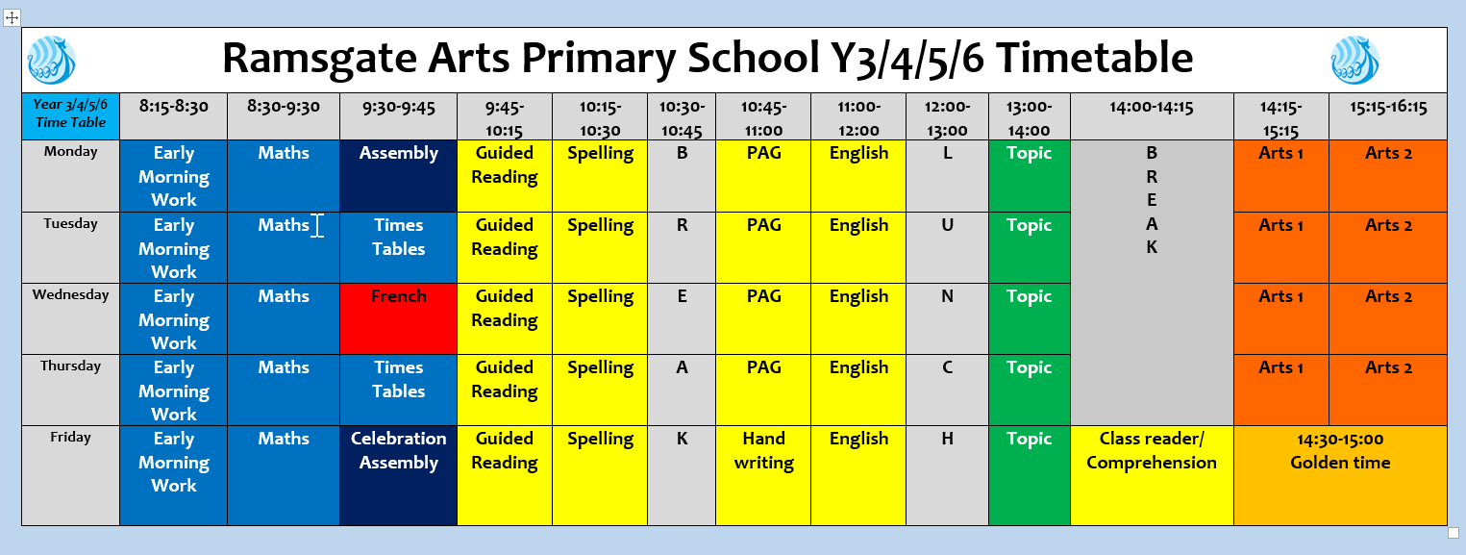
The School Day:

Slide 7
Arts Curriculum
Mon
Tues
Wed
Thurs
Year 5
PE
Dance
Drama
ICT
Art
Art
Music
PE

Slide 8
Learning
Maths – Focus on place value/revision
English – Kensuke’s Kingdom
RAPS Curriculum– Global Trade
Website will show termly update

Slide 9
Our Core Values…
These are at the heart of everything we do at Ramsgate Arts Primary School.
Engagement
Enquiry
Diversity
Aspiration
Challenge
Collaboration
Autonomy

Slide 10
Behaviour For Learning
At RAPS, we want our children to be ready to learn.
Happy Safe Successful

Slide 11

3
2
4
1
5
Hand signal

Slide 12
What are RAPS
Golden Rules?
Expected Behaviour at RAPS

Slide 13
Behaviour Points
Each child starts off with 5 points at the beginning of every day.
Possible total of 25 points a week. Expected to keep all 25 points!
The points will also be looked at on a 3 weekly basis. 25 x 3 = 75 points

Slide 14

Sanctions
If a child is:
talking
messing around
refusing to work
rude
disrupting the lesson etc
a NV warning, a verbal warning then a
yellow warning card
gets placed on the desk in front of you. This will act as a reminder to the child that they have got to improve their behaviour.

Slide 15

If a child improves their behaviour they can then earn the yellow card back. The yellow card can then be removed from the table.
If a child continues to misbehave the yellow card is changed to a red card.

Slide 16
If a child has a yellow card on their desk at the end of the lesson they lose 1 point.
If a child has a red card on their desk at the end of the lesson they lose 2 points.

Slide 17
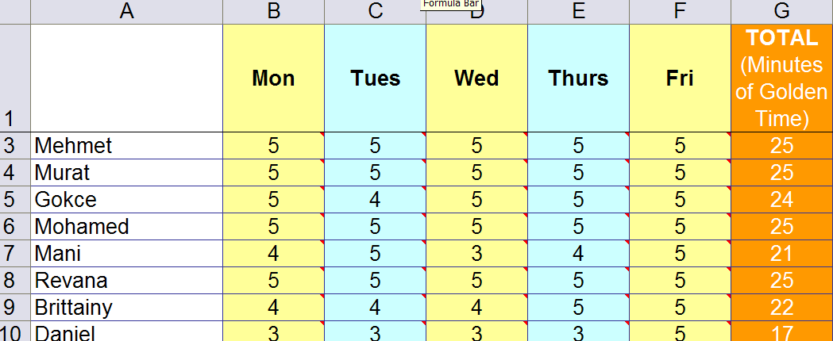
Behaviour Points

Slide 18

Daily rewards
Verbal praise
Superstar Learner cards. (If a child has a Superstar learner card on their table at the end of the lesson they can swap it for a house point as they leave).
Raffle tickets

Slide 19
Weekly Rewards
25 points= All golden time and text home.
22-24 points= All golden time.
11-22= Teacher to contact parents.
6-10 points= Mr Budge to send letter home to inform parents.
5 points or less= Mr Budge to have a meeting with parents.

Slide 20
Three week rewards
75 points= Letter home (emailed). Badge to wear.
3rd badge: RAPS lanyard
6th badge: silver behaviour badge
12th badge: Gold behaviour badge

Slide 21
Class rewards
Three week rewards
The class with the most points in each year group gets a £3.00 RAPS Cheque to display in their classroom.
At the end of terms 2, 4 and 6 each class can ‘cash’ in their cheques to buy something for the class as a reward/treat. For example, an ice-cream each down the beach.

Slide 22
Home Learning
Love 2 learn will be assign every 3 weeks
Home reading should be happening regularly – preferably every night, but at least 4 times a week
Spellings every week in KS2
KS2-Matheltics assigned every week – tables focus/reinforcing learning activity

Slide 23
Home Reading
School reading books have been assigned to every pupil in the class. The band is based on a combination of word reading and comprehension. If you feel it is too easy or too difficult please speak to a member of staff. Children are encouraged to change books themselves.
Bug Club- log ins stuck in reading record books

Slide 24
Mathletics
Accessible from home.
Logins in reading record
Tasks will be set from time to time.
Tool to support learning
Half hour in class a fortnight.

Slide 25
Times Tables Rockstars
Logins in Reading Record
You can download the app.
They can practise as they so wish.
We will practise in class.

Slide 26
Other information
School Uniform expectations
PE kits
Face masks not compulsory
Class blogs -3 x weekly letting you know what is going on in classroom plus homework blog
Padlet
Ask questions

Slide 27


