Slide 1
Ramsgate Arts Primary School
KS1 SATs Parents Guide
2018

Slide 2
What are SATS? (Statutory Assessment Tests)
At the end of Year 2 the children will undertake assessments in:
Reading
Maths
Punctuation and Grammar
Spelling

Slide 3
The Reading Paper
The Reading Test consists of two separate papers:
Paper 1 – consists of a combined reading prompt and answer booklet. The paper includes a list of useful words and some practice questions for teachers to use to introduce the contexts and question types to pupils. The test takes approximately 30 minutes to complete, but is not strictly timed.
Paper 2 – consists of an answer booklet and a separate reading booklet. There are no practice questions on this paper. Teachers can use their discretion to stop the test early if a pupil is struggling. The test takes approximately 40 minutes to complete, but is not strictly timed.
The texts will cover a range of poetry, fiction and non-fiction.

Slide 4
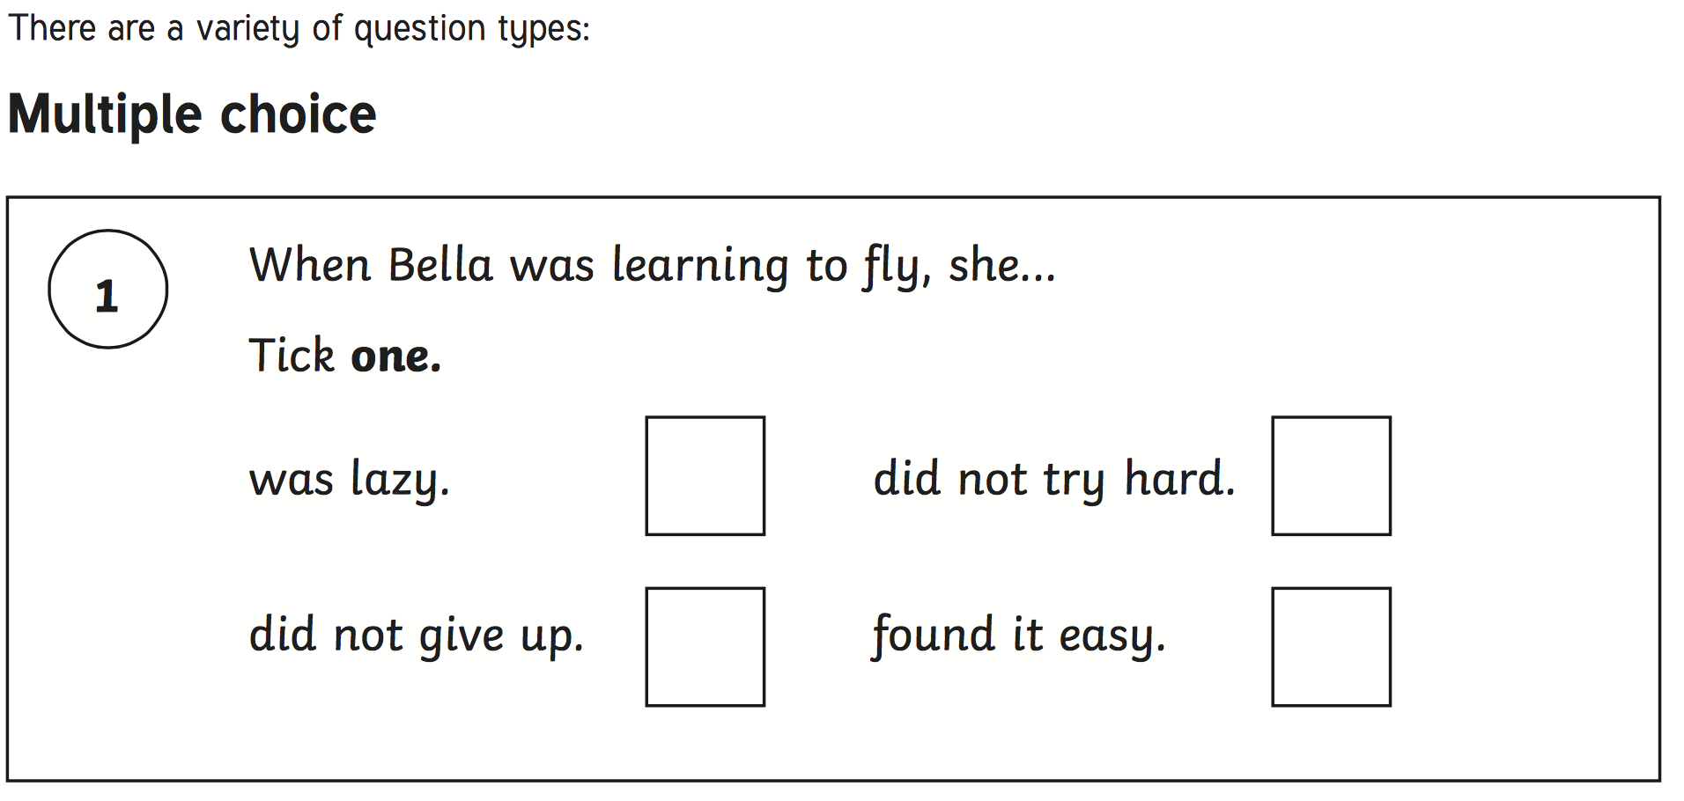
The Reading Paper

Slide 5
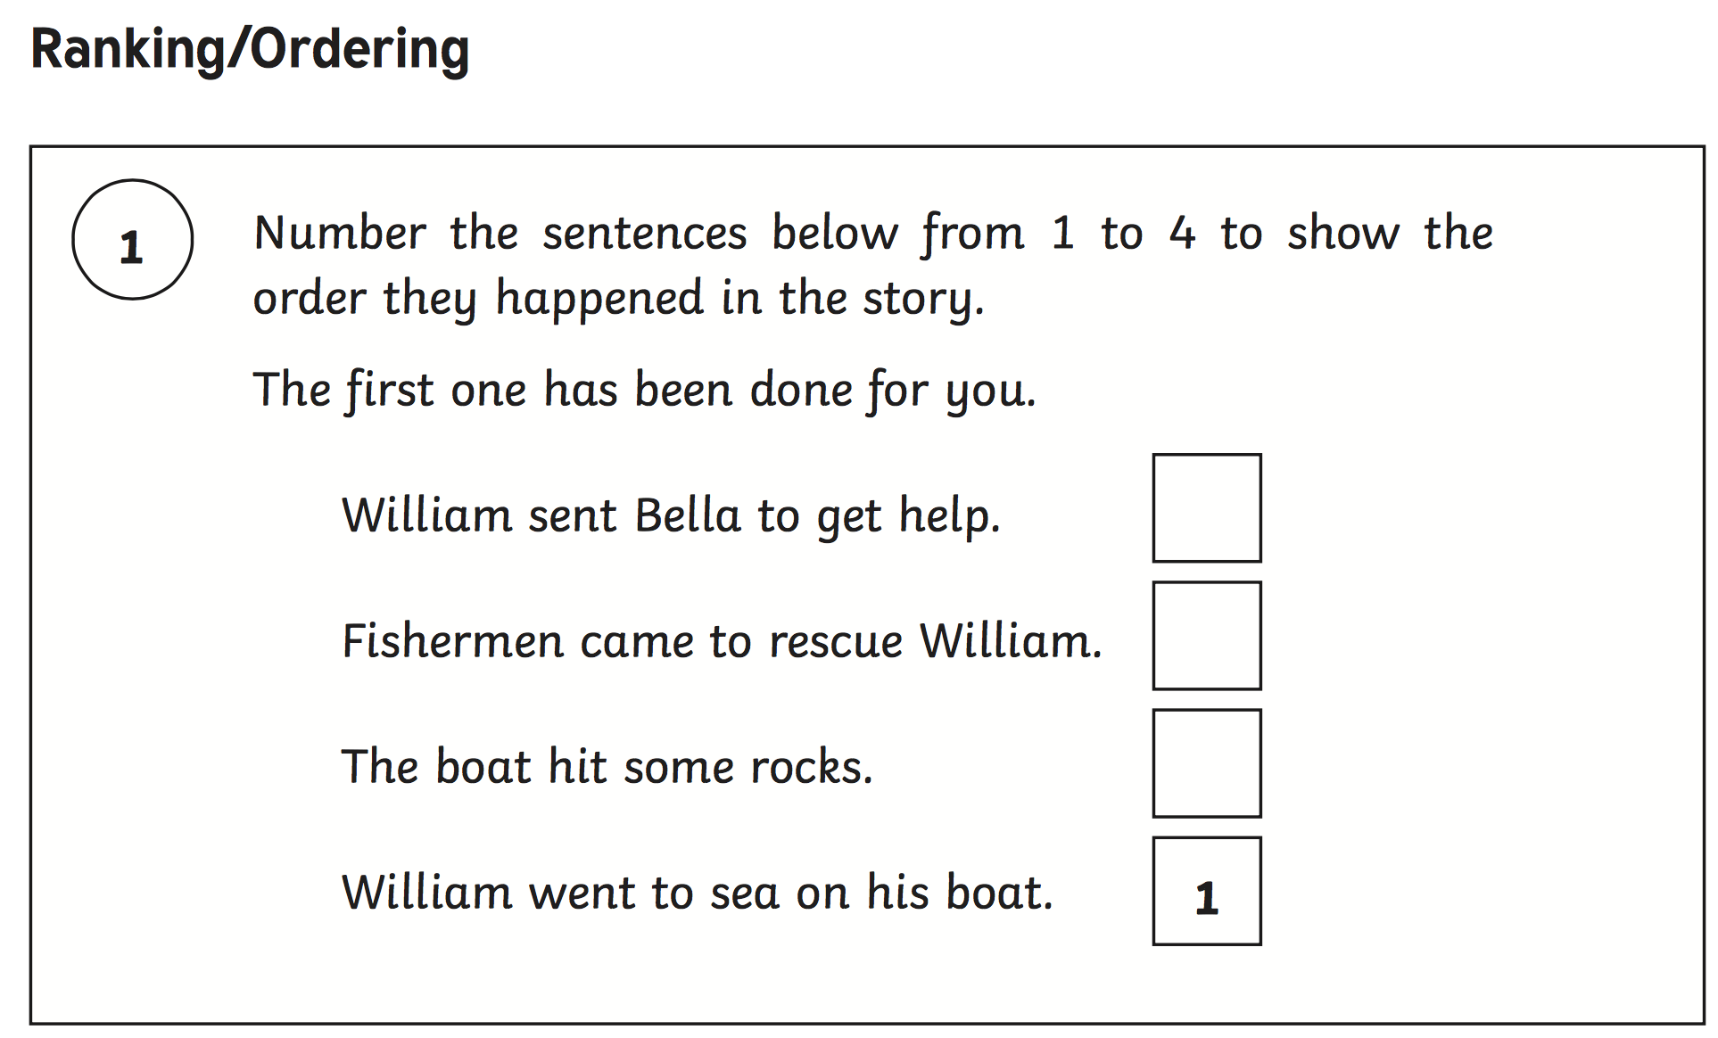
The Reading Paper

Slide 6
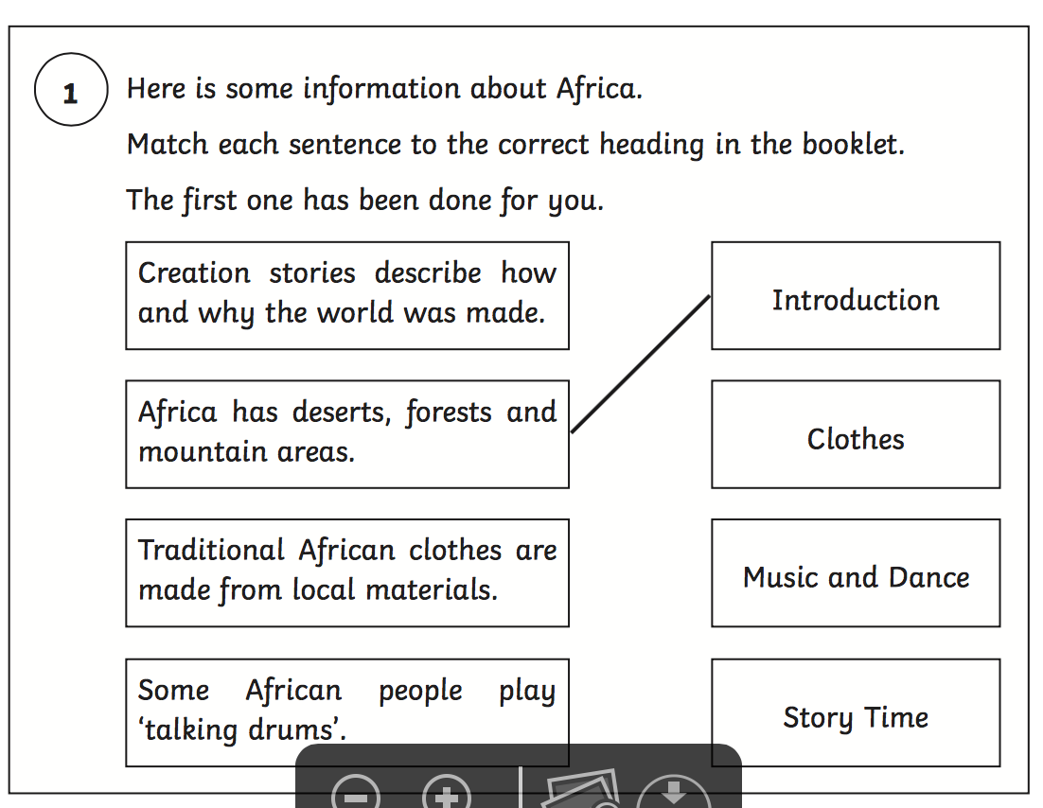
The Reading Paper

Slide 7
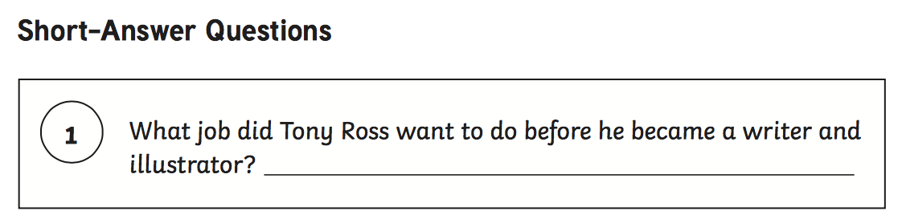
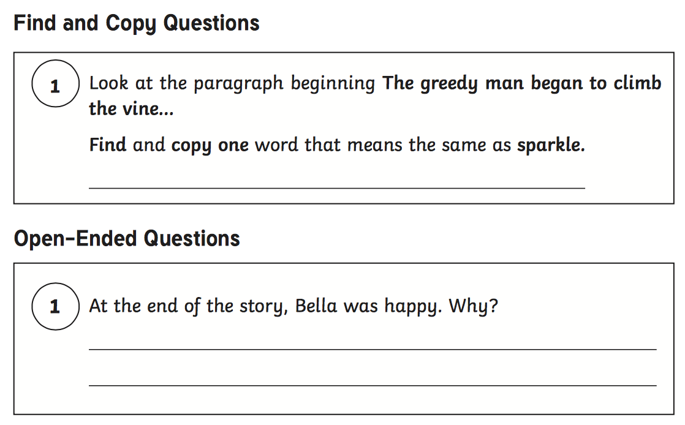
The Reading Paper

Slide 8
The SPAG Paper
This year, the Spelling, Punctuation and Grammar test will be optional for all Year 2 classes. We will still administer the assessment in order to inform my teacher-assessed writing judgements. The test consists of two separate papers:
Paper 1: Spelling - pupils to spell 20 missing words within a test booklet. The test is expected to take approximately 15 minutes to complete, but is not strictly timed.
Paper 2: Grammar, Punctuation and Vocabulary - a combined question and answer booklet focusing on pupils’ knowledge of grammar, punctuation and vocabulary. Pupils will have approximately 20 minutes to complete the questions in the test paper, but it is not strictly timed.

Slide 9
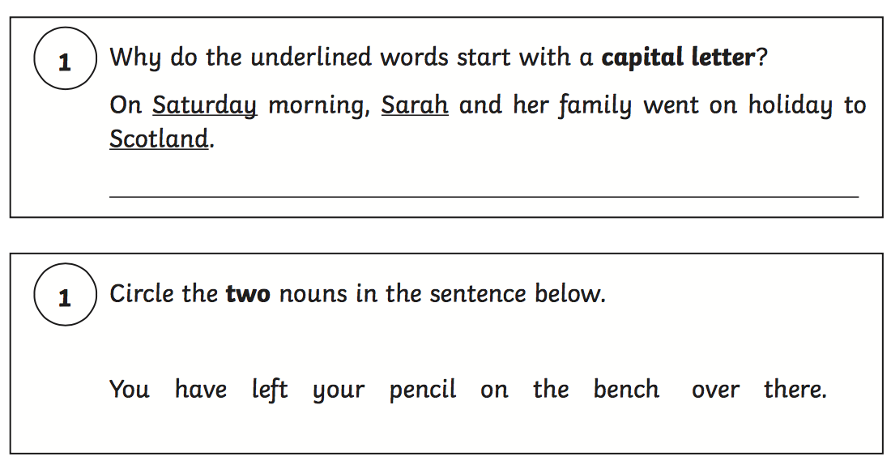
The Grammar and Punctuation Paper

Slide 10
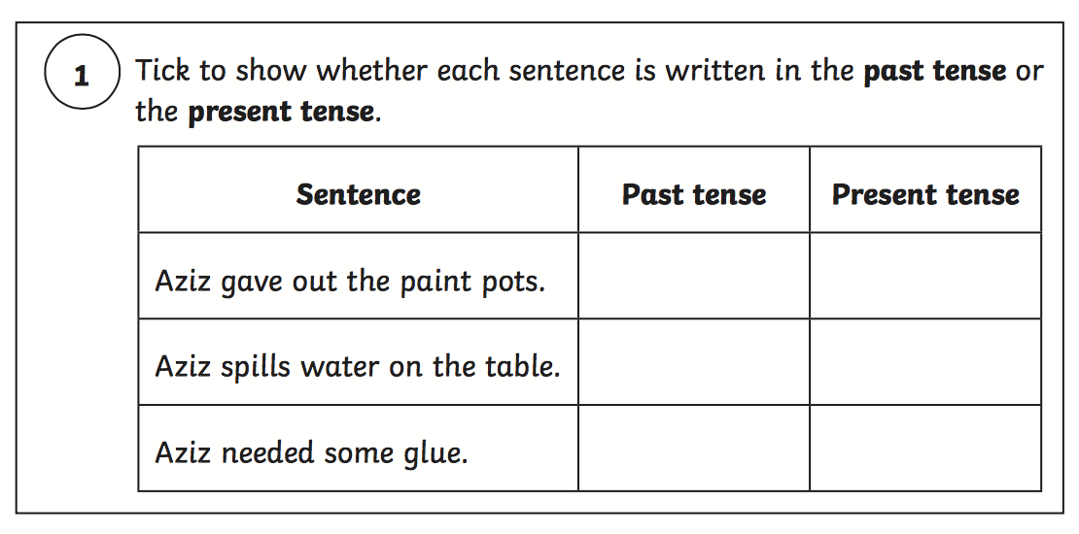
The Grammar and Punctuation Paper

Slide 11
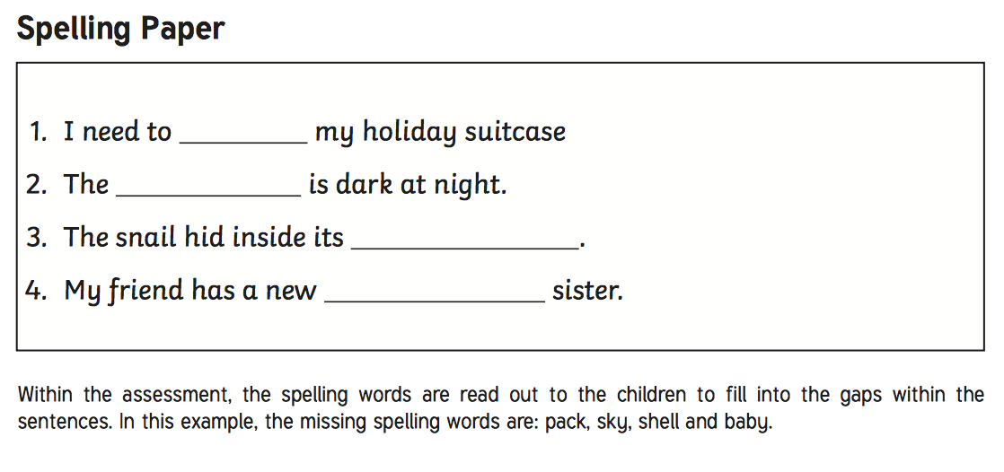
The Spelling Paper

Slide 12
The Maths Paper
Children will sit two tests: Paper 1 and Paper 2:
Paper 1: Arithmetic - lasts approximately 20 minutes (but this is not strictly timed). It covers calculation methods for all operations.
Paper 2: Reasoning - lasts for approximately 35 minutes, which includes time for five aural questions. Pupils will still require calculation skills and questions will be varied including multiple choice, matching, true/false, completing a chart or table or drawing a shape. Some questions will also require children to show or explain their working out.

Slide 13
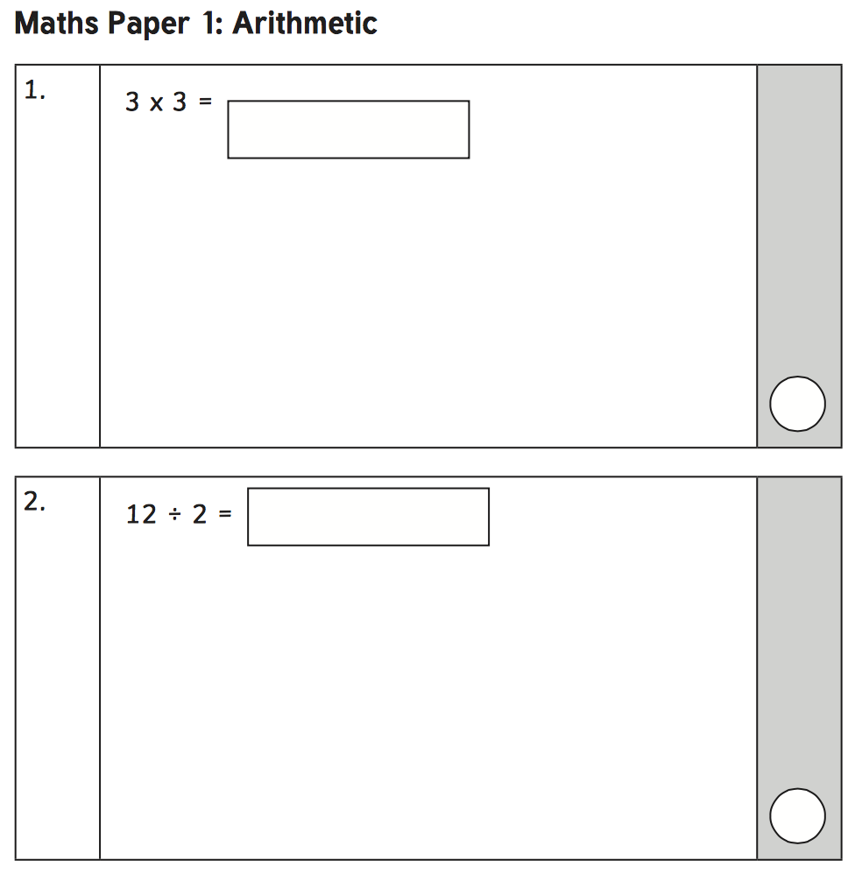
The Maths Paper

Slide 14
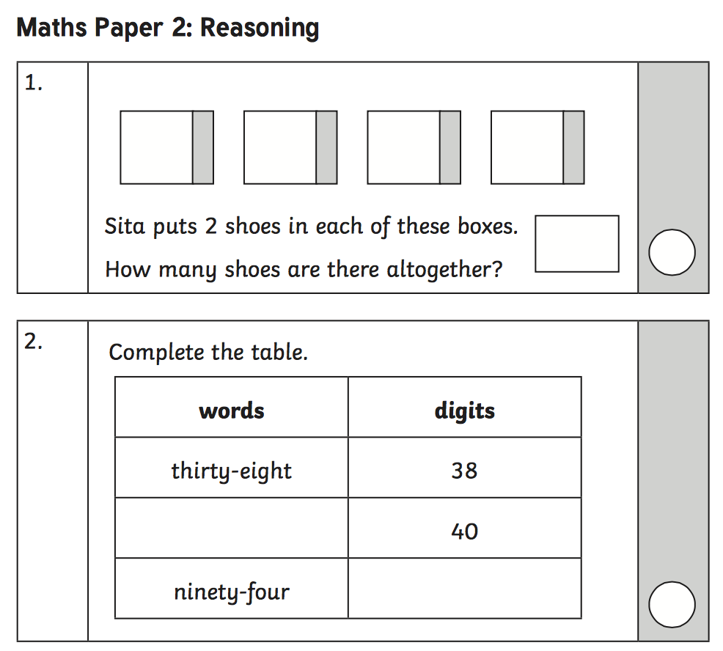
The Maths Paper

Slide 15
How will we administer the tests?
Small groups (maximum 6)
In a calm and relaxed room
They will be in there for as long/little as they need
Breaks are welcome!
The children have the month of May to complete all the tests, therefore they don’t have to worry about sticking to time limits.
We will only administer tests in the morning

Slide 16
Where will Miss Rees-Boughton be?
I will be out of class throughout May taking the small groups to do their tests.
Miss Amin (year 4 teacher) will be teaching the remainder of the children.
Miss Amin will be spending this week in class getting to know Team R-B.
Mrs Beech (the new deputy head) will be in Year 4
I will be taking other small groups out in the afternoon for booster sessions.

Slide 17
What can you do?
First and foremost, support and reassure your child that there is nothing to worry about and that they should always just try their best.
Praise and encourage!
Ensure your child has the best possible attendance at school.
Support your child with any homework tasks.
Reading, spelling and arithmetic (e.g. times tables) are always good to practise.
Talk to your child about what they have learnt at school and what book(s) they are reading (the character, the plot, their opinion).
Make sure your child has a good sleep and healthy breakfast every day!

Slide 18
Any Questions?

