Slide 1
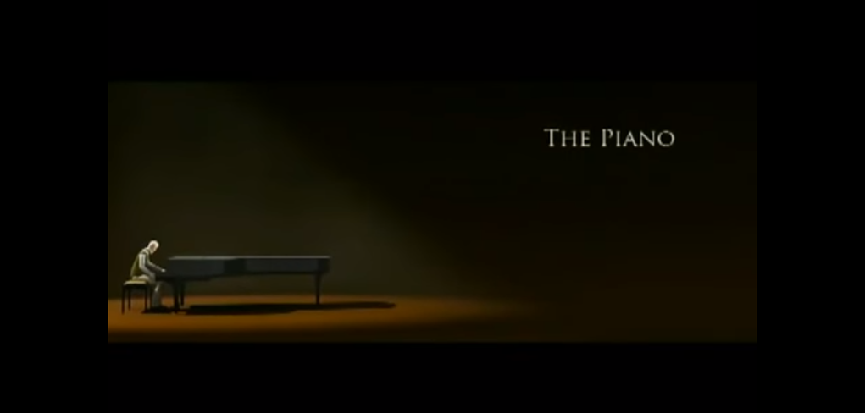

The piano
By byron

Slide 2
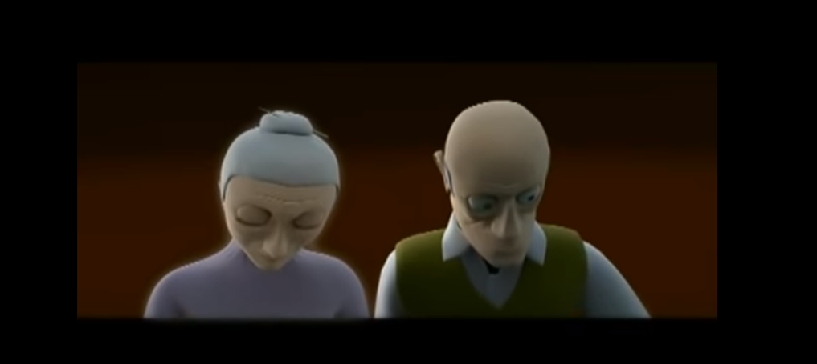
happy
mellowiss
LOVELY
FEEL GOOD

Slide 3
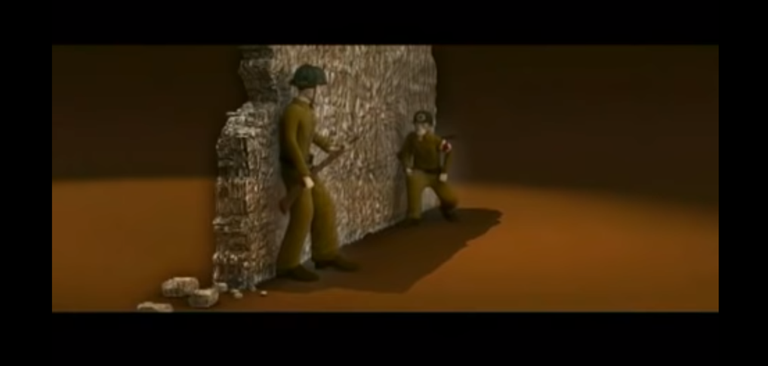
bravely
NOT NICE

Slide 4
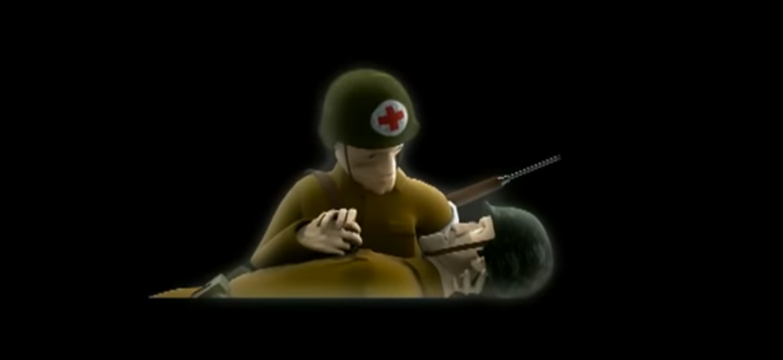
horrible

Slide 5
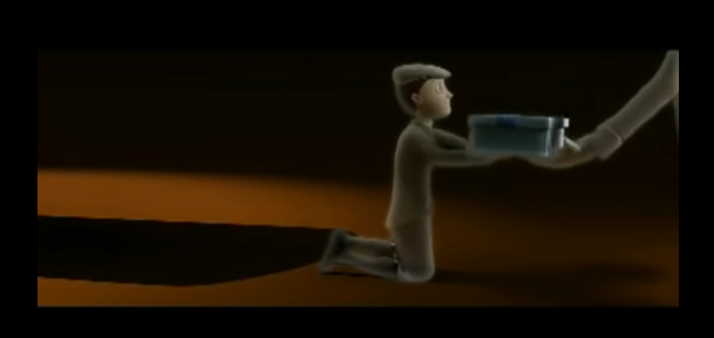
blissful
NICE

Slide 6
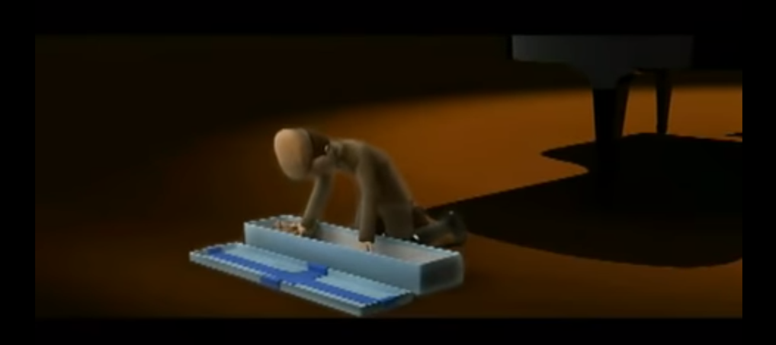
exited
GREAT
LOVELY

Slide 7
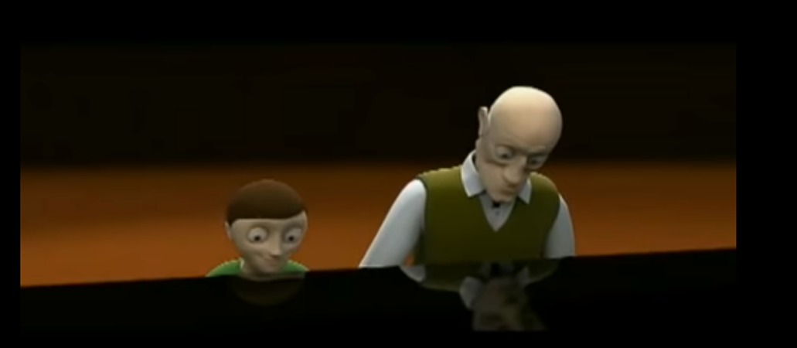
lively

Slide 8
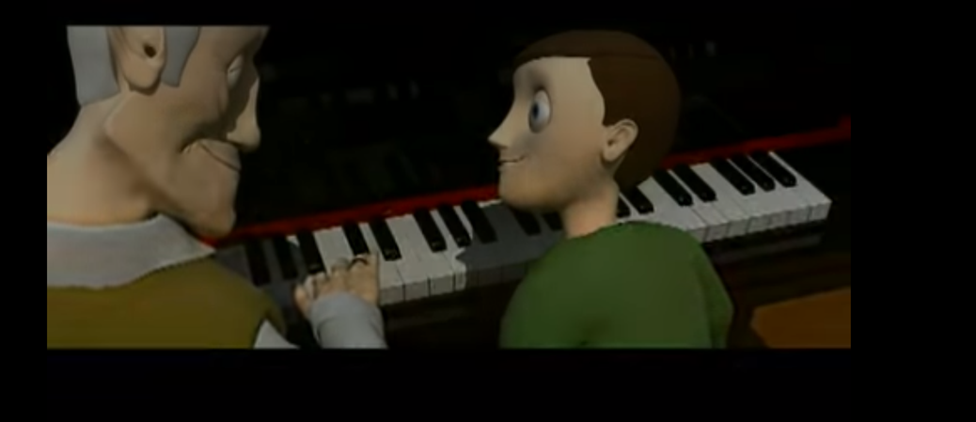
nice
warm

Slide 9

The end

