Slide 1
The piano
By Ellis

Slide 2
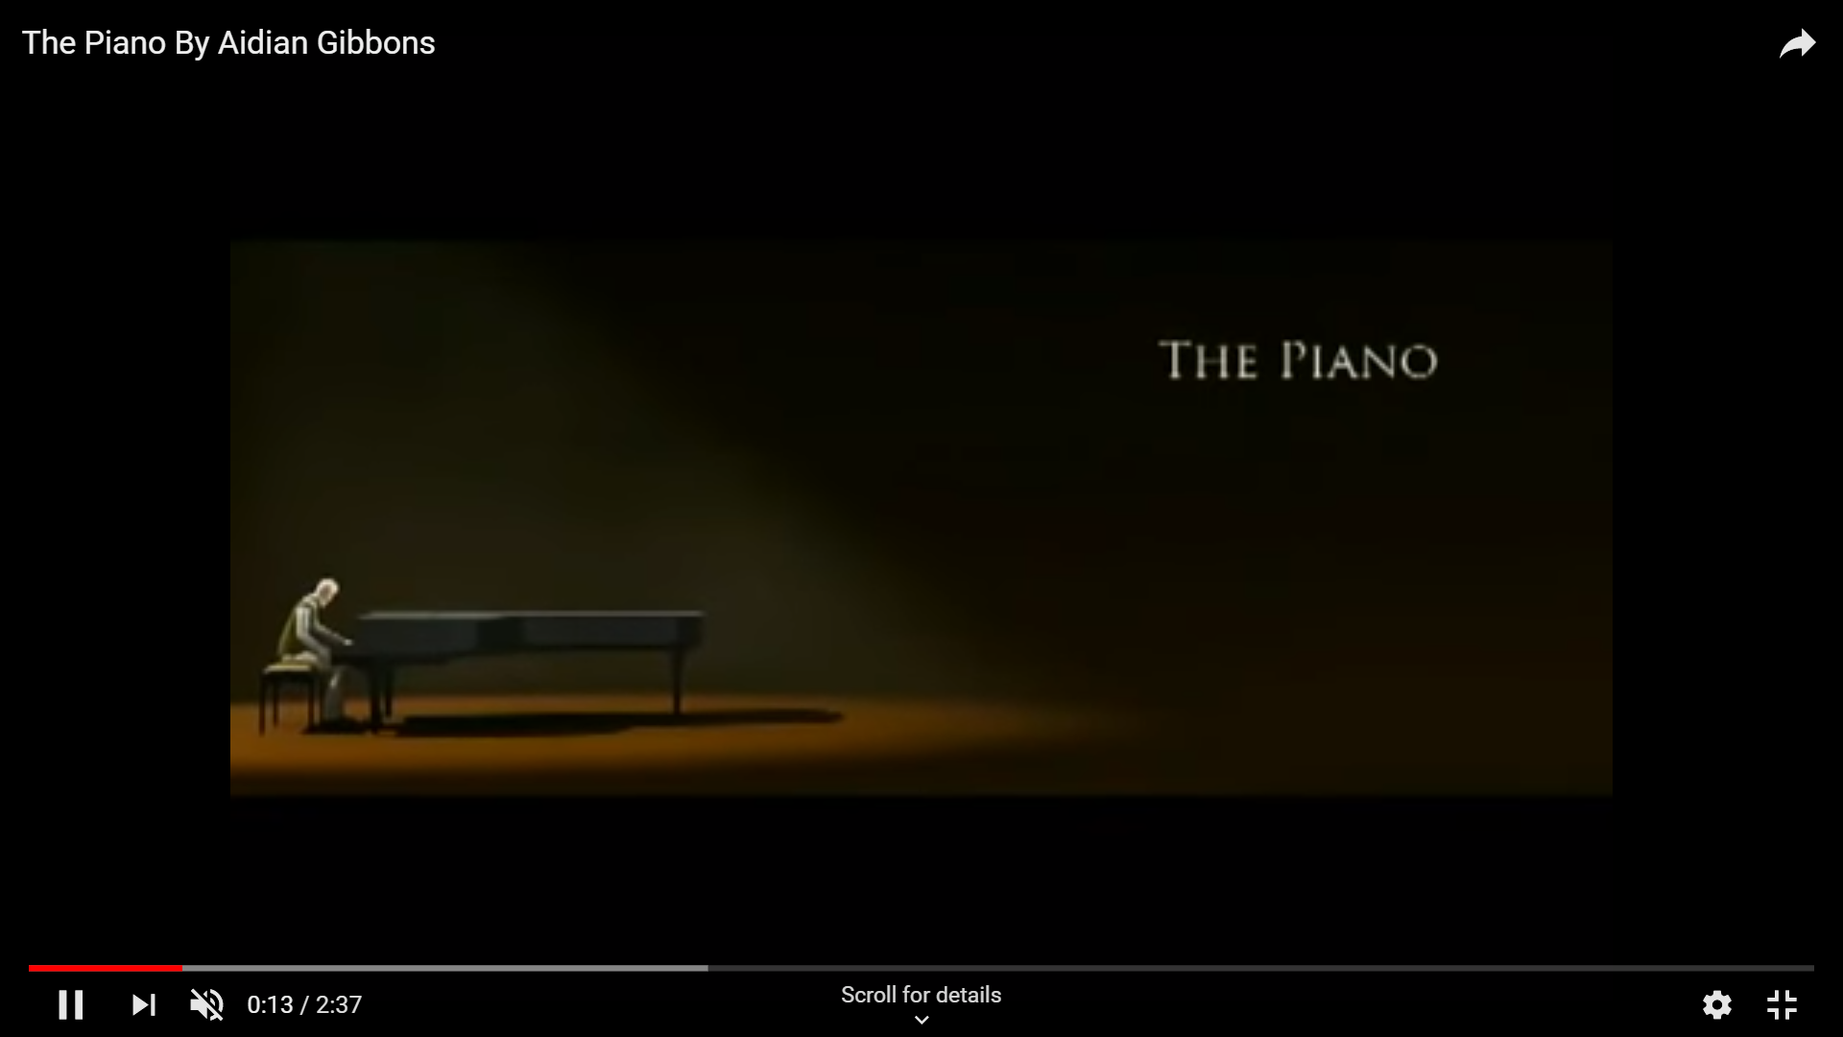

Slide 3
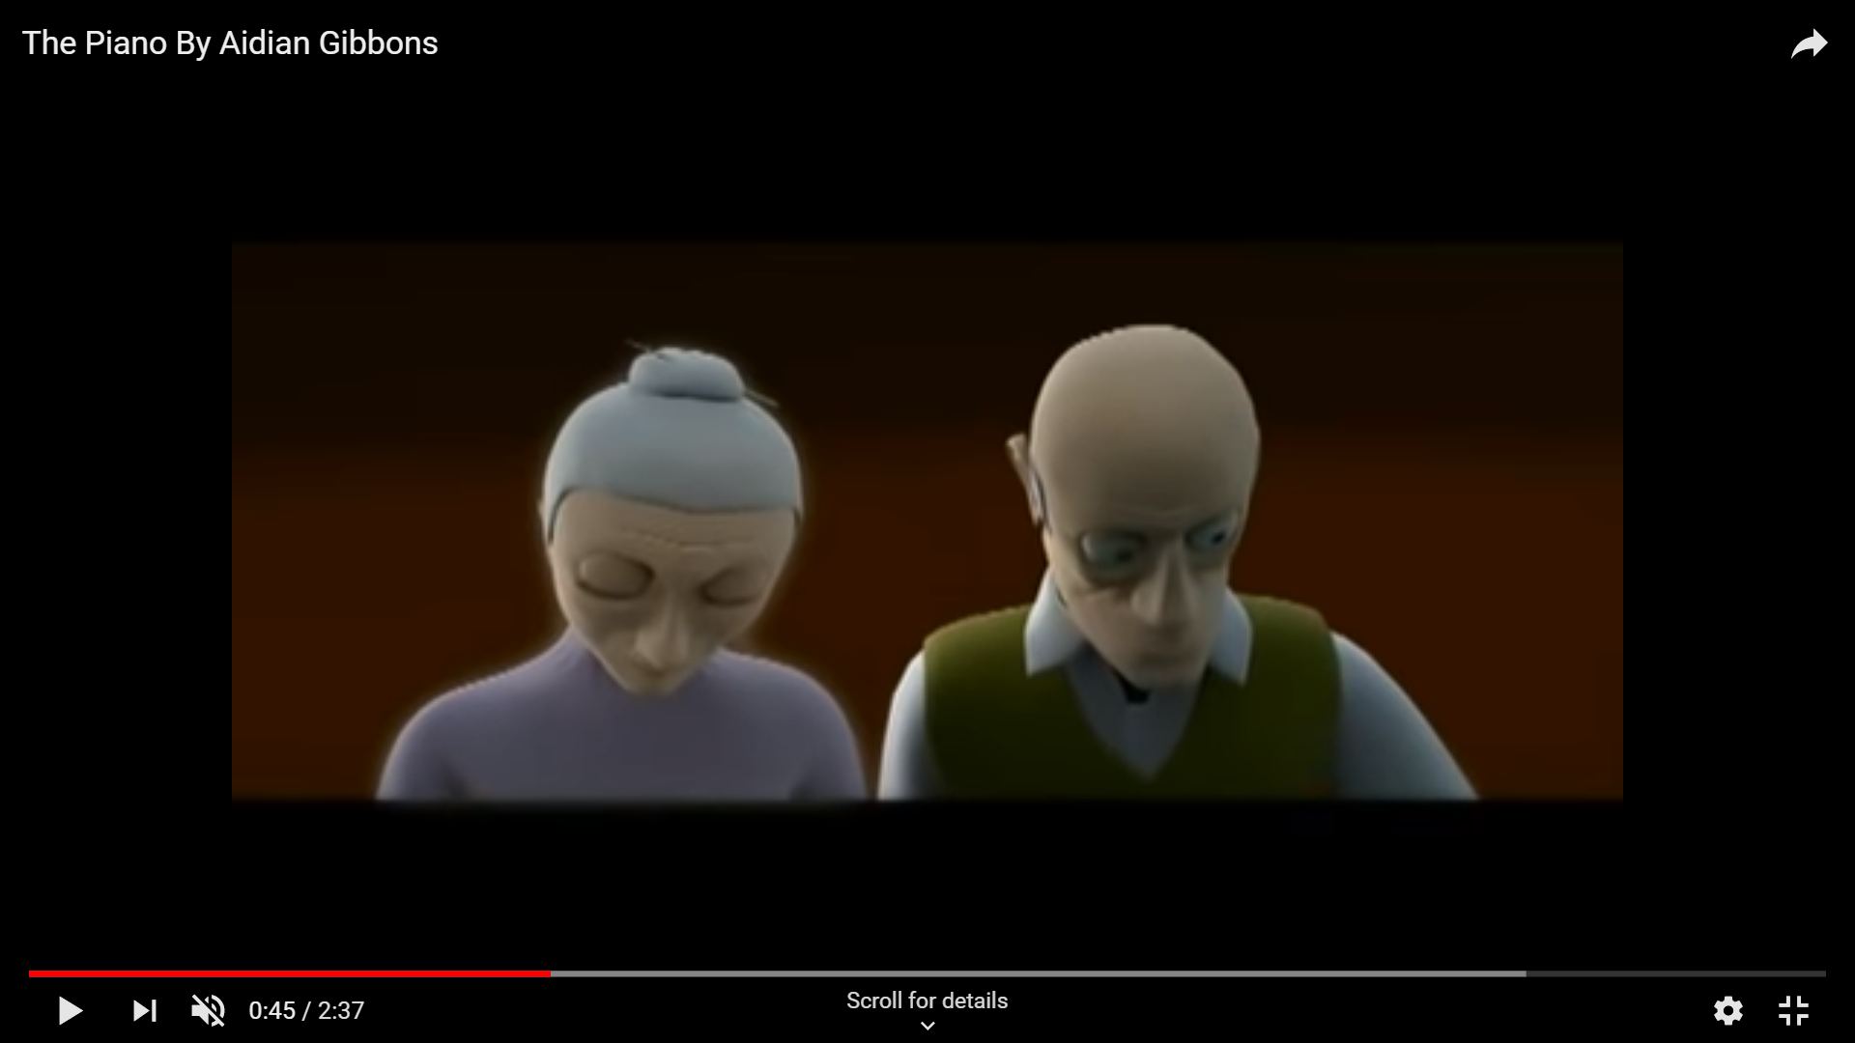

ghostly
Spiritual duet
forlornly

Slide 4
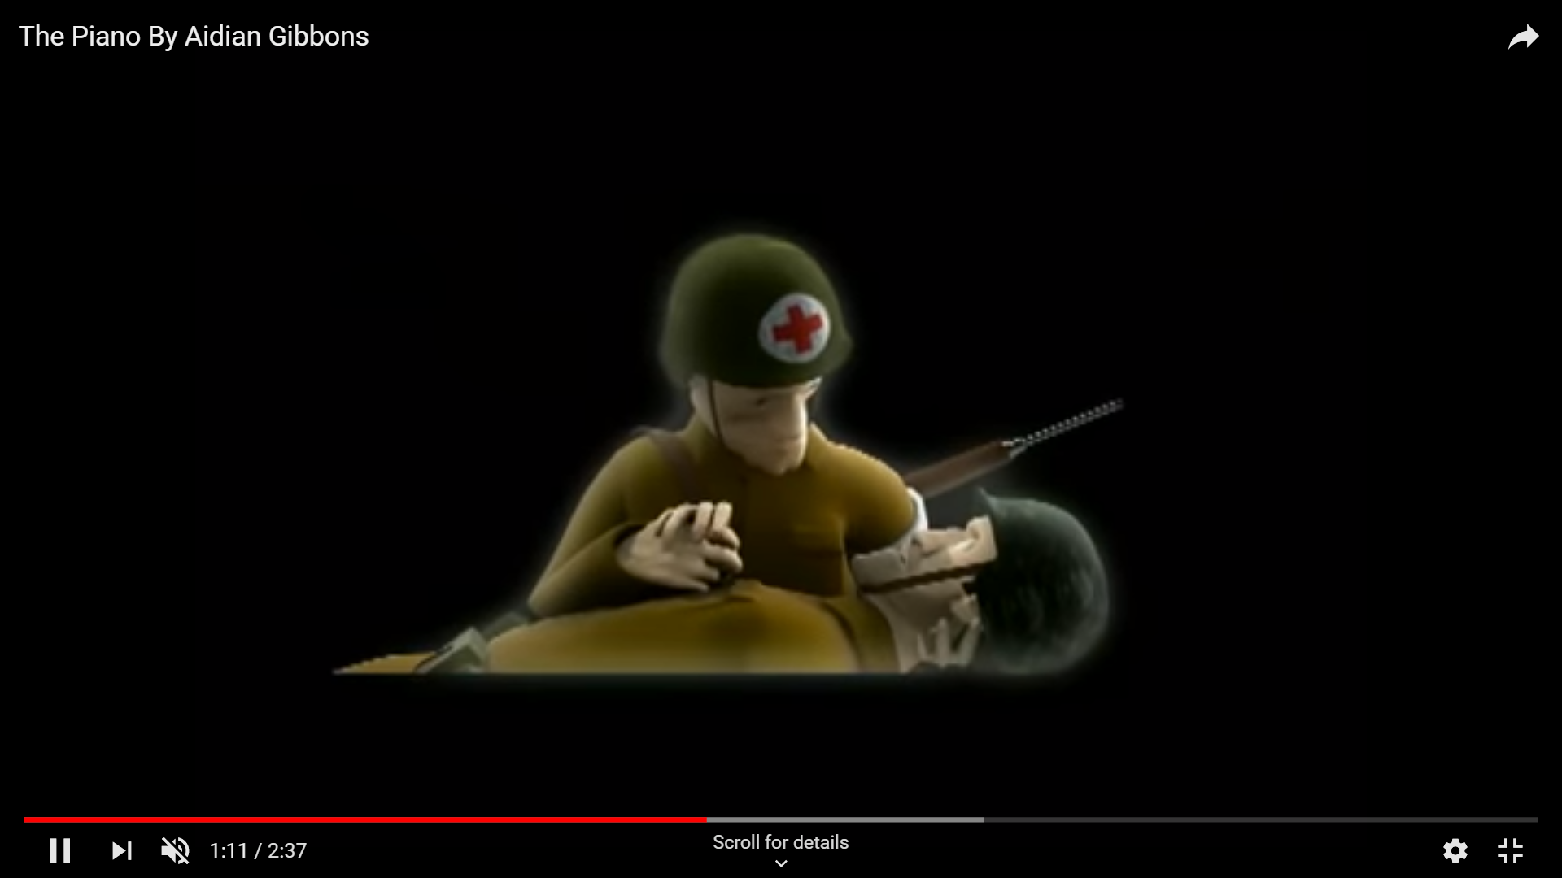
His hip pouring with blood
The bullet ripples through him

Slide 5
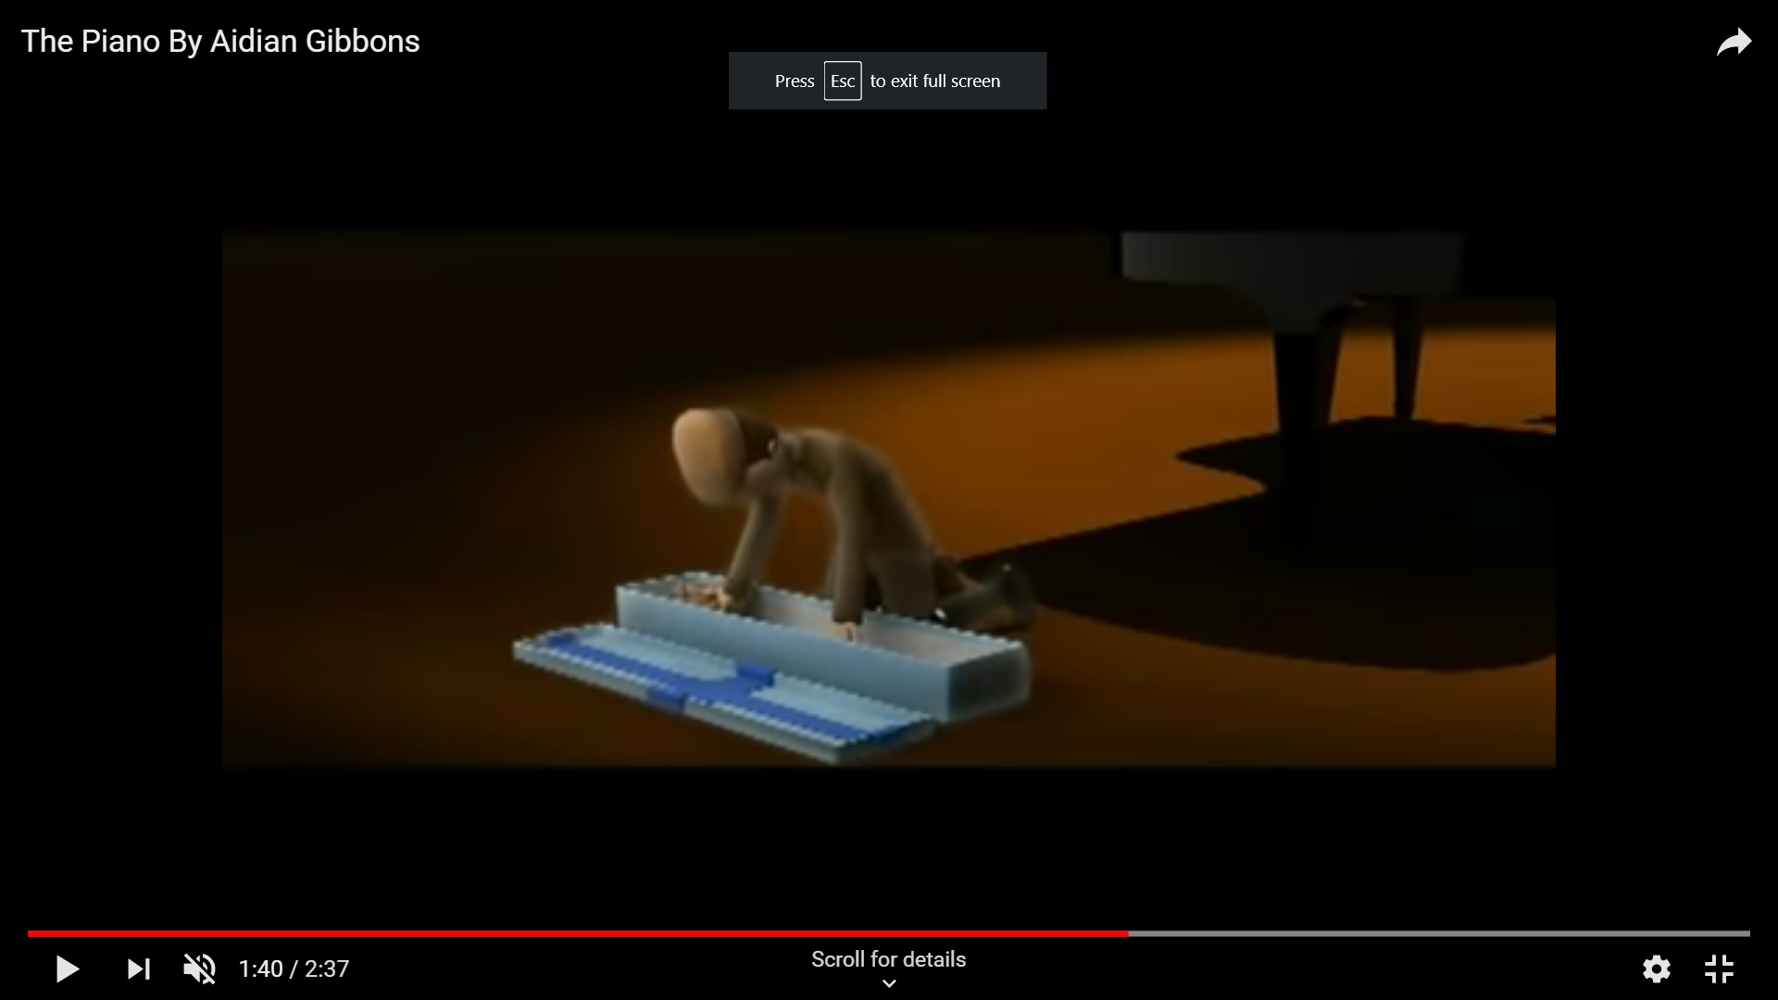
Emerald green eyes
Vibrant
Luscious

Slide 6
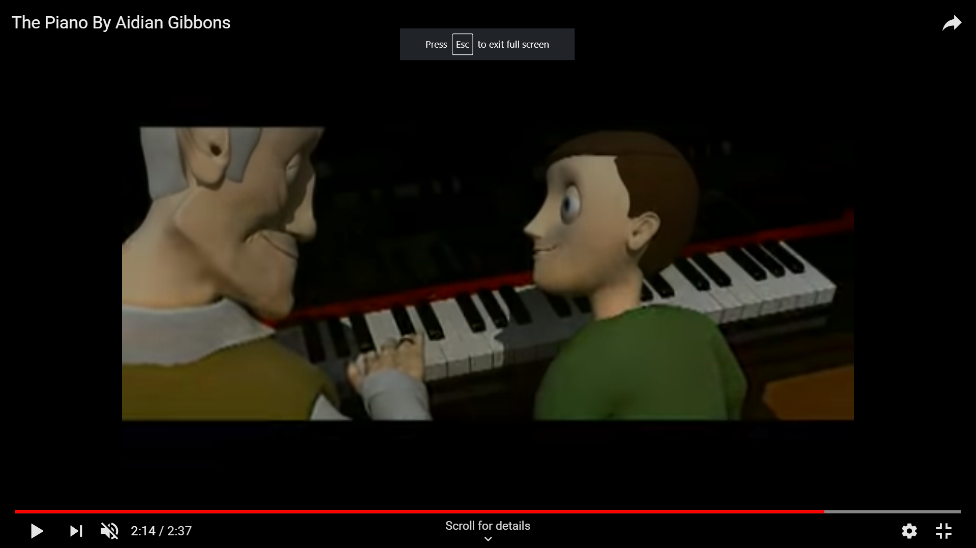
Beloved
prances
Tender

