Slide 1
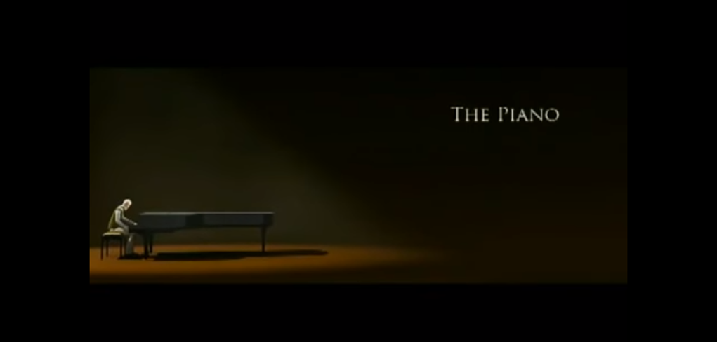
By Evie

Slide 2
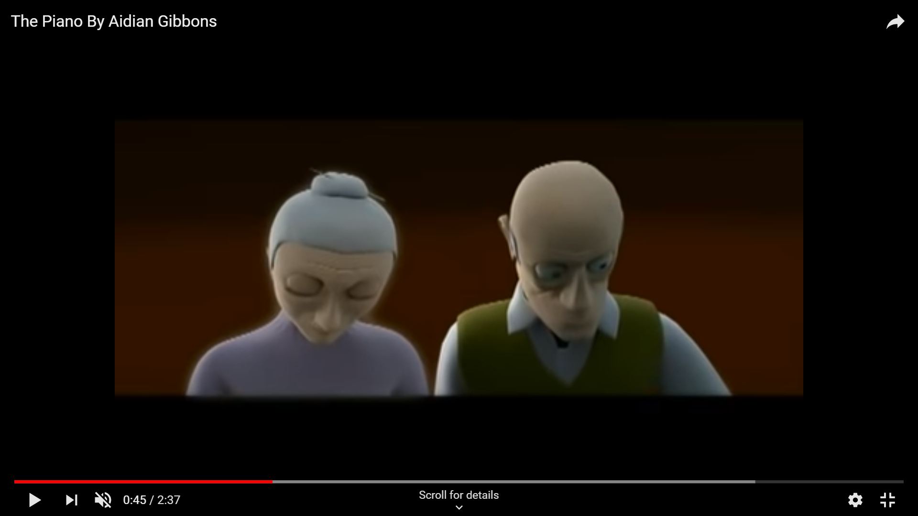

gentle
depressed
soft
downhearted

Slide 3
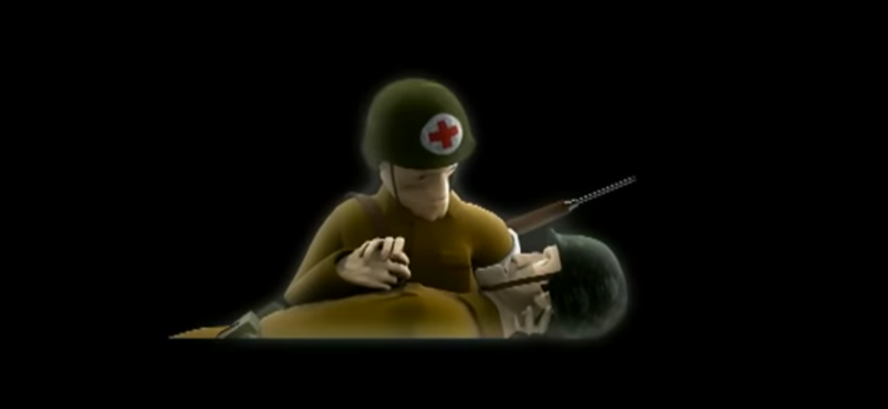
Putrid Smoke
Glimmering
Pierced
Bang
Rapid Fire

Slide 4
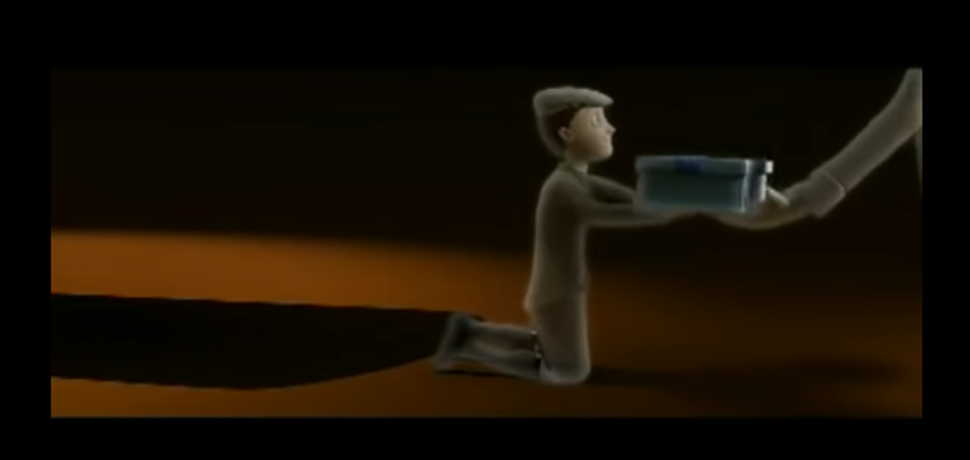
Flash back
Smiling
Joy
Cowboys
10th birthday
Most loved present
Beautiful teal tissue-paper

Slide 5
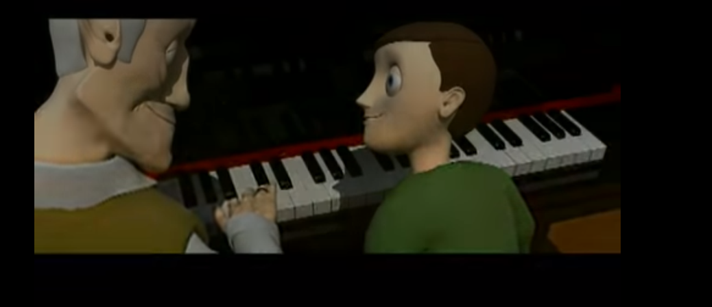
Grandson playing
Hobby horse
Glisterning eyes
Glimmering
Wife
notes
Feelings of glee

