Slide 1
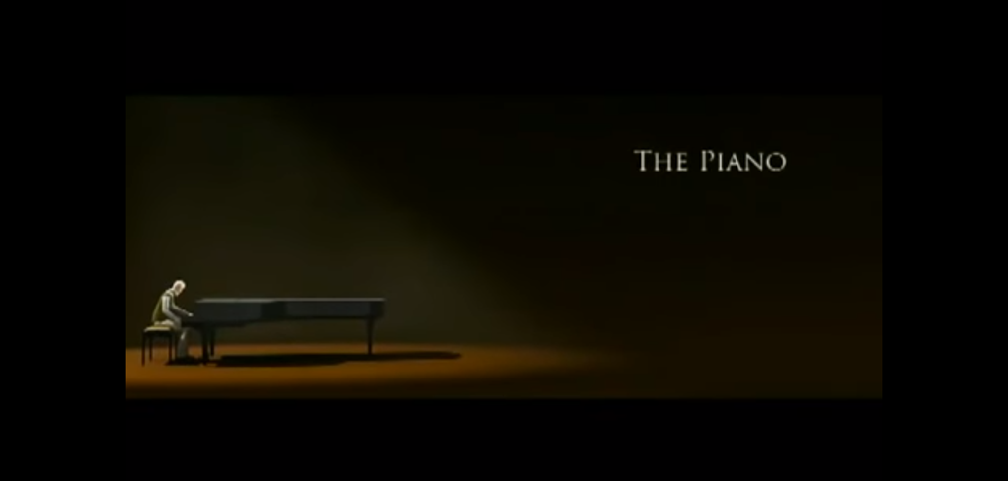
The Piano
By Oakley Williams

Slide 2
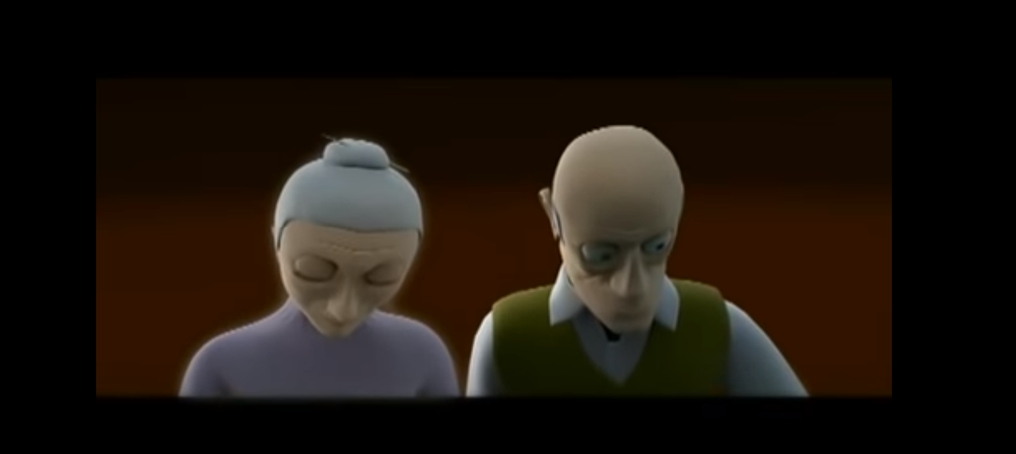

Ghostly
Like a volcano in my mind in my mind
Countless
Sadness surrounding my body

Slide 3
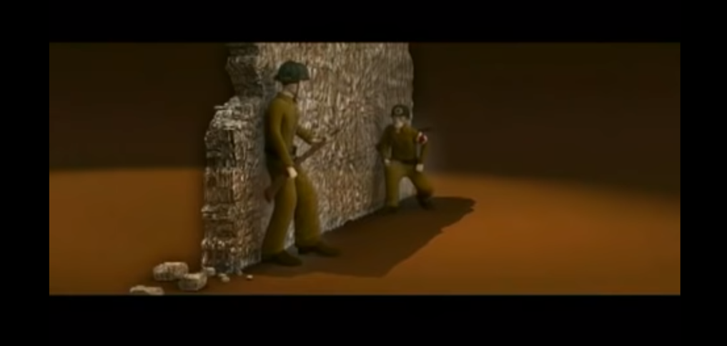
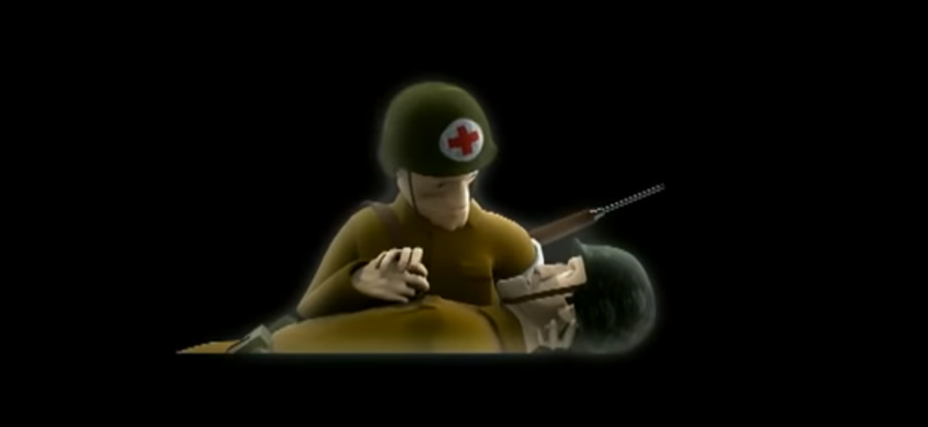
Putrid
Rapid-Fire
Darkness fell
Guilt

Slide 4
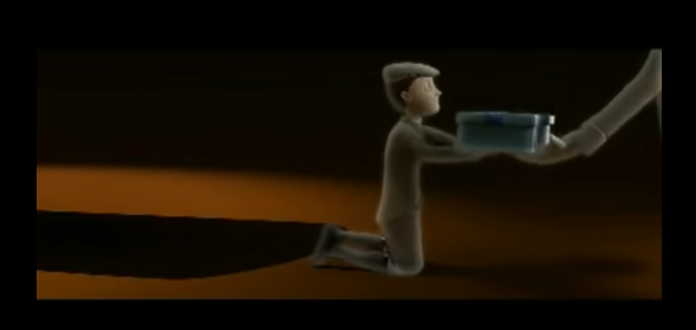
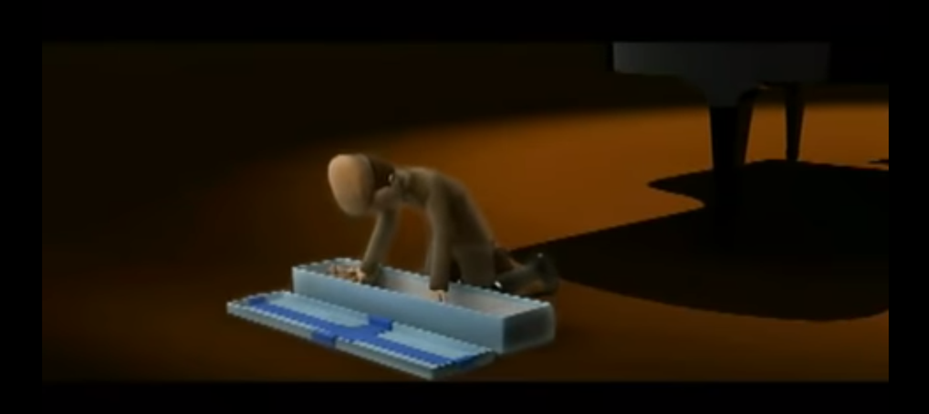
Approached
Warm smile
Joy filled my body
Treasured

Slide 5
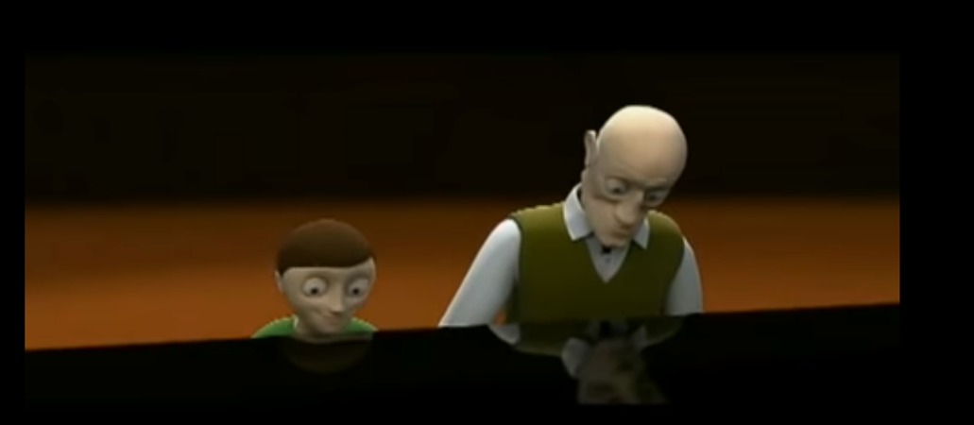
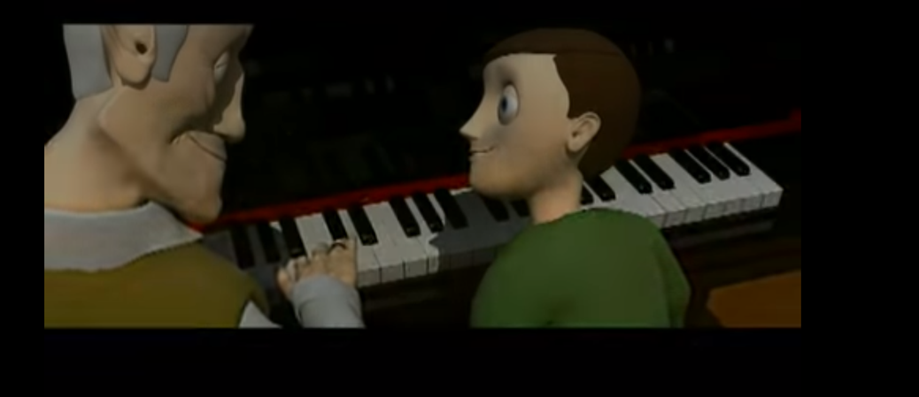
contentment
Pride
Simple things
peace

