Slide 1
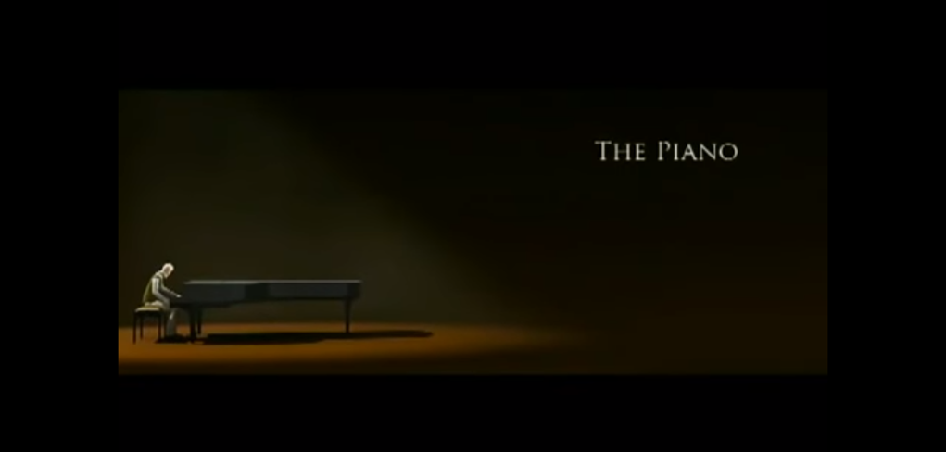
The piano
By Riley

Slide 2
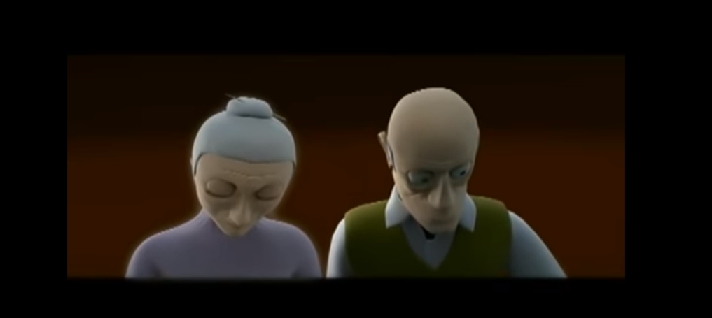

Solitary
Isolated
Wonderful moments
Isolated
Million memories

Slide 3
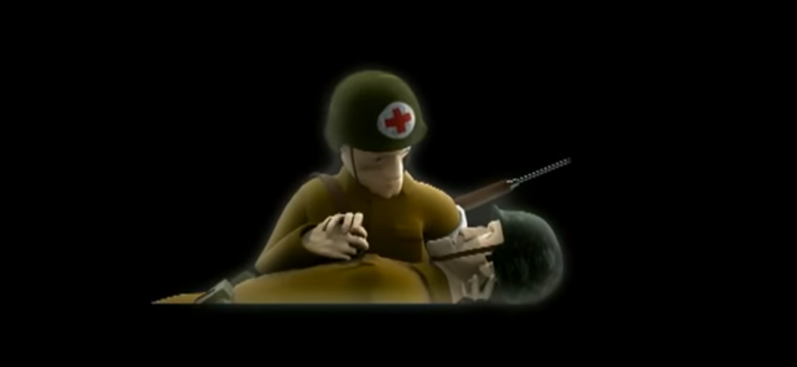
Sadly
Bullets ripped through him
cradling in my arms
He was going to die

Slide 4
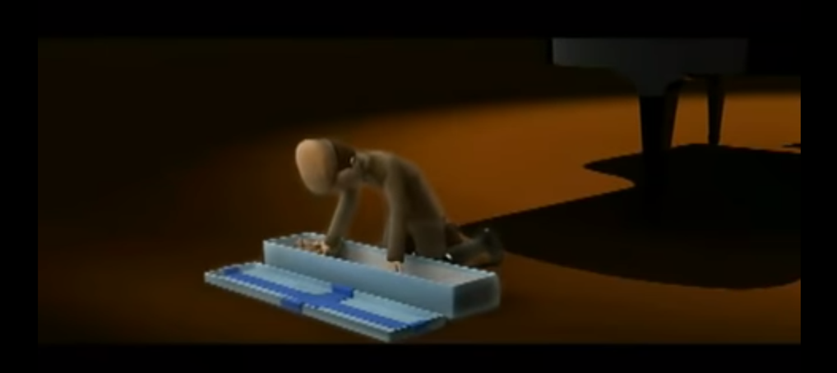
Beloved memories
One moment
Gigantic present
Glimmered in my eyes
Glimmering hobby horse

Slide 5
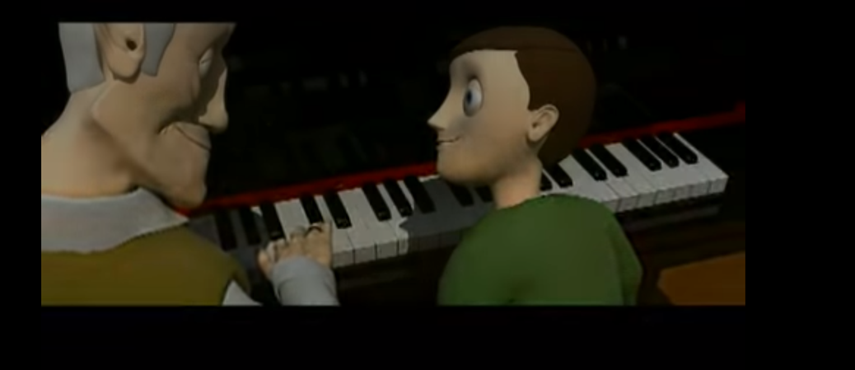
Charming
Same smile
Beautiful grandson
Serene melody
My Grandson
Hobby horse
Wild west games
Proud

