Slide 1
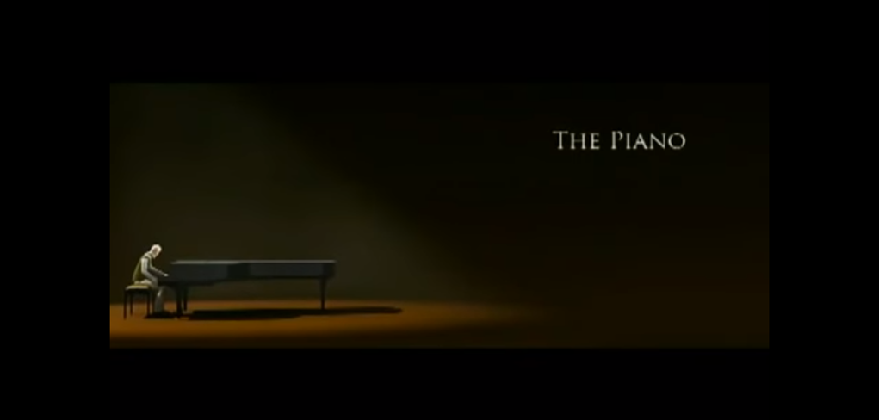

Presented by ruby h

Slide 2
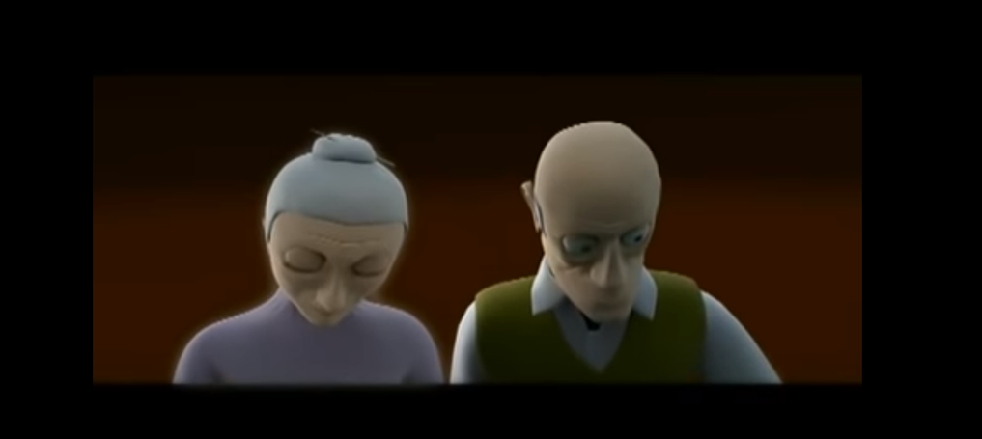

solitary
forlon
Down cast

Slide 3
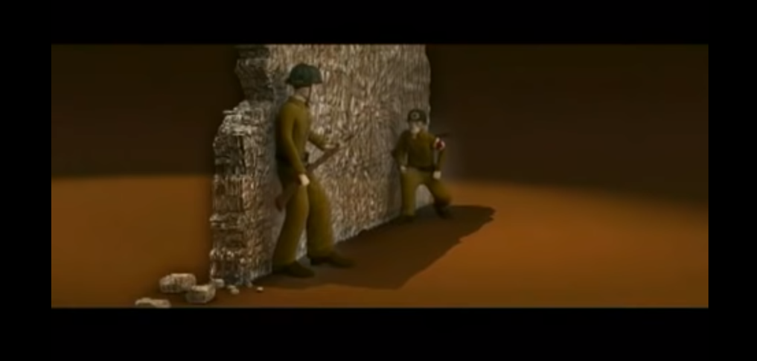
diabolical
ashen
Frozen with fear

Slide 4
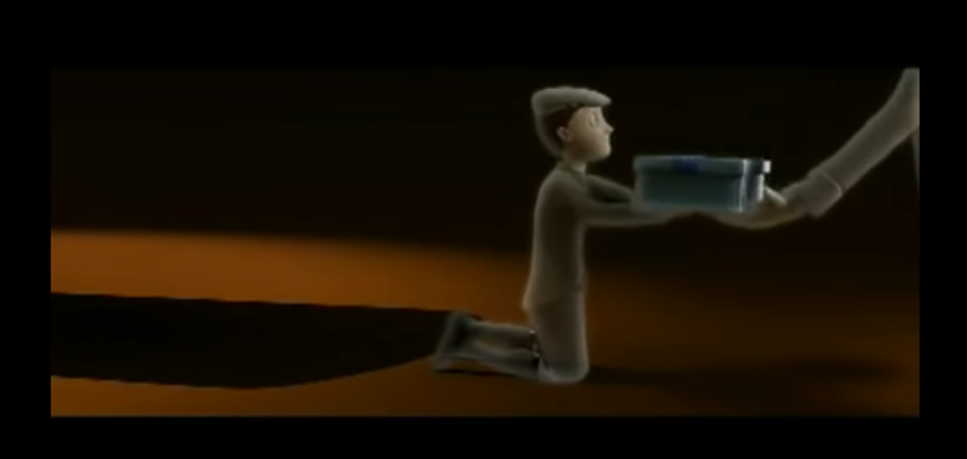
treasured
sleek
turqoise

Slide 5
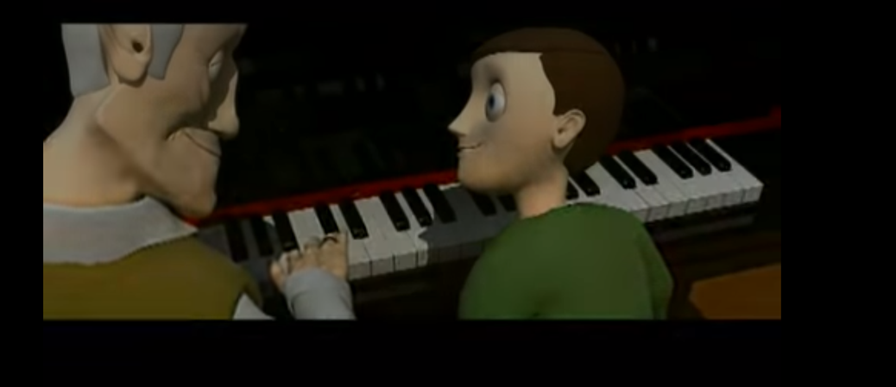

Long-lasting
wooden
moment

