Slide 1
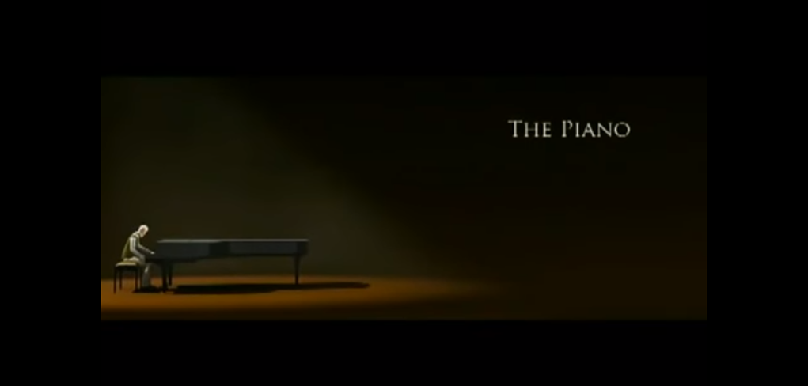
The piano
By Ruby. B

Slide 2
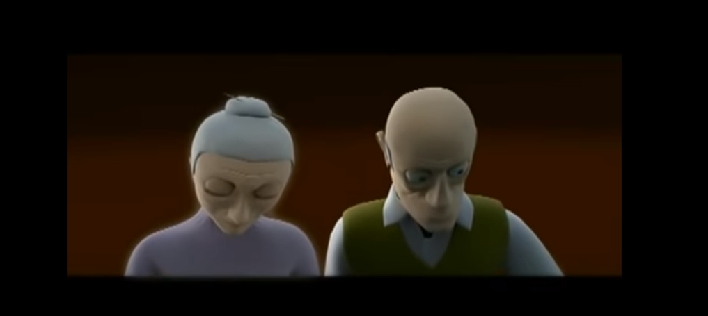

Isolated
delightful
beautiful
depressed

Slide 3
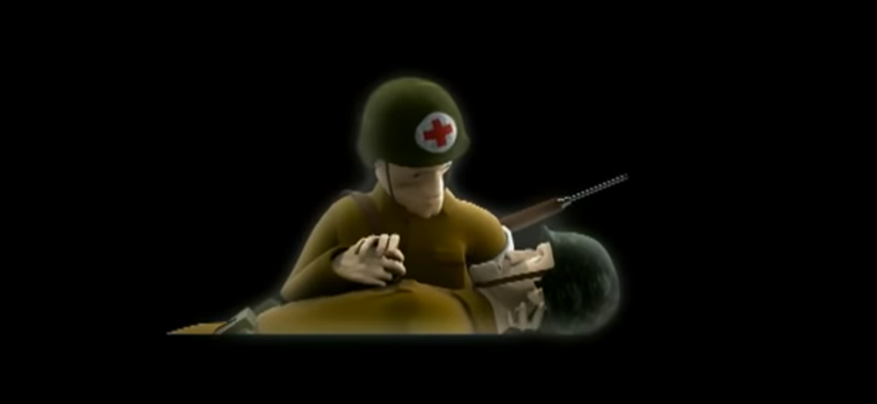
pierced
grimy
soaring

Slide 4
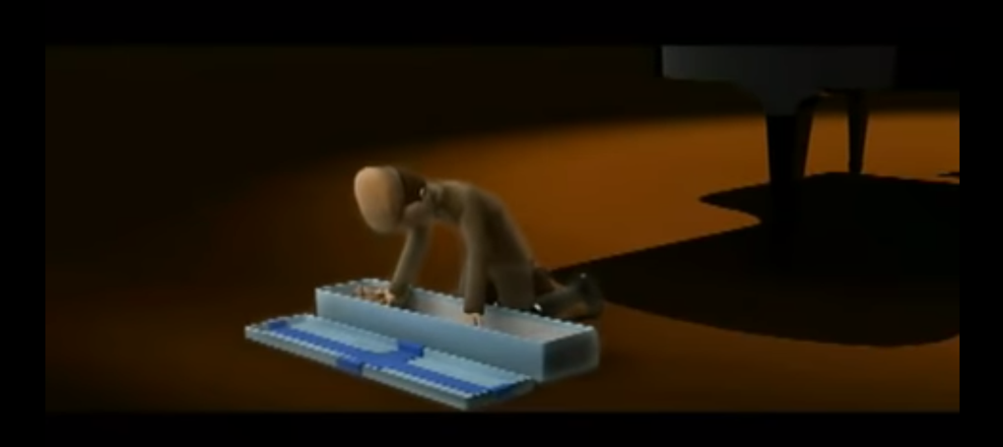
burnished
beamed
varnished

Slide 5
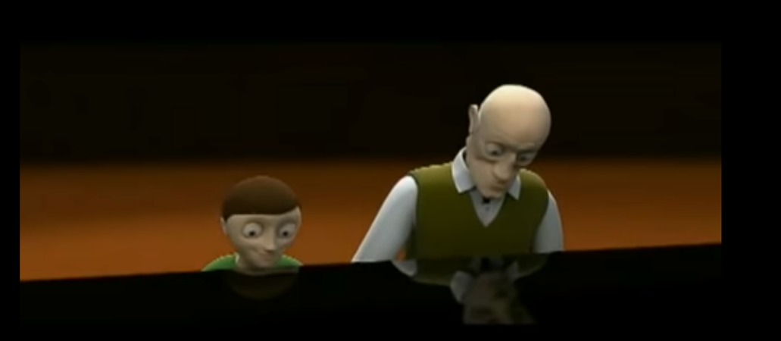
radiant
beloved
Sweet grandson

