Slide 1
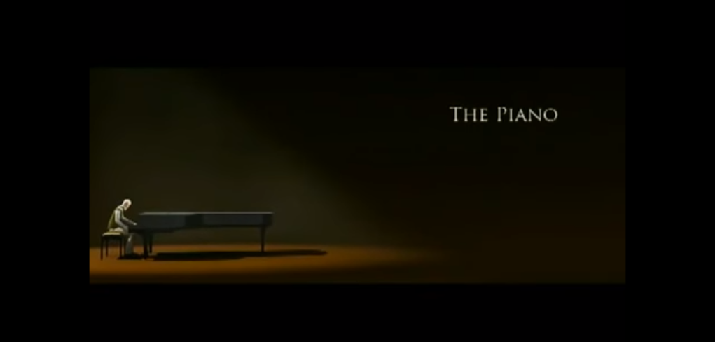
The Piano
By Tallulah Piras

Slide 2
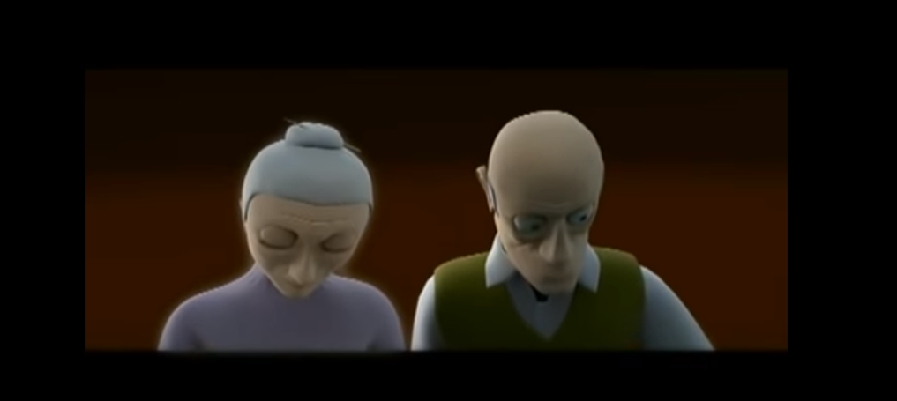

depressing
beloved
gloomy

Slide 3
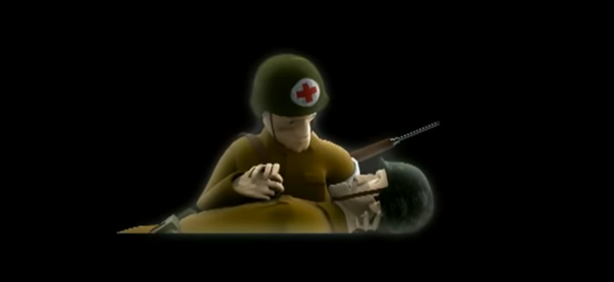
trembled
my heart pouted
Guilty

Slide 4
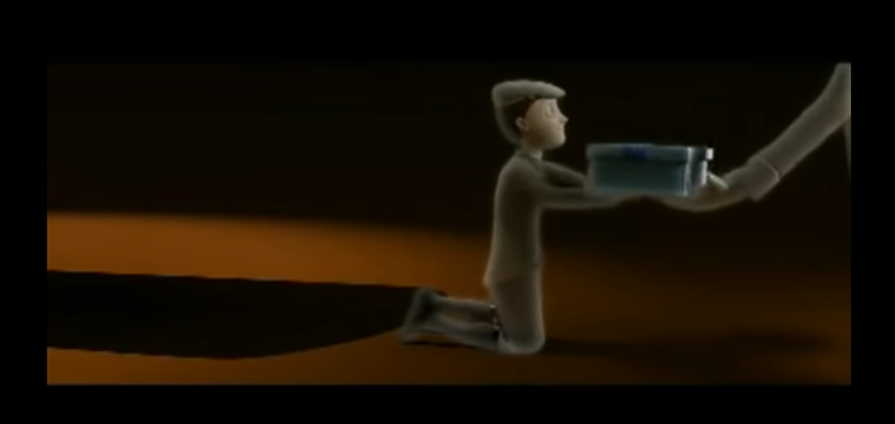
elegant
joyful
cheerful

Slide 5
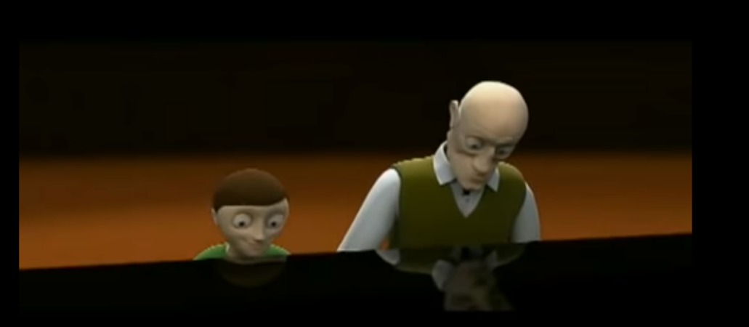
gratefulness
hopee
delight

