Slide 1
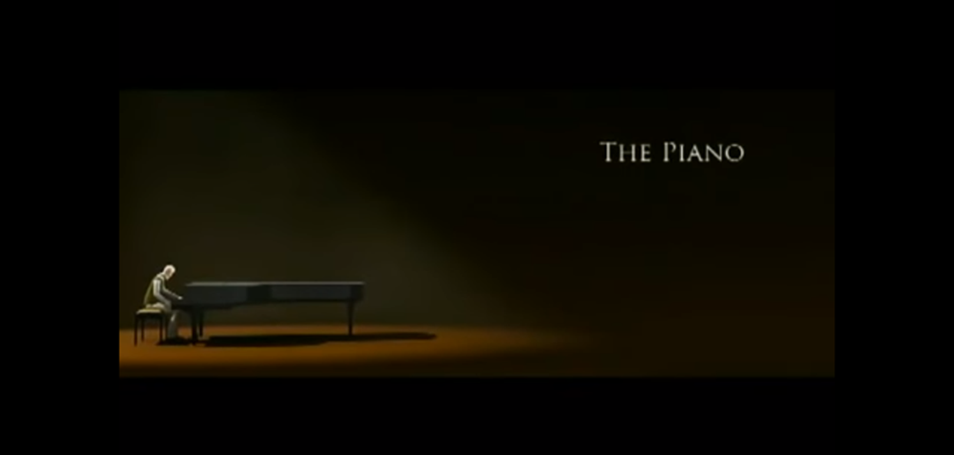
The Piano
By Avia Cartwright

Slide 2


Slide 3
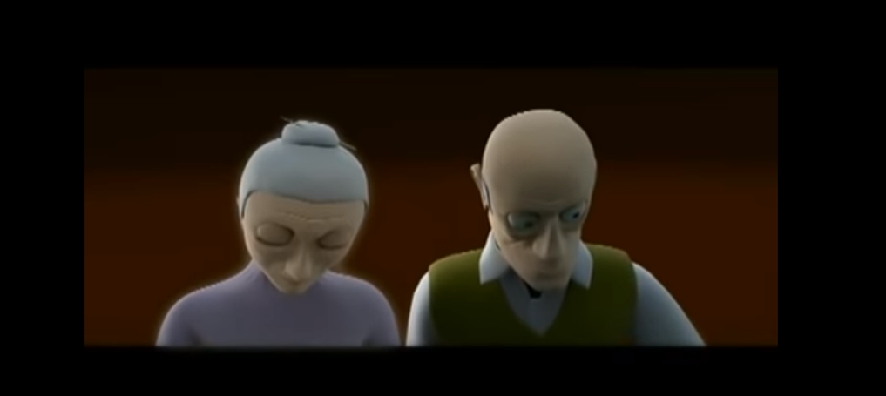

Dark
Silently
Beloved Wife
Soft Lips
Perfecting every note
Guilt
Blue
dark
Spirit Beside Me

Slide 4
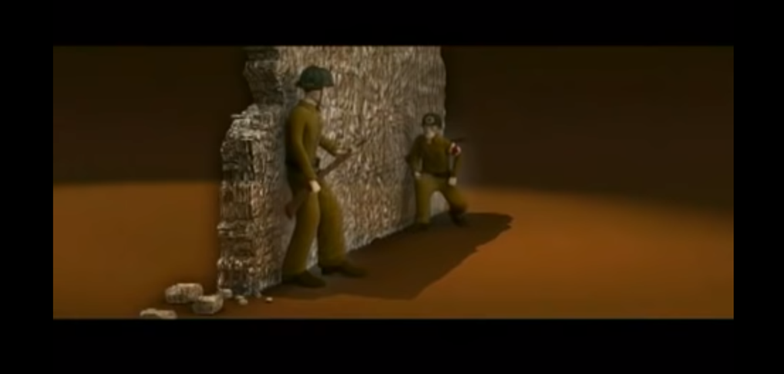
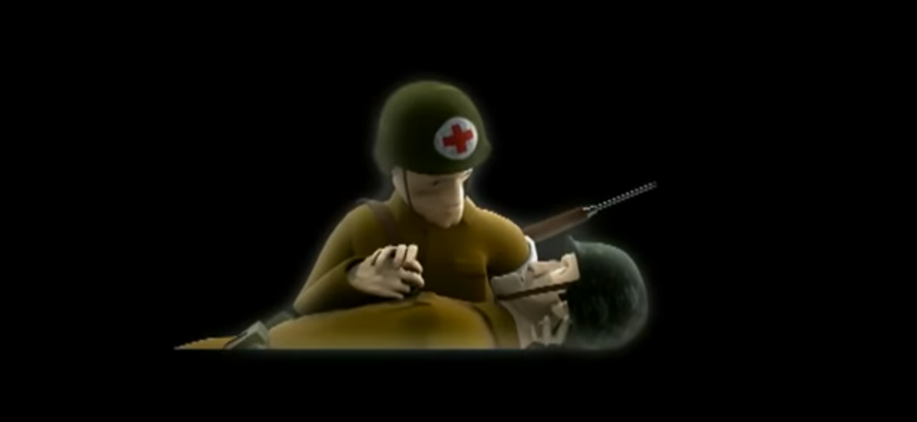
Putrid smoke
Loud sirens
He's hit
Bombs
He would die
World was ending

Slide 5
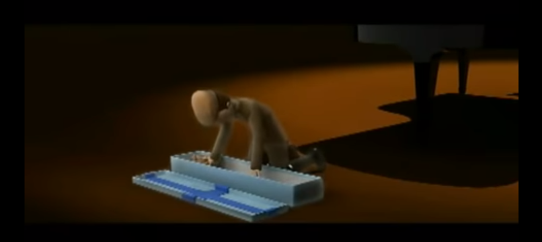
Birthday!!!!
Wrapped shiny blue tissue paper
Put on pressure
Eyes lit up
Excitement
Hobby horse!!
Amazing

Slide 6
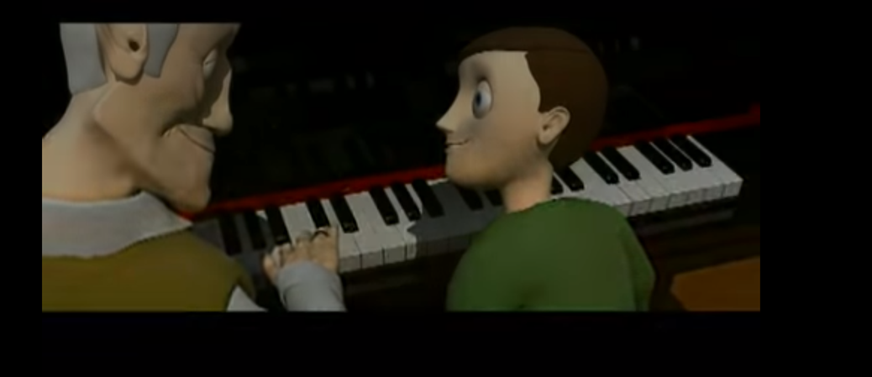
Sweet Grandson
Hobby horse!!!
Climbed up on the stool
Next to me
Final key
My wife

