Slide 1
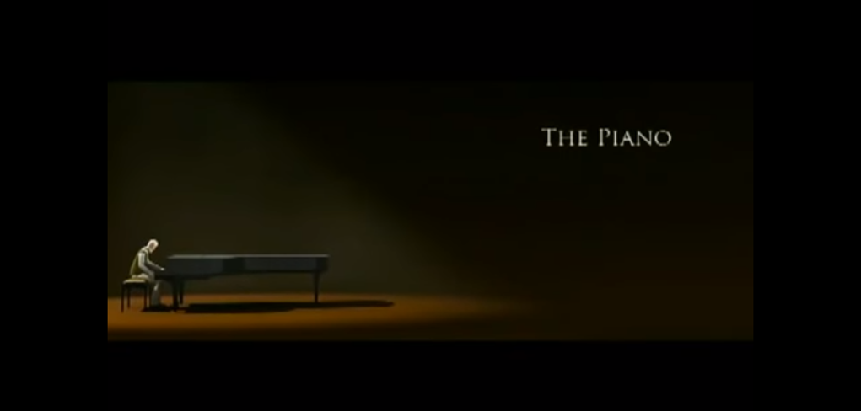
By Cayden

Slide 2
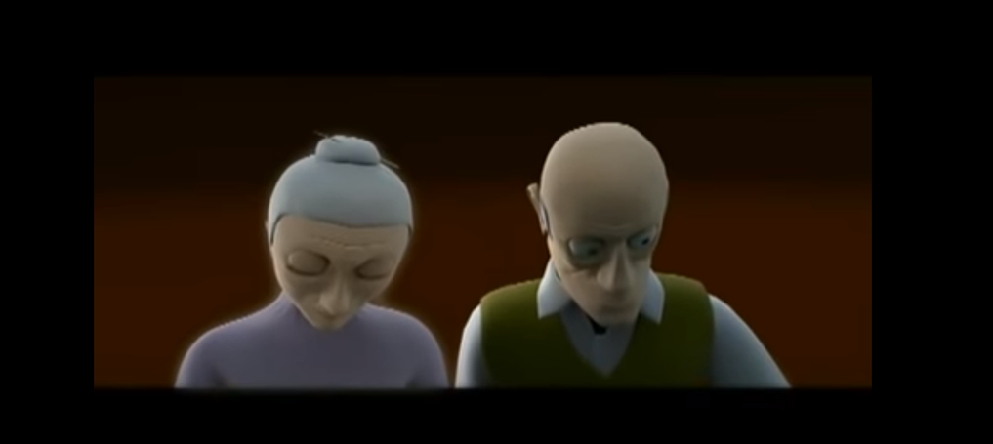

Melancholy
Peaceful
Isolated
Secluded

Slide 3
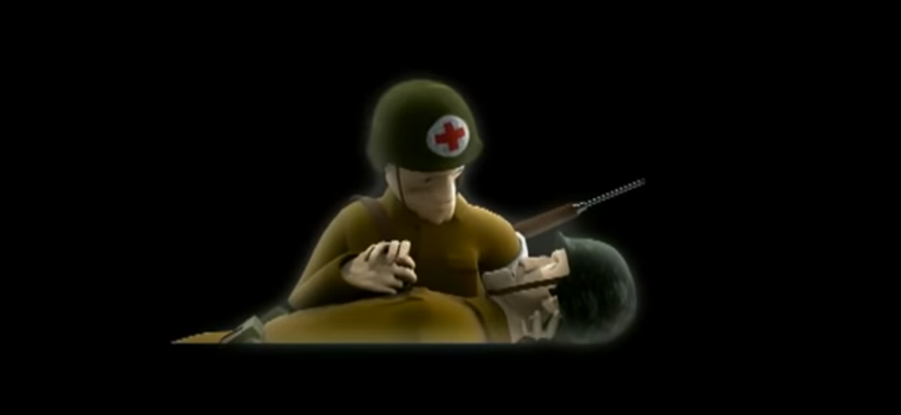
Vicious
Rapid
Horrified
Anxious

Slide 4
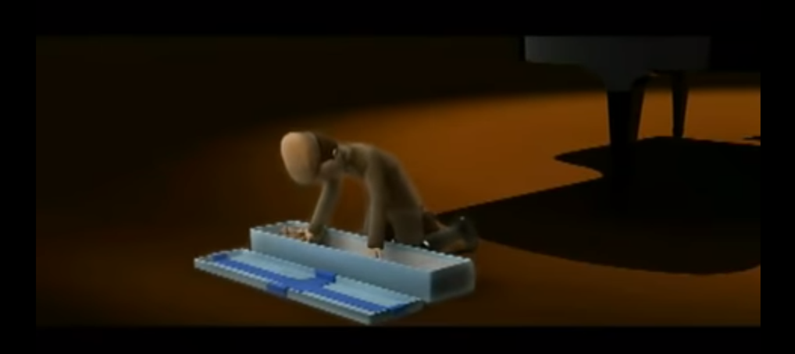
Joyful
Hopeful
Amazed
Gleeful

Slide 5
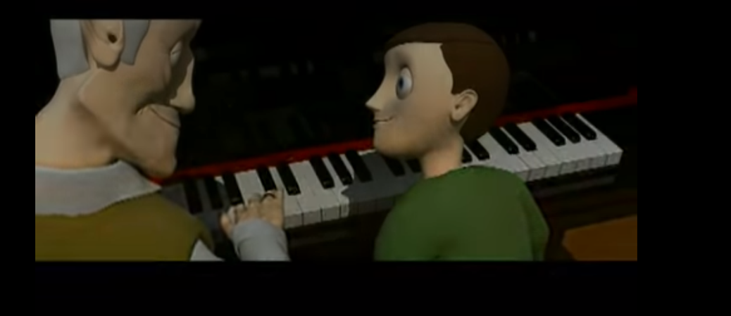
Cheerful
Grateful
Bittersweet
Excited

