Slide 1
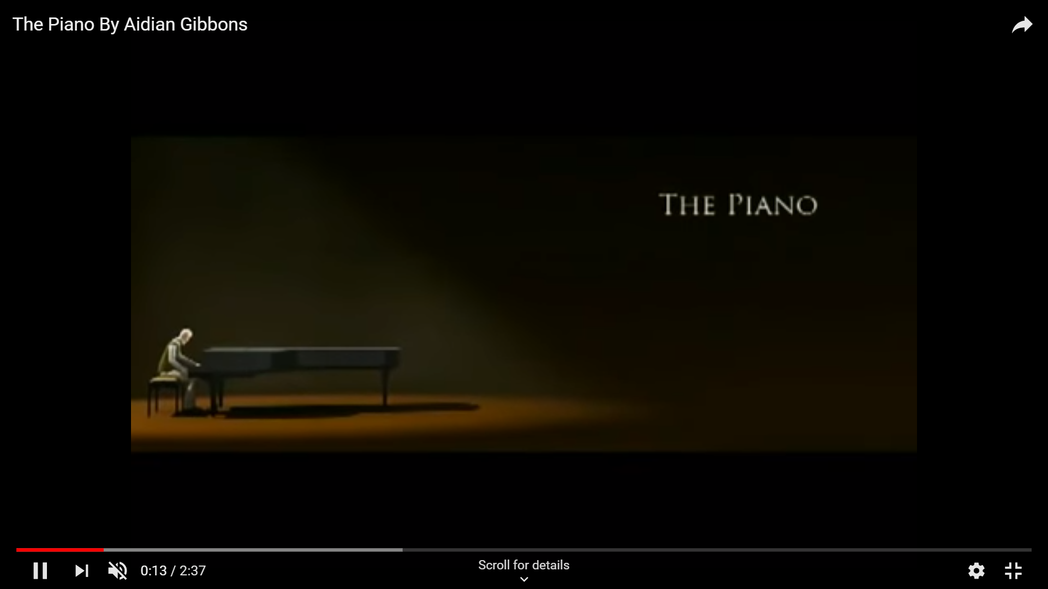
The piano
By Henry Taylor

Slide 2
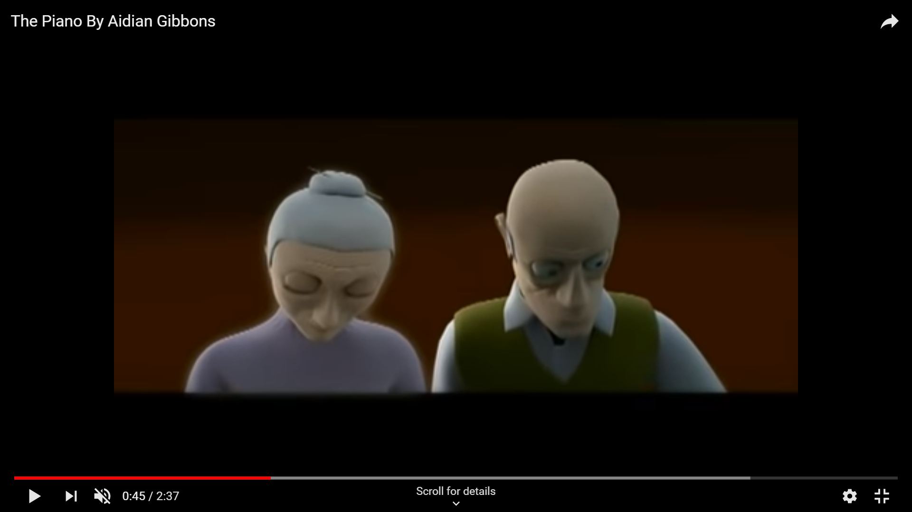

nostalgia
melody
tune
vivid

Slide 3
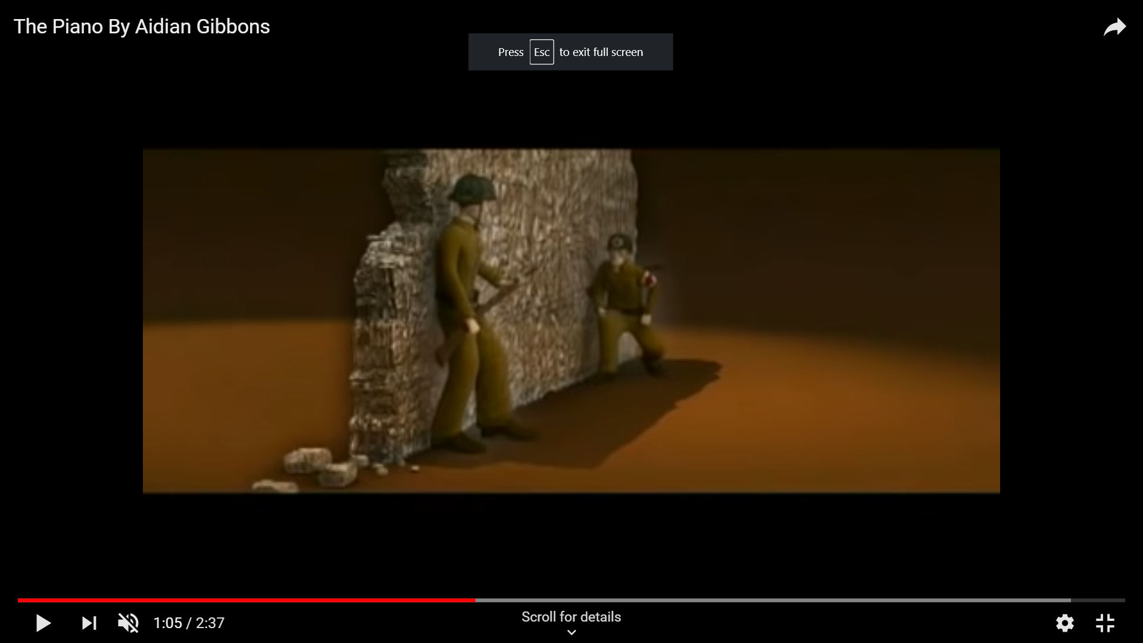
explosions
Flat guns
sirens
crack

Slide 4
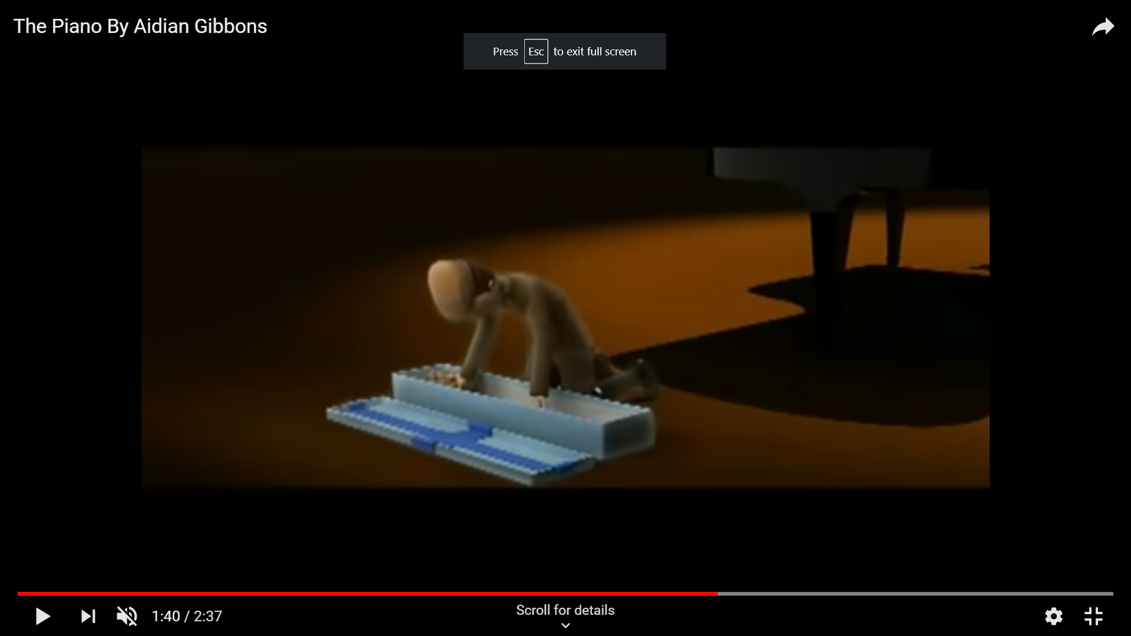
glee
9th birthday
Sheriff
f
Horse toy

Slide 5
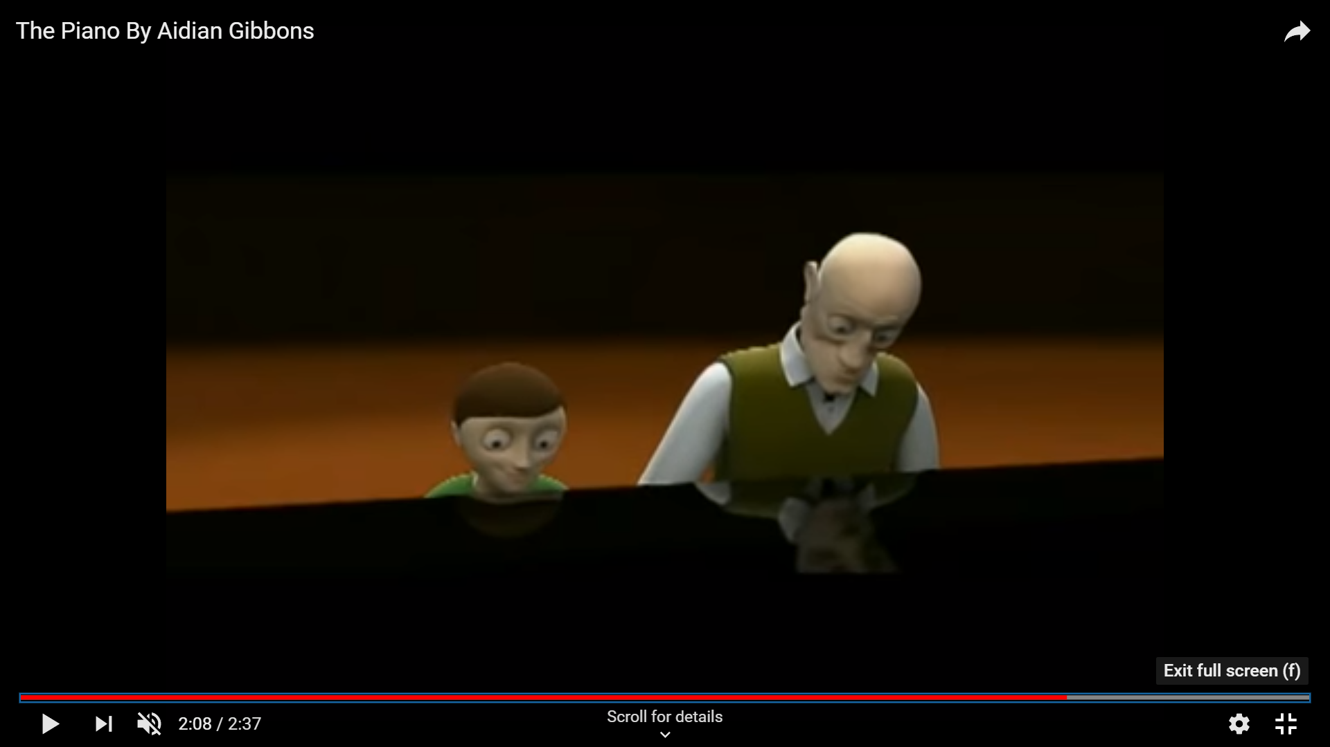
proud
family
Beaming smile
piano

