Slide 1
The piano
By jack Wiltshire

Slide 2
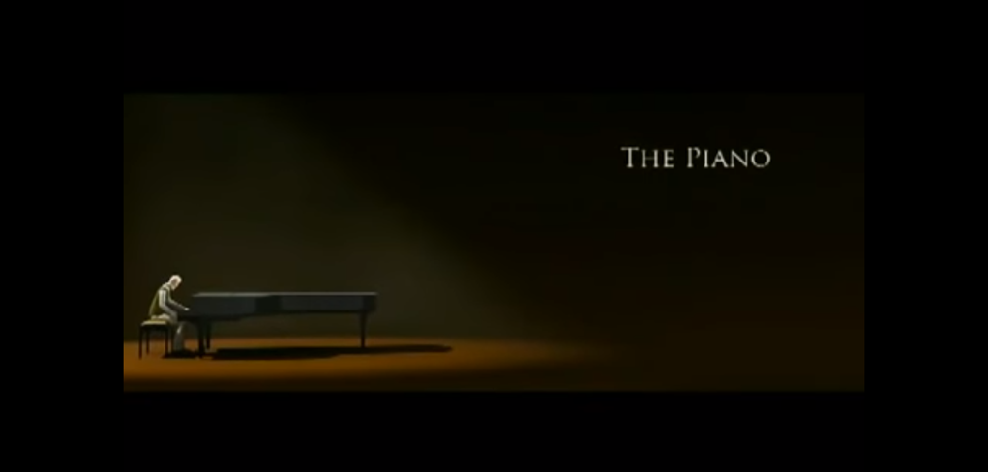

Slide 3
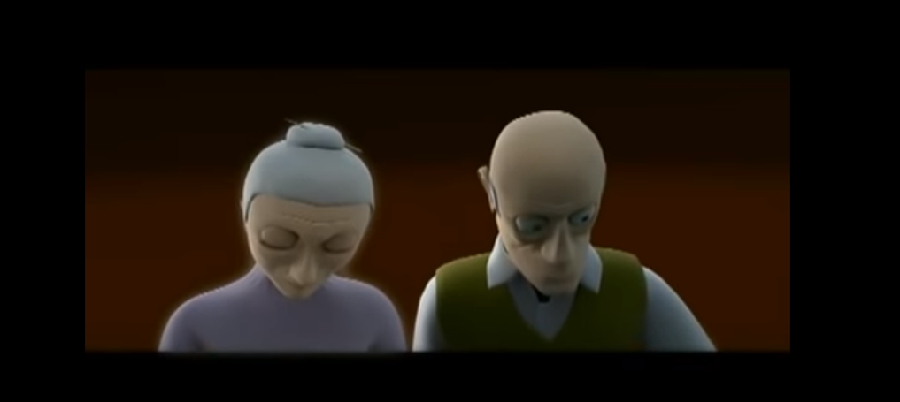

heartbraking
Memory unleashed
Notes:
Melody

Slide 4
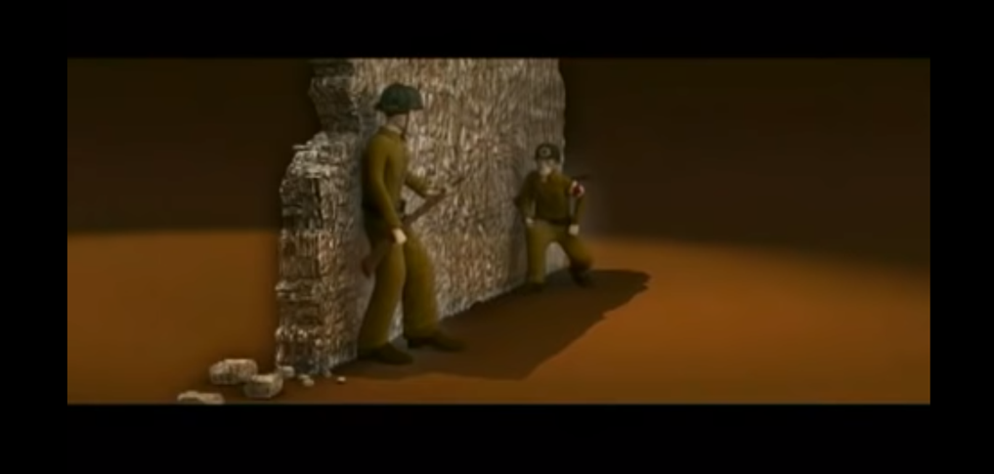
crumbling
explode
destruct

Slide 5
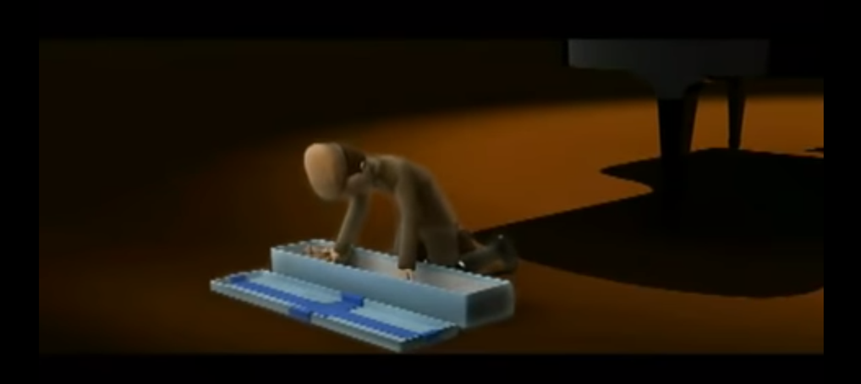
terrific
exited
Beloved heart

Slide 6
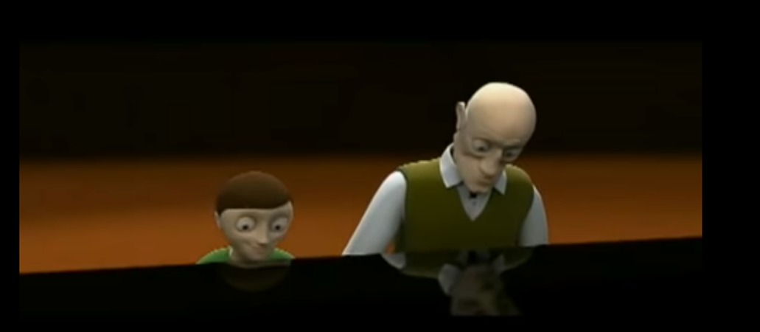
Beloved grandson
Happiness
Follow my bright red heart

