Slide 1
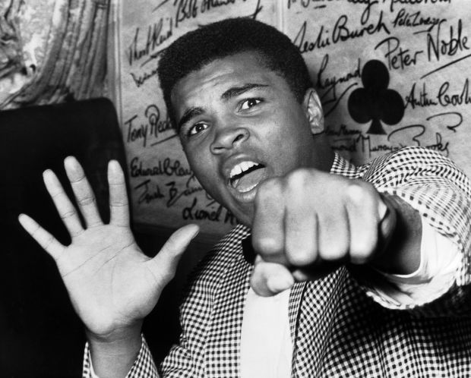


Welcome to
Team Rees-Boughton
Year 2
One Childhood, One Chance
Together we make a difference

Slide 2
Who We Are:
Alice Rees-Boughton
Mikayla Fetherston
Mike Brown

Slide 3
The School Day: (ish)
8:15 – doors open, activities on tables
8:30 – doors close, registration
9:00-9:20 - assembly
9:25-10:25 - English and RWI
10:25-10:40 - Break Time
10:40-11:00 – Spelling and Punctuation
11:00-12:00 – Maths
12:00-1:00 – Lunch Time
1:00 – 2:00 – Topic
2:00 – 2:30 - Handwriting
2:30 – 3:00 – Busy time/Story Time/Packing Away Time
3:00 – End of the day

Slide 4
The Arts Curriculum:
Drama is on a Tuesday with Mr Williams.
PE is on a Tuesday with me.
Art and Music is on a Thursday with Mr Brown and Mrs Walton.
Mr Brown will be in charge of letting your child go at the end of the day.

Slide 5
The Beginning of the Day
The school doors open at 8:15
Please encourage your child to say good bye at the door
Please get your child to hang up their own coat and bag and put their reading book bag in the box for us to change the book
Begin the morning work - already on the tables

Slide 6
The End of the Day
Please collect your child at 3:00 from my classroom door.
I will be stood at the door and will say your child’s name to release to you.
Please let me know if there is a change of person picking up your child.
Please bare with me at the start, I have a lot of faces to learn!

Slide 7
Core Values
Aspiration
Challenge
Collaboration
Autonomy
Engagement
Enquiry
Diversity

Slide 8
Behaviour For Learning
At RAPS, we want our children to be ready to learn.
Happy Safe Successful

Slide 9
Each child starts off with 5 points at the beginning of every day.
Possible total of 25 points a week. Expected to keep all 25 points!
The points will also be looked at on a 3 weekly basis. 25 x 3 = 75 points

Slide 10

Sanctions
If a child is:
talking
messing around
refusing to work
rude
disrupting the lesson etc
a NV warning, a verbal warning then a
yellow warning card
gets placed on the desk in front of you. This will act as a reminder to the child that they have got to improve their behaviour.

Slide 11

If a child improves their behaviour they can then earn the yellow card back. The yellow card can then be removed from the table.
If a child continues to misbehave the yellow card is changed to a red card.

Slide 12
If a child has a yellow card on their desk at the end of the lesson they lose 1 point.
If a child has a red card on their desk at the end of the lesson they lose 2 points.

Slide 13
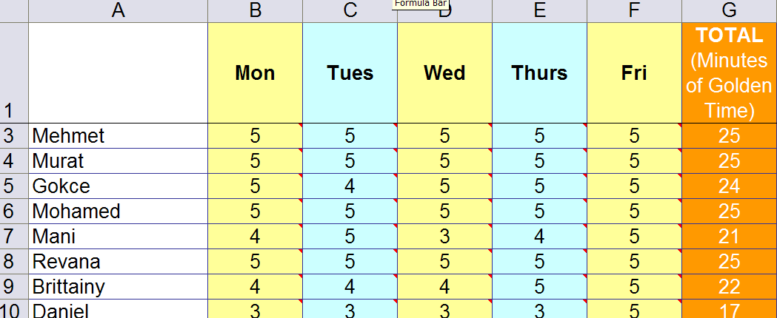
Behaviour Points

Slide 14

Daily rewards
Verbal praise
Smiles
Superstar Learner cards. (If a child has a Superstar learner card on their table at the end of the lesson they can swap it for a house point as they leave).

Slide 15
Weekly Rewards
25 points= All golden time and text home.
22-24 points= All golden time.
11-22= Teacher to contact parents.
6-10 points= Mr Budge to send letter home to inform parents.
5 points or less= Mr Budge to have a meeting with parents.

Slide 16
Three week rewards
75 points= Letter home (emailed). Badge to wear.
3rd badge: RAPS lanyard
6th badge: silver behaviour badge
12th badge: Gold behaviour badge

Slide 17
Class rewards
Three week rewards
The class with the most points in each year group gets a £3.00 RAPS Cheque to display in their classroom.
At the end of terms 2, 4 and 6 each class can ‘cash’ in their cheques to buy something for the class as a reward/treat. For example, an ice-cream each down the beach.

Slide 18
Maths
In maths this term the children will be re-capping their knowledge from Year 1.
We will focus on number, place value, number bonds, addition and subtraction.
Each term will build on the children’s learning from Year 1 and the previous term.

Slide 19
English/RWI
English: Focusing on the writing genre: Narrative.
We will study: The Snail and the Whale by Julia Donaldson.
RWI: Continuing where you left off in Year 1 before moving onto text based.

Slide 20
RPC (Raps Primary Curriculum)
This week, the children have begun our first topic: Habitats as Homes.
We will also study:
Healthy Minds, Healthy Bodies.
Life as a Journey.
Our Man Made World
Significant People
What We Wear

Slide 21
Topic Home Learning
Home learning will happen at least once a term and will be associated with the current topic.
Please let it be the child’s learning - I don’t want to know how much you know of the Year 2 curriculum.
Please check the website every week for the blog. When it has a love to learn on it we will send it home in the children’s Love to Learn books.

Slide 22
Times Tables Rock Stars
Pupils will be given a TTR log in this term.
You can download the app.
They can practise as they so wish.
We will practise in class.

Slide 23
Spelling Homework
Spellings will be sent home every Friday and tested the following Friday.
We will have already learnt them during the week.
I will send home a practise sheet but I do not expect to see the sheet returned to me.

Slide 24
Reading Records
We expect children at RAPS to read at least 4 times a week at home.
Parents, please comment in your child’s book every time they have read.
We have a Race to 100, please write ANY book the children read in your record … every book counts!
Please encourage your child to put their record in the box by the door, I cannot look through 30 blue book bags every day.
We also expect to see every child’s record every day because every week your child will be listened to by me, Mr Brown or Mrs Fetherston and we will also make a comment.
I will check the record on a Friday and make a comment.
If I haven’t seen your child’s record on the Friday I will be sending a letter home.

Slide 25
Class Blogs
I will publish 3 blogs a week on our class page on RAPS website.
Please keep up to date with the website as it includes key information about our class.
Please let me know if you do not want your child’s photo’s on the school website.

Slide 26
Open Door Policy!
PLEASE come and see me if you have ANY problems. Big or small.
I sometimes may be chatting to other parents but please let Mr Brown or Mrs Fetherston know you would like to see me and I will arrange a suitable time with you.

Slide 27
Other information
Tucking in shirts
PE kits – All week
Letters will now be sent by email.
Money/Notes to the office please.

Slide 28

Any Questions?

