Slide 1
Monday 27th January 2020
ME:Did the Anglo Saxons like art?

Slide 2
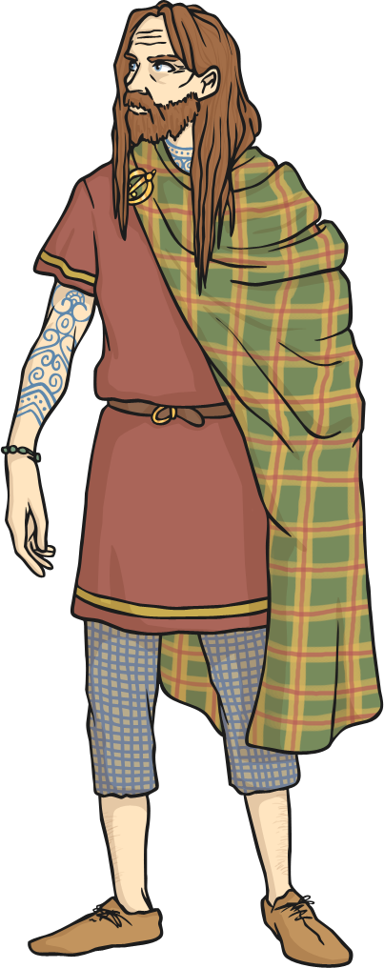
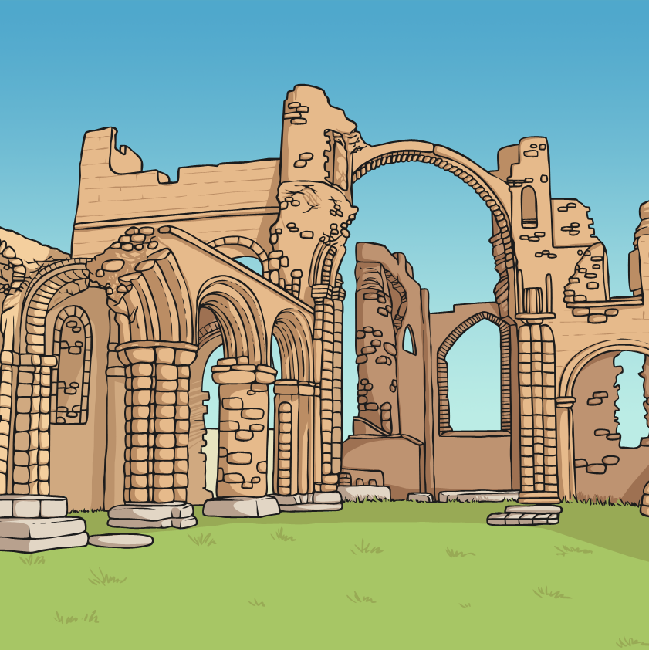
Early Britain
The Anglo-Saxons lived in Britain from the 5th century – so around AD 400. The term relates to people from mainly the Germanic areas of Europe, who migrated to Britain after Roman rule came to an end, and lived amongst the people already living in Britain.
The Anglo-Saxons were highly skilled craftsmen and women who created jewellery, ceramics, sculptures and
wall paintings.

Slide 3
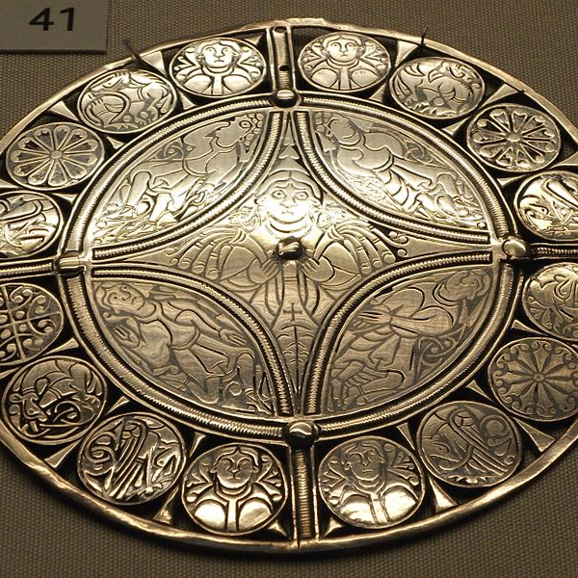
Metalwork Craft
The Anglo-Saxons created buckles, jewellery and purse fittings which were made from gold, silver and bronze. The metal was beaten and engraved, often with dots and dashes representing the fur of animals. Gemstones like garnet were inlaid into the metal. Niello was used to add letters and symbols to the engraved items.
Niello was a black paste made from copper, sulphur, silver and lead.
It was added to the metal and then fired – heated to a very high temperature – to set the paste.
The Fuller Broch – 9th century Anglo-Saxon
By Johnbod - Own work, CC BY-SA 3.0.

Slide 4
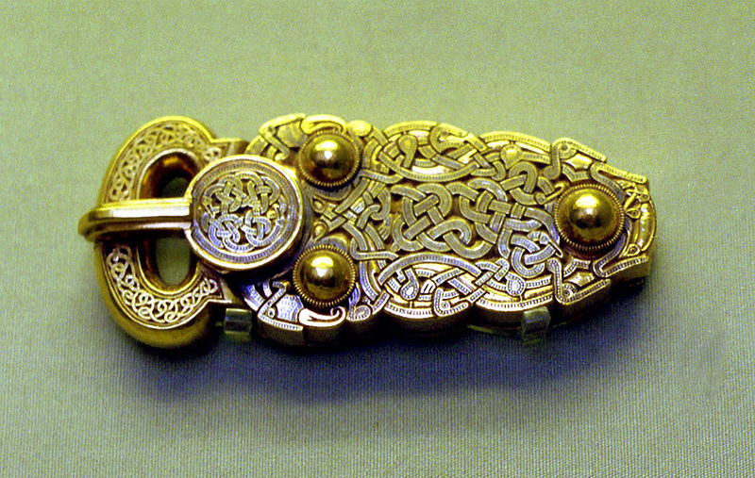
The Great Buckle
In 1939, an Anglo-Saxon burial site was discovered in Sutton Hoo, Suffolk. It consisted of a buried ship containing objects of incredible historical and archaeological importance.
This buckle, known as The Great Buckle, was part of the hoard. Its plate is hollow and has a hinge at the back. This reveals a secret chamber which might have contained a religious relic. The engraving is intricate and inlaid with niello.
By Kenecjert –Self-published work, CC-BY-SA-4.0.

Slide 5
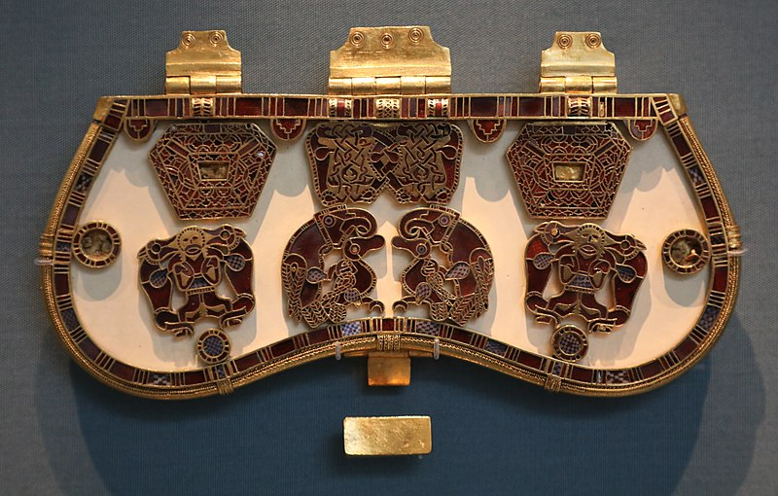
A Purse Lid
Purse lids were attached to the fabric of a purse and would clasp shut. This purse lid was also part of the Sutton Hoo hoard and was discovered in the burial mound thought to be that of the Anglo-Saxon King of East Anglia, Raedwald. It is decorated in gold and garnet enamel and is a sign of great wealth.
By Geni - Photo by user:geni, CC BY-SA 4.0,

Slide 6
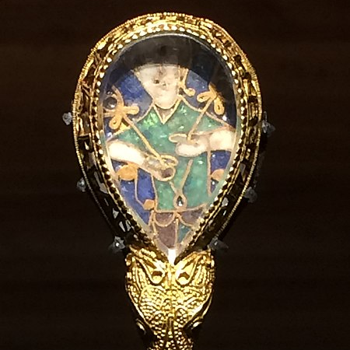
The Alfred Jewel
The Alfred Jewel is made from enamel and quartz and surrounded by gold. It was made for Alfred the Great, who was the King of Wessex from AD 871 to AD 899.
It was designed to be on the top of a pointing stick used to point at words when reading a book. There is the
figure of a man inside the teardrop
shape and this is thought to be of Christ.
The Alfred Jewel is engraved with the phrase aelfred mec heht gewyrcan which means Alfred ordered me made.
By Mkooiman - Own work, GFDL CC-BY-SA.

Slide 7
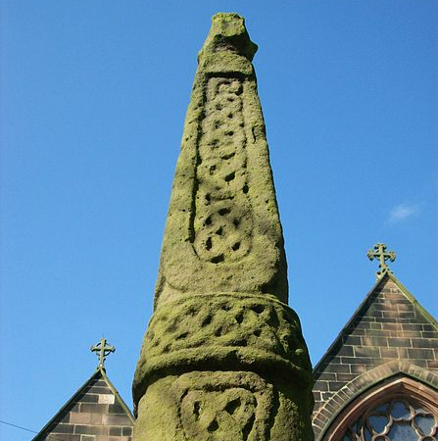
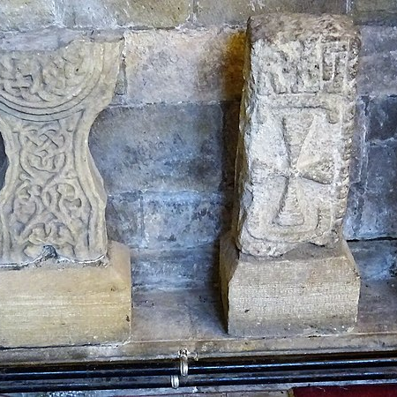
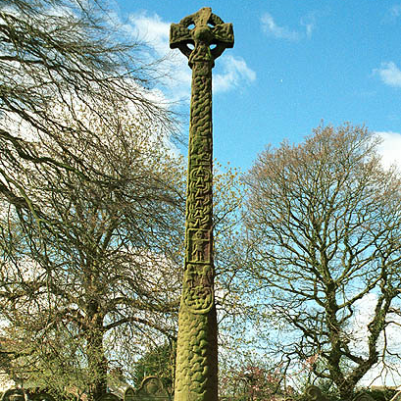
Stone Sculpture and Carving
Most Anglo-Saxon stone carving is of crosses on or beside churches. Many are now incomplete with carving faded.
These remnants of crosses are at St Mary’s Church, Masham, North Yorkshire.
This cross is in the churchyard of St Edward the Confessor in Leek, Staffordshire.
The Gosforth Cross has images from Norse mythology carved into it. The gods Thor and Loki have been identified within the engravings.
Photo by Rosser1954, Photo by Doug Sim, -Photo by user:geni, CC BY-SA 4.0,

Slide 8
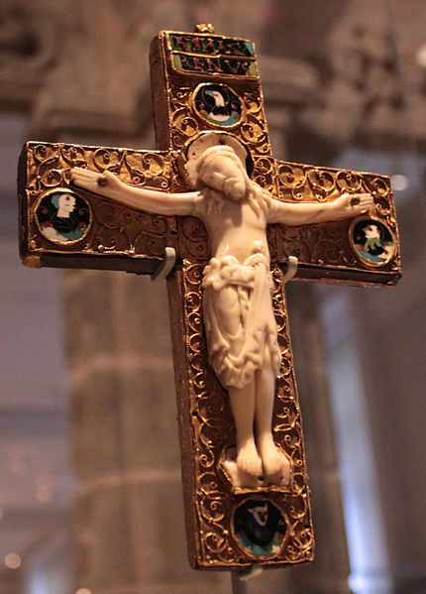
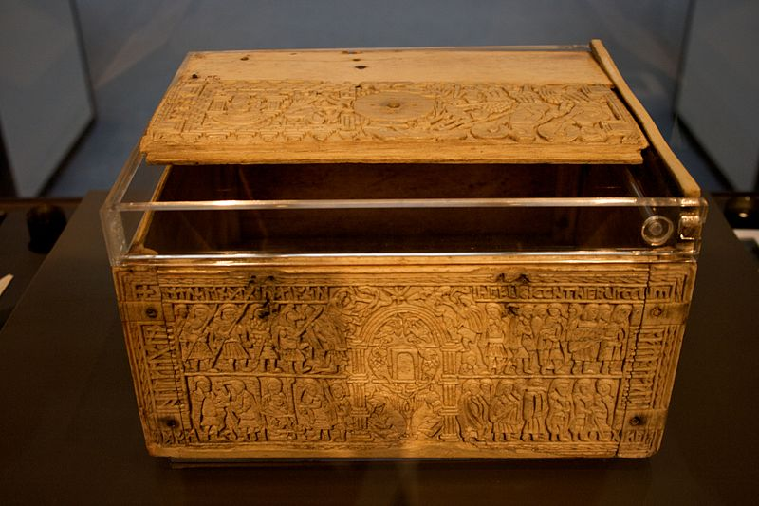
Ivory and Bone Carving
The Anglo-Saxons carved ivory and bone using ivory from the tusks of walruses and bones from whales.
Franks Casket is a small box carved from whalebone. It is decorated with images from the Bible and Roman history.
This late 10th century Anglo-Saxon cross, with the image of Christ carved from walrus ivory, is now on display at the Victoria and Albert Museum in London.
By Mike Peel,. By Hchc2009 –Self-published work, CC-BY-SA-4.0.

Slide 9
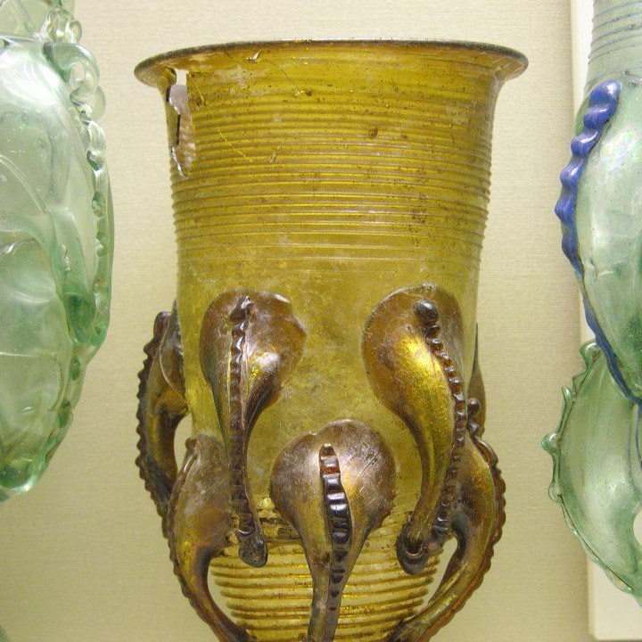
Glassware
Anglo-Saxon glass was usually one colour and if used as a goblet, would have been a claw foot design. Glass beads were made and discovered in female burial sites.
By Ringlemeer - Own photo, GFDL CC-BY-SA.

Slide 10
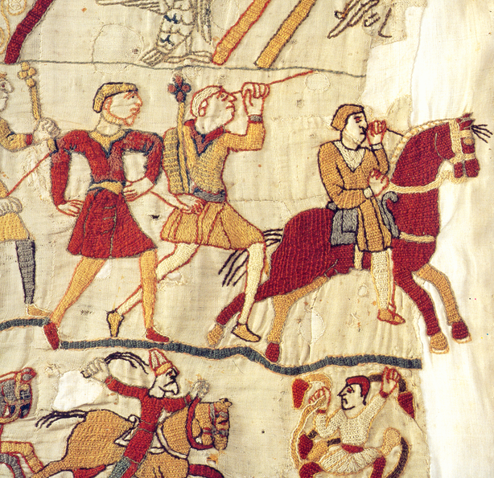
Tapestry
The Anglo Saxons were skilled in textile crafts though not many examples have survived the last 2000 years. The most famous is the Bayeux Tapestry which was made in typical Anglo-Saxon style.
It is 68.38 metres long and 0.5 metres wide and woven from wool. It tells of the Norman conquest and the story of William the Conqueror defeating the English King, Harold, in 1066, resulting in the Battle of Hastings. For many years, it was thought to have been made in France but it is now known to have been made in England.
By LadyofHats – Own Photo, CC-BY-SA-4.0.

Slide 11
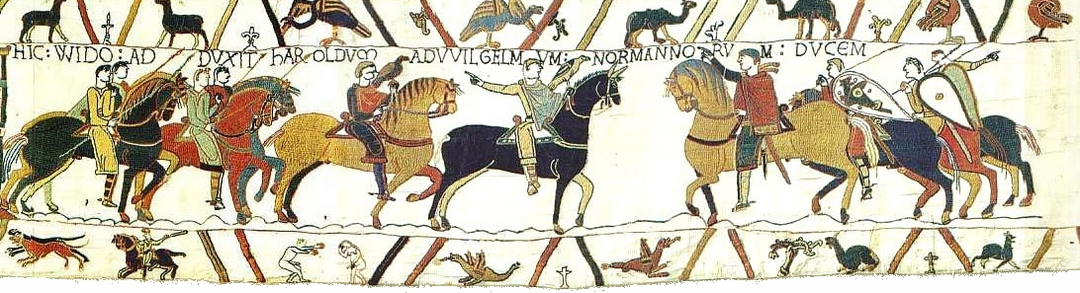
The Bayeux Tapestry
Here is one of the fifty scenes which make up the Bayeux Tapestry.
By BayeuxTapestry–Self-published work, CC-BY-SA-4.0.

