Slide 1
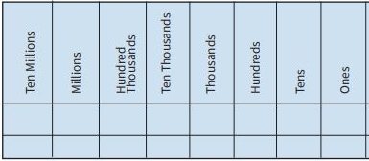
Hello and welcome to maths!
This PowerPoint might be useful to help you to understand the sheet I have set you. Press ‘slideshow’ then ‘from beginning’ and go through the slides.
Remember:
Good luck!

Slide 2
IALT
Read, write, order and compare numbers up to 10 000 000 and determine the value of each digit.

Slide 3

Numbers to Ten Million
Diving
Find the missing values in these partitioned numbers.
600 000 + 80 000 + 5000 + 400 + 20 + 3 = 685 423
80 000
20
1 000 000
1 000 000 + 500 000 + 70 000 + 200 + 60 + 9 = 1 570 269
70 000
60
600 000
4
8 000 000 + 600 000 + 200 + 4 = 8 600 204
4 000 000 + 100 000 + 900 + 1 = 4 100 901
4 100 901

Slide 4
Numbers to Ten Million
Diving
Complete the table.
 |  | Digits | Words
7 8 000 000 200 | 400 000 6000
M HTh TTh Th H T O |  | 6 042 730
300 000 2000 10 | 4 000 000 50 000 7
M HTh TTh Th H T O |  | 2 306 024
eight million, four hundred and six thousand, two hundred and seven
8 406 207
six million, forty-two thousand, seven hundred and thirty
four million, three hundred and fifty-two thousand and seventeen
4 352 017
two million, three hundred and six thousand and twenty-four

Slide 5

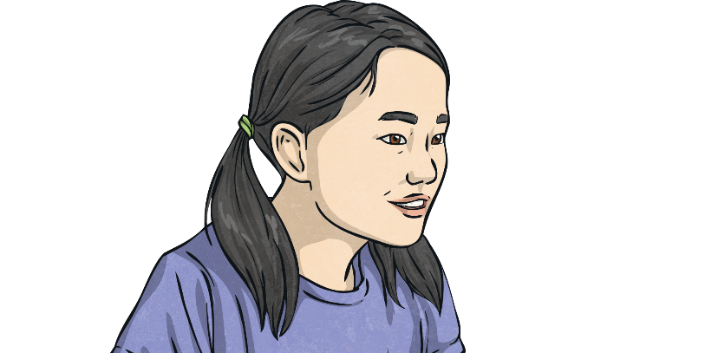
Numbers to Ten Million
Deeper
5 375 07
I have written five million, three hundred and seventy-five
thousand and seven.
Can you explain the mistake Maya has made?
The number Maya has actually written is five hundred and thirty-seven thousand, five hundred and seven. This is because she has written the second 5 digit in the hundreds column, when it should actually be in the thousands column.
M | HTh | TTh | Th | H | T | O
 | 5 | 3 | 7 | 5 | 0 | 7
The second 5 digit should be in the thousand column with zeros in the hundreds and tens positions. The correct number would be:
M | HTh | TTh | Th | H | T | O
5 | 3 | 7 | 5 | 0 | 0 | 7

Slide 6
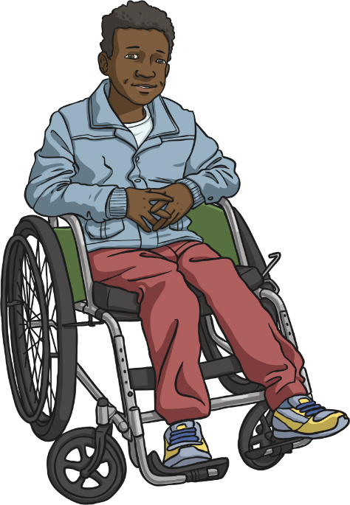
Numbers to Ten Million
Deeper
I have written the number 6 005 107.
six hundred and five thousand, one hundred and seven
Can you explain the mistake Benji has made?
Benji has read the six million as
six hundred thousand.
The correct number is six million, five thousand, one hundred and seven.
M | HTh | TTh | Th | H | T | O
6 | 0 | 0 | 5 | 1 | 0 | 7

Slide 7
Numbers to Ten Million
Deeper
Explain how you can use place value to calculate the difference between each number. The first one has been done for you.
604 508 | to | 304 408 | subtract 300 000 and 100 (300 100)
913 910 | to | 903 890 | subtract 10 000 and 20 (10 020)
3 167 295 | to | 2 967 275 | subtract 200 000 and 20 (200 020)
8 917 112 | to | 8 007 082 | subtract 900 000, 10 000 and 30 (910 030)
7 345 606 | to | 6 945 005 | subtract 400 000, 600 and 1 (400 601)

Slide 8


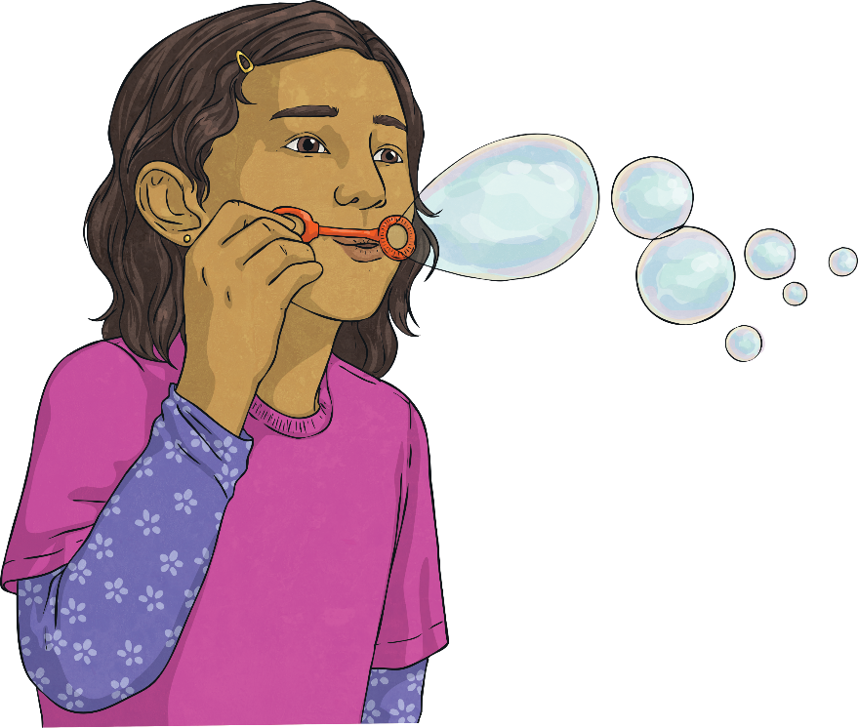
Numbers to Ten Million
Deepest
I’m thinking of a number.
The millions digit is the same as
the ones digit.
The hundreds digit is a multiple
of four.
The thousands digit is half of the hundreds digit.
The thousands digit is half of the millions digit.
The tens digit is 1².
The ones digit is 2³.
The hundred thousands digit is half of the ten thousands digit.
The hundred thousands digit is an odd number that is greater than one.
What number am I thinking of?
8 364 818
Can you say this number in words?
eight million, three hundred and sixty-four thousand,
eight hundred and eighteen

Slide 9
Numbers to Ten Million
Deepest
Find as many different numbers as you can that fit all the following statements. The number is a six-digit number.
The digit sum is 23.
It has six thousands.
The hundred thousands digit is odd.
It has eight tens.
It is an even number.
What are the largest and smallest answers you can find?
The smallest number possible is 106 088.
The greatest number is 906 080.

Slide 10


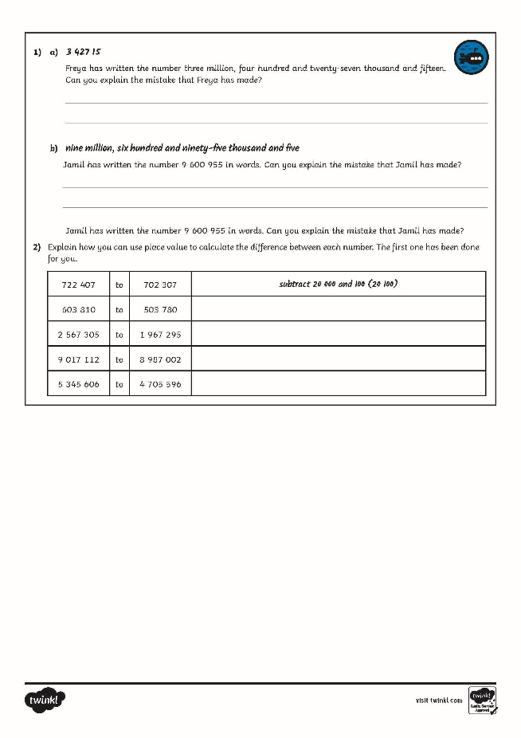
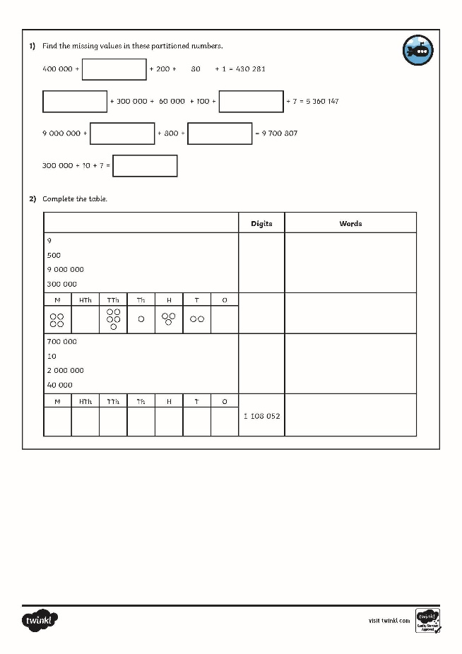
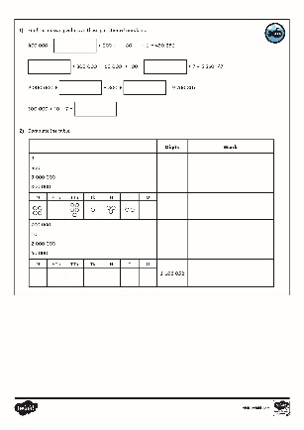
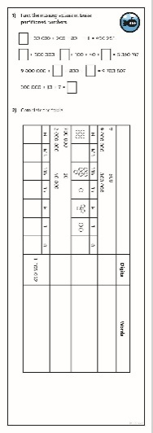
Numbers to Ten Million
Dive in by completing your own activity!

Slide 11


