Slide 1
IALT: Understand the term ‘propaganda’, what it was and how it was effective.

Slide 2
What is propaganda?
Propaganda can consist of posters or radio and tv adverts that are designed to persuade people or change their mind about something or get people to agree with an opinion

Slide 3
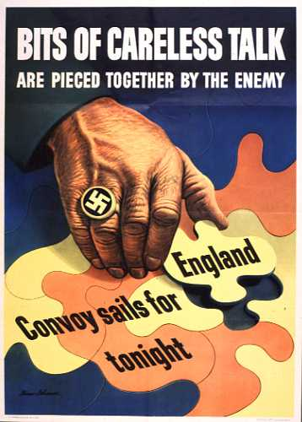

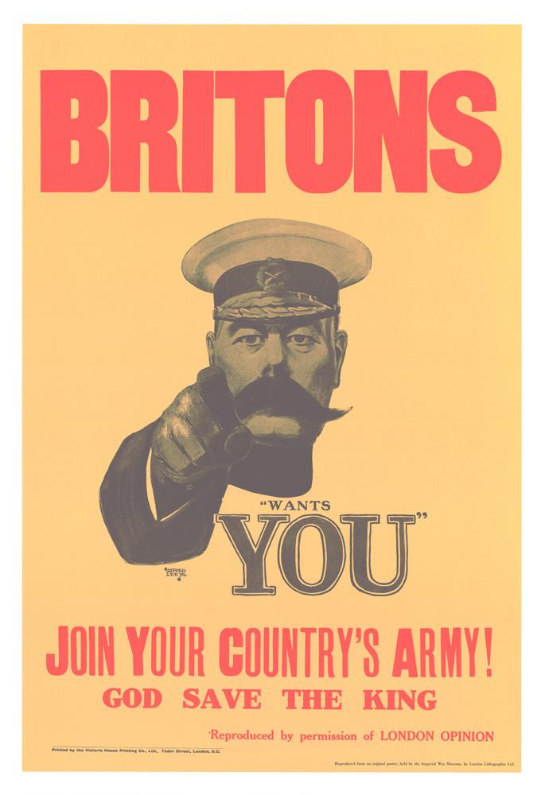
Propaganda
Propaganda was used during the war by the English and the Germans for lots of different reasons.

Slide 4

What is the poster trying to get the audience to do?
Who is the audience?
How is the poster persuasive? How successful do you think this poster was during World War II?
Why was it important to deliver this message at the time (WWII)?

Slide 5
The poster is trying to make people understand why rationing is important (so there is enough food for the soldiers)
The audience is adults living in Britain
The poster is persuasive because it shows a soldier smiling as he holds a soup mug, showing rationing makes soldiers happy.
It was important to deliver the message as rationing was enforced throughout Britain and the people needed to know the reasons.

Slide 6
You choose …
Choose 5-8 posters to write about:
What is the poster trying to get the audience to do?
Who is the audience?
How is the poster persuasive?
Why was it important to deliver this message at the time (WWII)?
Challenge: Propaganda posters helped the war effort in Britain. Agree or disagree?

