Slide 1



Welcome to Team Amin
Year 4
One Childhood, One Chance
Together we make a difference

Slide 2
What we’ll cover:
The School Day
Learning
Behaviour for Learning
Home Learning
Home reading
Mathletics
Other information
Questions

Slide 3
The School Day:
APPROXIMATE TIMES!
8:15 – doors open, early morning work
8:35 –Guided Reading
9:00 – Assembly
9:25-10:25 – Maths
10:25-10:40 – Break
10:40-11:00 – SP&G
11:00 – 12:00 – English
12:00-1:00 – Lunch
1:00 – 2:00 – RE/RAPS Curriculum
2:00 – 3:00 – Arts Curriculum
3:00 - 3:15 – Break
3:15 – 4:15 – Arts Curriculum
4:15 - End of the day

Slide 4
The School Day: This term
ICT and Drama is on a Monday
Music and PE is on a Tuesday
Dance and Art is on a Wednesday
PE and Art is on a Thursday

Slide 5
Topics
Maths – Term 1 - Place Value (numerals and written word), Addition (written and mental methods), Subtraction (written and mental methods), Multiplication, Division, Time
RAPS Curriculum – Term 1 – ‘Our Electric World’
English – Stories from different cultures – character and setting
Please see our first curriculum letter for full details

Slide 6
Our Core Values…
These are at the heart of everything we do at Ramsgate Arts Primary School.
Engagement
Enquiry
Diversity
Aspiration
Challenge
Collaboration
Autonomy

Slide 7
Behaviour for Learning…
Children to be ready to learn
Happy Safe Successful

Slide 8

3
2
4
1
5
Hand signal

Slide 9
What are the
GG
Golden Rules?
Expected Behaviour at RAPS

Slide 10
Behaviour Points
Each child starts off with 5 points at the beginning of every day.
Possible total of 25 points a week. Expected to keep all 25 points!
The points will also be looked at on a 3 weekly basis. 25 x 3 = 75 points

Slide 11

Sanctions
If a child is:
talking
messing around
refusing to work
rude
disrupting the lesson etc
a NV warning, a verbal warning then a yellow warning card gets placed on the desk in front of you. This will act as a reminder to the child that they have got to improve their behaviour.

Slide 12

If a child improves their behaviour they can then earn the yellow card back. The yellow card can then be removed from the table.
If a child continues to misbehave the yellow card is changed to a red card.

Slide 13
If a child has a yellow card on their desk at the end of the lesson they lose 1 point.
If a child has a red card on their desk at the end of the lesson they lose 2 points.

Slide 14
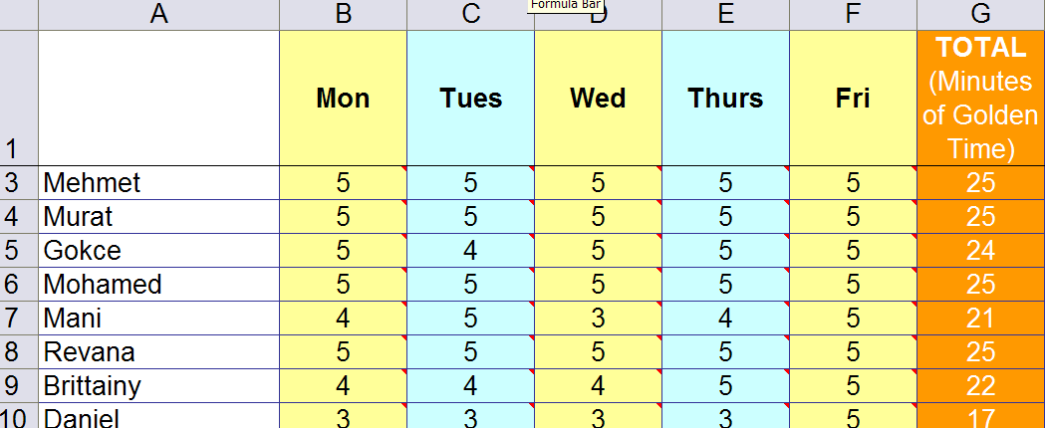
Behaviour Points

Slide 15

Daily Rewards
Verbal praise and smiles
Super Star Learner cards. (If a child has a Super Star Learner card on their table at the end of the lesson, they can swap it for a house point as they leave).

Slide 16
Weekly Rewards
25 points= All golden time and text home.
22-24 points= All golden time.
11-21= Teacher to contact parents.
6-10 points= Mr Budge to send letter home to inform parents.
5 points or less= Mr Budge to have a meeting with parents.

Slide 17
Three Week Rewards
75 points= Letter home (emailed). Badge to wear.
3rd badge: RAPS lanyard
6th badge: silver behaviour badge
12th badge: Gold behaviour badge

Slide 18
Class Rewards
Three week rewards
The class with the most points in each Key Stage gets a £3.00 RAPS Cheque to display in their classroom.
At the end of terms 2, 4 and 6 each class can ‘cash’ in their cheques to buy something for the class as a reward/treat. For example, an ice-cream each down the beach.

Slide 19
Home Learning
Love to Learns will be every 3 weeks, but home reading should be happening regularly – preferably every night, but at least 4 times a week.
Spelling – this will be set weekly.
Mathletics – focusing on reinforcing times tables etc.
Please check the website for any newsletters.

Slide 20
Home Reading
School reading books will be assigned to every pupil in the class online. The band is based on a combination of word reading and comprehension. If you feel it is too easy or too difficult please come and speak to me. Children are encouraged to change books themselves. Bug Club will be set up from next week.

Slide 21
Other information
Tucking in shirts is necessary
PE kits, packed lunches, water bottles
Reading books can be changed whenever your child has finished their book. Bug Club questions and correspondence will be completed online.
Class blogs will be uploaded 3x weekly.
Open door policy – come and chat with us!
If you need to contact me, my email address is kiki.amin@ramsgateartsprimaryschool.co.uk

Slide 22

Any Questions?

